Slide 1
Smarter Reconciliation and Anamoly Detection using Gen AI Team Code Frenzy

Slide 2
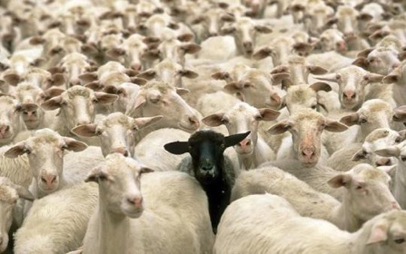

WHAT IS AN ANOMALY & XGBoost ?
Anomaly - A data point which differs significantly from other data points
XGBoost is an implementation of gradient boosted decision trees designed for speed and performance.
It is a powerful tool for solving classification and regression problems in a supervised learning setting.

Slide 3
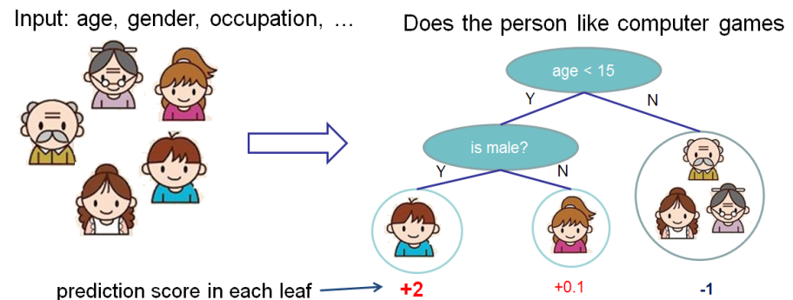
PREDICT: WHO ENJOYS COMPUTER GAMES
Example of Decision Tree

Slide 4
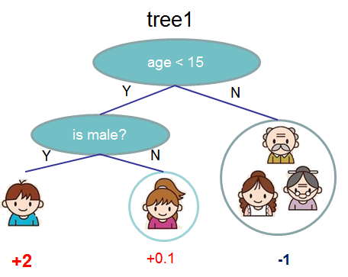
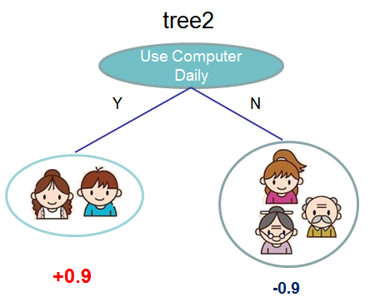


ENSEMBLED DECISION TREES
Source: https://goo.gl/eTxVtA

Slide 5
XgBoost
Intuitive Example for Tree Construction
Step 1: Start as a single leaf
Input all GL balance and IHUB balance
60000,10000,80000
15
10
Step 2: Calculate similarity score
For all balances
Set Threshold @ balance 50000
Sum of residuals squared
No. of residuals + Regularization
0
difference
50000
S0 = 4
Setting Reg = 0
0
0
40
80
Balances

Slide 6
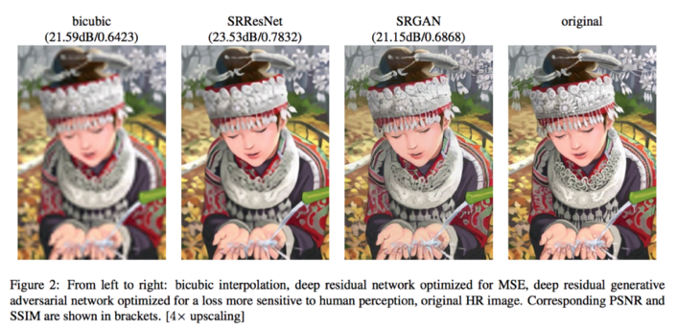
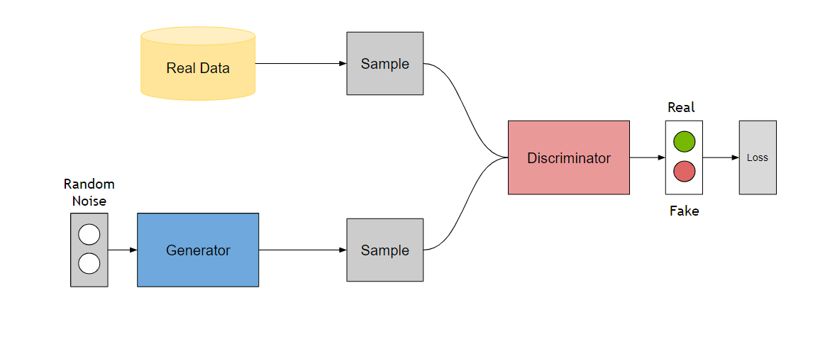
The Generator, `G`, produces fake samples
The discriminator, ‘D’, receives samples from both G and the dataset.
During Training: The generator tries to fool the discriminator by outputting values that resemble real data and the discriminator tries to become better at distinguishing between the real and fake data.

Slide 7
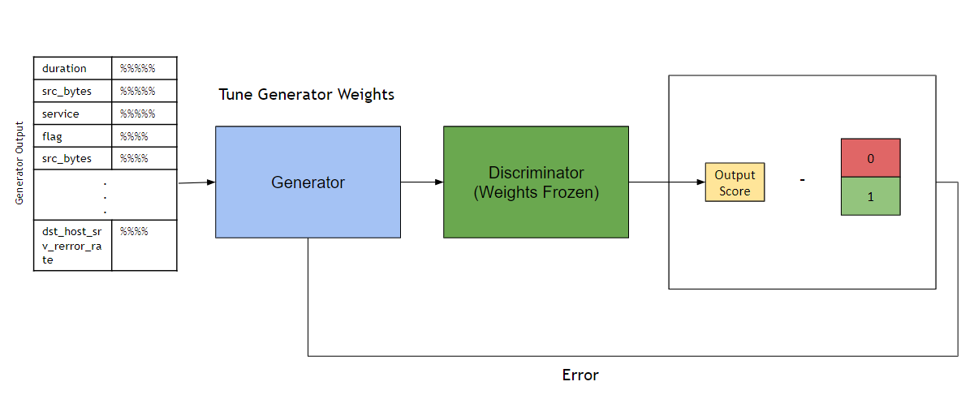
TRAINING THE tool
STEP 1
Input
Reconciler Entry
As of Date | %%%%
company | %%%%
Account | %%%%
AU | %%%%
currency | %%%%
. . .
GL Balance IHUB Balance | %%%% %%%%
Generate Fake Sample
Output
Reconciler Entry
Generator
Balance Difference | #####
Match status | #####
comments | #####
Meaningless Output

Slide 8

ANOMALY DETECTION
Input Test Point
duration | 0
src_bytes | 215
service | http (1)
flag | SF (1)
src_bytes | 215
. . .
dst_host_srv_rerror_rate | 0
Discriminator
Normal
P = 0.95

Slide 10
Thank You

