Slide 1


RAG-Powered Reconciliation Assistant
Automating banking reconciliation with intelligent AI. This presentation introduces a novel solution to streamline and enhance reconciliation processes.
We leverage Retrieval-Augmented Generation (RAG) to improve efficiency and accuracy. Discover how our AI-driven assistant can transform your banking operations.
By Contextualizers

Slide 2
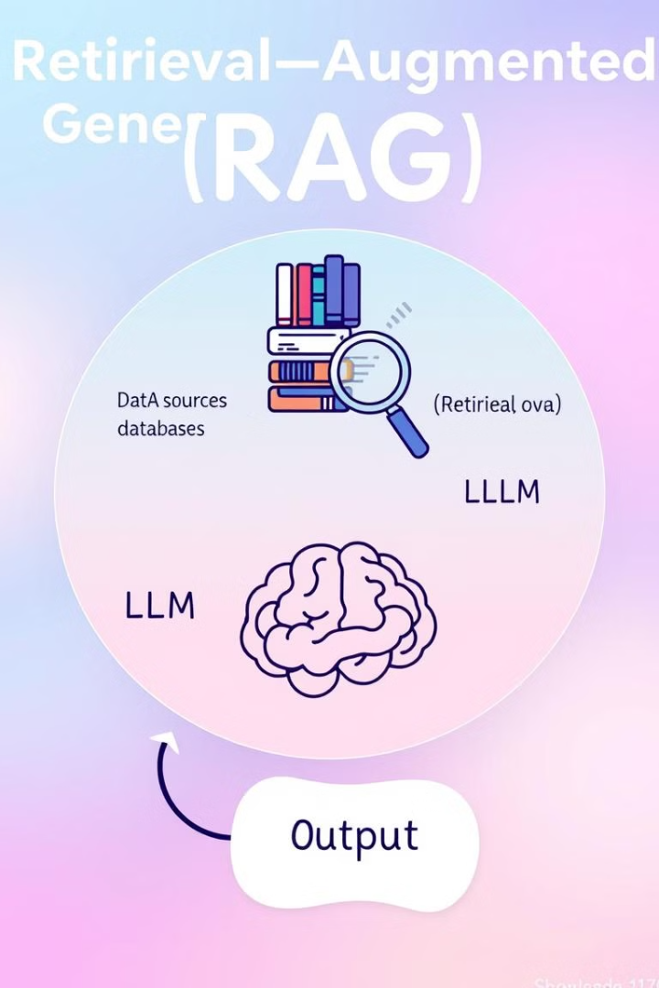
RAG-Powered Reconciliation Assistant
Intelligent Assistant
Streamlined Process
Leveraging Retrieval-Augmented Generation (RAG) to enhance reconciliation.
Our system streamlines and enhances the reconciliation process.
Data-Driven Decisions
Empowers users to make informed decisions with consolidated data access.
Target state: Agentic AI automatically scans files, flags anomalies, and acts on them.

Slide 3
The Challenge of Reconciliation
Critical Task
Essential Alignment
Reconciliation is critical for accurate accounting of client funds.
Ensuring precise alignment between GL balances and inter-system data is essential.
Manual reconciliation is time-consuming and error-prone.
Our automated solution improves efficiency and accuracy.

Slide 4

Unique Selling Points
Confidence Scoring
Provides confidence scoring for the anomaly record for RAG analysis.
Continuous Feedback
Corrects RAG and LLM decisions based on end-user confirmation.
Our tool provides innovative solutions that improve accuracy and streamline reconciliation.

Slide 5




Key Features and Benefits
Enhanced Efficiency
Automation reduces processing time.
Improved Accuracy
Minimizes human error.
Accelerated Reconciliation
Faster discrepancy resolution.
Optimizing operations frees staff for strategic tasks.

Slide 6
User Workflow and Record Classification
File Selection
1
Select files.
RAG Comparison
2
RAG compares.
If end user decides against the RAG decision, feed it back to RAG for correcting its learning
Classification
3
Classifies records.
Users select files, specify key columns, criteria, and dates. RAG compares records and classifies them.

Slide 7
Continuous Learning & Anomaly Confidence
Continuous Learning
Anomaly Confidence Scoring
Incorporates feedback to refine models and improve accuracy.
Provides a confidence score for each identified anomaly.
Learns from user corrections and applies them to similar records.
Users prioritize reviews based on system certainty.

Slide 8

How We Built It & Challenges Faced
Data Combinations
Confidence Scoring
Retraining
Combining data from various sources into a unified system.
Providing confidence scoring for every anomaly identified by the system.
Retraining the LLM/RAG for error correction and future improvements.
We used cutting edge technologies and frameworks.

Slide 9
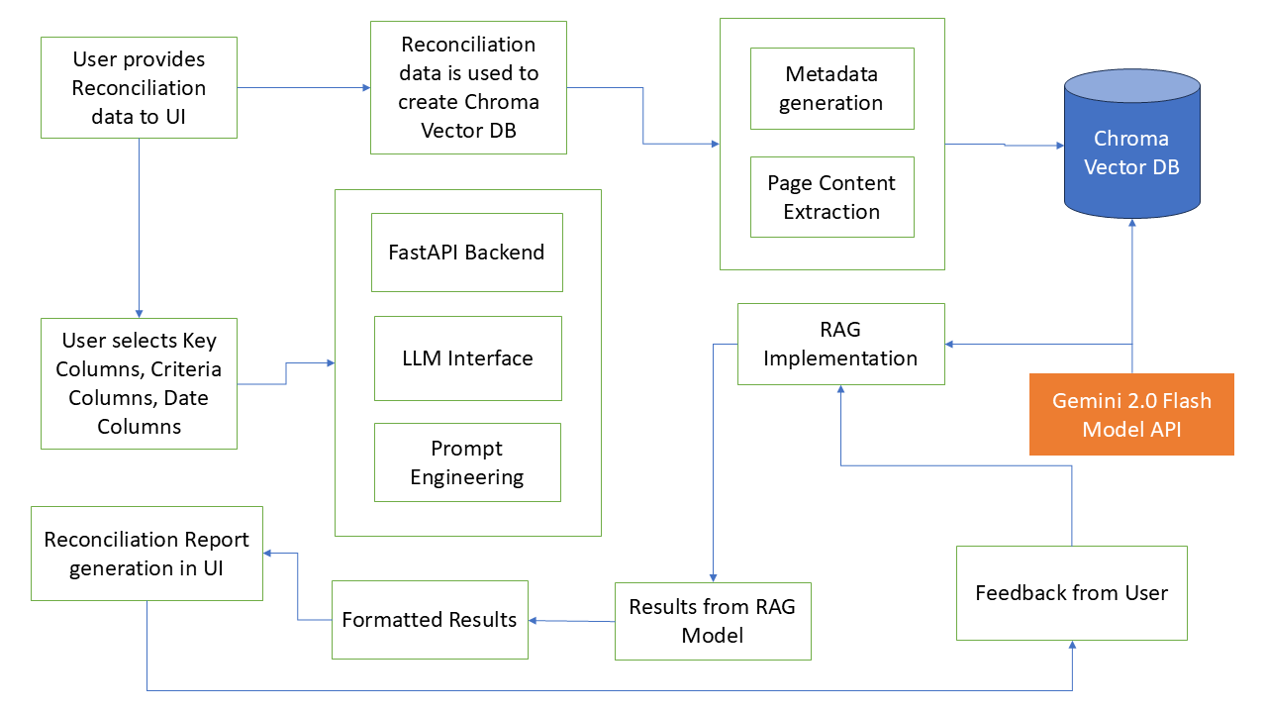
How We Built It

Slide 10
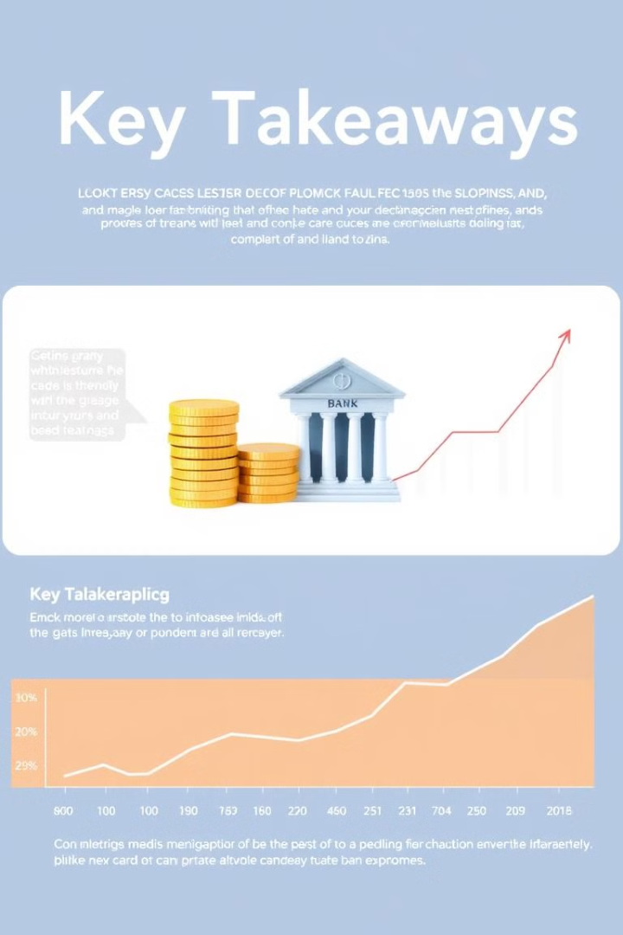
Key Takeaways
RAG Power
Continuous Learning
Harness the power of RAG for efficient reconciliation.
Leverage feedback for constant improvement.
Strategic Optimization
Optimize operations.
Automate banking reconciliation with intelligent AI.

