Slide 1
First Timers Reconciliation Anomaly Catcher
Streamlit App Overview

Slide 2
Agenda
• App Overview
• Key Features
• Walkthrough of Tabs
• Visualizations & Downloads
• Configuration Options
• Summary

Slide 3
App Overview
• Built using Streamlit with a tabbed UI.
• Detects anomalies in reconciliation data.
• Trained on historical labeled data.
• Offers download options with styled Excel output.
• Interactive filtering, threshold configuration, and visualization.

Slide 4
App Overview
Model Details:
Type: RandomForestClassifier from sklearn.ensembleInput
Feature: Balance Difference (numeric)Target
Variable: Anomaly_Label→ Derived from the Match Status column ('Break' → Anomaly = Yes)✅
Why Random Forest?
Works well with limited features
Handles non-linear relationships
Easy to interpret and fast to train
Robust to outliers and imbalance

Slide 5
Key Features
• Upload reconciliation files in CSV or Excel format.
• Detect anomalies using a pre-trained ML model.
• Generate dynamic labels: High Deviation, Zero Difference, Manual Break.
• Visualize label distribution with color-coded charts.
• Export results with colored Excel formatting.

Slide 6
Walkthrough of Tabs
• 📤 Upload File: Upload data and receive immediate feedback.
• 🔎 Anomalies: View anomalies in an interactive grid with filters.
• 📊 Visualizations: Label distribution charts with color coding.

Slide 7
Configuration & Filters
• Threshold options: Manual, ±1/2/3 Standard Deviations.
• Sidebar configuration preserved across tabs.
• AgGrid table enables filtering and sorting per column.

Slide 8
Summary
• The anomaly catcher app enables rapid analysis of reconciliation mismatches.
• Clear labeling and filtering streamline anomaly identification.
• Export and visualize results for audit or operational review.
• Built for flexibility, usability, and business insight.

Slide 9
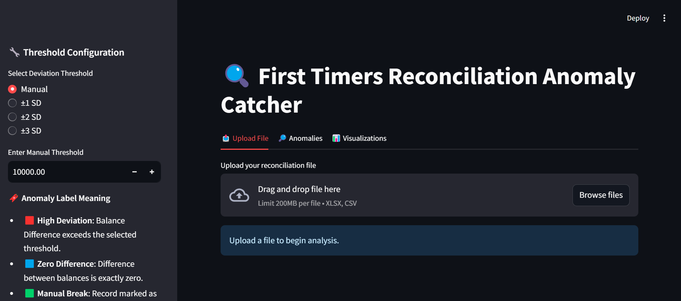
Screen Shots

Slide 10
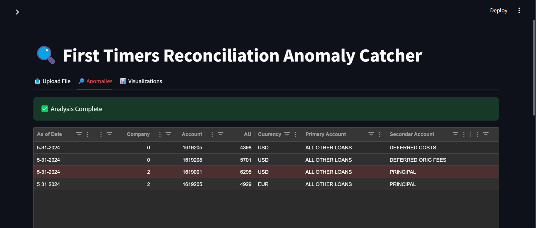
Screen Shots

Slide 11
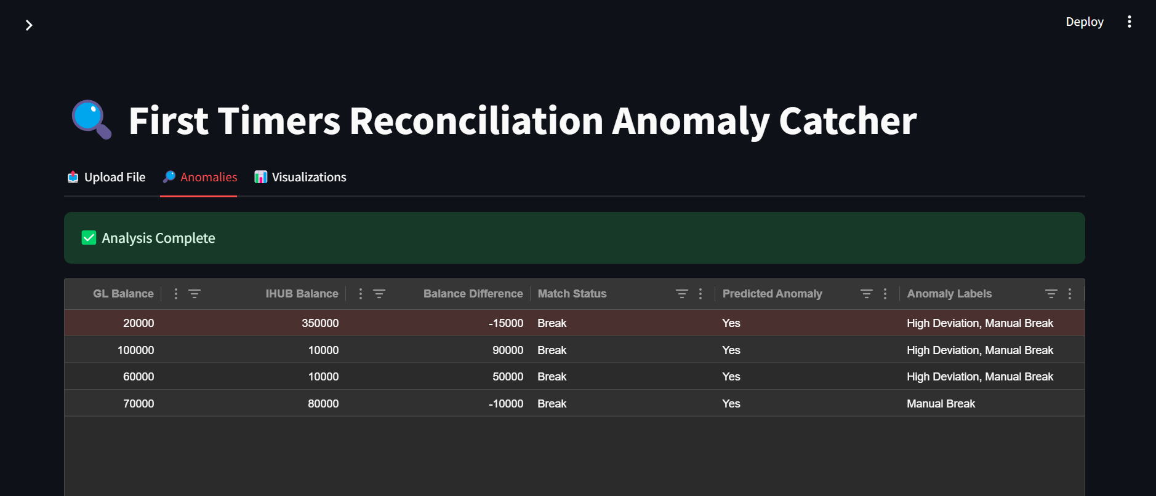
Screen Shots

Slide 12
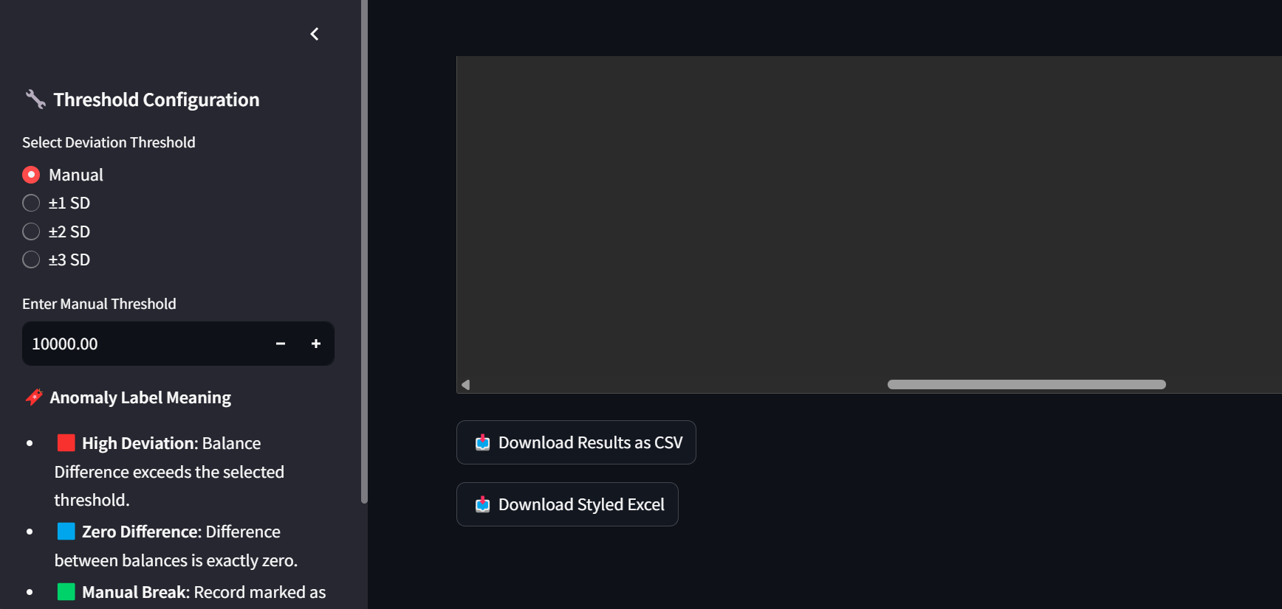
Screen Shots

Slide 13
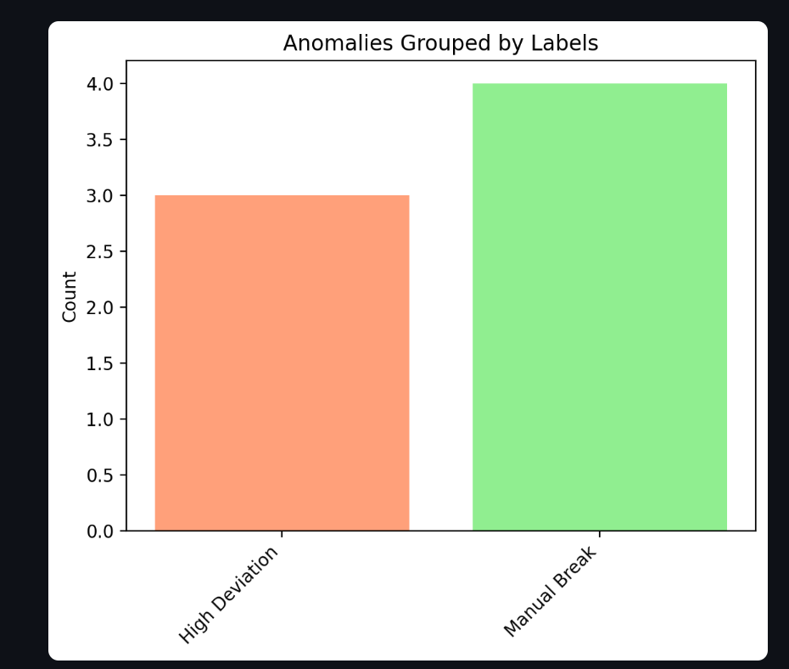
Screen Shots

