Slide 1
SMARTER RECONCILIATION AND Anomaly Detection USING GEN AI
A Detailed Overview of the Approach & Solution Architecture
Confidential | Anomaly Detection Workflow | © 2025

Slide 2
Members of hacktivists team
Arnab Nath
Manish Gupta
Harsha V. Thummalapenta
Uday Kumar Narayana
Jamili Chakradhari
Confidential | Anomaly Detection Workflow | © 2025

Slide 3
Approach in Detail
Load environment variables and initialize the LLM model.
Extract real-time and historical financial data from Excel files.
Compute balance differences and determine match status.
Apply anomaly detection logic based on historical trends.
Categorize breaks into predefined anomaly types.
Use LLM to generate meaningful comments based on anomaly type.
Remove unwanted columns and save the final processed data.
Confidential | Anomaly Detection Workflow | © 2025

Slide 4
Solution Architecture
Data Ingestion: Loads real-time and historical data.
Data Preprocessing: Computes balance differences and match status.
Anomaly Detection: Identifies anomalies using historical trends.
LLM Processing: Generates human-readable comments for anomalies.
Data Cleaning: Removes unnecessary fields.
Output Generation: Saves the processed data.
Confidential | Anomaly Detection Workflow | © 2025

Slide 5
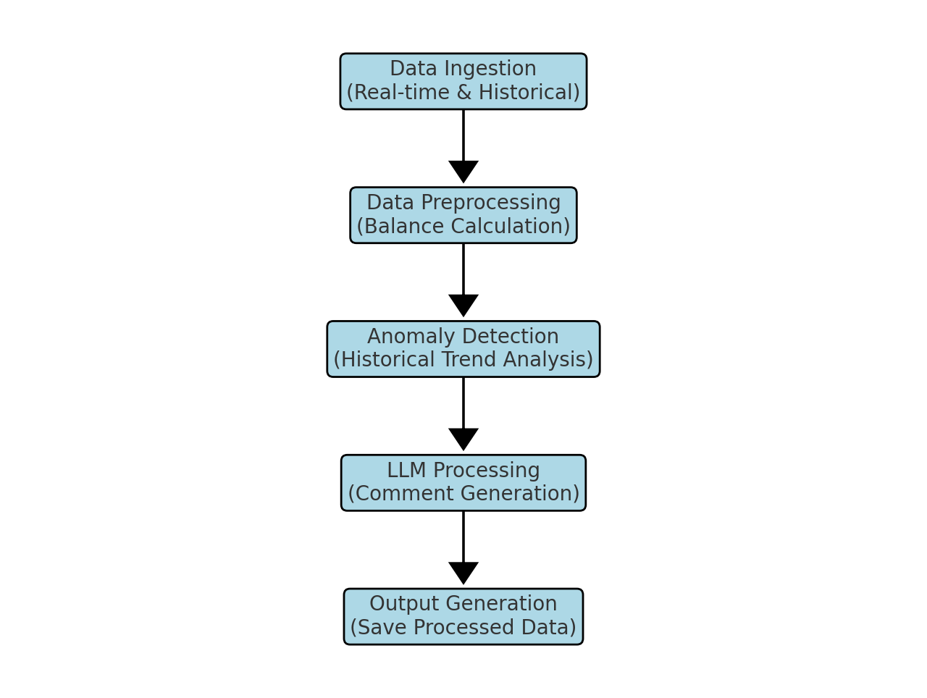
Solution Architecture Diagram
Confidential | Anomaly Detection Workflow | © 2025

Slide 6
Challenges faced
Determining the different combination of patterns in the dataset.
Constructing the prompt to get the uniform desired response from the respective LLM based on the category of break and anomaly.
Implementation of Agentic AI using Langgraph for the solution.
Confidential | Anomaly Detection Workflow | © 2025

Slide 7
Thank You!
We appreciate your time and attention.
Confidential | Anomaly Detection Workflow | © 2025

