Slide 1
Smart Reconciliation & Anomaly Detection
Techniques for Data Integrity and Insights

Slide 2
Introduction
• Data reconciliation ensures data consistency and correctness.
• Anomaly detection helps identify unexpected patterns or errors.
• Techniques include statistical methods, machine learning, and NLP-based sentiment analysis.

Slide 3
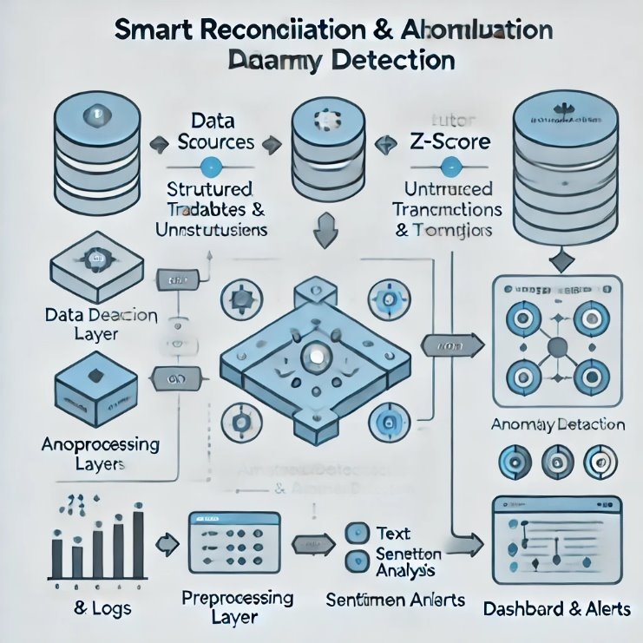
Architecture Diagram

Slide 4
Statistical Methods for Anomaly Detection
• Z-score: Identifies outliers by measuring standard deviations from the mean.
• Interquartile Range (IQR): Detects anomalies based on quartile dispersion.
• Effective for numerical data with known distributions.

Slide 5
Machine Learning for Anomaly Detection
• Isolation Forest: Identifies anomalies by isolating data points in a decision-tree manner.
• Autoencoders: Neural networks trained to detect deviations from normal patterns.
• Useful for complex and high-dimensional data.

Slide 6
LLM-based Pattern Recognition
• Uses Large Language Models (LLMs) for context-aware anomaly detection.
• Can identify inconsistencies based on historical patterns and semantic meanings.
• Useful when structured and unstructured data mix.

Slide 7
Sentiment Analysis for Comments
• Analyzes text data for sentiment classification (positive, neutral, negative).
• Techniques include:
- VADER (lexicon-based, best for short texts)
- TextBlob (rule-based)
- Transformers (deep learning-based for contextual understanding).

Slide 8
Use Cases & Benefits
• Finance: Fraud detection, transaction monitoring.
• Healthcare: Identifying unusual patient data.
• E-commerce: Detecting fake reviews or pricing anomalies.
• Benefits: Improved data accuracy, early fraud detection, and better decision-making.

Slide 9
Conclusion & Next Steps
• Combining statistical, ML, and NLP techniques improves anomaly detection.
• Future work includes real-time processing and adaptive AI models.
• Next Steps: Implement and test models with real datasets.

Slide 10
THANK YOU

