Slide 1
Challenge Name : Smarter Reconciliation and Anomaly
Detection using Gen AI
Team Name : Smart-Coder
Team Size : 3

Slide 2
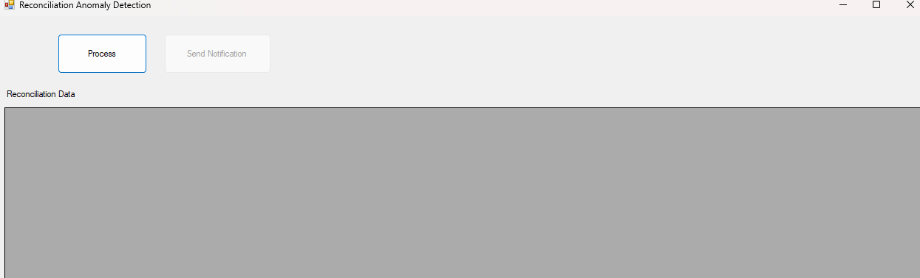
Initially form will be loaded as follows

Slide 3
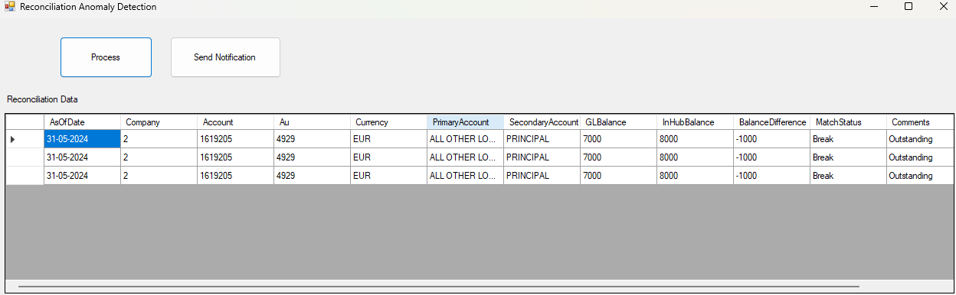
Click on Process button will show the reconciliation data as follows.

Slide 4
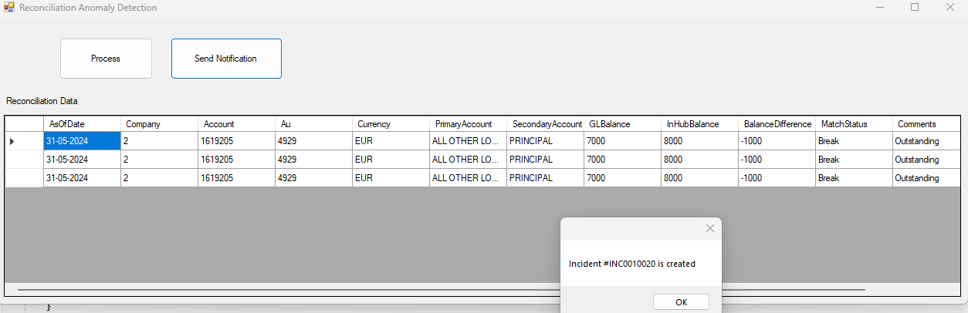
“Send Notification” button will be automatically activated.
Click on ”Send Notification” will create the incident and popup will show the
”Incident# xxxx created “

Slide 5
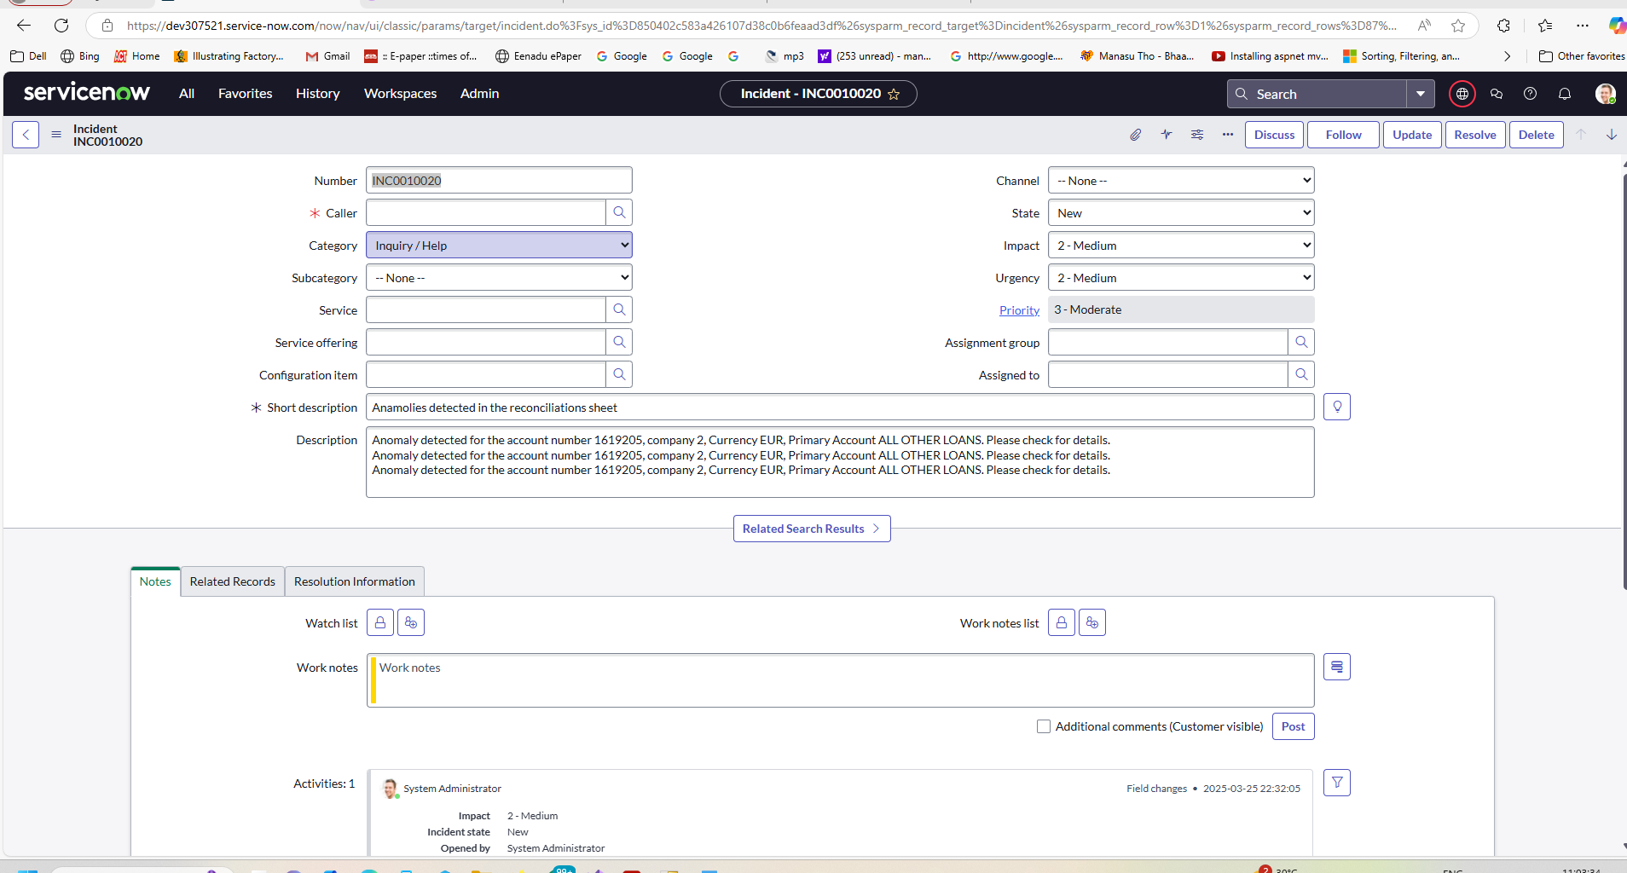
Incident will be having the anomalies information in the description field as
shown above.

