Slide 1
Technology Hackathon 2025
Smarter Reconciliation and Anomaly Detection using Gen AI.
Team Name : Team_HackPioneers
Rupashree C Dutta
Nishit Upal
Sritam Sarkar

Slide 2
Problem Statement and Approach
Problem Statement
Existing Reconciliation tools process huge number of transactions daily and
monthly.
Business users spend significant time manually identifying data anomalies
post-reconciliation for the breaks and fixing them.
Approach
Automatically detect data anomalies by comparing real-time data against historical baselines.
Provides insights into potential root causes of detected anomalies.
Integrates with existing reconciliation tools.

Slide 3

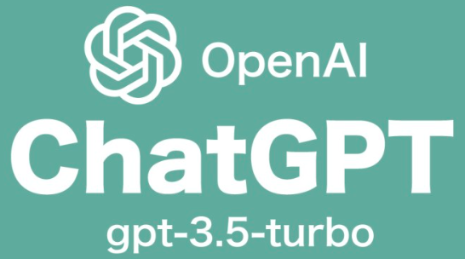


Technology Stack

Slide 4
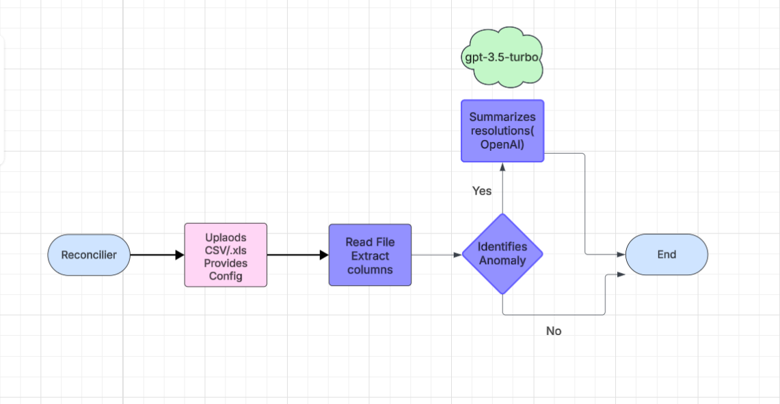
High Level Flow Chart

Slide 5
Major Highlights and Approach
This solution exposes two POST APIs. First One accepts the dataset in the form of CSV/XLS
and a config JSON which list out the names of criteria columns and comments.
The second api accepts a Json of anomaly data, and summarizes the resolution for each
anomaly just like the reconcilier would do.
Approach
The solution uses Isolation forest model to identify Anomalies.
The detected anomalies are summarized for resolutions by Gpt-3.5 turbo LLM.
Integrates with existing reconciliation tools as the two APIs can be integrated easily.

Slide 6
Major Highlights and Approach (contd..)
In order to keep the solution configurable, detect_anomalies accepts a config JSON which will
tell us which columns in the dataset should be considered for Anomaly detection. It will also tell us
the column to ready for Anomaly comments.
The comments Once read, will be summarized for resolution by a call made to gpt-3.5 turbo LLM . The
response will be for each of the unique comments that was read from the sample dataset.
Sample request and response for the APIs are provided in the README File.

Slide 7
Thank You

