Slide 1
Smarter Reconciliation and Anomaly Detection using
gen AI
Team: Victors
Members: Roopa Pattamsetty
Vanam Vasavi

Slide 2
Table of Contents
1
Introduction
2
Challenges in Manual detection
3
Our Solution
4
Case studies
4.1
Case-1: General Ledger(GL) Vs IHub Reconciliation
4.2
Case-2: Catalyst Vs Impact Reconciliation
Smarter Reconciliation and Anomaly Detection
Team Victors

Slide 3
Smarter reconciliation:
Anomaly Detection:
Introduction
The process of comparing data from different sources to ensure consistency and accuracy (e.g., financial transactions, inventory records, vendor payments).
Identifying unusual patterns, errors, or fraud in large datasets using AI.
Smarter Reconciliation and Anomaly Detection
Team Victors

Slide 4
2. Challenges we face in Manual detection
Manual effort and high processing time.
Susceptibility to human errors.
Difficulty in handling large and complex datasets.
Rules-based systems fail to adapt to new fraud patterns.
Smarter Reconciliation and Anomaly Detection
Team Victors

Slide 5
3. Our Solution provides
AI can reconcile mismatched records by understanding contextual differences.
Predictive Analysis: Identifies potential errors before they occur.
Self-Learning Systems: AI models improve over time by learning from historical patterns.
Smarter Reconciliation and Anomaly Detection
Team Victors

Slide 6
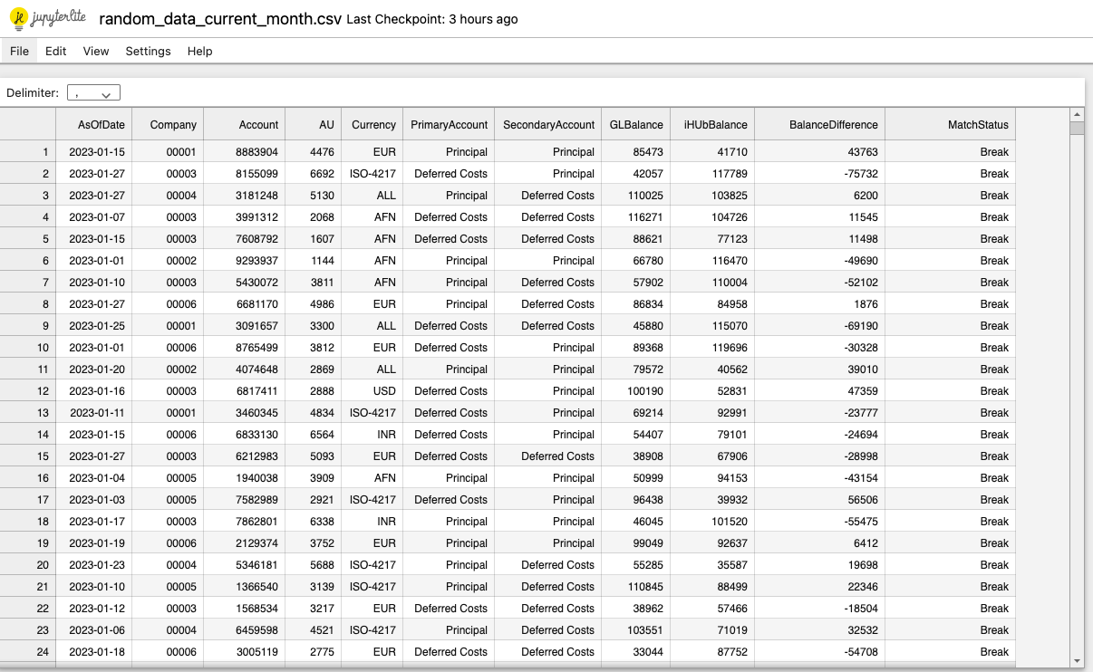
4.1 General Ledger(GL) Vs IHub Reconciliation
Current data:
Smarter Reconciliation and Anomaly Detection
Team Victors

Slide 7
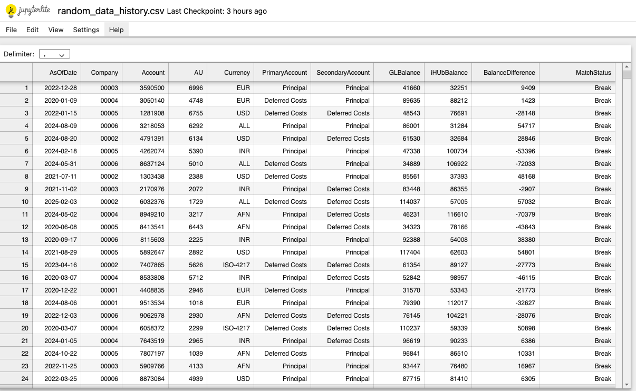
History data:
Smarter Reconciliation and Anomaly Detection
Team Victors

Slide 8
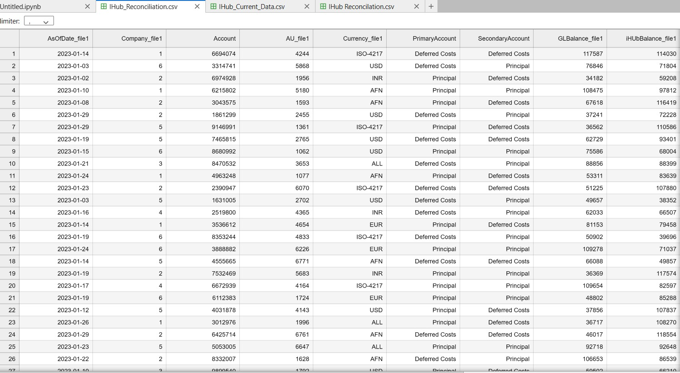
Reconciliation:
Smarter Reconciliation and Anomaly Detection
Team Victors

Slide 9
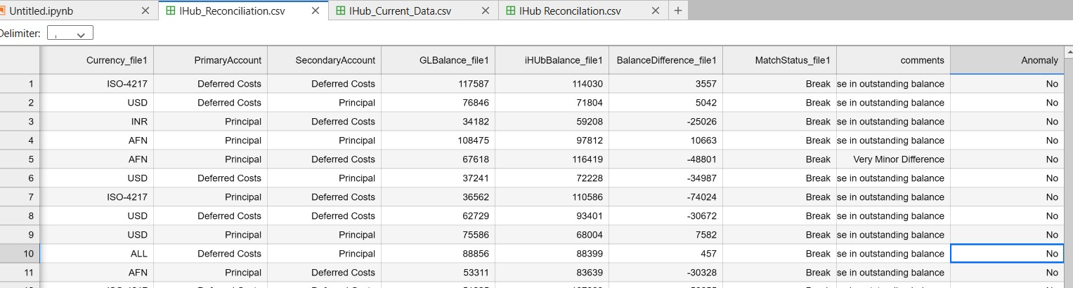
Anomaly detection:
Smarter Reconciliation and Anomaly Detection
Team Victors

Slide 10
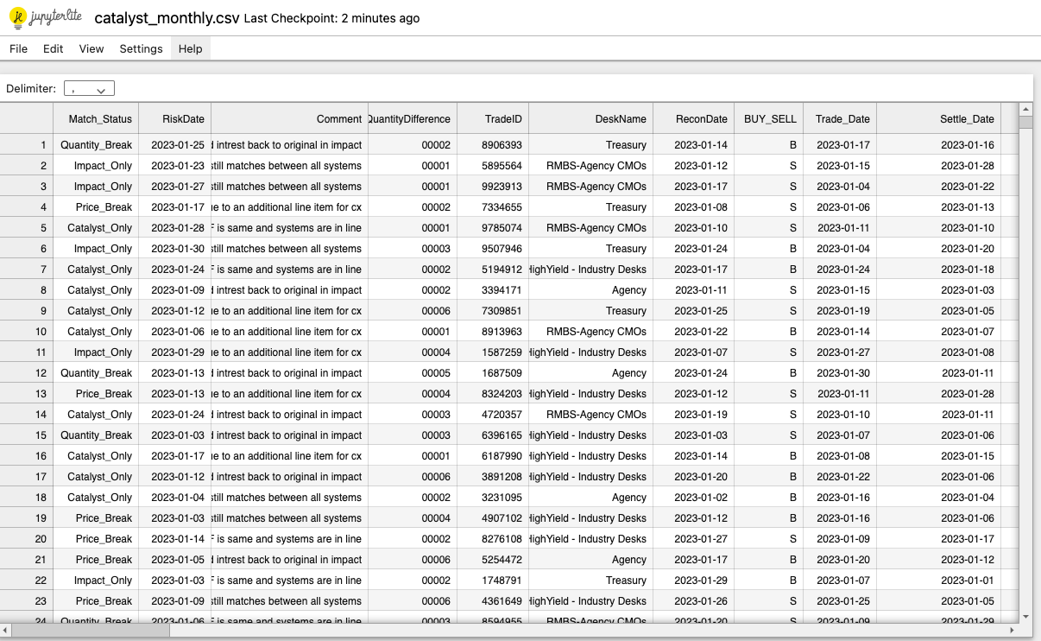
4.2 Catalyst Vs Impact Reconciliation
Current data:
Smarter Reconciliation and Anomaly Detection
Team Victors

Slide 11
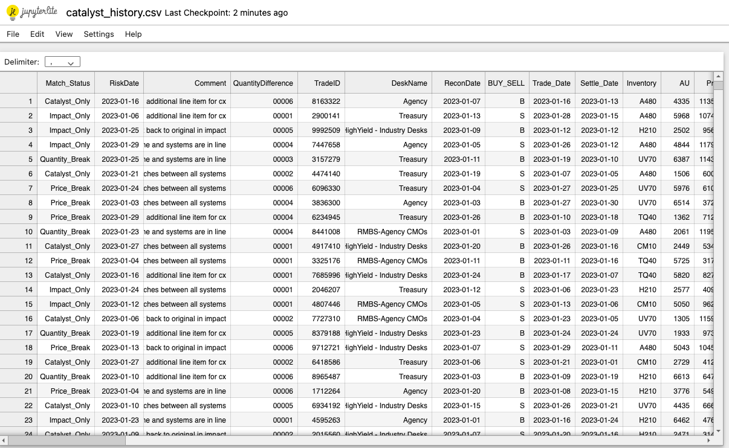
History data:
Smarter Reconciliation and Anomaly Detection
Team Victors

Slide 12
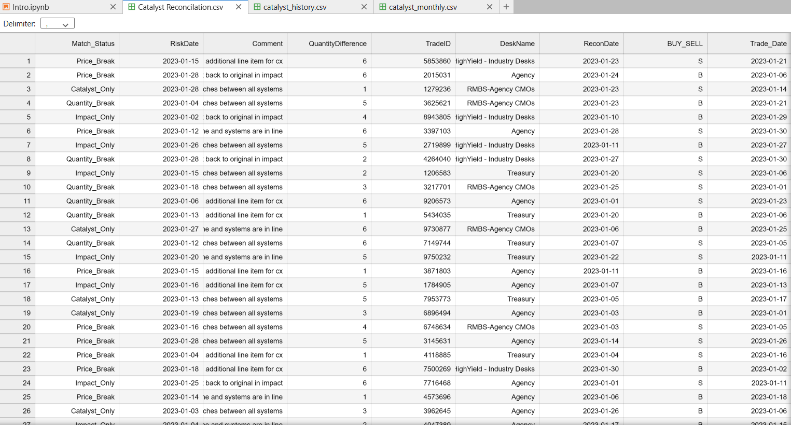
Reconciliation:
Smarter Reconciliation and Anomaly Detection
Team Victors

Slide 13
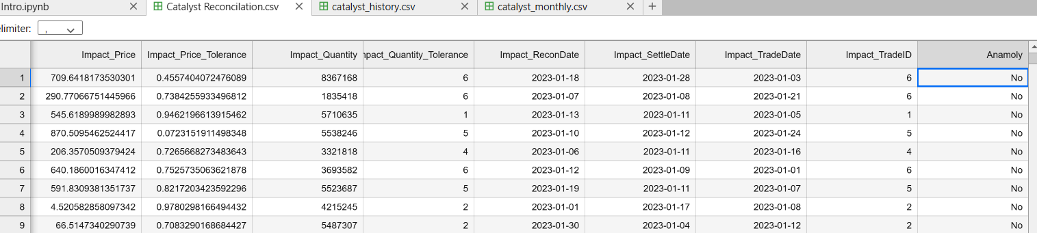
Anomaly detection:
Smarter Reconciliation and Anomaly Detection
Team Victors

Slide 14
Thank You!
Smarter Reconciliation and Anomaly Detection
Team Victors

