Slide 1
Smarter Reconciliation & Anomaly Detection Using Gen AI
Team VisionPro
Pramita, Pal
Akshaj, Gupta
Anand, Jha
Sougato, Pal
Vijith, Balakrishnan

Slide 2
Problem statement
Existing reconciliation tools process huge number of transactions daily and monthly. Business users spend significant time manually identifying data anomalies post-reconciliation for the breaks and fixing them. Process is tedious and error prone
Implement an anomaly detection system within the reconciliation process, by leveraging historical data to identify patterns, trends, and expected ranges. The system should be able to
Automatically detect data anomalies by comparing real-time data against historical baselines.
Provides insights into potential root cause of detected anomalies
Integrates with existing reconciliation tools to streamline the anomaly identification process.
Reduce manual effort and minimizes human error in anomaly detection.
Business users like Reconcilers, Operations users will interact with their existing reconciliation tools to see identified anomalies and additional insights generated from AI.

Slide 3





Solution overview
Agentic AI
Source file with mismatches
Anomaly Detector
Anomaly Classifier
Anomaly reconciliation
Human Reviewer
Perform actions on the final Report
Tools
Meta data
File Parser
File Operation
Report Generation
Feedback
Historical Data
Feedback Data

Slide 4
Agentic AI for Anomaly Detection & Reconciliation
Agent 1: Senior Data Analyst
Analyse banking data and find anomalies in inconsistencies.
Investigate the data present in historical data to find trends and common errors. Find out which mismatches in current data are anomalies.
Agent 2: Financial Reporting Analyst.
Analyse banking data to find reasons for anomalies. Classify anomalistic records into buckets based on appropriate reasoning.
Agent 3: Reconciliation Agent
Provide corrective measures to correct anomalies in the data. Look at the reasoning provided by the Reporting analyst and suggest steps to resolve the anomalies.

Slide 5
Tech Stack & Tools
CrewAI – Agentic AI framework
Model GPT 4o mini
Data generation/processing – Numpy
Python3

Slide 6
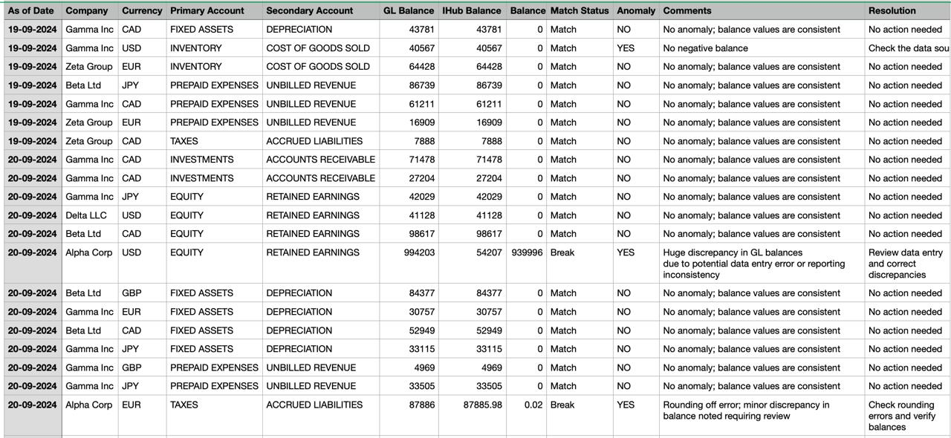
Results

Slide 7
Thank you

