Slide 1


Twitter Crawl
Edward Garcia
Petre Lukarov
Kina Winoto
Yongxu Zhang
Columbia University
Cloud Computing, Fall 2012
Final Project

Slide 2
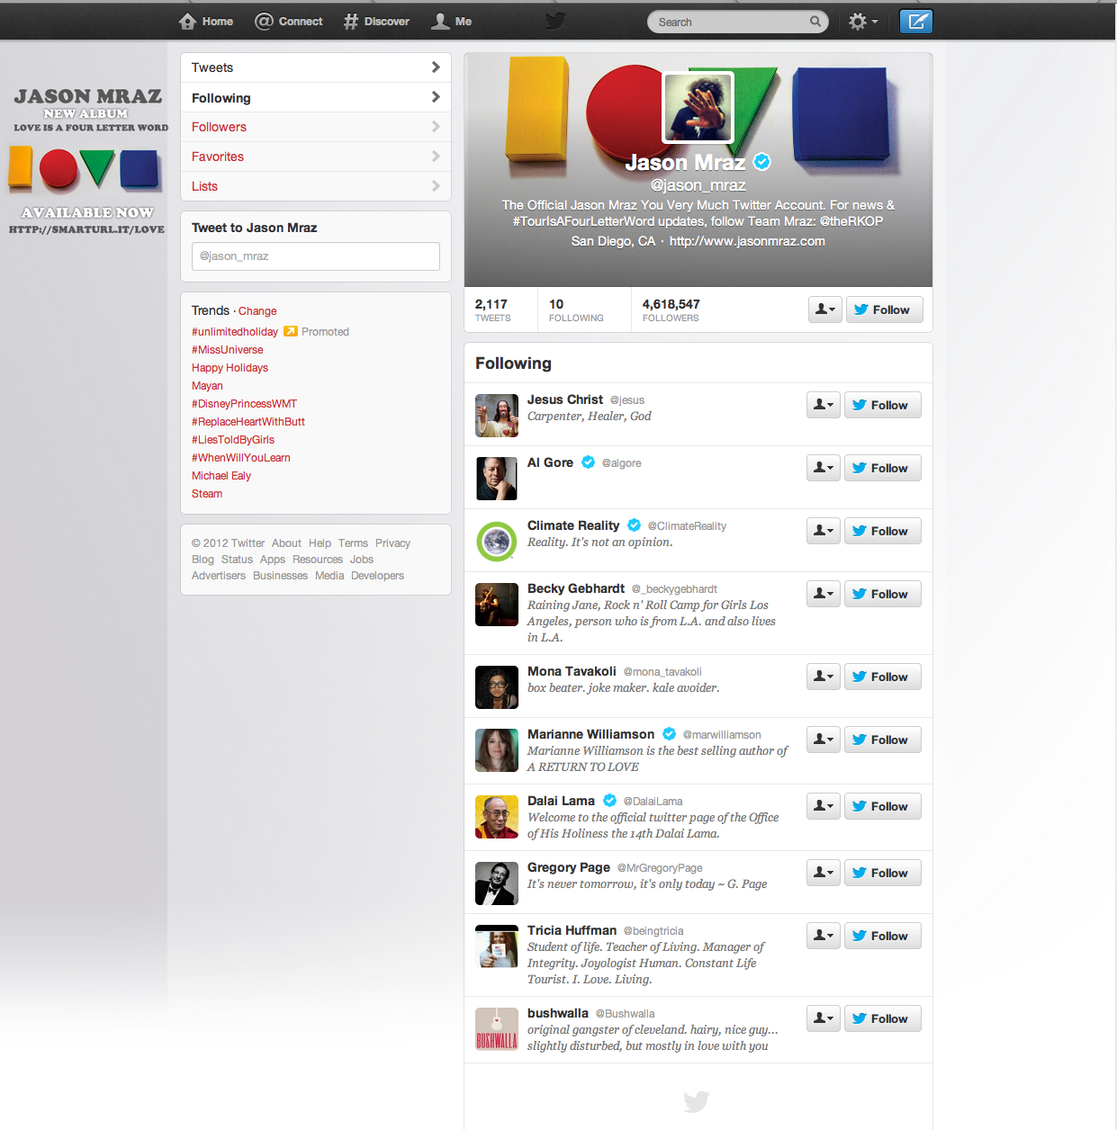
How to crawl.
There’s a lot happening on my twitter feed!
I’m going to miss something…

Slide 3

How to crawl.
I love crawling the web though…
Let’s kill two birds…

Slide 4
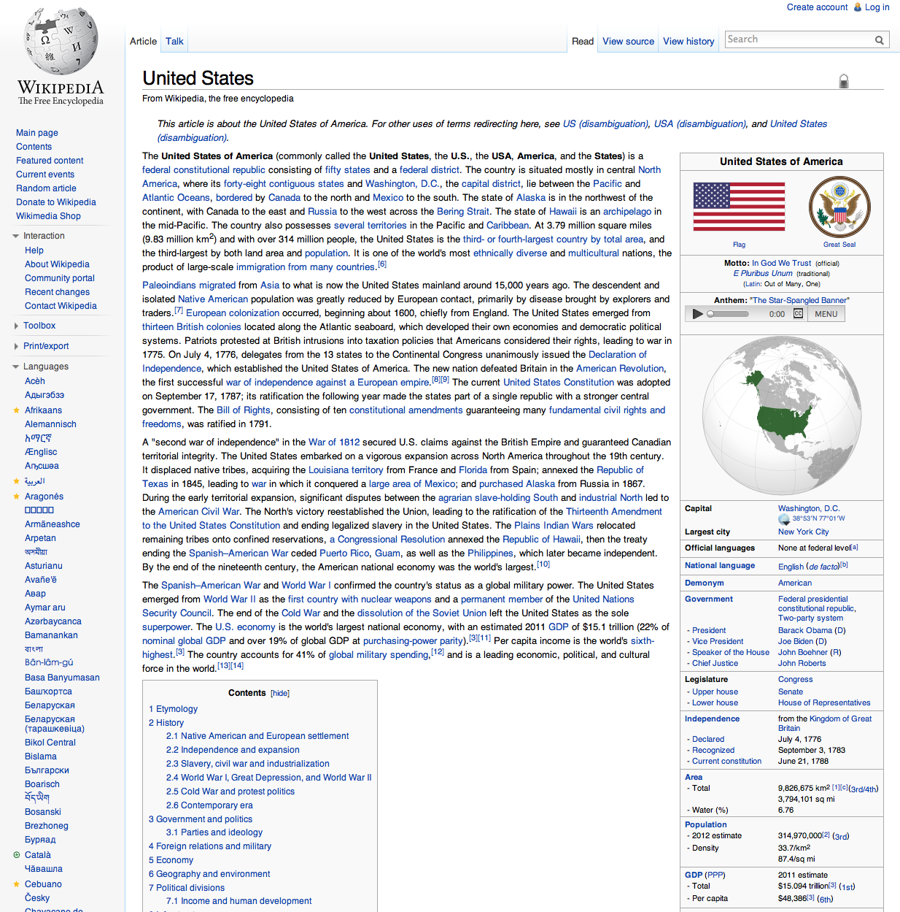


How to crawl.
Twitter Crawl will highlight keywords on a page that you’re browsing and show you tweets having to do with that keyword.
Relevant tweets:
From: TransWorldNews
Text: United States freight trucking long distance market: New market research published http://t.co/cjlN1ol3
From: RubyGrace
Text: @WTFCrazyFacts: There are more women in China's military than there are people in the United States.

Slide 5

How we did this.
Overview:
Analyzed user’s home timeline
Extracted keywords from each tweet
Created tags from these keywords
Tagged the tweet
Parsed web page that a user is viewing
Extracted keywords from the web page
Highlight and display tweets that correspond to that keyword

Slide 6
Technologies Used
Google App Engine
Twitter REST API
NLTK Python Library (for NLP: keyword extraction)
Chrome Extension Tools, Javascript

Slide 7
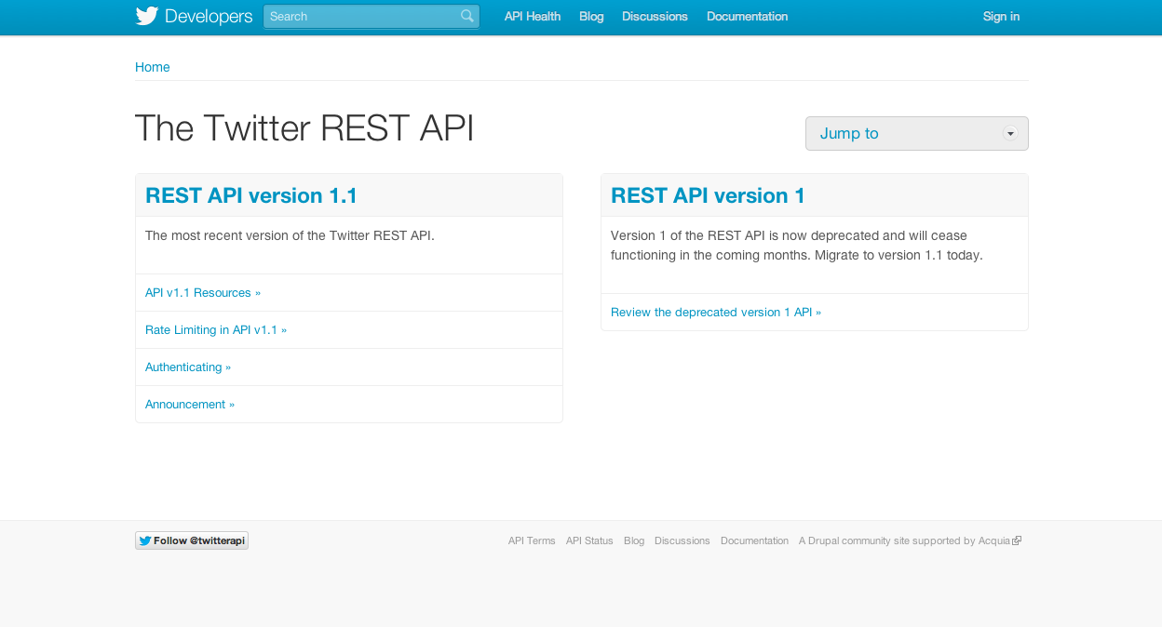
Technologies Used
Twitter REST API
REST API uses Oauth API to make authorized GET requests
We power it using Google App Engine
Can retrieve any user’s home timeline, controlling
Count
Replies allowed
IDs returned

Slide 8
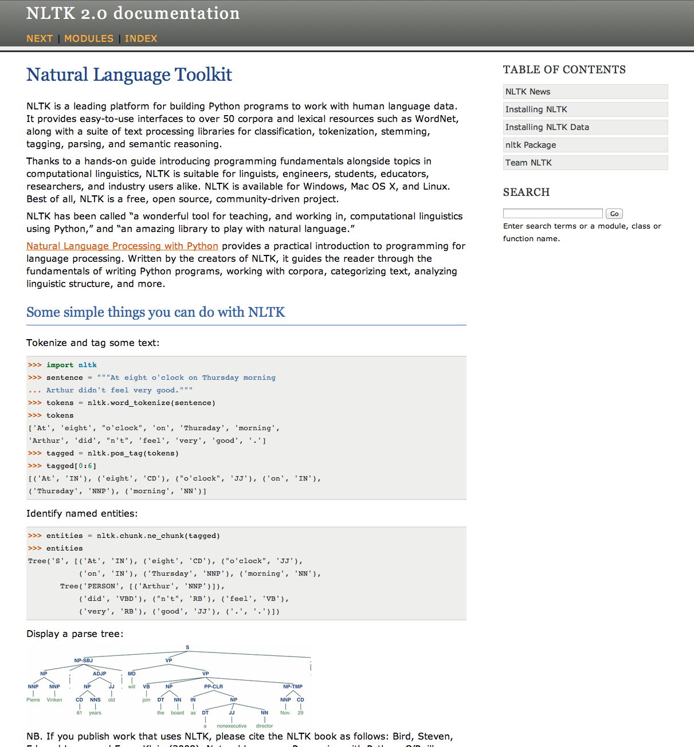
Technologies Used
NLTK Python Library (for NLP: keyword extraction)
NLTK is a natural language toolkit for Python
Very powerful
Many corpuses (e.g. dictionaries)
Create tree structures
Cleans text
Calculates various distributions

Slide 9
Technologies Used
Chrome Extension Tools, Javascript
Uses jQuery to create tooltip highlighting
Sends requests to the Cloud
Sends keywords and receives back tweets in json format

Slide 10
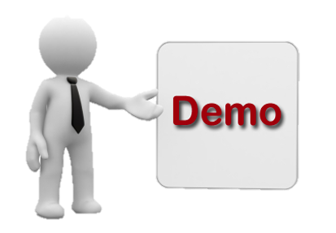
Now for a demo.

