Slide 1


Twitter Crawl
Edward Garcia
Petre Lukarov
Kina Winoto
Yongxu Zhang
Columbia University
Cloud Computing, Fall 2012
Final Project

Slide 2
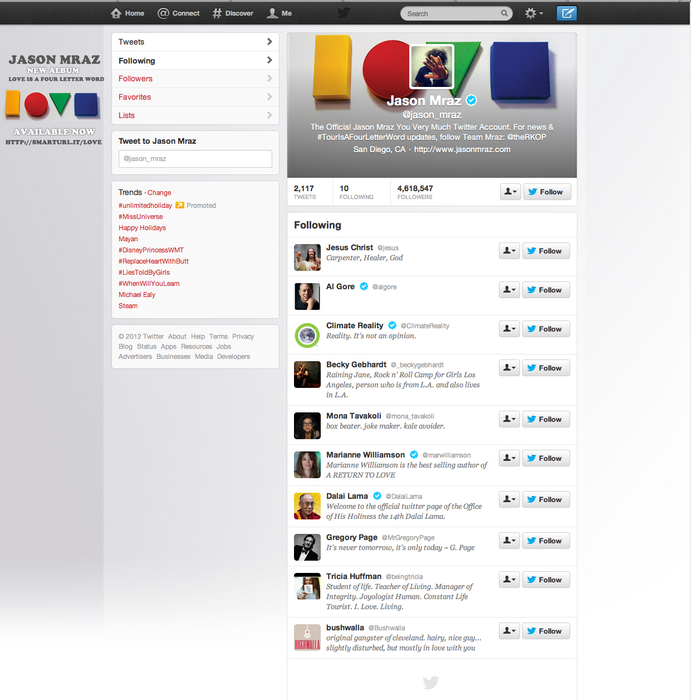
How to crawl.
There’s a lot happening on my twitter feed!
I’m going to miss something…

Slide 3

How to crawl.
I love crawling the web though…
Let’s kill two birds…

Slide 4
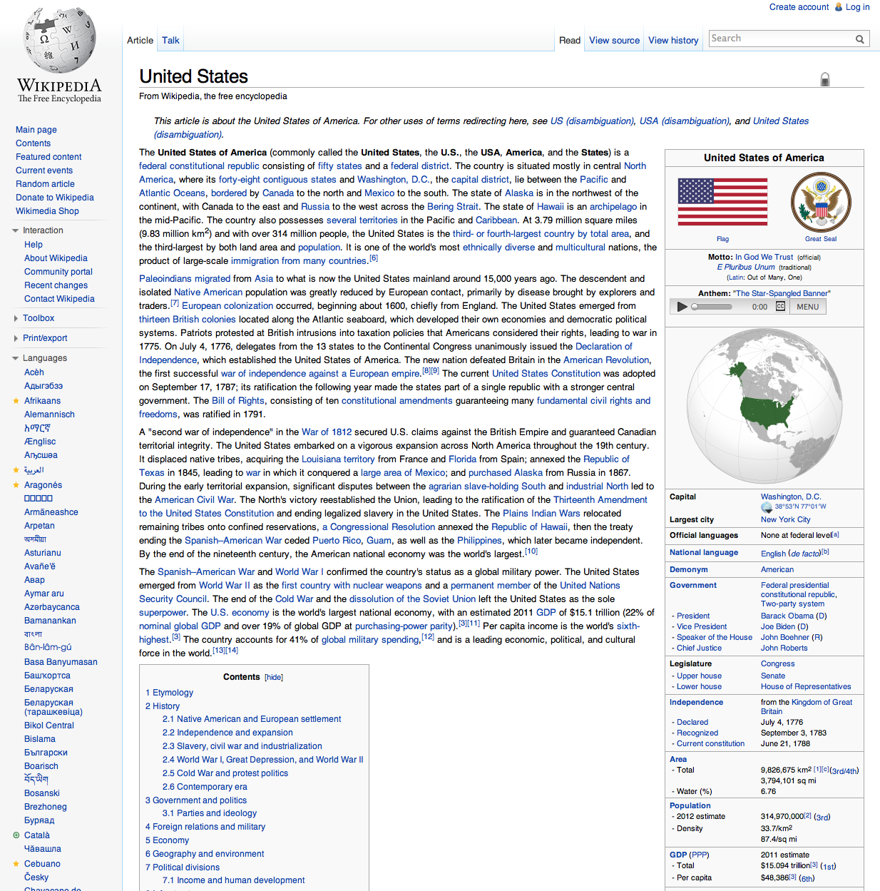


How to crawl.
Twitter Crawl will highlight keywords on a page that you’re browsing and show you tweets having to do with that keyword.
Relevant tweets:
From: TransWorldNews
Text: United States freight trucking long distance market: New market research published http://t.co/cjlN1ol3
From: RubyGrace
Text: @WTFCrazyFacts: There are more women in China's military than there are people in the United States.

Slide 5

How we did this.
Overview:
Analyzed user’s home timeline
Extracted keywords from each tweet
Created tags from these keywords
Tagged the tweet
Parsed web page that a user is viewing
Extracted keywords from the web page
Highlight and display tweets that correspond to that keyword

Slide 6
Technologies Used
Google App Engine
Twitter REST API
NLTK Python Library (for NLP: keyword extraction)
Chrome Extension Tools, Javascript

Slide 7
Technologies Used
Twitter REST API
yongxu

Slide 8
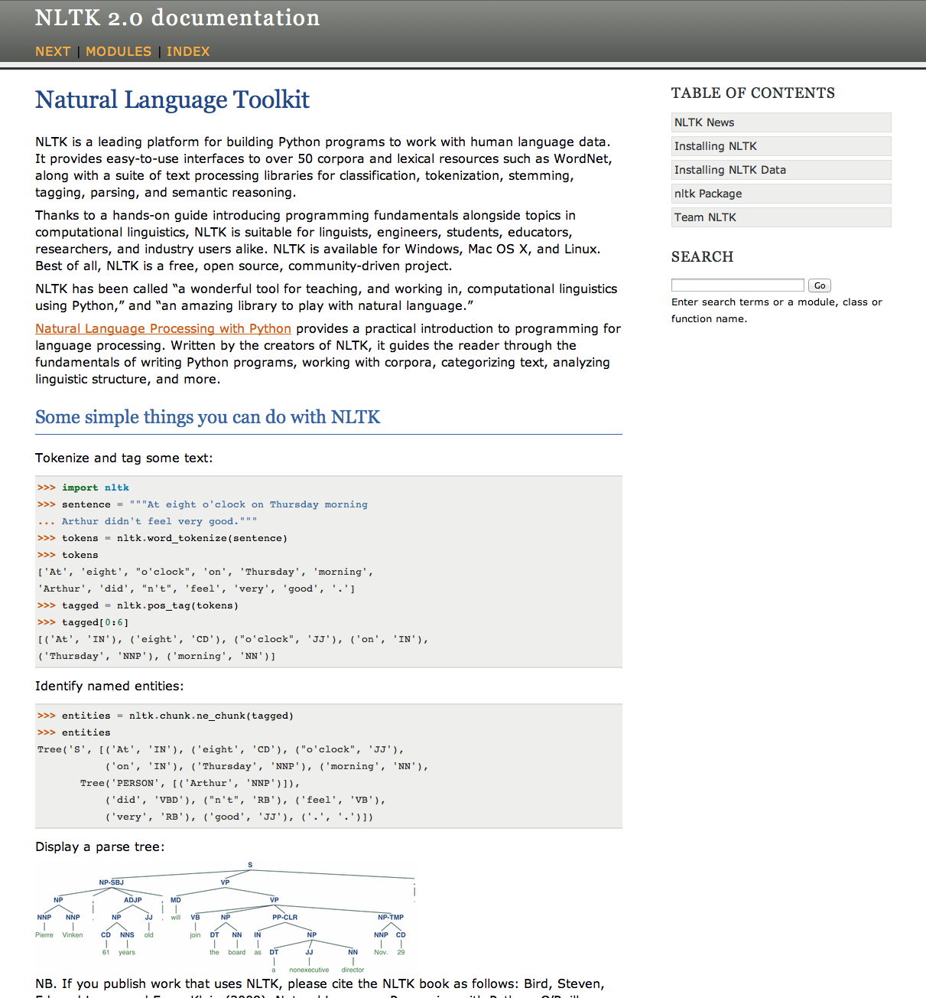
Technologies Used
NLTK Python Library (for NLP: keyword extraction)
NLTK is a natural language toolkit for Python
Very powerful
Many corpuses (e.g. dictionaries)
Create tree structures
Cleans text
Calculates various distributions

Slide 9
Technologies Used
Chrome Extension Tools, Javascript
petre

Slide 10
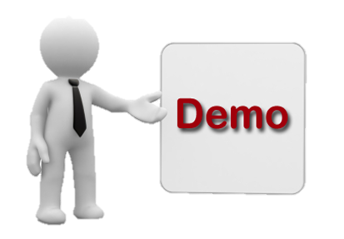
Now for a demo.

