Slide 1
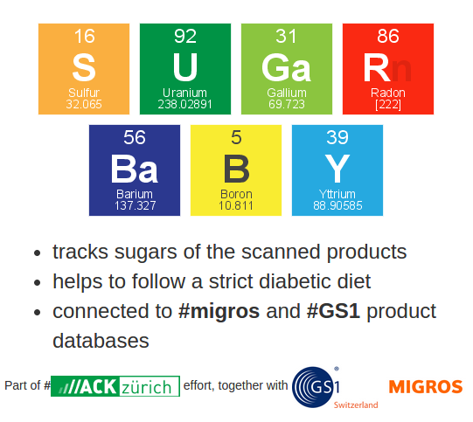

Slide 2
Why?
Each year every 40th person is diagnosed with diabetes
This could mean a significant change of life style:
  Understanding what, when and how much you can eat?
  Monitoring the levels of blood sugar
  Paying more attention to physical training and rest

Slide 3

So what does it mean?
Patient has to systematically track what is consumed
Strict diet improves quality of life and chances of remission

Slide 4
Progress so far
A django web app serving as a proof of simple concept:
  User scans or enters a bar code (GTIN)
  Product's nutrition facts are located in the database
  Consumed product is tracked in the diabetic diary and can be browsed

Slide 5
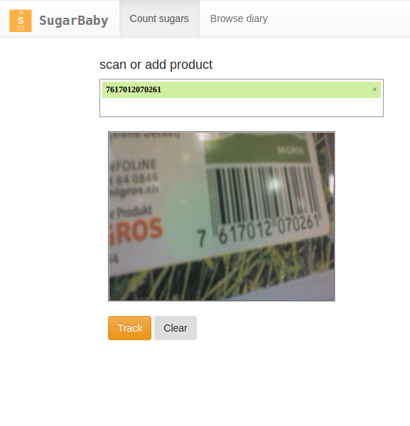
Tracking a product

Slide 6
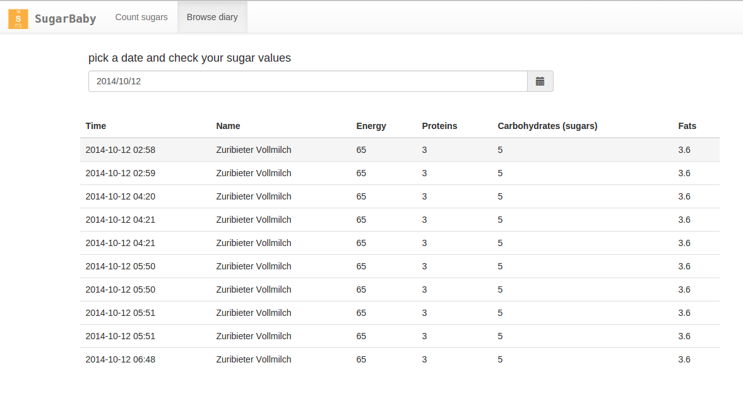
Browsing through sugar levels

Slide 7
How the “h@ck” it works?
Building blocks behind the software service consist
A cloud service providing aggregated insight into Migros products, GS1, USDA and more databases
- A personalized web-interface with tracking products, diary overview and statistical dashboard
- A mobile app linked with the user account that simplifies scanning of products and keeping an track over patients diet

Slide 8
Further improvements
Tracking precision is everything:
  Aggregate more products
  Compare information reported by vendors and
  Add localization of names to simplify search
Fast, minimalistic food tracking is mobile
  Mobile app should have “one button only” and be fast in looking up values of the food
  Can be competitive with apps like Low Fat Recipes or WeightWatchers

Slide 9
Thank you for time! Questions?
@github (MIT licensed code)
https://github.com/ewiger/sugarbaby

