Slide 1
Delivery → CSAT → Repeat Growth Engine
Orders analyzed: 99,441
Late deliveries: 6.57%
Avg review: on-time 4.21 vs late 2.27
Repeat in 90d: on-time 2.36% vs late 2.04%
Assumed AOV: $137.75

Slide 2
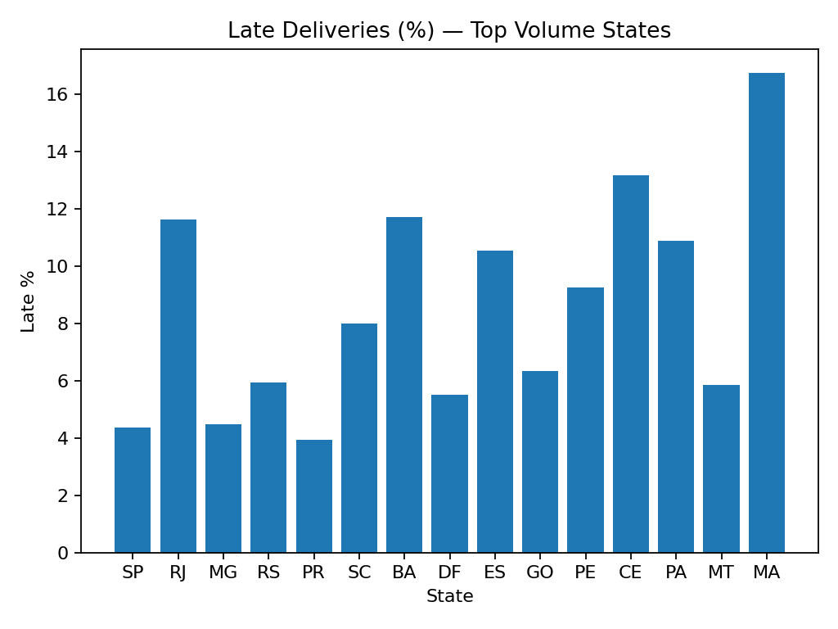
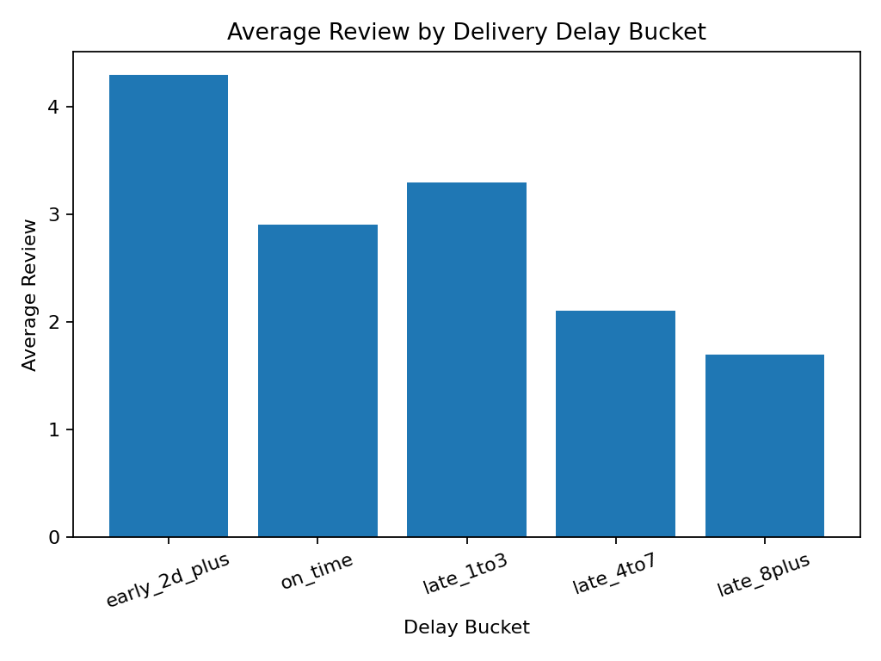
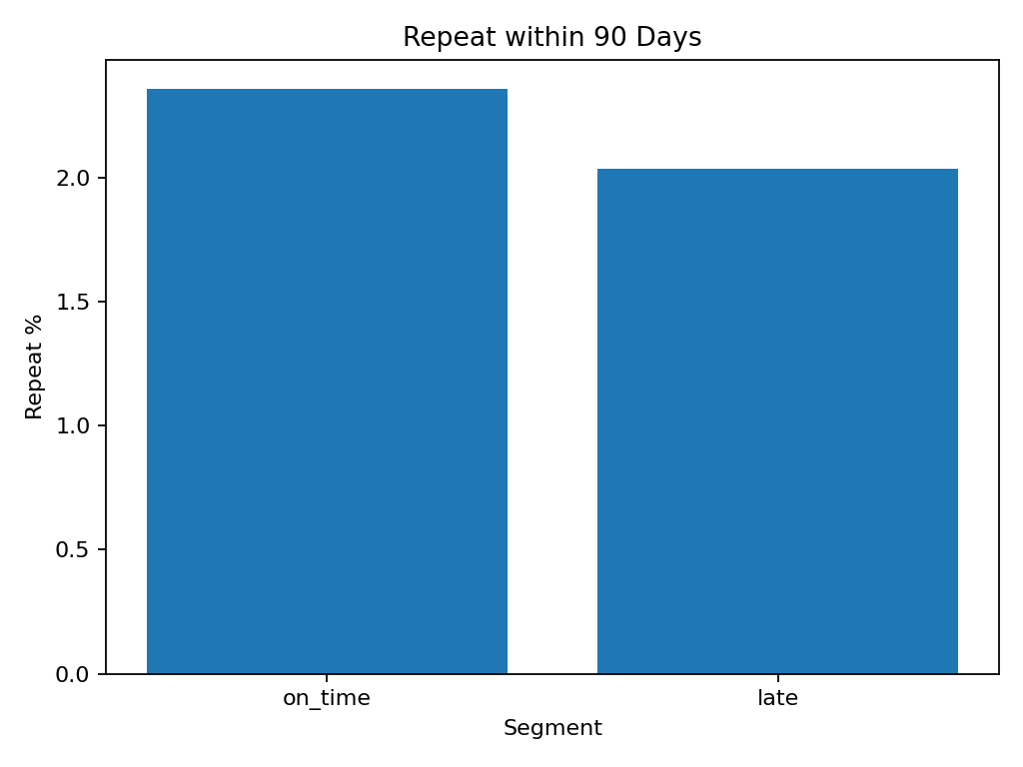
Key KPIs

Slide 3
Where to Fix First (Impact & Priorities)
Impact summary:
=== DELIVERY → CSAT → REPEAT: $ IMPACT SIMULATION ===
Orders analyzed: 99,441
Baseline late%: 6.57%
Observed repeat 90d: on-time 2.36% | late 2.04%
Delta repeat rate from fixing lateness: +0.32 pp
Assumed AOV: $137.75
[Overall] Reduce late% by 5.0 pp:
Prioritization:
=== WHERE TO FIX FIRST — PRIORITIZATION ===
Lift assumption: converting late → on-time yields +0.32 pp to repeat-in-90d
Assumed AOV: $137.75
Top states by $ impact (simulate -3 pp late):
- SP: 41,746 orders, late 4.4% → convert 1,252 → +$509
- RJ: 12,852 orders, late 11.6% → convert 386 → +$178
- MG: 11,635 orders, late 4.5% → convert 349 → +$155
- RS: 5,466 orders, late 5.9% → convert 164 → +$73
- PR: 5,045 orders, late 3.9% → convert 151 → +$67
- SC: 3,637 orders, late 8.0% → convert 109 → +$51
- BA: 3,380 orders, late 11.7% → convert 101 → +$50

