Slide 1
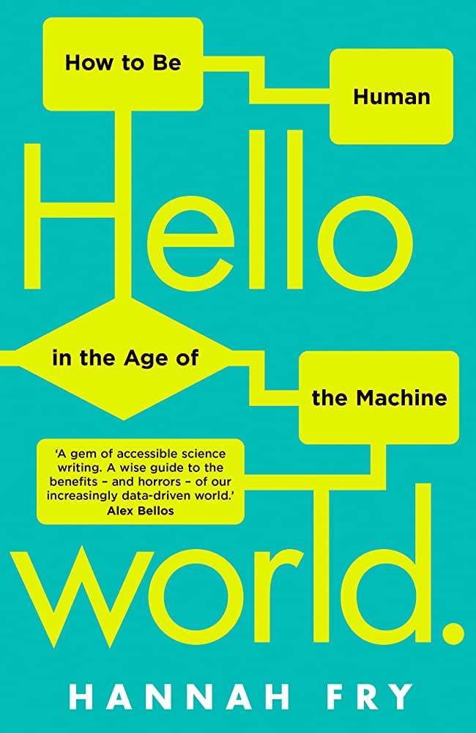
Data 303 Presentation
Presented by Yuqian Wang
Hello World:
How to be Human in the Age of the Machine
By Hannah Fry

Slide 2
Summary of the Big Ideas
The book raises ethical considerations about the transparency, human oversight, and potential biases in algorithms, and emphasizes the importance of human touch, morality, and individualized ethical solutions.
Sometimes, using algorithms means forcing people to develop a practical solution to ethical or philosophical problems
Don't rely too much on algorithms written by others

Slide 3
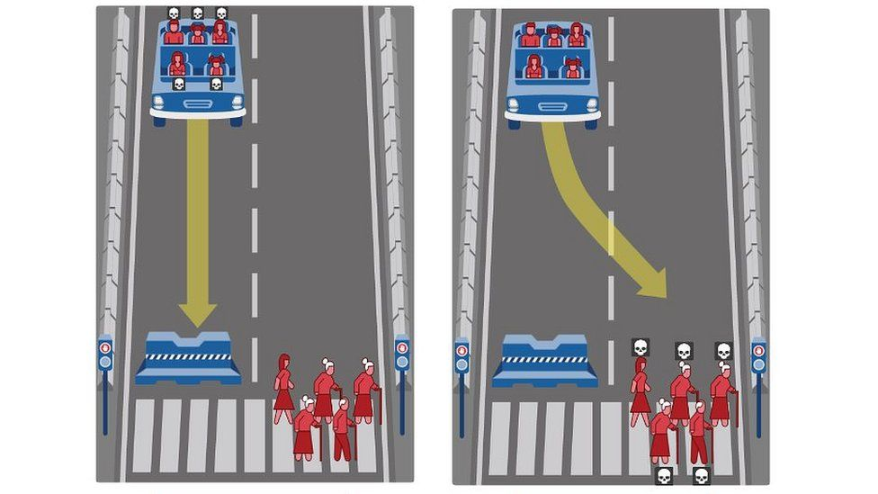
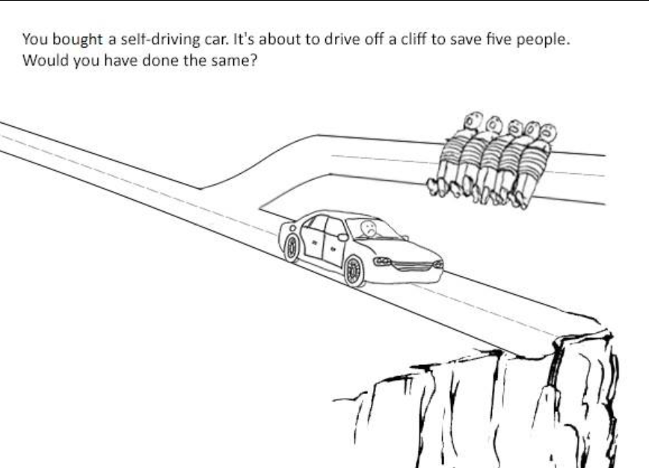
Trolley Problem in Self-Driving Cars
Notes:
The "trolley problem" scenario for a self-driving car is, in the event of an accident, whether the car will prioritize protecting the occupants and hitting pedestrians, or prioritize protecting pedestrians on the road and putting the occupants in danger.

Slide 4
Response to Trolley Problem
This question directly challenges our view of algorithms making value judgments about our own lives and the lives of others, because algorithms will prioritize protecting their own users when there is no better solution.
Notes:
Fry argues that if manufacturers do devise an algorithm that sacrifices themselves to save others, they could be heavily liable for it, since it is illegal to harm consumers.
Therefore, Fry suggests that since each individual has his or her own moral considerations, allowing people to develop their own individualized ethical solutions for algorithms to practice may help certain groups in real life.

Slide 5
Interesting Points
What we should be more worried about is not machines becoming people, but people becoming machines
Artificial intelligence is all about old algorithms running on high-speed computers

Slide 6
Recommendation
But… Great for Data 101 student

