Slide 1

Realtime log analysis as the approach for attacks and anomalies detection
based on author's own tool Intrusive2
made by ewilded, april 2012

Slide 2
List of contents
definitions
goals
events classification policy
Intrusive2 – how does it work
Intrusive2 – rules creation
Intrusive2 – vices, virtues
Intrusive2 – general information
discussion

Slide 3
Definitions
IDS (Intrusion Detection System)
events
  attacks
  anomalies
system logs
logs monitoring
blocking traffic
alerting

Slide 4
Goals
catching EVERY unwanted/unpredicted event
alerting
automatic traffic blocking
automatic blacklist extending

Slide 5
Events classification policy
hybrid set of rules
  norm-definition rules
  additional rules with known issue patterns + frequency tresholds
  default policy configurable (permissive/enforcing)
each event which is not a norm, is either
  anomaly
  attack

Slide 6
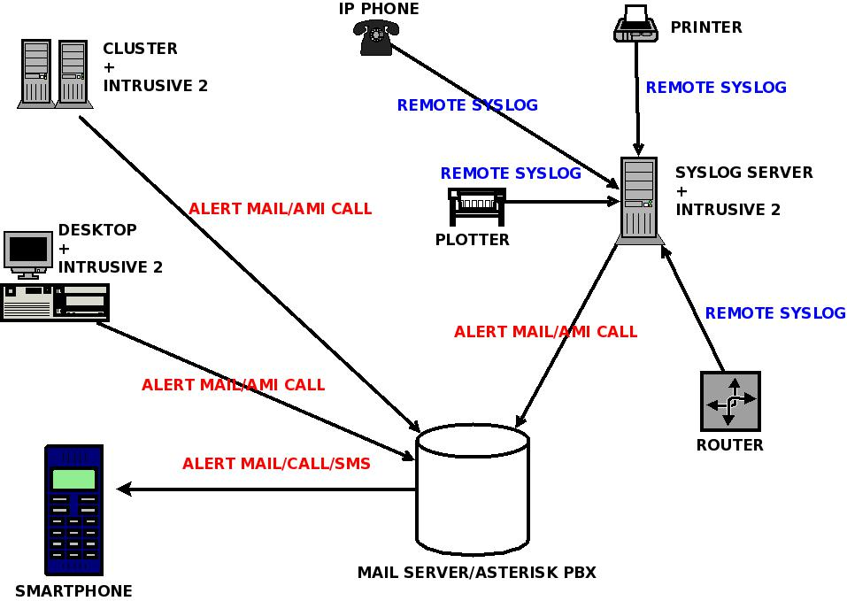
Intrusive2 – example deployment

Slide 7
Intrusive2 – how does it work
run separate task on each log file
whence new content appears, check it with rule patterns
if matched, check time conditions
if event does not fit into norm definition – alert and (dependand on the policy) block traffic with relevant host

Slide 8
Intrusive2 – configuration files
/etc/intrusive/config – global configuration
configuration of log pathes and basic settings on per logfile-level: /etc/intrusive/rulefiles
rule files - /etc/intrusive/rules/*
whitelist /etc/intrusive/excluded_hosts_list
shun (black) list - /var/run/intrusive/intrusive.shun
flexibility

Slide 9
Intrusive2 – how does it work
Configurable alerting forms
  sound
  e-mail
  VoIP (planned)
two operation modes/policies
  permissive (alert only)
  enforcing (alert + ban with iptables)

Slide 10
Intrusive2 – creating rules
STEP 1
STEP 1
STEP 1
bash-4.1# echo /var/log/auth.log | perl /home/ewilded/src/Perl/Intrusive2/intrusive_audit2allow.pl
Apr \d+ \d+:\d+:\d+ ewil su\[\d+\]: \+ \/dev\/pts\/\d+ ewilded:root::-1:-1:
Apr \d+ \d+:\d+:\d+ ewil proftpd\[\d+\]: localhost \(\d+\.\d+\.\d+\.\d+\[\d+\.\d+\.\d+\.\d+\]\) - USER ewilded: Login successful\. ::-1:-1:
Apr \d+ \d+:\d+:\d+ ewil su\[\d+\]: Successful su for root by ewilded::-1:-1:
Apr \d+ \d+:\d+:\d+ ewil su\[\d+\]: \+ \/dev\/pts\/\d+ ewilded:root::-1:-1:
Apr \d+ \d+:\d+:\d+ ewil su\[\d+\]: Authentication failed for root::-1:-1:
Apr \d+ \d+:\d+:\d+ ewil su\[\d+\]: FAILED su for root by ewilded::-1:-1:
Apr \d+ \d+:\d+:\d+ ewil su\[\d+\]: - \/dev\/pts\/\d+ ewilded:root::-1:-1:
Apr \d+ \d+:\d+:\d+ ewil sshd\[\d+\]: Accepted publickey for ewilded from \d+\.\d+\.\d+\.\d+ port \d+ ssh\d+::-1:-1:
Apr \d+ \d+:\d+:\d+ ewil sshd\[\d+\]: Received disconnect from \d+\.\d+\.\d+\.\d+: \d+: disconnected by user::-1:-1:
Apr \d+ \d+:\d+:\d+ ewil login\[\d+\]: ROOT LOGIN on '\/dev\/tty\d+'::-1:-1:
Apr \d+ \d+:\d+:\d+ ewil sshd\[\d+\]: Server listening on \d+\.\d+\.\d+\.\d+ port \d+\.::-1:-1:
Apr \d+ \d+:\d+:\d+ ewil sshd\[\d+\]: Received signal \d+; terminating\.::-1:-1:
STEP 2
\w{3} \d+ \d+:\d+:\d+ ewil su\[\d+\]: \+ \/dev\/pts\/\d+ ewilded:root::-1:-1:
\w{3} \d+ \d+:\d+:\d+ ewil proftpd\[\d+\]: localhost \(\d+\.\d+\.\d+\.\d+\[\d+\.\d+\.\d+\.\d+\]\) - USER ewilded: Login successful\. ::-1:-1:
\w{3} \d+ \d+:\d+:\d+ ewil su\[\d+\]: Successful su for root by ewilded::-1:-1:
\w{3} \d+ \d+:\d+:\d+ ewil su\[\d+\]: \+ \/dev\/pts\/\d+ ewilded:root::-1:-1:
\w{3} \d+ \d+:\d+:\d+ ewil su\[\d+\]: Authentication failed for root::4:2:enforcing
\w{3} \d+ \d+:\d+:\d+ ewil su\[\d+\]: FAILED su for root by \w+::4:2:enforcing
\w{3} \d+ \d+:\d+:\d+ ewil su\[\d+\]: - \/dev\/pts/\d+ ewilded:root::-1:-1:
\w{3} \d+ \d+:\d+:\d+ ewil sshd\[\d+\]: Accepted publickey for ewilded from \d+\.\d+\.\d+\.\d+ port \d+ ssh\d+::-1:-1:
\w{3} \d+ \d+:\d+:\d+ ewil sshd\[\d+\]: Received disconnect from \d+\.\d+\.\d+\.\d+: \d+: disconnected by user::-1:-1:
\w{3} \d+ \d+:\d+:\d+ ewil login\[\d+\]: ROOT LOGIN on '\/dev\/tty\d+'::-1:-1:
\w{3} \d+ \d+:\d+:\d+ ewil sshd\[\d+\]: Server listening on \d+\.\d+\.\d+\.\d+ port \d+\.::-1:-1:
\w{3} \d+ \d+:\d+:\d+ ewil sshd\[\d+\]: Received signal \d+; terminating\.::-1:-1:

Slide 11
Intrusive2 – vices, virtues
vices
  does not block malicious traffic on the fly, but rather after at least one event
  requires rules creation and tuning
virtues
  detection of known and unknown problems
  simplicity
  flexibility (every software/device, which generates events, can be monitored)

Slide 12
Intrusive2 – general information
it's written in Perl (~700 lines)
IMHO better than fail2ban, denyhosts, logwatch, swatch and others (did not compare with logcheck, didn't know it exists)
platform – GNU/Linux
license – GPLv3
inspiration
  SELinux
  Intrusive (previous version)

