Slide 1

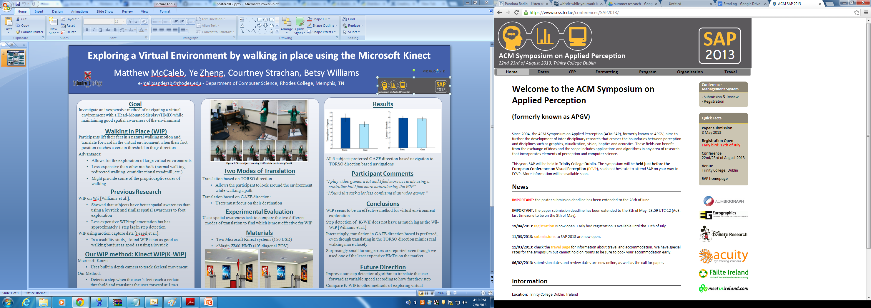
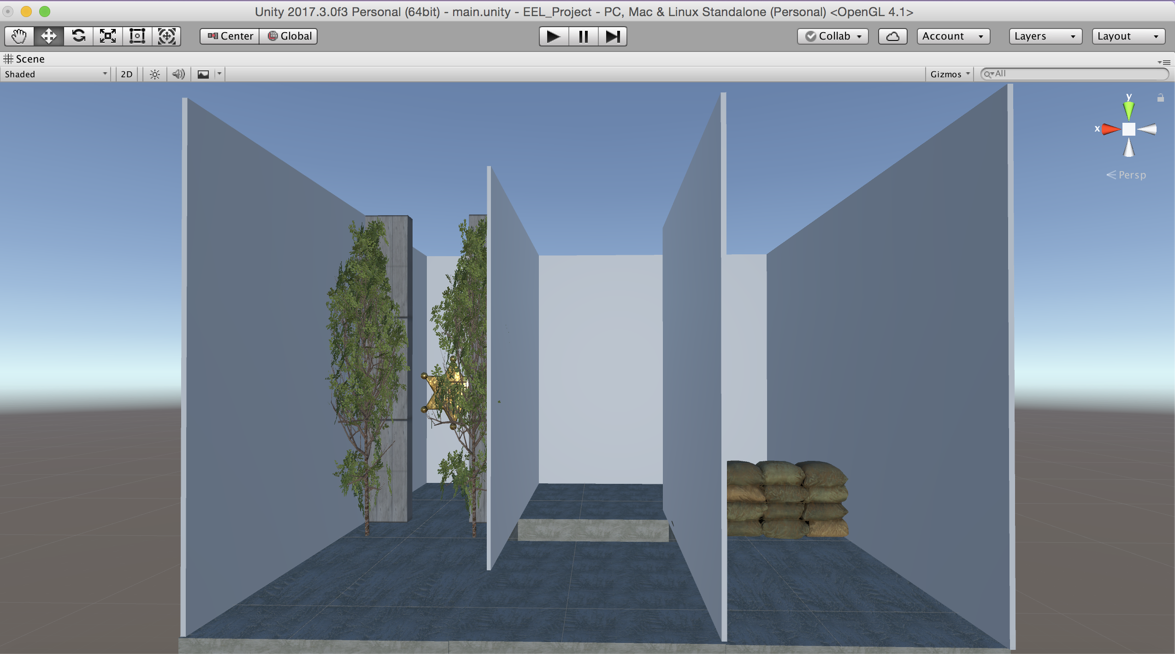
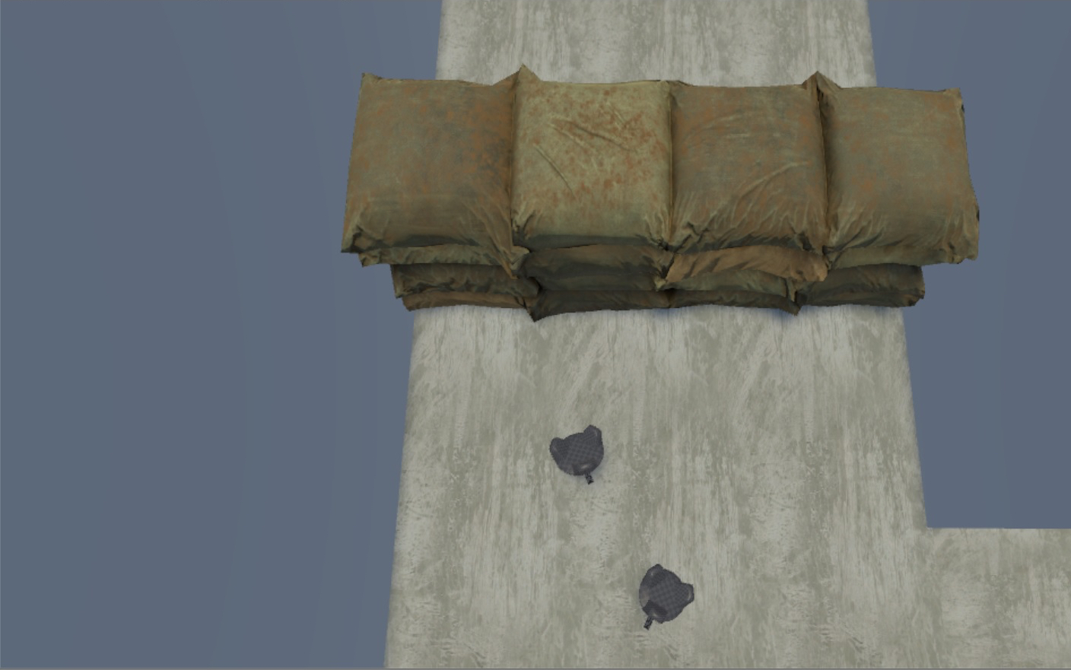
The Effect of Basic Foot Representation on the Navigation of Virtual Obstacles
Emily Wilson, Emma Goff, Leah Borsari, Betsy Sanders¹
¹sandersb@rhodes.edu
Department of Computer Science, Rhodes College; Memphis, TN
Why Study Embodiment Using Commodity Level Tracking Systems?
Embodiment is thought to be vital to obtaining a high level of presence in a virtual environment [Schubert et al., 1999].
If they are comparable to a more expensive high fidelity tracking system, then more people could have access to quality virtual reality experiences and understand when it’s important to use a high fidelity system.
Results
Participants tended to have greater reactions to the sandbags when they were wearing the foot trackers as opposed to not, F (1, 10) = 4.1, p = 0.07.
When not wearing foot trackers, the participants reacted to all the obstacles with about the same level of intensity.
When wearing the foot trackers, participants had the strongest reactions to the sandbags out of all the obstacles, F (2, 9) = 7.3, p = 0.01.
In fact, whether or not they were wearing foot trackers, participants reacted more strongly to the sandbags than either of the other obstacles, F (2, 10) = 5.6, p = 0.04.
The graphs below show participants’ reactions to each obstacle with and without foot trackers. (“w/f” = with foot trackers)
A view of the maze along with the trees (left), pit (middle), and sandbags (right)
Methods
11 participants traversed a virtual maze and their reaction to three different obstacles were observed.
Obstacles:
A pile of sandbags
A pit in the floor
Two trees on either side of the maze
Two Conditions (with-in subjects):
With virtual feet
Without a body
Each obstacle was assigned a number from 0-3 based on how intense their reaction was. 0 meant that they had no reaction at all, and 3 meant they reacted as if the obstacles were real.
There were 6 measures for each participant
Discussion
It is possible that the use of the foot trackers increased the participants’ levels of presence to a point where the sandbags seemed more realistic than the other obstacles.
We hypothesize that participants reacted so strongly to the sandbags because it is both somewhat tall as well opaque; unlike the pit and trees.
There are a couple of things that we think could further increase presence in this experiment.
Having the foot trackers appear as shoes.
Making the tree branches appear more solid.
A participant’s view of the foot trackers and the sandbags.
Materials
HTC Vive HMD, graphics rendered using Unity
Two HTC Vive trackers (attached with velco straps to the participants’ feet)
Two HTC Vive base stations.
References
Thomas Schubert, Frank Friedmann, and Holger Regenbrecht. 1999. Embodied presence in virtual environments. In Visual representations and interpretations. Springer, 269– 278.

