Slide 1
SC TV
A Comprehensive Security System
and
Media Player
Nepcons, Dhaka

Slide 2
SCTV Control
Security System
&
Media Player

Slide 3
TV/Media Play/Security System
Control
WebCam
WebCam
WebCam
Wireless
TV Media Play
Computer
TV-Computer
/UI Control /
PIP (Security)
SVGA /
HDMI
TV Security

Slide 4
Speech Control
Security System

Slide 5
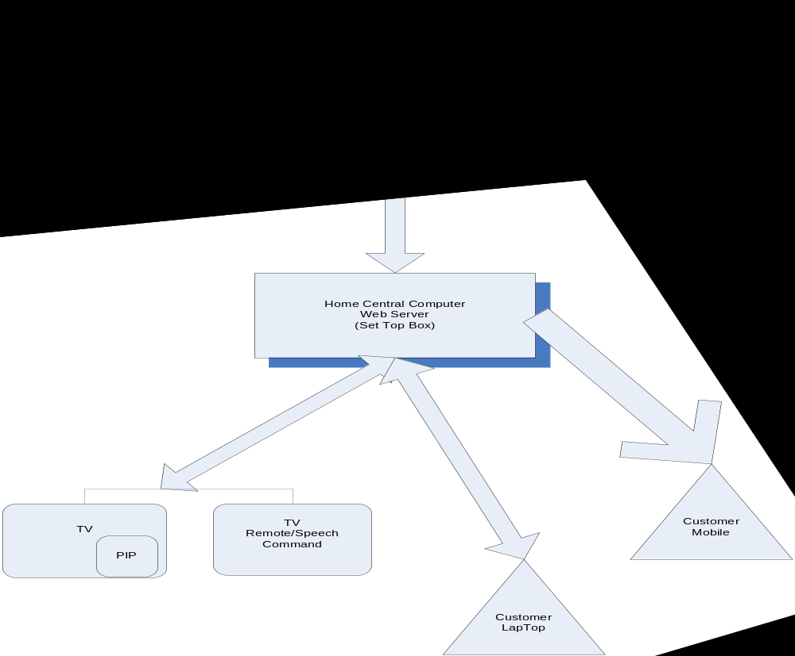

Slide 6
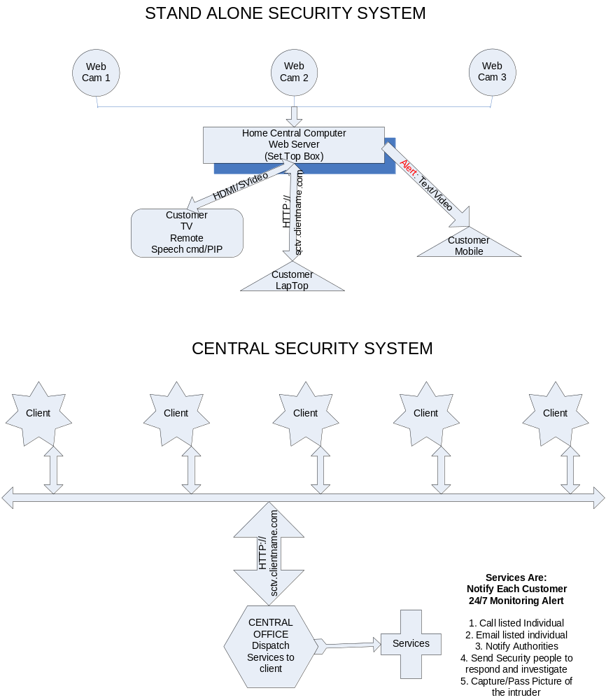

Slide 7
Security
The idea is to have multiple wireless webcams set up around the outside of your house and be able to view any/all of them using TV picture in picture (pip) type functionality
When my doorbell rings I want to be able to tell my TV to show me the front door and see and talk (through my TV) to whoever is there.
Command to show any of the camera in my TV in pip when running Regular TV show or In full computer Security Mode
I will be able to see any of the camera capture activity through internet from my Computer/Laptop.
Any Alarming Activity will be monitor 24/7 during Active mode and will be sent to client through email or text message mobile with capture image.

Slide 8
Speech Control
Media Player

Slide 9
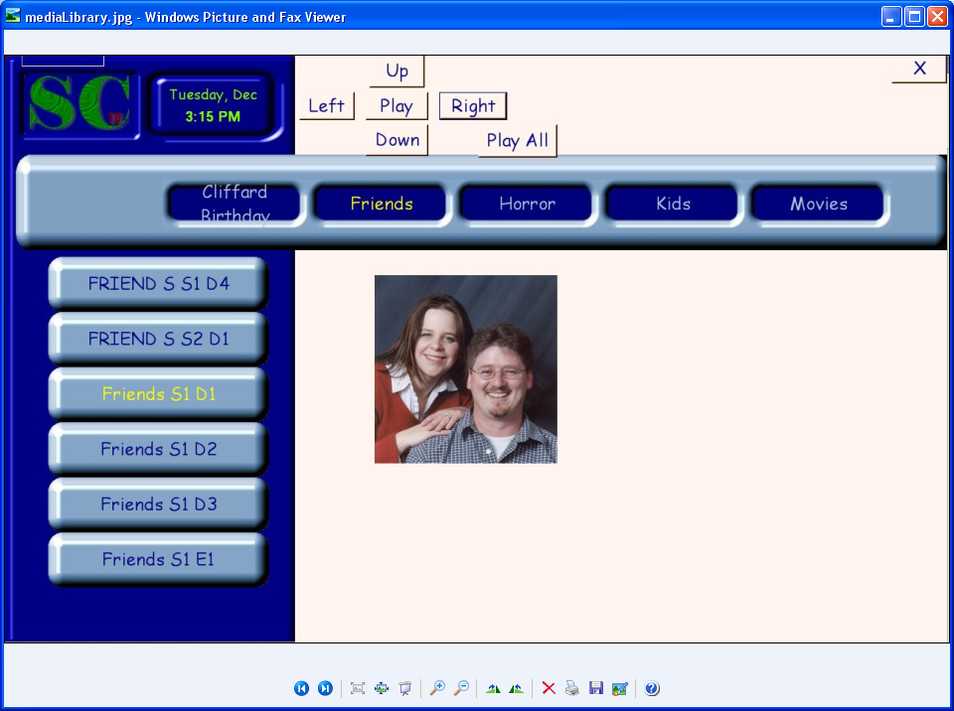

Slide 10
Media Library
The media library displays a categorized list of all available media files. As you highlight the media files you will be able to see data specific to that file, things like description, ratings, reviews and odd facts taken from the IMDB data base. I would also like to add user ratings and comments and the ability to password protect media files, so only those who should be viewing a movie can.
The media library can be pointed to any number of local and network locations to find and display available media. It will automatically watch and update itself when new files are added to these locations.
Usage:
Keyboard: - all functionality can be tied to an all in one remote
right or left arrows
  scrolls through the available media categories one at a time
up or down arrows
  scrolls through media in the selected category one at a time
enter
  play the selected media file

Slide 11
Media Library Contd.
Speech:
Computer name -> scroll up/down
  Scrolls through the available media categories until stopped
Computer name -> scroll left/right
  scrolls through media in the selected category until stopped
Computer name -> stop
  Stops any scrolling
Computer name -> play
  Plays selected media
Computer name -> play all
  Plays all media in selected category

Slide 12
Media Player
Media Player
The media player plays our media files and displays information about the currently running file. As the file is playing you are able to control all playback functions as well as view current position in the file and view the next queued media file. You will be able to view information about current media including a description, ratings, reviews and odd facts taken from the IMDB data base.
Usage:
Keyboard: - all functionality can be tied to an all in one remote
right or left arrows
  fast forwards or rewinds
up or down arrows
  jump forward or back
Enter
  display IMDB information

Slide 13
Media Player Contd.
Speech:
Computer name -> close
  Stops playing of file and returns back to media library
Computer name -> play/pause
  Plays or pauses current media
Computer name -> stop
  Stops playing of file and returns back to media library
Computer name -> what’s on
  Displays information about currently playing media
Computer name -> fast forward
  Fast forwards the current media
Computer name -> rewind
  Rewinds the current media

Slide 14
System Configuration
System
Desktop PC (Controller)
  P4
  1.5 GHZ
  1 gig RAM
  Min 100 gig HD – Depends on customers needs
  #USB, HDMI, SVG
  Web Server
  HD/Digital TV
  Web Cam
Client Service
  High Speed Internet Connection
  Obtain URL through ISP

Slide 15
Future Feature
Remoteless
I don’t want to have to look for my remote ever again. On top of the speech recognition to control everything I want to be able to use a webcam on my tv to control what is going on. The webcam will watch and feed video of your “couch area” to SCTV. The video feed will then be parsed and analyzed for any known gestures which will fire their corresponding actions.

