Slide 1
SCTV
A Comprehensive Security System
and
Media Player
Presented By
ElectroData LLC

Slide 2
Connectivity Security System / TV Media Player
  Installs web cam outside the premises
  Domain Server captures real time images from Camera through RF link
  High speed internet connection is implemented for video streaming
  TV runs on regular mode and computer monitor mode selected by the remote
  in SVGA mode TV works as a monitor of the Computer
  UI renders services for security and Media Player runs through voice command
  Security system is implemented through Voice Command
  Media player is implemented through voice command
  Client can access to the domain server through HTTP:// connection from remote location via laptop/desktop to view near real time images

Slide 3
Layout Security System / TV Media Player
WebCam
WebCam
RF Infrared Cameras
RF Receiver
Regular/Cable
TV
USB
USB
UI Control
Security Sys
TV Remote
Wireless Keyboard
TV Security
Media Player
SVGA
SVGA
UI Control
Media Player
Wireless Mouse
SCTV/Computer

Slide 4
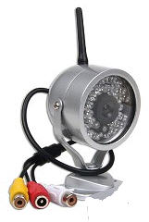
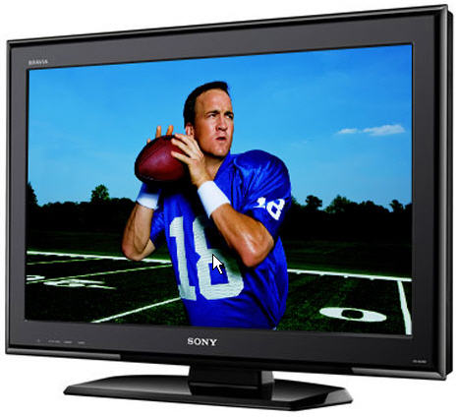
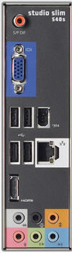
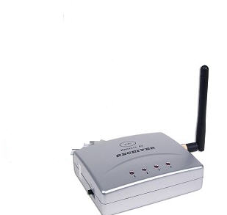
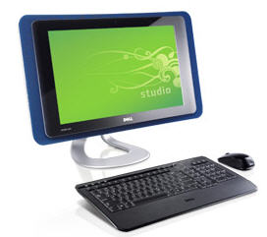

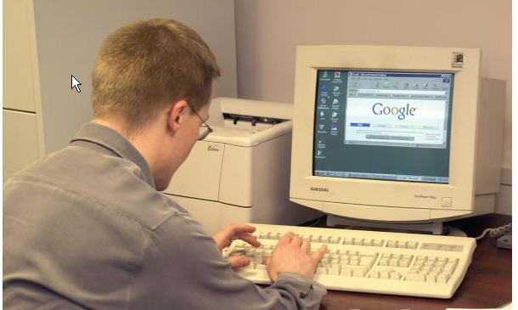
SCTV Connections
Wireless Infrared Camera powered by AC
Wireless Infrared Camera powered by AC
Connect TV with SVGA When Use TV As Monitor
Disconnect Monitor When Use TV As Monitor
SVGA Connection
SVGA Connection
USB
Camera Receivers powered with AC Outlet
Remote Change Mode between Cable / SVGA
USB
Monitor Camera Activity from Remote Location via HTTP

Slide 5
Speech Control
Security System

Slide 6
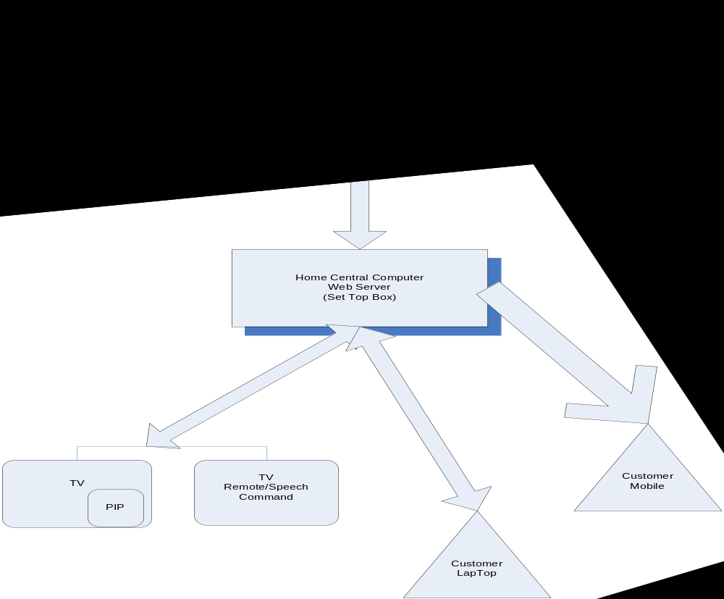

Slide 7
Stand Alone Security System
TV runs in SVGA mode hooked to SCTV Unit with SVGA connection
Speech Command or Mouse/Keyboard interface
  Swap back and forth between Surveillance Mode and Media Player
  Surveillance Mode swap between each or all camera picture display
The idea is to have multiple wireless webcams set up around outside of your house and be able to view any or all of them using SCTV
When my doorbell rings I want to be able to tell my SCTV to show me the front door and see and talk (through my SCTV) to whoever is there.
I will be able to see any of the camera capture activity through internet from my Computer/Laptop.
SCTV arm mode monitor any alarming activity and will send Message/Images to client email or mobile

Slide 8
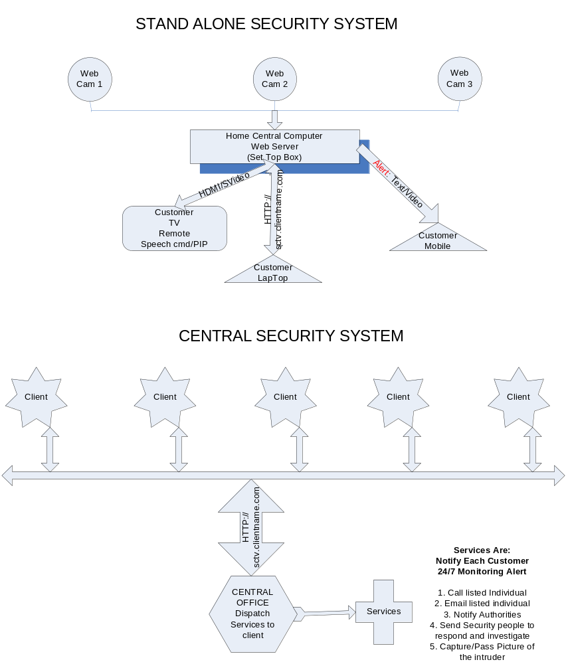

Slide 9
Central Security System
Central Unit operator monitor standalone security systems 24/7 when armed
Identify threat and act accordingly to contact client
  Can notify with Telephone/Voice Mail
  Can Call local law enforcement authority
  Can send email with captured picture of intruder
  Can call other given contacts

Slide 10
Speech Control
Media Player

Slide 11
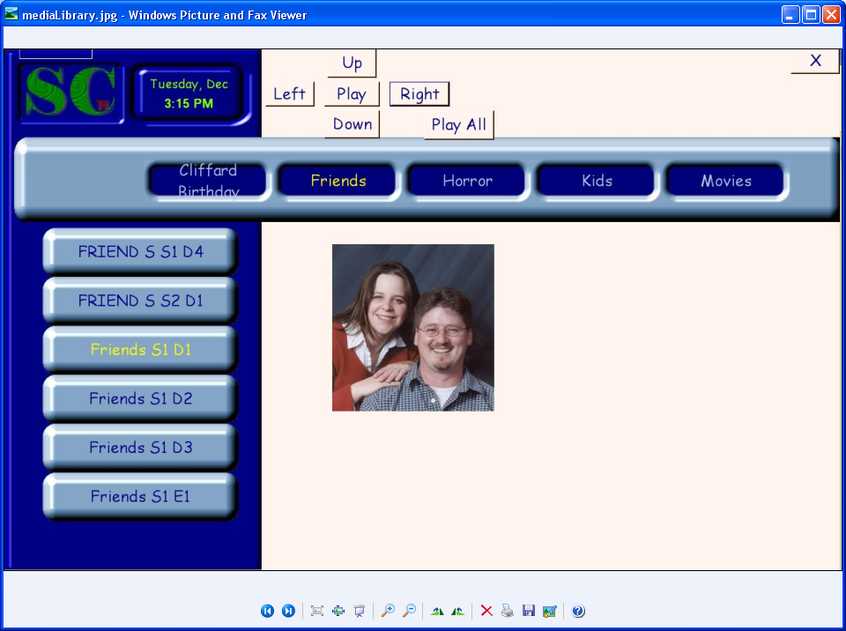

Slide 12
Media Library
The media library displays a categorized list of all available media files. As you highlight the media files you will be able to see data specific to that file, things like description, ratings, reviews and odd facts taken from the IMDB data base. I would also like to add user ratings and comments and the ability to password protect media files, so only those who should be viewing a movie can.
The media library can be pointed to any number of local and network locations to find and display available media. It will automatically watch and update itself when new files are added to these locations.
Usage:
Keyboard: - all functionality can be tied to an all in one remote
right or left arrows
  scrolls through the available media categories one at a time
up or down arrows
  scrolls through media in the selected category one at a time
enter
  play the selected media file

Slide 13
Media Library Contd.
Speech:
Computer name -> scroll up/down
  Scrolls through the available media categories until stopped
Computer name -> scroll left/right
  scrolls through media in the selected category until stopped
Computer name -> stop
  Stops any scrolling
Computer name -> play
  Plays selected media
Computer name -> play all
  Plays all media in selected category

Slide 14
Media Player
Media Player
The media player plays our media files and displays information about the currently running file. As the file is playing you are able to control all playback functions as well as view current position in the file and view the next queued media file. You will be able to view information about current media including a description, ratings, reviews and odd facts taken from the IMDB data base.
Usage:
Keyboard: - all functionality can be tied to an all in one remote
right or left arrows
  fast forwards or rewinds
up or down arrows
  jump forward or back
Enter
  display IMDB information

Slide 15
Media Player Contd.
Speech:
Computer name -> close
  Stops playing of file and returns back to media library
Computer name -> play/pause
  Plays or pauses current media
Computer name -> stop
  Stops playing of file and returns back to media library
Computer name -> what’s on
  Displays information about currently playing media
Computer name -> fast forward
  Fast forwards the current media
Computer name -> rewind
  Rewinds the current media

Slide 16
System Configuration
System
Desktop PC (Controller)
  P4
  1.5 GHZ
  1 gig RAM
  Min 100 gig HD – Depends on customers needs
  #USB, HDMI, SVG
  Web Server
  HD/Digital TV
  Web Cam
Client Service
  High Speed Internet Connection
  Obtain URL through ISP

Slide 17
Prospective Clients
Home (security/Media)
Baby Monitoring (security)
Motel/Hotel (security/Media – Check legality)
Grocery store (security)
Restaurant/Fast food (security)
Game room/Gambling (security/Media – Check legality)
Parking Lot (security)
Car dealership lot (security)
Warehouse (security)
Nursing Homes (security/Media – Check legality)
Condos (security/Media – Check legality)
Apartment (security/Media – Check legality)
Day Care (security)
School (security)
Office buildings (security)
Community Centers (security/Media – Check legality)
Tourist Attraction (security)
Transportation Transit Location (security)
Adult Entertainment (Media – Check legality)

