Slide 1

Object Oriented Analysis and Design using
UML
Rafiqul Islam

Slide 2
Module 1:
Best Practices of Software Engineering
This Presentation is the sole property of ETC Engineers Inc. Any disclosure or use of this material for business purposes with out the prior consent of Rafiqul Islam or Mizanur Rahman is strictly prohibited

Slide 3
Best Practices of Software Engineering
Explore the symptoms and root causes of software development problems
Explain six best practices for software development
Look at how these six best practices address the root causes of software development problems

Slide 4
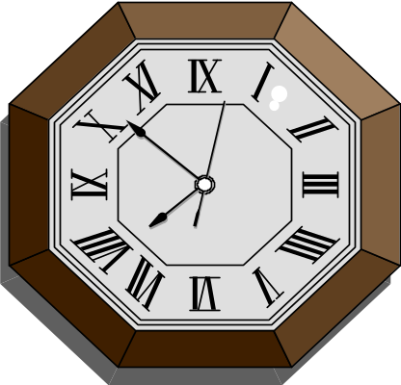


Software Development Situation Analysis
World economics increasingly
software dependent
Business demands increased productivity & quality in less time
Applications expanding in size, complexity, & distribution
Not enough qualified people

Slide 5
Software Development Situation Analysis (contd.)
Worldwide economics are increasingly dependent on software
The software for improved technology are expanding in size, complexity, distribution, and importance
US alone spends more than $250 billion each year for IT application development of approx. 175,000 projects
This push the limits of what we in the software industry know how to do; Poor quality SW becoming more visible
  AT&T: A software switching system failed and hinder long distance communication in the US for almost 24 hours. The resolution required a single line of code
  Denver Airport: Software defects delayed the Airport’s opening almost 9 months, at the expense of about 1/2 million $ a day
Business continue to demand increased productivity and quality with faster development and deployment

Slide 6






Software Development is a Job for Teams
Challenges
Larger Teams
Specialization
Distribution
Rapid technology change
Analyst
Project Manager
Performance Engineer
Developer
Tester
Release Engineer

Slide 7
Software Development is a Job for Teams (contd.)
Because of the size and complexity of the modern software system, software development is a tem of endeavor
Larger teams present communication challenges which are aggravated if the team is distributed
Complex technology requires experts who specialize in one area; a team may include many such specialists
It is a challenge to ensure they communicate effectively with the rest of the team and that all technologies are integrated to produce a successful system

Slide 8
How Are We Doing ?
World economics increasingly
software dependent
Many Successes
Too Many Failures
Business demands increased productivity & quality in less time
Applications expanding in size, complexity, & distribution
Not enough qualified people

Slide 9
Symptoms of Software Development Problems
Inaccurate understanding of end-user needs
Inability to deal with changing requirements
Module that don’t fit together
Software that’s hard to maintain or extend
Late discovery of serious project flaws
Poor software quality
Unacceptable software performance
Team members in each other’s way, unable to reconstruct who changed what, when, where, why
An untrustworthy build-and-release process

Slide 10
Treating Symptoms Doesn’t Solve the Problem
Symptoms
End-user needs
Changing requirements
Modules doesn’t fit
Hard to maintain
Late discovery
Poor quality
Poor performance
Colliding developers
Build-and-release
Root Causes
Insufficient requirements
Ambiguous communications
Brittle architecture
Overwhelming complexity
Undetected inconsistencies
Poor testing
Subjective assessment
Waterfall development
Uncontrolled change
Insufficient automation
Diagnose

Slide 11
Treating Symptoms Doesn’t Solve the Problem
(contd.)
Unfortunately, treating these symptoms doesn’t treat the disease
A late discovery of serious project flaws is only a symptom of larger problems, namely inadequate testing
Waterfall development compounds the problem since testing is done very late in development schedule
When the flaws discovered it can’t be corrected without a significant delay in delivery

Slide 12
Root Causes of Software Development Problems
Insufficient requirements management
Ambiguous and imprecise communications
Brittle systems and software architecture
Overwhelming complexity of the project
Undetected inconsistencies
  Requirements, design and implementations
Poor testing plan, insufficient testing & reporting
Subjective project status assessment
Delayed risk reduction for Waterfall development
Uncontrolled change propagation
Insufficient automation

Slide 13
Root Causes of Software Development Problems (contd.)
Insufficient requirements management makes scope creep inevitable
Seriously jeopardizes the development team’s ability to bring the project to a conclusion on time
Brittle architecture are architectures that breaks easily in response to stress or requirement/technology changes
They typically provide no reusable components nor are they based on a reusable framework
Subjective project status assessment depends on subjective estimates of the level of “doneness”- refer to 90% done or 30% remaining phenomenon
Developers estimate 90% done, but from that point it takes 90% of the project resources to complete 100% done

Slide 14
Best Practices Address Root Causes
Root Causes
Insufficient requirements
Ambiguous communications
Brittle architecture
Overwhelming complexity
Undetected inconsistencies
Poor testing
Subjective assessment
Waterfall development
Uncontrolled change
Insufficient automation
Best Practices
Develop iteratively
Manage requirements
Use component architectures
Model the software visually
Verify quality
Control changes

Slide 15
Addressing Root Causes Eliminates the Symptoms
Root Causes
Insufficient requirements
Ambiguous communications
Brittle architecture
Overwhelming complexity
Undetected inconsistencies
Poor testing
Subjective assessment
Waterfall development
Uncontrolled change
Insufficient automation
Symptoms
End-user needs
Changing requirements
Modules doesn’t fit
Hard to maintain
Late discovery
Poor quality
Poor performance
Colliding developers
Build-and-release
Best Practices
Develop iteratively
Manage requirements
Use component architectures
Model the software visually
Verify quality
Control changes

Slide 16
Best Practices of Software Engineering
Develop Iteratively
Manage
Requirements
Use
Component
Architectures
Model
Visually
Verify
Quality
Control Changes

Slide 17
Best Practices Enable High-Performance Teams
Team
Project Manager
Analyst
Developer
Performance Engineer
Tester
Release Engineer
Etc.
Results
More Successful Projects
Develop Iteratively
Manage
Requirements
Use
Component
Architectures
Model
Visually
Verify
Quality
Control Changes

Slide 18
Practice 1: Develop Software Iteratively
Develop Iteratively
Manage
Requirements
Use
Component
Architectures
Model
Visually
Verify
Quality
Control Changes

Slide 19
Develop Software Iteratively (contd.)
An initial design will likely be flawed with respect to its key requirements
Late-phase discovery of design defects results in costly over-runs and/or project cancellation
$$$
Time & Money spent implementing a faulty design are not recoverable

Slide 20
Waterfall Development
Requirement
Analysis
Design
Code & Unit
Testing
Subsystem
Testing
System
Testing
T I M E

Slide 21
Waterfall Development (contd.)
Methodology followed for more than 30 years
Entire system goes through the phases linearly and in lock steps
Requirements are defined; Design is complete; Code is written & tested
Key assumptions
  When Design begins, Requirements no longer change
  When Coding starts Design cease to change
These assumptions are of course incorrect
Hence problems result and software is late, over budget, and/or unacceptable

Slide 22
Waterfall Development Delays Reduction Risk
Requirement
Analysis
Design
R
I
S
K
Code & Unit
Testing
Subsystem
Testing
System
Testing
T I M E

Slide 23
Waterfall Development Delays Reduction Risk (contd.)
It pushes risk forward in time; where it is costly to undo mistakes from earlier phase
An initial design will likely be flawed with respect to its key requirements
The late discovery of design defects tends to result in costly runs and/or project cancellation
The waterfall approach tends to mask the real risk to a project until it is too late to correct

Slide 24
Apply Waterfall Iteratively to System Increments
Iteration 1
Iteration 2
Iteration 3
R
R
R
D
D
D
C
C
C
T
T
T
T I M E
R: Requirement Analysis D: Design
C: Coding, Unit Testing T: Subsystem & System Test
Earliest iterations address greatest risks
Each iteration produces an executable release; an additional increment of the system
Each iteration include integration and test

Slide 25
Apply Waterfall Iteratively to System Increments (contd.)
Iterative process were adopted in waterfall approach
Instead of of developing the whole system in lock steps, an incremental process is selected
Selection of increment is based on the highest priority risks first
The minimal implementation that will allow objective verification (i.e, through a set of executable tests) that this risk has been addressed is developed
Then the next increment is selected to address the next highest risk; and so on
Waterfall applied at the increment level; system evolves incrementally

Slide 26
Iterative Development Accelerates Reduction Risk
Iterative
Waterfall
R
I
S
K
Iteration
Iteration
Iteration
Iteration
Iteration
Iteration
Iteration
Iteration
T I M E

Slide 27
Iterative Development Characteristics
Projects risks are driven down in early iterations before significant implementation investments are made
Initial iterations enable early user feedback
Testing and integration are continuous
Objective milestone provide short-term focus
Progress is measured by assessing implementations
Partial implementations can be deployed

Slide 28
Iterative Development Characteristics (contd.)
Enables users to be involved in a meaningful way throughout the project lifecycle
Each iteration produces an executable release; user observe partially executing system; provide satisfaction level feedback
This ensures final product will be user acceptable
Continuous testing & integration ensures that at every iteration the pieces all fit together properly to meet system requirements
Short-term focus of an iteration provides a very objective measures of doneness
  Either a class is included in the build or it id not (it can be 90% done)
  Either a test is executed successfully, or it is not
  There is very little room for subjective estimates

Slide 29
Apply Best Practices throughout the lifecycle
Phases
Inception
Elaboration
Construction
Transition
Process Workflows:
Business Modeling
Requirements
Analysis & Design
Implementation
Test
Deployment
Supporting Workflow:
Config. & Change Management
Project Management
Environment
Primary Iterations(s)
Iter.
#1
Iter.
#2
Iter.
#n
Iter.
#n+1
Iter.
#n+2
Iter.
#m
Iter.
#m+1

Slide 30
Outline Development Process Phases
Inception
Elaboration
Construction
Transition
1
2
3
..
..

Slide 31
Software Development Process Phases
Inception phase seeds idea for the development is brought up to a point to establish the business rationale and decide on the scope of the project
Elaboration phase defines the product vision and its architecture ; Systems requirements are articulated, prioritized and baselined
A system’s requirement may range from general vision statements to precise evaluation criteria, each specifying particular functional or nonfunctional behavior and each providing a basis for testing
Construction phase brought software from an executable architectural baseline to being ready to be transitioned to the user community
During Construction system’s requirements and its evaluation criteria are constantly reexamined against the business need of the project, and resources are allocated as appropriate to actively attack risks to the project
Construction phase consists of of many iterations, in which each iteration builds production-quality software, tested and integrated; that satisfies a subset of requirements of the project
Transition phase turned software into the hand of user community. During this phase the system is continuously improved, bug fixes, and new features are added getting feedback from user community

Slide 32
Problems Addressed by Iterative Development
Root Causes
Insufficient requirements
Ambiguous communications
Brittle architecture
Overwhelming complexity
Undetected inconsistencies
Poor testing
Subjective assessment
Waterfall development
Uncontrolled change
Insufficient automation
Solutions
Enables and encourages user feedback
Serious misunderstanding evident early in the life cycle
Development focus on critical issues
Inconsistencies detected early
Testing starts earlier
Objective assessment through testing
Risks identified and addressed early

Slide 33
Problems Addressed by Iterative Development (contd.)
Iterative development enables and encourages user feedback, so as to elicit the system’s real requirements
Serious misunderstanding are made evident early in the lifecycle, when it is possible to react to them
Development team is forced to focus on most critical issues and are shielded from those issues that distract the team from the project’s real risk
Continuous, iterative testing enables an objective assessment of project’s status; provides concrete evidence of status to all stakeholder all along the way
Inconsistencies among requirements, design, and implementations are detected early, when corrections can be made without jeopardizing the schedule
Testing starts earlier in the life cycle; likely to be more thorough.
The workload of the team, specially the testing team, is spread out more evenly across the lifecycle
An iterative approach allows risk to be identified and addressed early in the schedule, when it is possible to pursue alternative solutions to tackle the issues

Slide 34
Practice 2: Manage Requirements
Develop Iteratively
Manage
Requirements
Use
Component
Architectures
Model
Visually
Verify
Quality
Control Changes

Slide 35
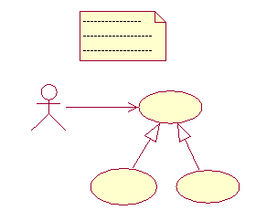
Manage Requirements (contd.)
Elicit, organize, and document required functionality and constraints
Evaluate changes and determine their impact
Track and document tradeoffs and decisions
Requirements are dynamic – Expect them to change during software development

Slide 36
Manage Requirements (contd.)
Software requirements are quite dynamic that challenges to manage
Identifying a system’s requirements- those that weigh most heavily upon the system’s economic and technical goals; is a continuous process
Except for the most trivial system, it is impossible to completely & exhaustively state a system’s requirements prior to start of development
Indeed, the mere presence of a new or evolving system tends to change a user’s own understanding of the system’s requirements
Change cannot be stopped; but it can be managed

Slide 37
Definitions: Requirements and Their Management
A Requirement is a condition or capability to which the system must conform
Requirements specify what the system must do rather than how the system will do it
Requirements management is a systematic approach to
  Eliciting, organizing, and documenting the requirements of the system, and
  Establishing and maintaining agreement between the customer/user and project team on the changing requirements of the system
Requirements management will only be successful if it allows for uncertainty of the requirements early in the project
However, Requirements managements also ensures that requirements converge over time

Slide 38



Agreement on What the System Should Do
The Goal
Customer
User Community
System
To be build
Requirements
Verification
Surrogate
Goal
Requirements

Slide 39
Agreement on What the System Should Do (contd.)
We most probably will not have direct access to our customer and user community at all times
Some customers have been known to change their minds! – It is important to write down the agreed-upon requirements of the system to be build
Requirements can be viewed as a “proxy” for the customer, as they provide the details of the customer’s desires and agreements on what the system should do
The requirements should be captured in a form that is understandable to both the customer and the development team
Those will provide the surrogate goal for the development team while building the system
Those will be the criteria for acceptance and validation of the system by the customer upon delivery

Slide 40
Requirements Trace To Many Project Elements
Design &
Implementation
Change
Management
Requirements
Project
Management
QA &
Test

Slide 41
How to Catch Requirements Error Early
Effective Problem analysis and elicitation of user needs
Gain agreement with the customer/user on the requirements
Model interaction between the user and the system
Established a baseline and change control process
Maintain forward and backward traceability of requirements
Use an iterative process

Slide 42
How to Catch Requirements Error Early (contd.)
Since Requirements are so important in driving development, it is important to find errors in requirement as early as possible
First work with users to help identify requirements; incorporate them into a model that can be shared among all project members
Modeling helps identify incompleteness and inconsistencies
Establish baseline and manage change to it
Since development will be iterative, not all requirements need to be known or baseline before beginning development of the first iteration
However, at the start of each iteration , a baselined set of requirements is selected for the development in that iteration
Tracking changes to the model also helps to make visible the degree to which requirements are stabilizing or converging
Tracing between requirements and other project elements is essential in managing the impact of changes on the project

Slide 43
Problems Addressed by Requirements Management
Root Causes
Insufficient requirements
Ambiguous communications
Brittle architecture
Overwhelming complexity
Subjective assessment
Undetected inconsistencies
Poor testing
Waterfall development
Uncontrolled change
Insufficient automation
Solutions
A disciplined approach is built into requirements management
Communications are based on defined requirements
Requirements can be prioritized, filtered, and traced
Objective assessment of functionality and performance
Inconsistencies are more easily detected
RM tools provides a repository for requirements, attributes and tracing, with automatic links to documents

Slide 44
Problems Addressed by Requirements Management (contd.)
A disciplined approach is built into the requirements development process
Incremental baseline are established and changes controlled
Communications are based upon defined requirements, captured by some mechanism (e,g., requirement management tool) and shared by all stakeholders
Requirements can be prioritized, filtered, and traced
An objective assessment of functionality and performance is possible
Inconsistencies are more easily detected since a baseline is available to all stakeholders
With suitable tool support, it is possible to provide a repository for a systems’ requirements, attributes, and traceability information, with automatic links to external documents where appropriate

Slide 45
Practice 3: Use Component-Based Architectures
Develop Iteratively
Manage
Requirements
Use
Component
Architectures
Model
Visually
Verify
Quality
Control Changes

Slide 46
Use Component-Based Architectures (contd.)
Software architecture is the development product that gives the highest return on investment with respect to quality, schedule, and cost according to Software Architecture in Practice.
The Software Engineering Institute (SEI) has an effort underway called the Architecture Tradeoff Analysis (ATA) initiative to focus on software architecture, a discipline much misunderstood in the software industry
The SEI has been evaluating software architectures for some time and would like to see architecture evaluation in wider use
By performing architecture evaluations, AT&T reports a 10% productivity increase (from news@sei, Vol. 1, No. 2)

Slide 47
Software Architecture Defined
Software architecture encompasses significant decisions about the organization of a software system
  Selection of the structural elements and their interfaces by which a system is composed
  Behavior as specified in collaborations among those elements
  Composition of these structural and behavioral elements into progressively larger subsystems
  Architectural style that guides this organization, these elements and their interfaces, their collaborations, and their composition

Slide 48
Software Architecture Defined (contd.)
Software architecture is a part of design; is about making decisions on how the system will be built
But architecture is not all of design, It stops at the major abstractions, the major elements
In other words, the element that have some pervasive and long lasting effect on the qualities of the system, namely its evolvability, its performance
A system’s architecture is perhaps the most important artifact that can be used to control the iterative and incremental development of a system throughout its lifecycle
An example of an architectural concern is an integration risk; Does database D work properly with operating system Y ?
An example of an architectural concern is a performance risk; Can we compute the trajectory of the artifact in the time allowed ?

Slide 49
Architectural Concerns
Software architecture is concerned with structure and behavior and context
  Usage
  Functionality
  Performance
  Resilience
  Reuse
  Comprehensibility
  Economic and Technological constraints and tradeoffs
  Aesthetics

Slide 50
Architectural Concerns (contd.)
Architecture is not only looking inward, it also looks at the ‘fit’ of the system in two contexts
  The operational context (i.e, its end-user)
  The development context (i, e , the organization that develop the system) not purely on the technical side, but also the economic and sociological aspect
There are also some very ‘soft’ aspects in architecture; Style and Aesthetics
Can an architecture be pleasing? Yes to the educated eye.
Issues of aesthetics have their place in making a decision uniform, easy to understand, and easy to evolve, with minimal surprises to the designers
Architectural design is especially difficult since it is not only must address technical issues; also greatly affected by business and organizational forces.
If the business wants a long term system, it must be built with flexibility and modifiability in mind.
The architecture team must anticipate future requirements and technologies that must be incorporated into the system over time
If business is expecting high growth system must consider load tolerance
If time to market is the driver, the system must be built in shortcuts with hooks provided to replace those shortcuts with full blown systems when time permits

Slide 51
Resilient, Component-Based Architectures
Good architectures meet their requirements, are resilient, and are component-based
A resilient architecture enables
  Improved maintainability and extensibility
  Economically-significant reuse
  Clean division of work teams of developers
  Encapsulation of hardware and system dependencies
A component-based architecture permits
  Reuse or customization of existing components
  Choice of thousands of commercially-available components
  Incremental evolution of existing software

Slide 52
Resilient, Component-Based Architectures (contd.)
The word ‘component’ is used to mean many different things in the industry
In this case, a component is meant to be non-trivial, nearly independent, and replaceable or reusable part of a system that fulfills a clear function in the context of well-defined architecture
A component conforms to and provides the physical realization of a set of interfaces; hence the component is the unit of reuse
Reuse is an architectural issue and must be addressed at that level
Microsoft’s COM, The OMG’s CORBA, and suns Enterprise Java Beans offer pervasive and widely supported platforms upon which Component-Based architectures are made possible

Slide 53
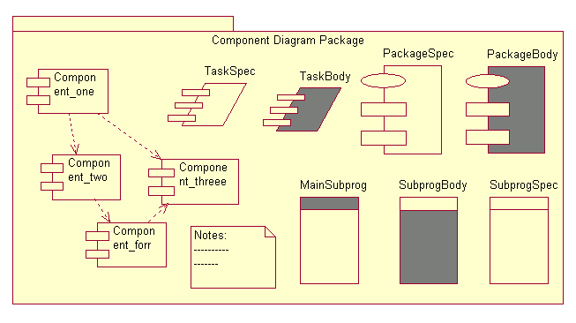
Example: Component-Based Architecture

Slide 54
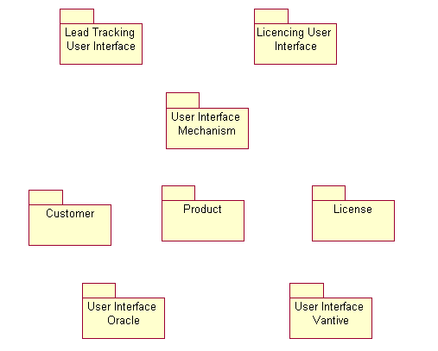
Example: Component-Based Architecture (contd.)
Key:
Purchased
Built
New
Oracle
Vantive

Slide 55
Example: Component-Based Architecture (contd.)
This IS application displays an architectural that utilizes components
There is a pair of databases, access to which is mediated through purchased components
Built on this are custom-developed components that capture the organization’s semantics and business rules for Customer and Products
There is a set of UI mechanisms, some of which were purchased, and and a user interface for Lead Tracking
Suppose we also institute and manage software licensing; First we need a component to capture the business rules for licensing
Access requires a new GUI; As we are implementing the GUI we encounter the additional UI mechanism capabilities, satisfied by re-using an existing component and puchasing a new one

Slide 56
Problems Addressed by Component Architectures
Root Causes
Insufficient requirements
Ambiguous communications
Brittle architecture
Overwhelming complexity
Subjective assessment
Undetected inconsistencies
Poor testing
Waterfall development
Uncontrolled change
Insufficient automation
Solutions
Components facilitate resilient architectures
Reuse of commercially available components and framework s is facilitated
Modularity enables separation of concerns
Components provide a natural basis for configuration management
Visual modeling tools provide automation for component based design

Slide 57
Problems Addressed by Component Architectures (contd.)
Resilient Architecture, since they enable economically-significant degree of reuse
Component-Based development further enables reuse or customizing of existing components or components from thousands of commercially-available resources
Modularity enables a clear separation of concerns among elements of a system that are subject to change
Components provide a natural basis for configuration management, facilitating the incremental control of subsets of a system over many iterations
A component-based approach also permits modular creation of tests so that each component has an associated test suite and every time a component is reused, the test can be rerun

Slide 58
Problems Addressed by Component Architectures (contd.)
Visual modeling tools provide automated support for visualizing and communicating architectural decisions
Coupled with the practice of developing software iteratively, using Component-Based architectures involves continuous evolution of a system’s architecture, with each iteration producing an executable architecture that can be measured, tested, and evaluated against the system’s requirements
This approach permits the development team to continuously attack the most important risk of the project

Slide 59
Practice 4: Visually Model Software
Develop Iteratively
Manage
Requirements
Use
Component
Architectures
Model
Visually
Verify
Quality
Control Changes

Slide 60
Visually Model Software
Capture the structure and behavior of architectures and components
Show how the elements of the system fit together
Hide or expose details as appropriate for the risk
Maintain consistency between a design and its implementation
Promote unambiguous communication
Visual Modeling improves our ability
To manage software complexity

Slide 61
Visually Model Software (contd.)
A model is simplification of reality that provides a complete description of a system of a particular perspective
We build models so that we can better understand the system we are developing; We build models of complex systems because we cannot comprehend any such system in its entirety
Modeling helps the development team visualize, specify, construct, and document the structure and the behavior of a system’s architecture
Using a standard modeling language such as UML (Unified Modeling Language), different members of development team can communicate their decisions unambiguously to one another
Using visual modeling tools facilities the management of these models let hide or expose details as necessary
Visual modeling helps to maintain consistency among a systems artifact; its requirements, design, and implementations.
Visual modeling helps improve a team’s ability to manage software complexity

Slide 62
What is the UML ?
The Unified Modeling Language (UML) is a language for
  Specifying
  Visualizing
  Constructing
  Documenting
  The artifacts of a software-intensive system
To increase comprehension, a common language like UML is used to express models
The UML is platform independent; has been adopted as an industry standard
UML defines a graphical language for presenting models and defines the semantics for each graphical elements
UML

Slide 63
Diagrams Are View of a Model
Class
Diagrams
Use Case
Diagrams
Class
Diagrams
Use Case
Diagrams
Class
Diagrams
Use Case
Diagrams
Object
Diagrams
Object
Diagrams
Object
Diagrams
Activity
Diagrams
Activity
Diagrams
Activity
Diagrams
State
Diagrams
State
Diagrams
Model
State
Diagrams
Sequence
Diagrams
Sequence
Diagrams
Sequence
Diagrams
Collaboration
Diagrams
Deployment
Diagrams
Component
Diagrams
Collaboration
Diagrams
Deployment
Diagrams
Component
Diagrams
Collaboration
Diagrams
Deployment
Diagrams
Component
Diagrams
  A model is a complete description of a system from a particular perspective

Slide 64
Diagrams Are View of a Model (contd.)
The UML provides a rich notation for visualizing models. This includes the following Key diagrams:
  Use Case diagrams to illustrate user interactions with the system
  Class diagrams to illustrate logical structure
  Object diagrams to illustrate objects and links
  State diagrams to illustrate behavior
  Component diagrams to illustrate physical structure of the software
  Deployment diagrams to show the mapping of software to hardware configuration
  Interaction diagram (i.e, collaboration and sequence diagram) to illustrate behavior
  Activity diagram to illustrate the flow of events in a use case

Slide 65
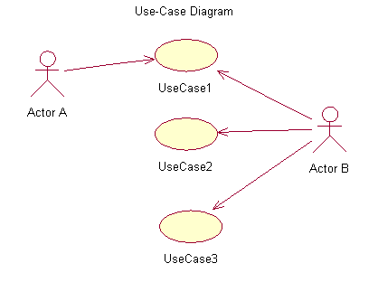
Visual Modeling Using UML Diagram
Use Case Diagram

Slide 66
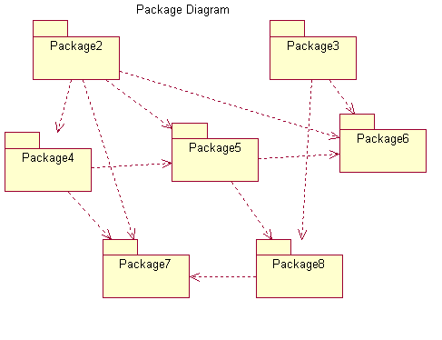
Visual Modeling Using UML Diagram
Package Diagram

Slide 67
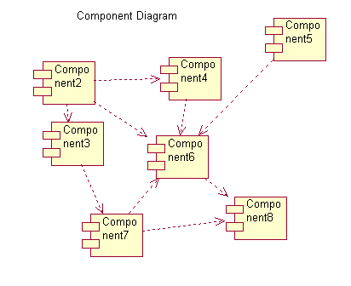
Visual Modeling Using UML Diagram
Component Diagram

Slide 68
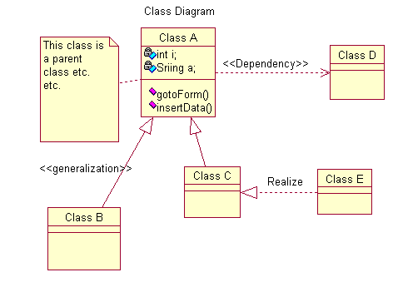
Visual Modeling Using UML Diagram
Class Diagram

Slide 69
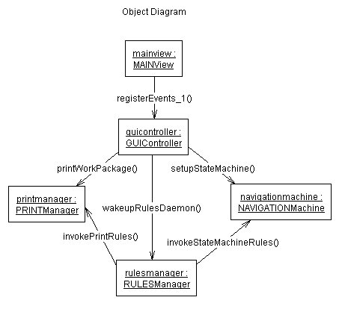
Visual Modeling Using UML Diagram
Object Diagram

Slide 70
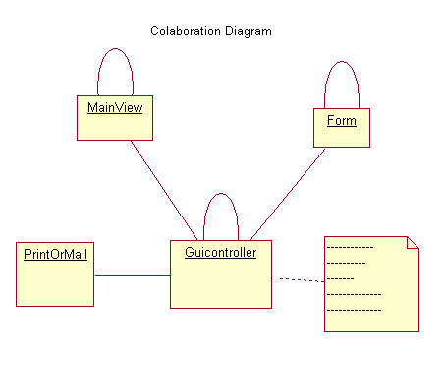
Visual Modeling Using UML Diagram
Collaboration Diagram
Collaboration Diagram

Slide 71
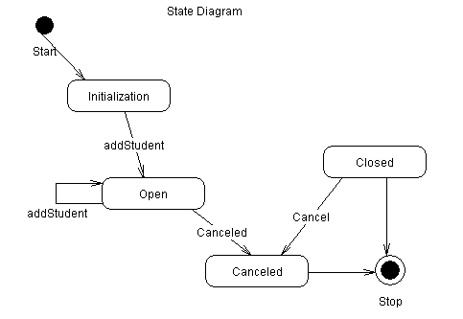
Visual Modeling Using UML Diagram
State Diagram

Slide 72
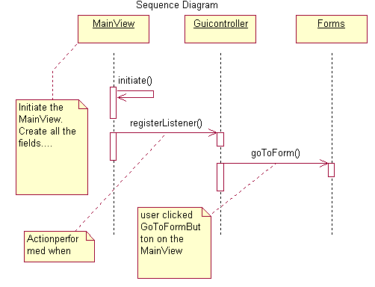
Visual Modeling Using UML Diagram
Sequence/Activity Diagram

Slide 73
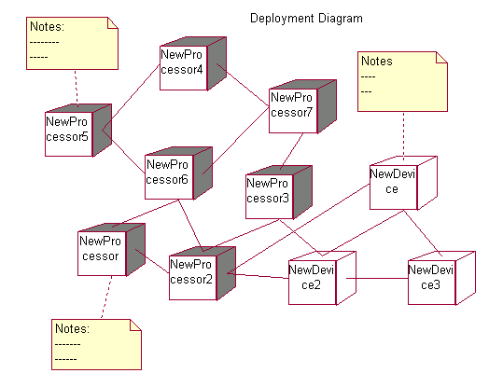
Visual Modeling Using UML Diagram
Deployment Diagram

Slide 74
Visual Modeling Using UML Diagrams
Use Case
Diagrams
Class
Diagrams
Use Case
Diagrams
Class
Diagrams
Use Case
Diagrams
Class
Diagrams
Object
Diagrams
Object
Diagrams
Object
Diagrams
Collaboration
Diagrams
Activity
Diagrams
State
Diagrams
Collaboration
Diagrams
Activity
Diagrams
State
Diagrams
Collaboration
Diagrams
Package
Diagrams
State
Diagrams
Deployment
Diagrams
Sequence
Diagrams
Deployment
Diagrams
Component
Diagrams
Sequence
Diagrams
Deployment
Diagrams
Component
Diagrams
Sequence
Diagrams
Component
Diagrams
  Executable System

Slide 75
Visual Modeling Using UML Diagram (contd.)
The UML provides a single, common modeling language that is usable across many methods, across the entire lifecycle, and across many different implementation technologies
It maps artifacts between business engineering, requirements capture and analysis, design, implementation, and test.
It defines an expressive and consistent notation that can point out omissions and inconsistencies
It scales to support very small to very large systems development
It facilitates effective communications with all members of the development team

Slide 76
Visual Modeling and Iterative Development
Initial requirements
Risk targeting
assessment
Requirements analysis
& design
implementation
& Testing
  Changes to Design ?
Deployment

Slide 77
Visual Modeling and Iterative Development (contd.)
Coupled with the practice of developing software iteratively, Visual Modeling helps us detect and assess architectural changes and to communicate those changes to the entire development team
With the right kind of tool models and source code can be synchronized during iteration
During implementation and testing within an iteration, it is likely that architectural or design changes are made via changes to the source code.
Some of this changes are intentional; others are inadvertent

Slide 78
Visual Modeling and Iterative Development
Initial requirements
Risk targeting
Requirements analysis
& design
ASSESSMENT
Implementation
& Testing
  What Changed ?
  Are These Changes Acceptable ?
Deployment

Slide 79
Visual Modeling and Iterative Development (contd.)
During the assessment activities at the end of each iteration, changes can be detected and determined if they should be preserved (introduced into models) or corrected (i.e., source code changed)
Detection are is facilitated by tools that reverse engineer source code to extract structural information
Synchronization of the model with the source code is done during every iteration
While the assessment must be done manually, model updates can be facilitated by automated tools

Slide 80
Problems Addressed by Component Architectures
Root Causes
Insufficient requirements
Ambiguous communications
Brittle architecture
Overwhelming complexity
Subjective assessment
Undetected inconsistencies
Poor testing
Waterfall development
Uncontrolled change
Insufficient automation
Solutions
Use cases and scenarios unambiguously specify behavior
Models capture software designs unambiguously
Non-Modular or inflexible architectures are exposed
Unnecessary detail hidden when appropriate
Unambiguous designs reveal inconsistencies more readily
Application quality starts with good design
Visual modeling tools provide support for ULM modeling

Slide 81
Practice 5: Verify Software Quality
Develop Iteratively
Manage
Requirements
Use
Component
Architectures
Model
Visually
Verify
Quality
Control Changes

Slide 82
Verify Software Quality (contd.)
Software Quality is defined as “The characteristics of having demonstrated the achievement of producing a product which meets or exceeds agreed upon requirements, criteria and is produced by an agreed upon process”
Achieving Quality is not simply “meeting requirements” or producing a product that meets user needs and expectations
Quality includes identifying the measures and criteria, and the implementation of a process to ensure that the resulting product has achieved the desired degree of quality and can be repeated and managed
In many organizations, software testing accounts 30% to 50% of software development cost, Yet most people believe that software is not well tested before it is delivered
This contradiction is rooted in two clear facts; first, testing software is enormously difficult. The different ways a given program can behave are unquantifiable; Second, Testing is typically done without a clear methodology and without the required automation or tool support
While the complexity of software makes complete testing an impossible goal, a well-conceived methodology and the state-of-art tools, can greatly improve the productivity and effectiveness of the software testing to ensure Quality

Slide 83
Verify Software Quality (contd.)
Software problems are 100 to 1000 times more
Costly to find and repair after deployment
C
O
S
T
Development
Deployment

Slide 84
Verify Software Quality (contd.)
Software problems are 100 to 1000 times more expensive to find an repair after deployment; also negatively affect user satisfaction with the system
Errors that require modification of software are always expensive to fix
It is important to continuously assess a system’s quality with respect to its functionality, reliability, application performance, and system performance
It is important to structure the development plan t verify architectural decisions in the earliest iterations

Slide 85
Iterative Development Permits Continuous Testing
Iteration 1
Iteration 2
Iteration 3
R
R
R
D
D
D
C
C
C
T
T
T
Test
Test
Test
T I M E
R: Requirement Analysis D: Design
C: Coding, Unit Testing T: Subsystem & System Test

Slide 86
Iterative Development Permits Continuous Testing (contd.)
Iterative development permits to use testing more effectively; instead of testing just before delivery, test is done incrementally
Each iteration produces an executable release that is integrated and tested within the iteration in which it is developed
As development proceeds through many iterations, more and more of the system is complete and is integrated and tested at the end of each iteration
At the end of final iteration, all functionality is in place and the entire system is tested as a whole
Many errors detected in early lifecycle are less expensive to fix; Focus the earliest iterations on validating architectural decisions, the most expensive design decision to change
Well-performed tests, initiated early in the software life cycle, will significantly lower the cost of completing and maintaining the software
It greatly reduce the risk or liabilities associated with poor quality software, such as poor user productivity, data entry & calculation errors and unpredictable functional behavior etc. etc.

Slide 87
Testing is an Iterative Environment
R
E
Q
U
I
R
E
M
E
N
T
S
Iteration 1
Iteration 2
Iteration 3
A
U
T
O
M
A
T
E
D
T
E
S
T
S
Test Suite 1
Test Suite 2
Test Suite 3

Slide 88
Testing is an Iterative Environment (contd.)
In each iteration, automated tests are created that test the requirements addressed in that iteration
As new requirements are added in subsequent iterations, new tests are generated and run
At times, a requirement may be changed in a later iteration; In that case the tests associated with the changed requirement may be modified or simply regenerated by an automated tool

Slide 89
Automation Reduces Testing Time and Effort
One Manual Test Cycle
13,000 Tests 2 weeks 6 People
Test
Automation
13,000 Tests
6 hours
1 person
RUN MORE TESTS MORE OFTEN
Continuous testing is ideal, until automated test tools became available
Test setup, execution, and evaluation just look too much time
With the reduction in time and effort to perform testing with automated tools, an iterative approach based on continuous testing became feasible

Slide 90
Dimensions of Software Quality
Type
Why?
How?
Reliability
Functionality
Application Performance
System Performance
Does application leak memory ?
Does application do what required ?
Does application respond acceptability
Does system perform under production load?
Analysis tools and code instrumentation
Test cases for each scenario implemented
Check performance for each use case implemented
Test performance on all use case under worst-case load

Slide 91
Dimensions of Software Quality (contd.)
Reliability verification is not typically accomplished through test and debug; some verification is done by compilers and analysis tools; some through instrumentation (i,e., detection of memory leaks in C++ compiler)
System functionality can be verified by creating test cases for each use case scenario, each of which represents some aspect of the systems desired look and behavior
Systems functionality can be assessed by testing what scenario failed and where, and what scenarios are corresponding code have not been excercised
Performance testing is done at the application and at all overall system levels
With modern architectures that include distributed processing, heterogeneous hardware environment environment, network configurations, and the like, performance testing is quite challenging
Each individual application may meet its performance requirements, yet the overall system performance may be deficient; may be impossible to test all configurations in which the system will be developed

Slide 92
Problems Addressed by Verifying Quality
Root Causes
Insufficient requirements
Ambiguous communications
Brittle architecture
Overwhelming complexity
Subjective assessment
Undetected inconsistencies
Poor testing
Waterfall development
Uncontrolled change
Insufficient automation
Solutions
Testing Provides objective project status assessment
Objective assessment exposes inconsistencies early
Testing and verification are focused on high risk areas
Defects are found earlier and are less expensive to fix
Automated testing tools provide testing for reliability, functionality, and performance

Slide 93
Problems Addressed by Verifying Quality (contd.)
Project status assessment is made objective, not subjective, through evaluation of test results rather than paper documents
Objective assessment exposes inconsistencies among requirements, designs, and implementations
Testing an verification are focused upon areas of highest risk, therefore increasing their quality and effectiveness
Defects are identified and fixed earlier, radically reducing the cost for fixing them
Automated testing tools facilitate testing or functionality, reliability, and performance; also significantly reduce the cost of regression testing, a key enabler of iterative development

Slide 94
Practice 6: Control Changes to Software
Develop Iteratively
Manage
Requirements
Use
Component
Architectures
Model
Visually
Verify
Quality
Control Changes

Slide 95
Control Changes to Software
Without explicit control,
Parallel development degrades to chaos
Multiple Developers
Multiple Teams
Multiple Sites
Multiple Iterations
Multiple Releases
Multiple Projects
Multiple Platforms
Change can’t be stopped from being introduced in the project
Changes must be controlled when introduced into project artifacts
Must synchronize change across development team and locations

Slide 96
Control Changes to Software (contd.)
Key challenge to developing software-intensive systems is the need to cope with multiple developers organized into different teams possibly at different sites, all working together on multiple iterations, releases, products, and platforms
In the absence of disciplined control, the development process rapidly degrades into chaos; forward progress can come to a dead stop
Three common problems that results are:
  Simultaneous update; when two or more workers separately modify the same artifact, the last one to make changes destroys the work of former
  Limited notifications; when a problem is fixed in shared artifacts, some of the users are not notified of the change
  Multiple versions; with iterative development, it would not be unusual to have multiple versions of an artifact in different stages of development at the same time (i,e., one release is in customer use, one is in test, and one is still in development. If a problem is identified in any one of the versions, the fix must be propagated among all of them

Slide 97
Control Changes to Software
Change Request Management (CRM)
CR
CR
EXE
Measurement
C3
A4
B5
A1
B1
C1
A1
B1
C1
A1
B1
C1
Configuration Management (CM)

Slide 98
Control Changes to Software (contd.)
The methods, process, and tools used to provide change and configuration management for an organization are the CM Systems
CM Systems holds key information about product development, deployment, maintenance process and retains the asset base of potentially reusable artifacts resulting from the execution of these processes
Three major aspects of CM Systems:
  Change Request Management addresses the organizational infrastructure required to assess the cost and schedule impacts of a requested change to the existing product
  Configuration Management describes the software product structure and identifies its constituent configuration items that are treated as single versionable entities in the configuration management process
  CM deals with defining configurations, building and labeling, and collecting version artifacts into constituent sets and maintaining traceability between these versions
  Measurement, often called Configuration Status Accounting, describes the state of the product based on the type, number, rate, and severity of defects found and/or fixed during the course of product development

Slide 99
Concepts of Configuration & Change Management
Decompose the architecture into subsystems and assign responsibility for each subsystem to a team
Establish secure workspaces for each developer
  Provide isolation from changes made in other workspaces
  Control all software artifacts; models, code, docs, etc.
Establish an integration workspace
Establish an enforceable change control mechanism
Know which changes appear in which releases
Release a tested baseline at the completion of each iteration

Slide 100
Concepts of Configuration & Change Management (contd.)
Change Control applies to all software artifacts; requirements, model, code, documents etc.
Problem Reports or enhancement requests must be traceable to the particular version of each artifact to which they apply
Change Request (CR) must be prioritized, impact assessed, and a plan put in place to introduce them into a particular iteration and release
Rates of changes are specially important to monitor, this includes:
  Requirements churn: Unusable requirements, non-convergence
  Interface churn: Unstable component interface
  Change breakage: Rework per defect repair
Audited baseline include an accurate bill-of-materials that enable one to determine exactly what a release contains
Fist a baseline is created and identified for each iteration; An audit trail is kept which records what went into that baseline

Slide 101
Change Control Supports All Other Best Practices
Progress is incremental only if changes to
artifacts are controlled
Develop Iteratively
To avoid scope creep, identify, assess And
approve all changes
Manage
Requirements
Use Component
Architectures
Components must be reliable, i,e., the correct
Versions of all constituent parts are found
To assure convergence, incrementally control
models as designs stabilize
Model Visually
Tests are only meaningful if the versions of the
items under test are known and the items
protected from changes
Verify Quality

Slide 102
Change Control Supports All Other Best Practices (contd.)
Develop Iteratively: Without change control, iterations can be degraded into infinite loops. How do we know that we are making forward progress? We can track the artifacts baselined at the end of each iterations
Manage Requirements: To manage requirements, we must know the current baseline and identify and control all changes to the baseline. For each proposed change, an impact assessment is made before the change is approved for incorporation
Use Component Architecture: In order to reuse a component, it must be possible to locate all the related artifacts (model, documentation, test suites, etc.). The correct version of each artifact must also be identifiable, otherwise the reuser will become discouraged and reject the component

Slide 103
Change Control Supports All Other Best Practices (contd.)
Model Visually: The design model is a key artifact of the development process and must be controlled. Portions of the model are developed in each iteration, so an increment of the model is baselined in each iteration
Verify Quality: The results of every test run must be traceable to the specific versions of all artifacts involved, including source code, data bases, test cases, etc. Problem reports that result must similarly be traceable to specific version

Slide 104
Problems Addressed by Controlling Changes
Root Causes
Insufficient requirements
Ambiguous communications
Brittle architecture
Overwhelming complexity
Subjective assessment
Undetected inconsistencies
Poor testing
Waterfall development
Uncontrolled change
Insufficient automation
Solutions
Requirements change workflow is defined and repeatable
Change requests facilitate clear communications
Isolated workspaces reduce interface from parallel work
Change rate statistics are good metrics for objectively assessing project status
Workspaces contain all artifacts, facilitating consistency
Change propagation is controlled
Changes maintained is a robust customizabale system

Slide 105
Problems Addressed by Controlling Changes (contd.)
The requirements change workflow is defined and repeatable; Changes to requirements are made in a disciplined, rigorous way
Changes request are visible and accessible, facilitating clear communication among all stakeholders
Isolated workspaces reduce the interface among developers working parallel; Workspaces enable a developer to chose which changes they want to see while protecting them from changes that might disrupt their work
In assessing project status, change rate statistics are key metrics to be collected, tracked, and reported on a regular basis. They provide a measure of the quality of the development process as well as the quality of the system under development
Workspaces contains all artifacts, making inconsistencies obvious and facilitating their resolution
Change propagation is controlled, ensuring that the convergence on functionality and quality is achieved. A suitable CM tool makes the change management policy cost effective and reduces the impact to the development process

Slide 106
Best Practices Reinforce Each Other
Ensures users involve
Manage
Requirements
as requirements evolve
Validates architectural
Use Component
Architectures
decisions early on
Develop
Iteratively
Address complexity of design and
Model Visually
Implementation incrementally
Measures quality early and often
Verify Quality
Evolves baselines incrementally
Control Changes
In case of six best practices, the whole is much greater than the sum of the parts. Each of the best practices reinforces and, in some cases enables the others

Slide 107
Summary: Best Practices of Software Engineering
The results is software that is
On Time
On Budget
Meets Users Need
Analyst
Project Manager
Develop Iteratively
Manage
Requirements
Use
Component
Architectures
Performance Engineer
Developer
Model
Visually
Verify
Quality
Tester
Control Changes
Release Engineer

Slide 108


Summary
We have examined each of the six best practices of software engineering. To apply them successfully to a project requires that the operating procedures of the development organization incorporates and enforces them. In most cases automated support from the development environment is also critical

