Slide 1
Introduction to Unified Modeling Language (UML) and
Rational Unified Process (RUP)
Rafiqul Islam

Slide 2
Objectives: Rational Unified Process (RUP)
Describe the Unified Modeling Language (UML)
Define what a software development process is
Describe the Rational Unified Process
Explain the four phases of the RUP and their milestones
Define iterations and their relation to phases
Explain the relations between:
  Modules and workflows
  Phases, iterations, and workflows
Define artifacts, worker, and activity
State the importance of automated tool support

Slide 3
Building a System - A Language Is Not Enough
Team-Based Development
Modeling Language
Process
The UML provides a standard for the artifacts of development (Semantic Models, notations, and diagrams)
UML is not a standard for the process of development
Despite all of the value that a common modeling language brings, successful development of today’s complex systems can’t be achieved solely by the use of the UML
Successful development also require the local procedures a robust development process of an organization

Slide 4
What is the UML ?
The Unified Modeling Language (UML) is a language for
  Specifying
  Visualizing
  Constructing
  Documenting
  The artifacts of a software-intensive system
To increase comprehension, a common language like UML is used to express models
The UML is platform independent; has been adopted as an industry standard
UML defines a graphical language for presenting models and defines the semantics for each graphical elements
UML

Slide 5
A Brief History of UML
The UML is now the industry standard modeling language
Its development was spearheaded by three Amigos in the Object-Oriented industry : Grady Booch, Ivar Jacobson(OOSE-object oriented software engineering), and Jim Rumbaugh(OMT-Object Modeling Technique).
Other important methods including Fusion, Shaler-Mellor, and Coad-Yourdon. Each of them had unique approaches in the early 90’s that were converging independently.
A critical mass of ideas started to form by mid 1990s, when Booch (Rational Software Corporation), Jaxcobson(Objectory), and Rumbaugh (General Electric) began to adopt ideas from each other’s methods.
Rational Software brought these three leaders together to accelerate convergence to a single modeling approach. UML is the outcome of that effort a recognized leading object-oriented method worldwide.
The UML’s early versions have gradually converged into the UML standard 1.1 that was adopted by Object Management Group (OMG) in November 1997.
The OMG Revision Task Force(RFT) released UML1.2 in June 1998 nd UML 1.3 in fall 1998

Slide 6
UML History
Fall ‘98
UML 1.3
June ‘98
UML 1.2
Sept ‘97
UML 1.1
Jan ‘97
UML 1.0
Jan ‘96
UML 0.9
Oct ‘95
Unified Method 0.8
Jacobson joins Rational Fall 1995
Use Case
Rumbaugh joins Rational Oct. 1994
OMT
Booch

Slide 7
Inputs To UML
Rumbaugh
Booch
Jacobson
Fusion
Operation descriptions, Message numbering
Meyer
Before and after conditions
Embley
UML
Singleton classes, High Level View
Harel
State Charts
Wirfs-Brock
Responsibilities
Gamma, et.al
Odell
Shaler - Mellor
Frameworks, patterns, notes
Classification
Object Lifecycles

Slide 8
UML Is a Language of Documenting
A healthy software organization produces all sorts of artifacts in addition to
raw executable code. These artifacts include ( but are not limited to)
Requirements
Architecture
Design
Source Code
Project Plans
Tests
Prototypes
Releases

Slide 9
A Conceptual Model of the UML
Three Major Elements: The UML’s basic building blocks, The rules that dictate
how these building blocks may be put together, and some common mechanisms that
apply throughout the UML
Building Blocks:
Things
Relationships
Diagrams
Things are the abstractions that are first-class citizens in a model; relationships tie
these things together; diagrams group interesting collections of things.
Things in the UML:
Structural things
Behavioral things
Grouping things
Annotational things
These things are the basic object oriented building blocks of the UML.

Slide 10
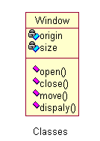
Things in the UML - Structural
Structural Things: Are nouns of UML models. These are the mostly static parts of a
model, representing elements that are either conceptual or physical. In all, there are
seven kinds of structural things.
Class: is a description of a set of objects that share the same attributes, operations, relationships, semantics. A class implements one or more interfaces.

Slide 11

Things in the UML - Structural
Interface: An interface is a collection of operations that specify a service of a class or component. Describes the externally visible behavior of that element. Interface might represent the complete behavior of a class or component or only a part of that behavior. An interface defines a set of operation specifications (signatures) but never a set of operation implementation.

Slide 12
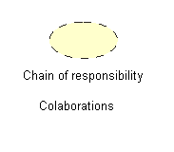
Things in the UML - Structural
Collaboration:defines an interaction and is a society of roles and other elements that work together to provide some cooperative behaviors that’s bigger than the sum of all elements. Collaborations have structural, as well as behavioral, dimensions.

Slide 13
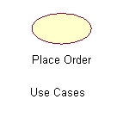
Things in the UML - Structural
Use Case: Is a description of set of sequence of actions that a system performs that yields an observable result of value to a particular actor.It is used to structure the behavioral things in a model. It is realized by a collaboration.

Slide 14
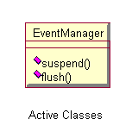
Things in the UML- Structural (contd.)
Active class: is a class whose objects own one or more processes or threads and therefore can initiate control activity. It is just like a class except that its objects represent elements whose behavior is concurrent with other elements.

Slide 15
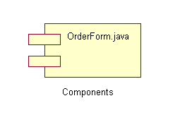
Things in the UML- Structural (contd.)
Component: is a physical and replaceable part of s system that conforms to and provides the realization of a set of interfaces. Such as COM+ or Java Beans as well as components that are artifacts of the development process, such as source code files. It typically represent the physical packaging of otherwise logical elements, such as classes, interfaces, and collaborations.

Slide 16
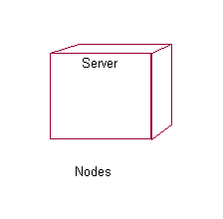
Things in the UML- Structural (contd.)
Node: is a physical element that exists at run time and represents a computational resource, generally having at least some memory and often processing capability. A set of components may reside on a node and may also migrate from node to node.

Slide 17
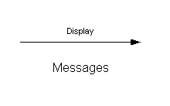
Things in the UML - Behavioral
Behavioral things are the dynamic parts of UML models. These are the verbs of a model, representing behavior over time and space.
Interaction: is a behavior that comprises a set of messages exchanged among a set of objects within a particular context to accomplish a specific purpose. The behavior of a society of objects or of an individual operation may be specified with an interaction. An interaction involves a number of other elements, including messages, action sequences(behavior invoke by a message), and links(connection between objects).

Slide 18
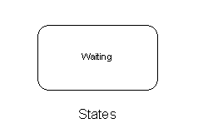
Things in the UML - Behavioral
State Machine: is a behavior that specifies the sequences of states an object or an interaction goes through during its lifetime in response to events, together with its responses to those events. The behavior of an individual class or a collaboration of classes may be specified with a state machine. A State machine involves a number of other elements, including states, transitions(flow from state to state), events(things trigger a transition), and activities (response to a transition).

Slide 19
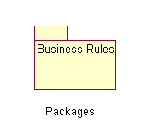
Things in the UML - Grouping
Grouping things are the organizational parts of UML models. These are the boxes into which a model can be decomposed. In all there is one primary kind of grouping thing, namely, packages.
Package: is a general-purpose mechanism for organizing elements into groups. Structure things, and even other grouping things may be placed in a package. Unlike components (exist at runtime), a package is purely conceptual(exists only at development time). .(UML2-10)

Slide 20
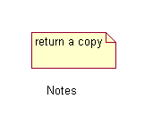
Things in the UML - Grouping
Annotational: are the explanatory parts of UML models. These are the comments which applied to describe, illuminate, and remarks about any element in a model. Primary annotational thing is called a Note. It is simply a symbol for rendering constraints and components attached to an element or a collection of elements. .(UML2-11)

Slide 21
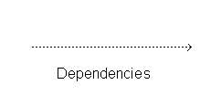
Relationships in the UML
There are four kinds of relationships in the UML. These relationships are the basic relational building blocks of the UML.
Dependency , Association, Generalization, Realization
Dependency: is a semantic relationship between two things in which a change to one thing (independent thing) may affect the semantics of the other thing (dependent thing) .(UML2-12)

Slide 22
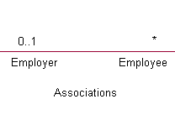
Relationships in the UML
Association: is a structural relationship that describes a set of links, a link being a connection among objects.
  Aggregation is a special kind of association, representing a structural relationship between a whole and its parts.(car has an engine and wheel as its parts).
  Compositions: is a stronger variety of Aggregation with it, the part object may belong to only one whole; further, the parts are usually expected to live and die with the whole. Any deletion of the whole is considered to cascade to the parts.

Slide 23
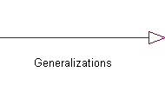
Relationships in the UML
Generalization:is a specialization/generalization relationship in which objects of the specialized element(parent). Child shares the structure and behavior of the parent.

Slide 24
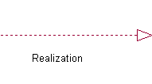
Relationships in the UML
Realization: is a semantic relationship between classifiers, wherein one classifier specifies a contract that another classifier guarantees to carry out. Between interfaces and the classes or components that realize them, and between use cases and the collaborations that realize them.

Slide 25
Diagrams in the UML
A Diagram is the graphical presentation of a set of elements, most often render as a connected graph of vertices (things) and arcs (relationships).
UML includes nine such diagrams:
Class diagram
Object diagram
Use Case diagram
Sequence diagram
Collaboration diagram
State chart diagram
Activity diagram
Component diagram
Deployment diagram

Slide 26
The UML Provides Standardized Diagrams
Class
Diagrams
Use Case
Diagrams
Class
Diagrams
Use Case
Diagrams
Class
Diagrams
Use Case
Diagrams
Object
Diagrams
Object
Diagrams
Object
Diagrams
Activity
Diagrams
Activity
Diagrams
Activity
Diagrams
State
Diagrams
State
Diagrams
Model
State
Diagrams
Sequence
Diagrams
Sequence
Diagrams
Sequence
Diagrams
Collaboration
Diagrams
Deployment
Diagrams
Component
Diagrams
Collaboration
Diagrams
Deployment
Diagrams
Component
Diagrams
Collaboration
Diagrams
Deployment
Diagrams
Component
Diagrams
  A Model is a complete description of a system from a particular perspective

Slide 27
The UML Provides Standardized Diagrams (contd)
The UML provides a rich notation for visualizing models. This includes the following Key diagrams:
  Use Case diagrams to illustrate user interactions with the system
  Class diagrams to illustrate logical structure
  Object diagrams to illustrate objects and links
  State diagrams to illustrate behavior
  Component diagrams to illustrate physical structure of the software
  Deployment diagrams to show the mapping of software to hardware configuration
  Interaction diagram (i.e, collaboration and sequence diagram) to illustrate behavior
  Activity diagram to illustrate the flow of events in a use case

Slide 28
Rules of the UML
UML Building Blocks can’t simply be thrown together in a random fashion. Like ant
language, the UML has a number of rules that specify what a well formed model is one
that is semantically self-consistent and in harmony with all its related models. The UML
has semantic rules for:
Names Things, Relationship and diagrams
Scope The context that gives specific meaning to a name
Visibility How those names can be seen and used by others
Integrity How things properly and consistently relate to one another
Execution What it means to run or simulate a dynamic model
Models built during the development of a software-intensive system tend to evolve and
may be viewed by many stakeholder in different ways and at different times. For that
reason it is common for the development team to not only build models hat are well-
formed, but also to build models that are:
Elided Certain elements are hidden to simply the view
Incomplete Certain elements may be missing
Inconsistent The integrity of the model is not guaranteed

Slide 29
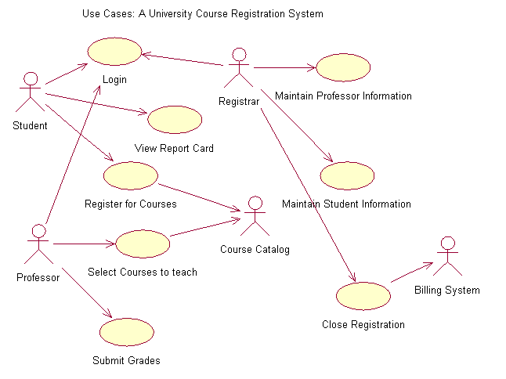
A Sample UML Diagram: Use Cases

Slide 30
A Sample UML Diagram: Use Cases (contd)
Use Case diagram are used to show the existence of use cases and their relationships, both to each other and to actors.
An Actor is something external to the system that has an interface with the system
A use case models a dialogue between actors and the system.
Use Case is initiated by an actor to invoke a certain functionality in the system(in the diagram one user of the system is a student who wishes to use the system to register for the courses. Hence, Register for course is a use case).
Arrow indicates direction of initiations of interaction
Use Case is a complete flow of events.
Use Case constitute all possible ways of using the system

Slide 31
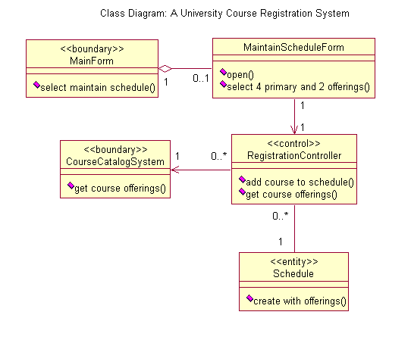
A Sample UML Diagram: Classes

Slide 32
UML Diagrams Are Key System Artifacts
The UML provides a single, common modeling language that is usable across many methods, across the entire lifecycle, and across many different implementation technologies
It maps artifacts between business engineering, requirements capture and analysis, design, implementation, and test.
It defines an expressive and consistent notation that can point out omissions and inconsistencies
It scales to support very small to very large systems development
It facilitates effective communications with all members of the development team

Slide 33
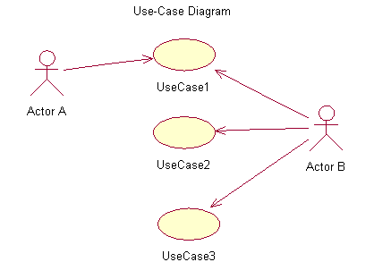
Visual Modeling Using UML Diagram
Use Case Diagram

Slide 34
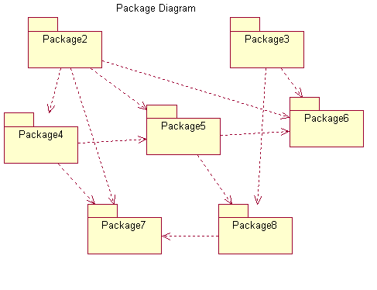
Visual Modeling Using UML Diagram
Package Diagram

Slide 35
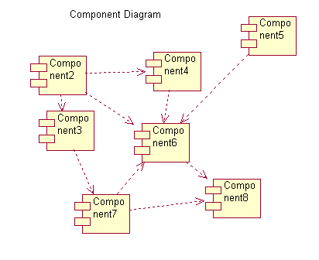
Visual Modeling Using UML Diagram
Component Diagram

Slide 36
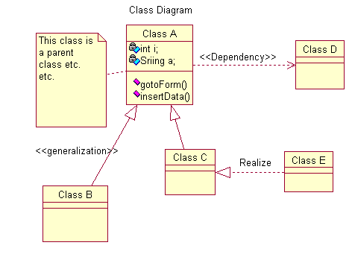
Visual Modeling Using UML Diagram
Class Diagram

Slide 37
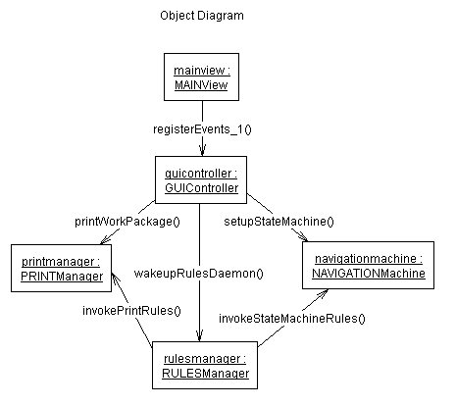
Visual Modeling Using UML Diagram
Object Diagram

Slide 38
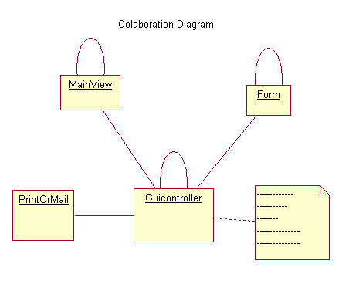
Visual Modeling Using UML Diagram
Collaboration Diagram
Collaboration Diagram

Slide 39
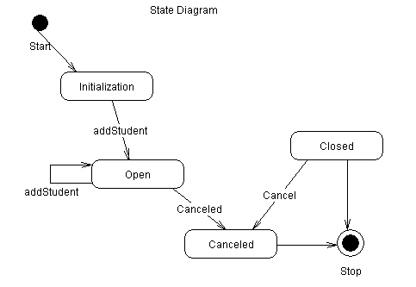
Visual Modeling Using UML Diagram
State Diagram

Slide 40
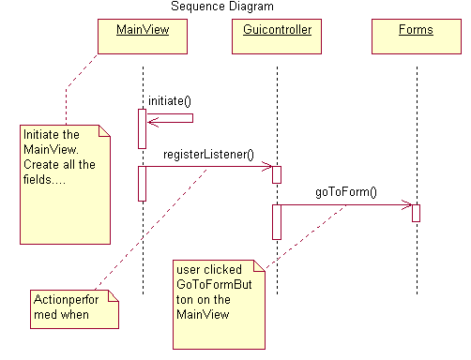
Visual Modeling Using UML Diagram
Sequence Diagram

Slide 41
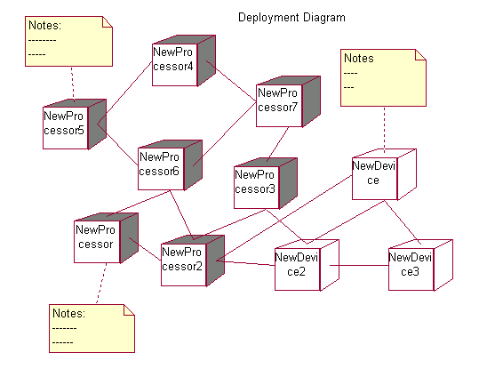
Visual Modeling Using UML Diagram
Deployment Diagram

Slide 42
Visual Modeling Using UML Diagrams
Use Case
Diagrams
Class
Diagrams
Use Case
Diagrams
Class
Diagrams
Use Case
Diagrams
Class
Diagrams
Object
Diagrams
Object
Diagrams
Object
Diagrams
Collaboration
Diagrams
Activity
Diagrams
State
Diagrams
Collaboration
Diagrams
Activity
Diagrams
State
Diagrams
Collaboration
Diagrams
Package
Diagrams
State
Diagrams
Deployment
Diagrams
Sequence
Diagrams
Deployment
Diagrams
Component
Diagrams
Sequence
Diagrams
Deployment
Diagrams
Component
Diagrams
Sequence
Diagrams
Component
Diagrams
  Executable System

Slide 43
What is a Process ?
  A Process defines WHO is doing WHAT, WHEN and HOW to reach a certain goal. In software engineering the goal is to build a software product or to enhance an existing one
Software Engineering
Process
  New or Changed
  system
  New or Changed
  requirements
  The Rational Unified Process (RUP) is a generic process that uses UML as a modeling language. RUP can be used for any kind of software system

Slide 44
An Effective Process….
Provides guideline for efficient development of quality software
Reduces risk and increases predictability
Captures and presents best practices
Promotes common vision and culture
Provides roadmap for applying tools
Delivers information on-line, at your finger tip

Slide 45
Process Architecture - Lifecycle Phases
Phases
Inception
Elaboration
Construction
Transition
Process Workflows:
Business Modeling
Requirements
Analysis & Design
Implementation
Test
Deployment
Supporting Workflow:
Config. & Change Management
Project Management
Environment
Primary Iterations(s)
Iter.
#1
Iter.
#2
Iter.
#n
Iter.
#n+1
Iter.
#n+2
Iter.
#m
Iter.
#m+1

Slide 46

Phase Boundaries Mark Major Milestones
Inception
Elaboration
Construction
Transition
1
2
3
..
..

Slide 47
Process Phases
Inception phase seeds idea for the development is brought up to a point to establish the business rationale and decide on the scope of the project
Elaboration phase defines the product vision and its architecture ; Systems requirements are articulated, prioritized and baselined
A system’s requirement may range from general vision statements to precise evaluation criteria, each specifying particular functional or nonfunctional behavior and each providing a basis for testing
Construction phase brought software from an executable architectural baseline to being ready to be transitioned to the user community
During Construction system’s requirements and its evaluation criteria are constantly reexamined against the business need of the project, and resources are allocated as appropriate to actively attack risks to the project
Construction phase consists of of many iterations, in which each iteration builds production-quality software, tested and integrated; that satisfies a subset of requirements of the project
Transition phase turned software into the hand of user community. During this phase the system is continuously improved, bug fixes, and new features are added getting feedback from user community

Slide 48
Major Workflows Produce Models
The Rational Unified Process is a model-driven approach. Several models are needed to fully describe the evolving system. Each major workflow produces one of those models.The models are developed incrementally across iterations.
Business Model is a model of what the business processes are and the business environment. It can be used to generate requirements on supporting information systems.
Use Case Model is a model of what the system is supported to do and the system environment
Design Model is an object model describing the realization of use cases. It serves as an abstraction of the implementation model and its source code
Implementation Model is a collection of components, and the implementation subsystems that contain them
Test Model encompasses all of the test cases and produces required to test the system

Slide 49
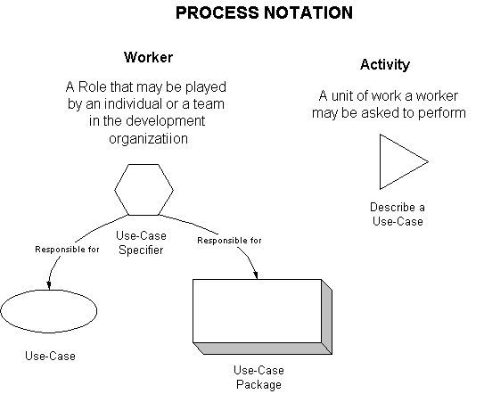
Process Notation

Slide 50
Process Notation
An Artifact is something one produce in the course of developing a software product. It includes the source code itself as well as the models, documents, and other products of the lifecycle.
An Activity is the smallest piece of work that is relevant. It is not responsible to do only part of an activity. Dividing the work in this manner makes it easier to monitor development.
A worker defines the behavior and responsibilities of an individual, or a set of individuals working together as a team.

Slide 51
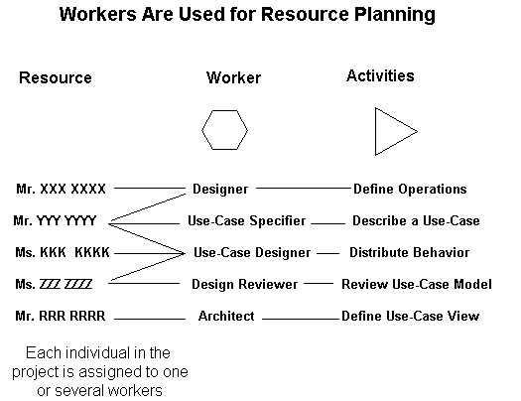
Workers Are Used for Resource Planning

Slide 52
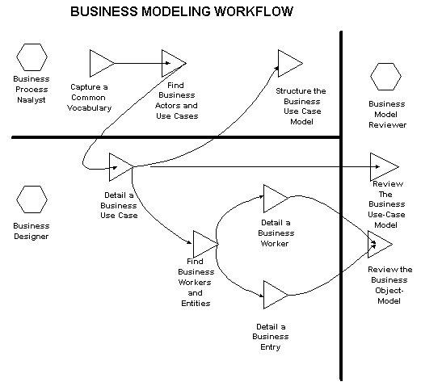
Business Modeling Workflow

Slide 53
Business Modeling Workflow
The purpose of the Business Modeling workflow are:
To understand the structure and dynamics of the organization
To Ensure the customers, end users, and developers have a common understanding of the organization
To derive requirements on systems to support the organization

Slide 54
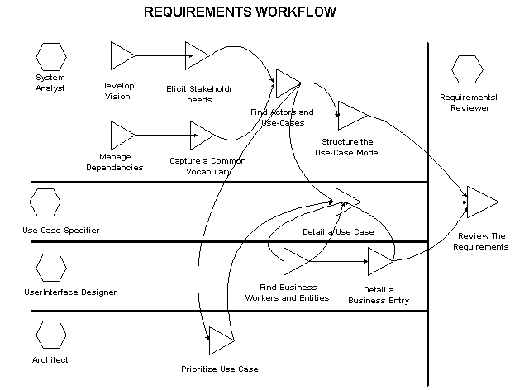
Requirements Workflow

Slide 55
Requirements Workflow
To come to an agreement with the customer and the users on what the system should do
To give system developers a better understanding of the requirements on the system
To delimit the system
To provide a basis for planning the technical contents of iterations
To define a user interface for the system
To Achieve these goals:
Vision document, a Stakeholder Needs documents, a Use Case model,
Supplementary Specifications, Glossary document are developed that describe WHAT
the system will do.
Complementary to the above mentioned artifacts following artifacts are developed:
Glossary, Use-Case Storyboard, Boundary Class, User-Interface Prototype

Slide 56
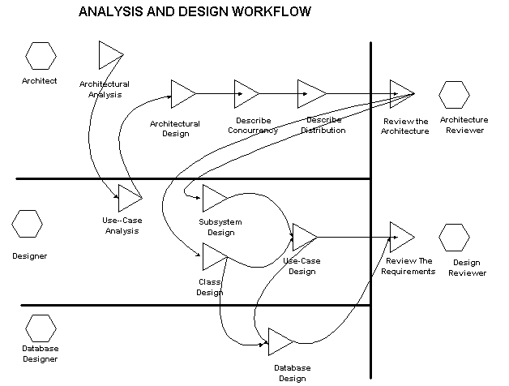
Analysis & Design Workflow

Slide 57
Analysis & Design Workflow
  To transform the requirements into a design of the system to-be
  To Evolve a robust architecture for the system
  To adapt the design to match the implementation environment, designing it for performance
The primary artifacts are:
Design model, defining use case realizations, classes, and design packages/subsystems
Software Architecture document
Data model

Slide 58
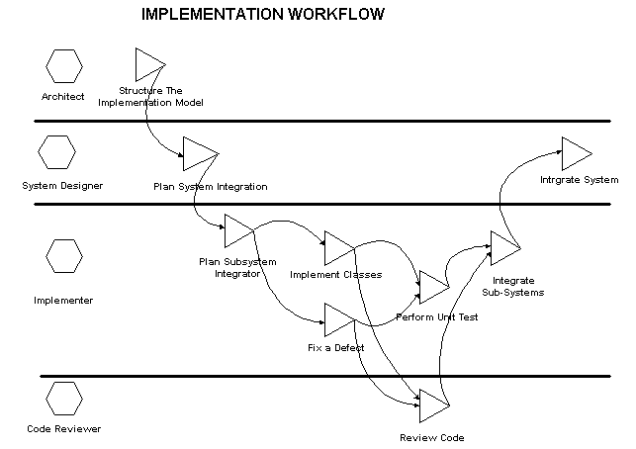
Implementation Workflow

Slide 59
Implementation Workflow
  To define the organization of the code, in terms of implementation subsystems organized in layers
  To implement classes and objects in terms of components (source files, binaries, executable, and others)
  To test the developed components as units
  To integrate the results produced by individual implementers (or teams), into an executable system
The primary artifacts are:
Implementation model, defining components and implementation subsystems
Integration Build Plan

Slide 60
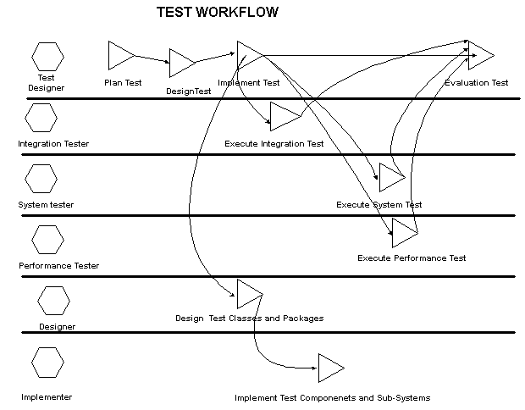
Test Workflow

Slide 61
Test Workflow
  To verify the interactions between objects
  To verify the proper integration of all components of the software
  To verify that all requirements have been correctly implemented
  To identify and ensure that defects are addressed prior to the deployment of the software
The primary artifacts are:
Test model, defining test cases, procedures and scripts
Test Plans
Defects
Test packages, classes, subsystems, and components

Slide 62
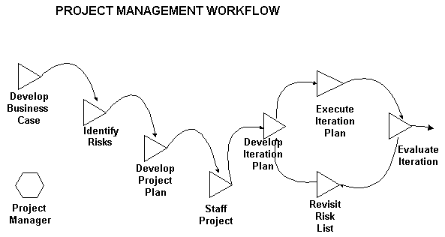
Project Management Workflow

Slide 63
Project Management Workflow
  To provide a framework for managing software-intensive projects
  To provide practical guidelines for planning, staffing, executing, and monitoring projects
  To a framework for managing risk
The primary artifacts are:
The Software Development Plan, including the Risk List, Ploject Plan, and Measurement Plan
The Business Case
The iteration Plan
The Iteration assessment
Status assessments

Slide 64
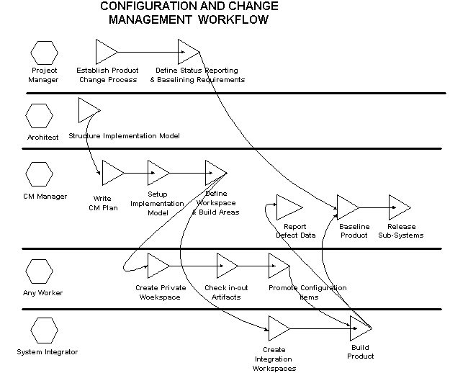
Configuration & Change Management Workflow

Slide 65
Configuration & Change Management Workflow
  Some of the direct benefits provided by a CM System are that it:
  Supports development methods
  Maintains product integrity
  Ensure completeness and correctness of the configured product
  Provides a stable environment within which to develop the product
  Restricts changes to artifacts based on project policies
  Provides an audit trail on why, when and by whom any artifact was changed

Slide 66
Environment Workflow
Configuring the process
Improving the process
Selecting and acquiring tools
Toolsmithing
Supporting the development
Training

Slide 67
Tools Support for the Entire Project Lifecycle
Process Workflows:
Requisite Pro, Rose, Soda
Business Modeling
Requirements
Requisite Pro, Rose, Soda
Rose, Soda, Apex
Analysis & Design
Rose, Soda, Apex, Purify
Implementation
SQA TeamTest, Quantify, PerformanceStudio….
Test
Deployment
Soda, ClearCase
Supporting Workflow:
ClearCase, ClearQuest
Config. & Change Management
Unified Process, Microsoft Project….
Project Management
Environment
Unified Process, Rational Tools

Slide 68
Tools Support for the Entire Project Lifecycle
As might be expected, many tools are required to fully support a software development process, including tools for:
Modeling
Requirements Management
Code development ( editors, compilers, and debuggers)
Configuration and Change Management
Testing
Planing and Tracking
Documentation
      END

