Slide 1

EYEdentify
Deepfake detection tool

Slide 2
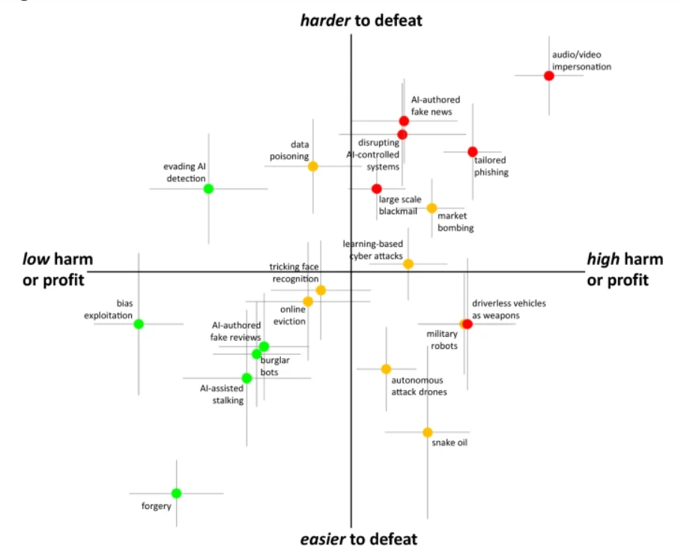




Project overview
General Adversarial Networks (GANs)
Hardest to defeat and greatest threat to organisations
Content absorption via social media
Notes:
Project EYEdentify is a solution to the growing problems associated with the development of AI generated imagery. As a team we have developed an app and website-plugin solution to combat deepfaked and synthetic imagery that we encounter in our daily lives.
To first understand why this problem has grown so rapidly we need to know how. This is largely due to General Adversarial Networks or (GANSs). This is where two machine learning configurations will compete against each other to advance the learning of the task.
Machines aren’t just ‘learning’ anymore, they are teaching.
The competition with each other creates an environment where both methods are improved so much so that the generated data is indistinguishable from the authentic content.
This fast-learning technique is a reason why we need new technology like our project to combat against synthetic content.
Caldwell conducted an analysis of crimes which were of the greatest concern in terms of AI-based criminal activity and resulted in audio and video impersonation being the highest (photos were also included in this category).
It has the highest threat to institutions although difficult to defeat (which can be seen in this figure on the slide.) This can have significant repercussions for criminal investigations as well as the legitimacy of political and social institutions.
Audio, video, or image-based impersonation is at the height of AI based criminal activities and the most common means in which the general populus engages with this content is via social media.
Cetina & Sierra reported many people using popular social media platforms said they got their news from these sources: 74% of all Twitter users, 68% of Facebook users, 32% of YouTube users, and 29% of Snapchat users. These platforms have created an environment where their audiences can consume more news than ever before at any time throughout the day.
It is understandable that users may be susceptible to absorbing this content which may be synthetic in nature due to these platforms being riddled with gossip, personalized information, advertising and other generalized content.

Slide 3
Why we are targeting a wide range of crimes
Deep fakes have the potential to be used in a range of crimes from spear phishing targeting CEOs to political pressure and manipulating stock markets.
As the prototype targets the root of the crime by detecting deep fakes, this prototype can address all these areas of crime.
Notes:
As a result of the wide range of crimes able to be perpetrated through the use of deepfakes, a number of theories are available to support the use of our proposed prototype. Our prototype is built to detect deepfakes and as a result can be used to prevent crimes on a number of targets ranging from large scale organisations, corporations, and governments to small scale individuals and stakeholders. As a result, the need to verify content remains a critical issue. These crimes can have a high cost to businesses such as one case that lost a business 35 million, as well as high cost to life, such as the attempted coup in Gabon in 2019. Rather than focusing on one specific area of crime, our solution has a wide range of applicability. To justify this application, we must examine two criminological theories.

Slide 4
Theories – Routine Activity Theory
Value
Inertia
Visibility
Access
Notes:
Routine Activity Theory is commonly applied to cybercrime to explain victimization and criminality. This approach posits that victimization is caused by a combination of three key areas converging in time or space. These areas are a motivated offender, which is an inherent factor, a suitable target, which can be analysed through the acronym VIVA: Value, Inertia, Visibility, and Access and capable guardians, such as our proposed deepfake detection tool. As a result, eydentifier needs to address the four areas of a suitable target.

Slide 5
Theories – Routine Activity Theory
Value – Victims are targeted for their high value, or as a pool of targets with a total high value due to the large number of victims.
Inertia – There are currently no barriers or risks to offenders.
Visibility – By implementing deep fake detection, the number of unprotected users can be reduced, lowering the visibility of the target.
Access – Access to social media remains unrestricted, allowing bots and automated services to proliferate deepfakes amongst these apps and reach a wide audience.
Notes:
The value of a target cannot be minimised, as attackers often resort to either targeting key figures with a high value such as CEOs, or a wide range of victims with a cumulative high value. Inertia relates to the level of barriers and risks present to the offender. As a gap in the market remains to address deep fakes, there is currently little to no barriers present for this type of crime, regardless of the risk present. By providing not only the ability to detect deepfakes, but report them, both the risk and barriers the offender faces can be raised. Visibility refers to the ease of access the offender has to commit the crime. Visibility refers to the ease of access the offender has to commit the crime. Desktop users account for 55.41% of all internet traffic in Australia, with mobile devices comprising 39.88% (Statista, 2022). As there is no current mitigation strategies to reduce the levels of victimisation for these users, the visibility for offenders remains high allowing offenders to reach a wide audience through a number of methods such as social media and targeted attacks. By implementing deep fake detection, the number of unprotected users can be reduced, lowering the visibility of the target. Access refers to the ease of offending. As a result of current trends in online spaces, an estimated 81% of the Australian population uses social media (https://wearesocial.com/au/blog/2023/02/digital-2023-australia-1-in-3-australians-use-social-networks-for-brand-research/). Access to social media remains unrestricted, allowing bots and automated services to proliferate deepfakes amongst these apps and reach a wide audience. While access will not be mitigated through our prototype, by allowing users to verify the images they see, the number of victims can be reduced. By introducing a capable guardian like eyedentifier, the prototype has the potential to minimise the widespread proliferation of deepfakes, reducing the accessibility and visibility of victims, and raising the barriers and risks present to offenders.

Slide 6
Theories – Lifestyle Exposure Theory
Proposes that the behaviours and lifestyles of an individual alter their exposure to crime risk and thus their suitability as a target and their chances of becoming the victim of crime. (Drew, 2019).
Higher risk = Higher victimisation.
Verification and trusted communication through eyedentifier = lower risk.
Lower risk = lower victimisation.
Notes:
The lifestyle exposure theory, developed by Hindelang et al in 1978, proposes that the behaviours and lifestyles of an individual alter their exposure to the risk of crime and therefore both their suitability as a target and chances of becoming a victim of crime. (Anderson and Dyson, 2002). By engaging in riskier behaviour, the victim has a higher chance of victimization. As information on the internet is largely unsecured and unverified, browsing and gaining information through methods such as social media or online communications can be classified as risky behaviour. By introducing behaviours such as verifying information through our prototype, the suitability and risk posed to victims can be reduced. Our prototype can therefore address the lack of security on information provided on the internet through verification and a criminological theory based approach.

Slide 7
Current Market
Product | Quick scan | Mobile app | Scan for all types of deepfake images | Self upload images
deepfake proof (very long scan time) | no | no | yes | no
Fake Profile Detector (GAN only) | Yes (but inaccurate) | no | no | no
deep fake detection (YouTube videos) | Yes (for videos scan time was good) | no | no | no
Deepfake detector (GAN, firefox) | No (didn’t scan) | no | no | no
Notes:
1. Independent research has identified a gap in the market for detecting deep fakes in social media and general internet use.
2. Social media is commonly accessed through phone apps and web browsers, but most social media platforms lack built-in deep fake detection.
3. Existing research has developed deep fake detection tools, but these tools are not readily available to end users, leading to a gap.
4. There is a large absence of deep fake detection apps for Apple, Android, and also web browsers extensions.
On Google Chrome and Firefox there were a few deep fake detection extensions found. However, two out of four tested apps had significant issues while the rest weren’t widely usable:
- "Duck Duck Goose" could only scan images and short videos. but was slow and had limited accuracy.
- "Fake Profile Detector" was inaccurate and prone to false positives; whilst only being able to detect GAN images
- Another tool could only detect deep faked YouTube videos
- A prototype tool listed for scanning images on Firefox extensions, but did not function and was unable to scan images
5. None of these four products were available as phone applications where most of social media is consumed.
6. because of this the market lacks products that meet the necessary standards for impactful deep fake detection.

Slide 8

Causes of the Gap in the Market
For phone applications:
The approval process for app stores
Computing power of phones
Updating software to keep up with new deepfake methods
Background running of applications not being allowed
For web extensions:
No financial incentive
Hosting a website for uploads is easier to run
Relatively new field of research
Lack of studies on criminological theories towards deepfakes
Notes:
Some research was by done by us to identify the reason there is a distinct gap in the market; and there was not much research out there to explain this. Using knowledge about the necessary step to produce the deepfake detection software we listed the issues that would likely arise whilst developing a tool.
These are likely why there is a gap in the market. Whilst designing the prototype these issues were taken into consideration and is clearly addressed in the report.

Slide 9
Prototype Overview
Key Stakeholders
Mobile Users: 39% of all Web Traffic
Evaluation Methods
Product Reach: Count of Application & Extension Downloads
Functionality: Count of False Positive & False Negative Scan Results
Project Risks/Limitations
Mobile Application Requires Manual Use: Unable to Perform Background Scans
Prototypes Can Only Scan Deep Fake Images: Not Compatible with Video and Audio – Given Development Restraints
Desktop Users: 55% of all Web Traffic
Dating App & Social Media Users: Susceptible to Deepfake Romance Scams & Other Online Scams
Celebrities, Politicians & Other High-profile Figures: Most Prone to Identity Theft
Product Use: Measure of Deepfake Reports
Notes:
In February 2022, internet traffic in Australia showed that 55% came from desktop users and 39% from mobile devices (Statista, 2022) . Excluding one of these groups, would have significantly hindered the reach of our solution, thus informing our decision to develop both a browser extension and a mobile application. With the general public as our target audience.
Notable stakeholders include users of dating apps and social media platforms. who can often fall victim to romance scams and other online hoaxes. Beyond this, celebrities, politicians and other high-profile figures who are most prone to identity theft would also heavily benefit.
One way to assess the solution’s impact, is to track download numbers, which will shed insight into its reach and word of mouth influence. For assessment of functionality, further scans of deepfake materials with a count of false positive & false negative test results will be done. Lastly, a measure of deepfake reports through the app and browser extension, will outline usage levels.
Where the project presents its limitations, is its inability to scan video and audio deepfakes, given the small-scale development team and resource constraints. Additionally, due to the nature of how mobile applications function, automatic backgrounds scans of media sources was not possible to implement. Users are required to upload images manually to the app. Despite these limitations, both protypes underscore the necessity of our solution in today's market.

Slide 10
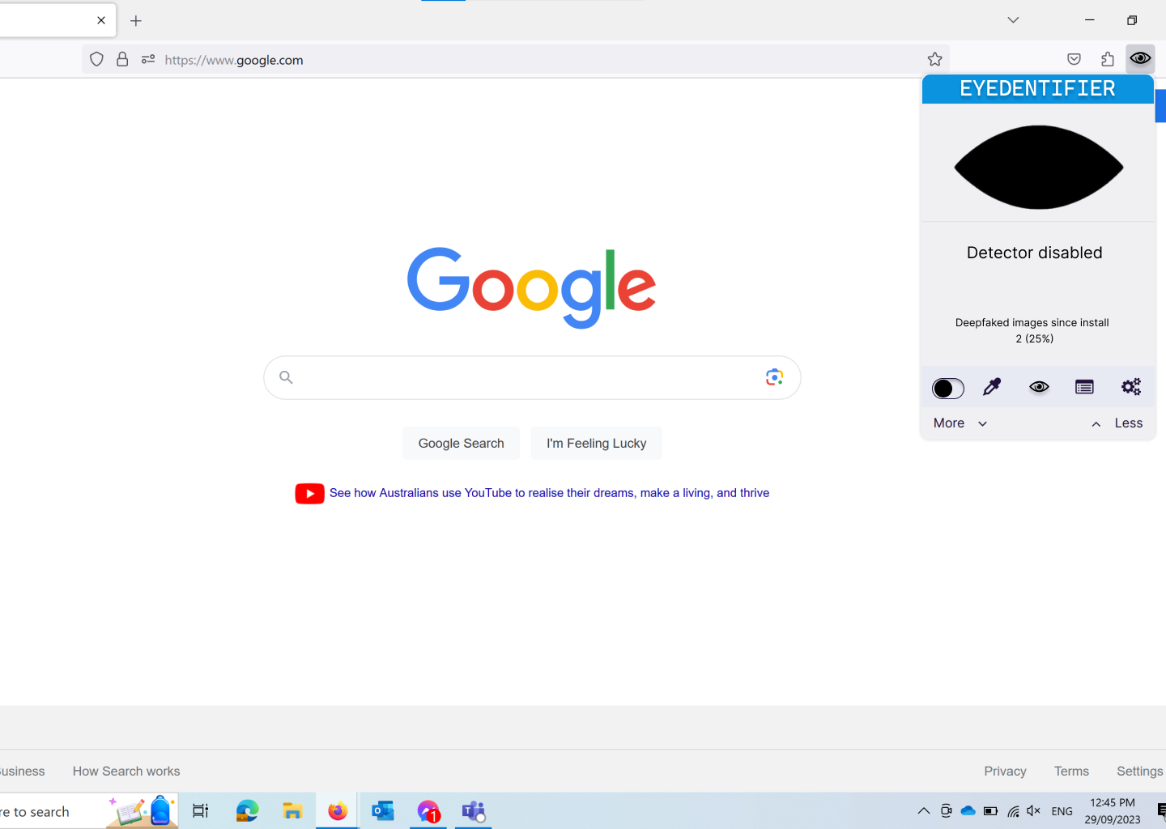
Extension prototype
Notes:
The image shown in this page details the landing page the user will see upon clicking the extension. This extension will be available for all browsers as it will be written in Javascript, a language supported by all popularly used browsers. The top bar provides our branding with our blue logo. Uniform color theory posits that blue evokes feelings of security in users. By using this colour scheme, the user feels confident in browsing. The closed eye is used to show that either no images are detected or the detector is turned off. In this image, the prototype is disabled, as toggled in the bottom bar. A status update is shown below the eye to inform the user that the detector is disabled. Below this status is the list of detected deepfakes since installation. The navigation bar in the light blue bar will always remain visible when the extension is clicked on, providing features such as toggling on or off, manually selecting an image, providing a legend, showing previous reports, and settings. The more and less buttons allow the user to increase or decrease font and icon size for easy legibility without having to navigate to settings.

Slide 11

Extension prototype
Notes:
This page shows an enabled detection tool. The status has been replaced with a list of all detected images and if there are any deepfakes present. At any time if another page within the extension is open, this is easily navigateable to by clicking on the current status which in this case is the closed eyelid.

Slide 12
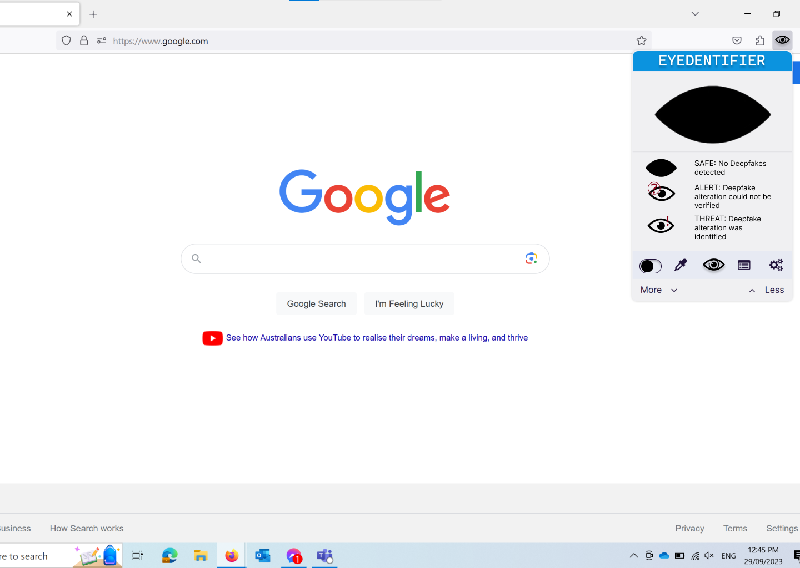
Extension prototype
Notes:
This image shows the legend for symbols used by the detector. In the bottom navigation bar, the eyedentifier logo used to navigate to this page is enlarged, to inform the user what page is currently accessed.

Slide 13
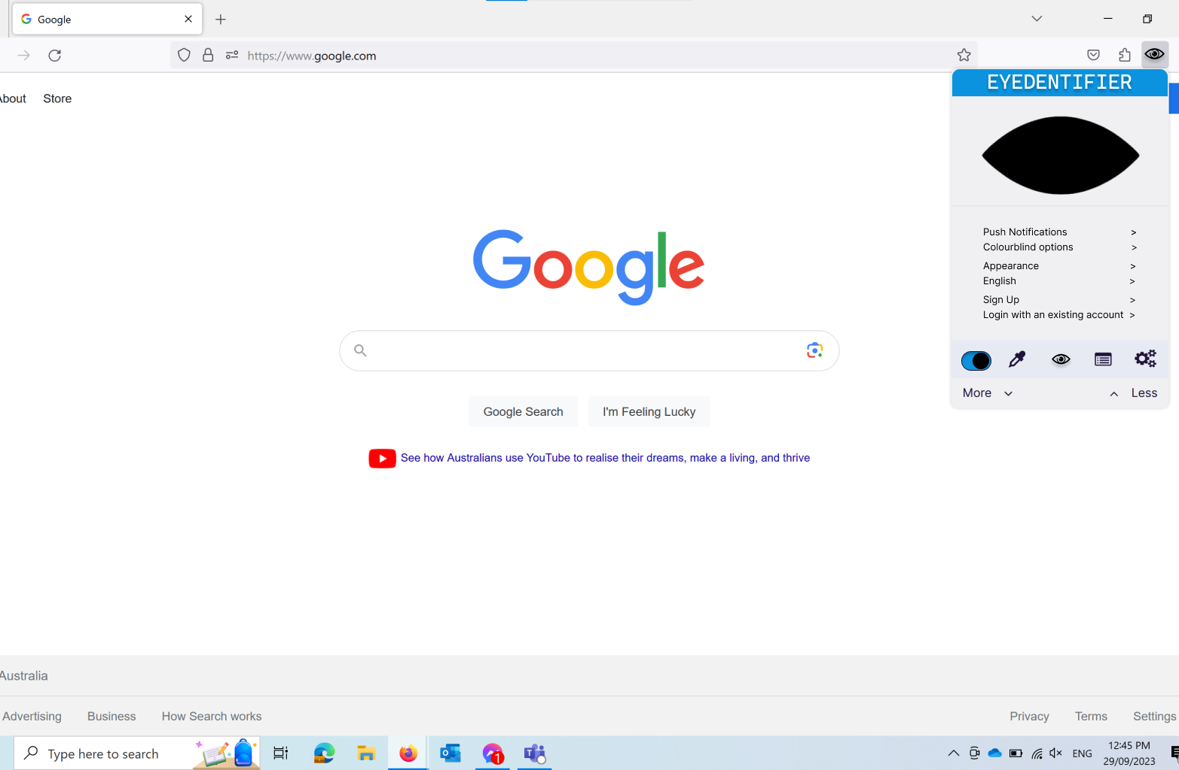
Extension prototype
Notes:
This is the settings page, providing the user with options on push notifications, accessibility and colourblind options. Appearance such as dark mode, Language as shown by the currently selected language, the feature to sign up to allow interconnectivity with the app, and logging in. These options have been grouped into sections of two for legibility. As mentioned, the selected page will have the icon size increased to inform the user what page they are currently accessing.

Slide 14

Extension prototype
Notes:
This is the page to manually select an image for verification. By doing so, the user can select an image that the tool has not automatically found. This replaces the status with instructions for the user.

Slide 15

Extension prototype
Notes:
This is the reports page. Once more the icon is enlarged for usability, allowing the user to access previously created reports for detected deepfakes.

Slide 16
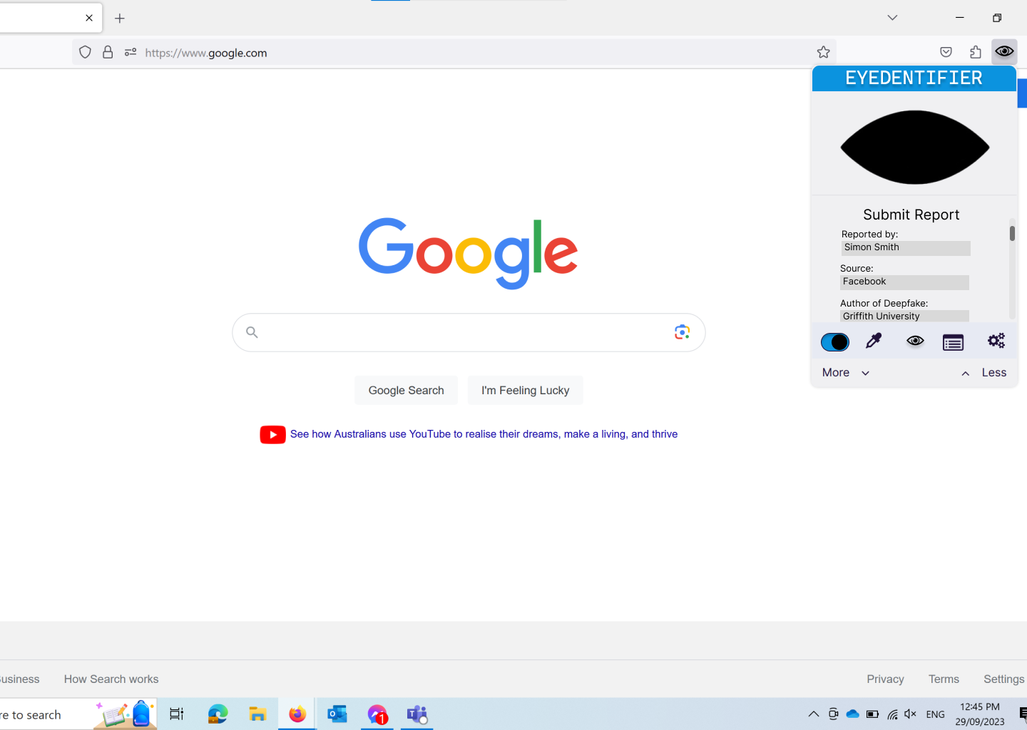
Extension prototype
Notes:
This page allows the user to submit a report. To reach this page, the user must click on the eye icon (which is currently a closed eye) when it is in the alert stage informing the user a deepfake has been detected. For visibility, the report page has a scroll feature to fill in the relevant fields. The other fields will be displayed on the app prototype.

Slide 17
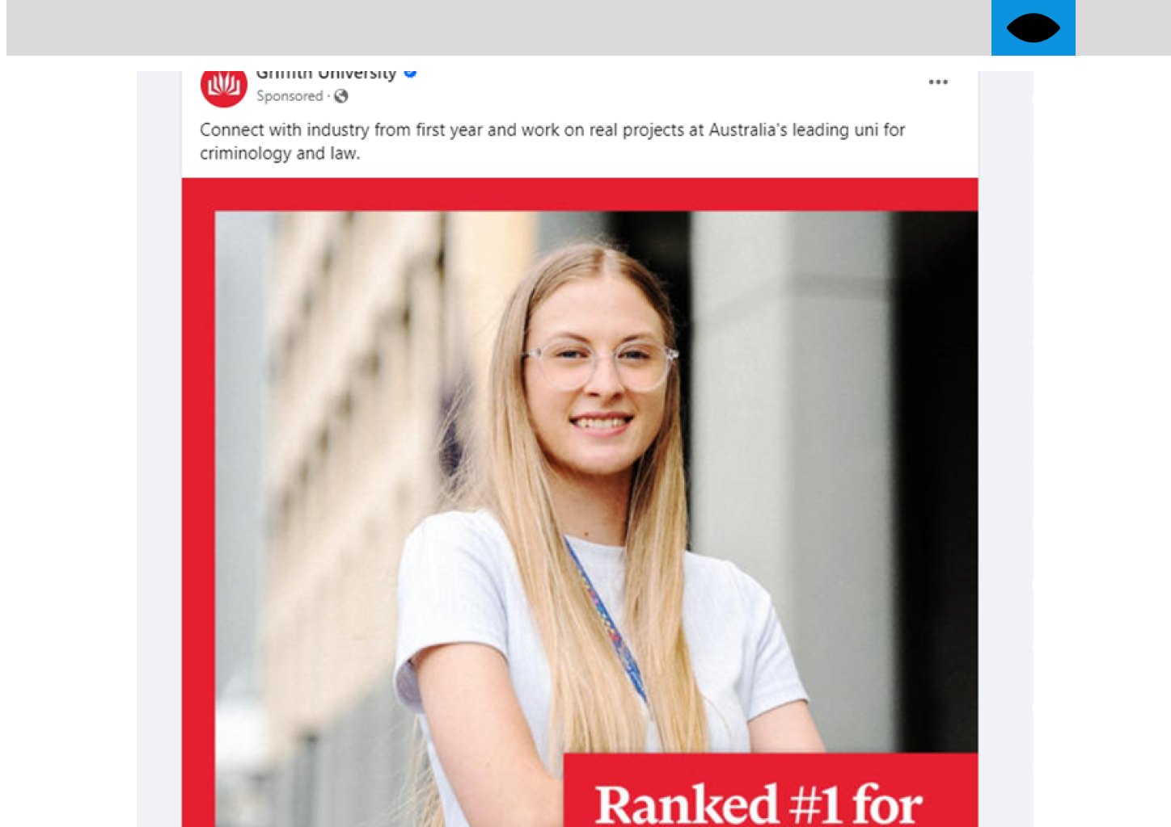
Extension prototype
Notes:
This is a page showing the detector in use. The background for the detector turns blue to inform the user that it is active, with the icon changing when relevant.

Slide 18

Extension prototype
Notes:
When an image has been detected as a deep fake, the icon will change to the alert icon as shown, and the detected deepfake face will be selected in a red box. The width of the red box is adjustable in settings.

Slide 19
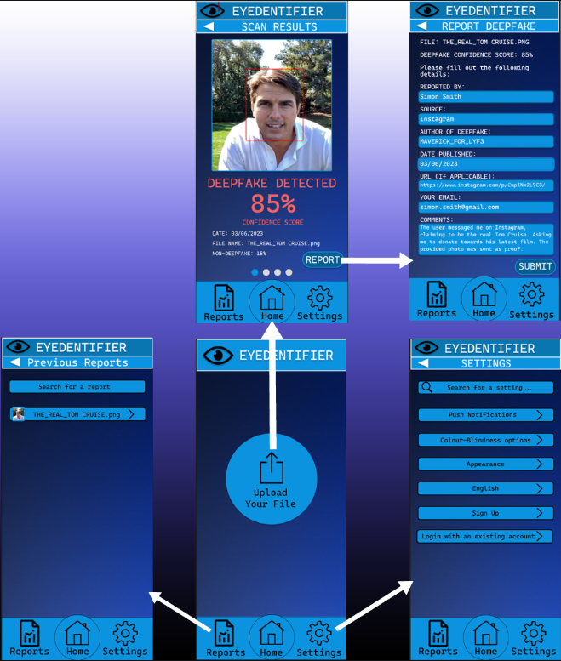
App prototype
Notes:
Presented here are the prototype mockups for the Eyedentify mobile app. Indicated by the arrows are the user flow experience, dictating which UI elements carry the user to the next page. In the bottom center you can see the landing page where users begin when they open the app. This page greets you with a simple and intuitive UI where users may choose to upload a photo, view their previous reports, or manage settings. By choosing to upload a photo the user will be taken to the scan results page where they are given a deepfake confidence score by the app. This confidence score is additionally communicated through symbols such as an exclamation mark appearing on the Eyedentifier banner when a deepfake is detected. By choosing to report a scanned image, the user will be taken to the report page where they can fill in metadata regarding the image. Previous reports can be viewed at any time by navigating through the reports button. This will index all previous reports made by the user, also with the ability to search via file name. The user can manage settings at any time by navigating through the settings button. This will allow the user to manage accessibility options such as language and color blindness options. As well as customize the appearance of the app, such as colour schemes, and sign up or log into an account to manage their Eyedentifer data cross-platform. All pages within the app are able to be navigated to in 1 or 2 presses ensuring optimal user experience.

Slide 20
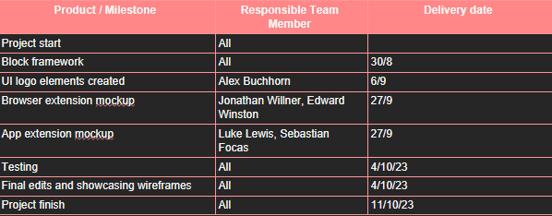
Team reflection
Notes:
Shown here is the timeline of project deliverables. The initialization of the project concept and block framework was performed collaboratively between all team members. UI logo elements were created by Alex, with the browser mockup being created by Jonathan and Edward, and the app extension mockup being created by myself and Sebastian. The project was finalized with all team members collaborating on testing, and final edits with a final delivery date of the 11th of October 2023. Finally, team communication consisted of weekly 3 hour meetings and regular correspondence through teams.

