Slide 1


NHL Points Percentage Study
SAL 603
Ed Wisnowski

Slide 2
What stats, if any, correlate to points percentage for the final four remaining teams in a season?
Use python to build a data frame of the final four teams from the last 10 seasons.
Create a scatterplot matrix and use linear regression to determine if there is any correlation.
Examine ways to maximize any statistical categories that have correlation to potentially increase points percentage.

Slide 3
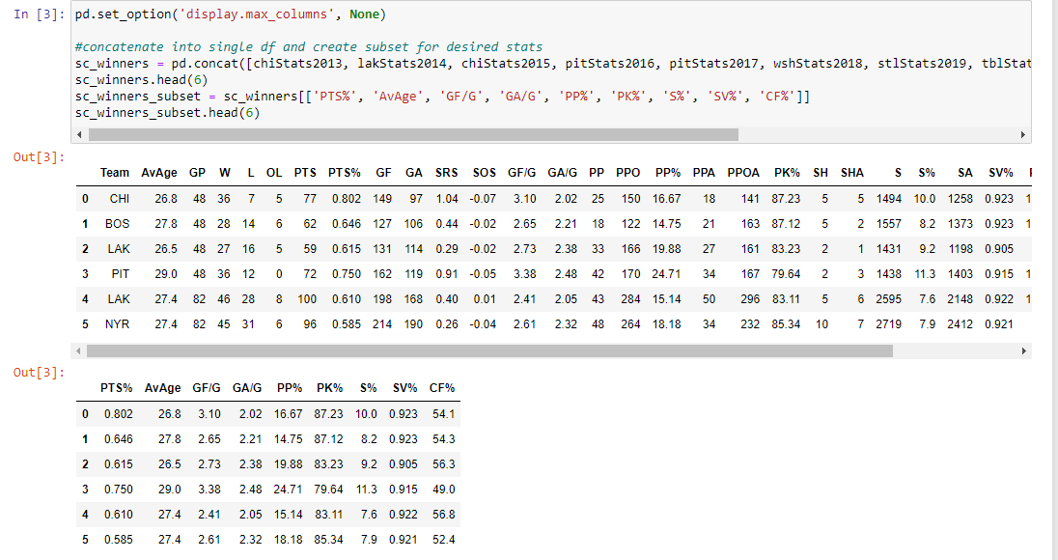
Data Frame
Store all information from the previous 10 seasons into a single data frame using pd.concat.
Subset that data frame by pulling out specific columns.

Slide 4
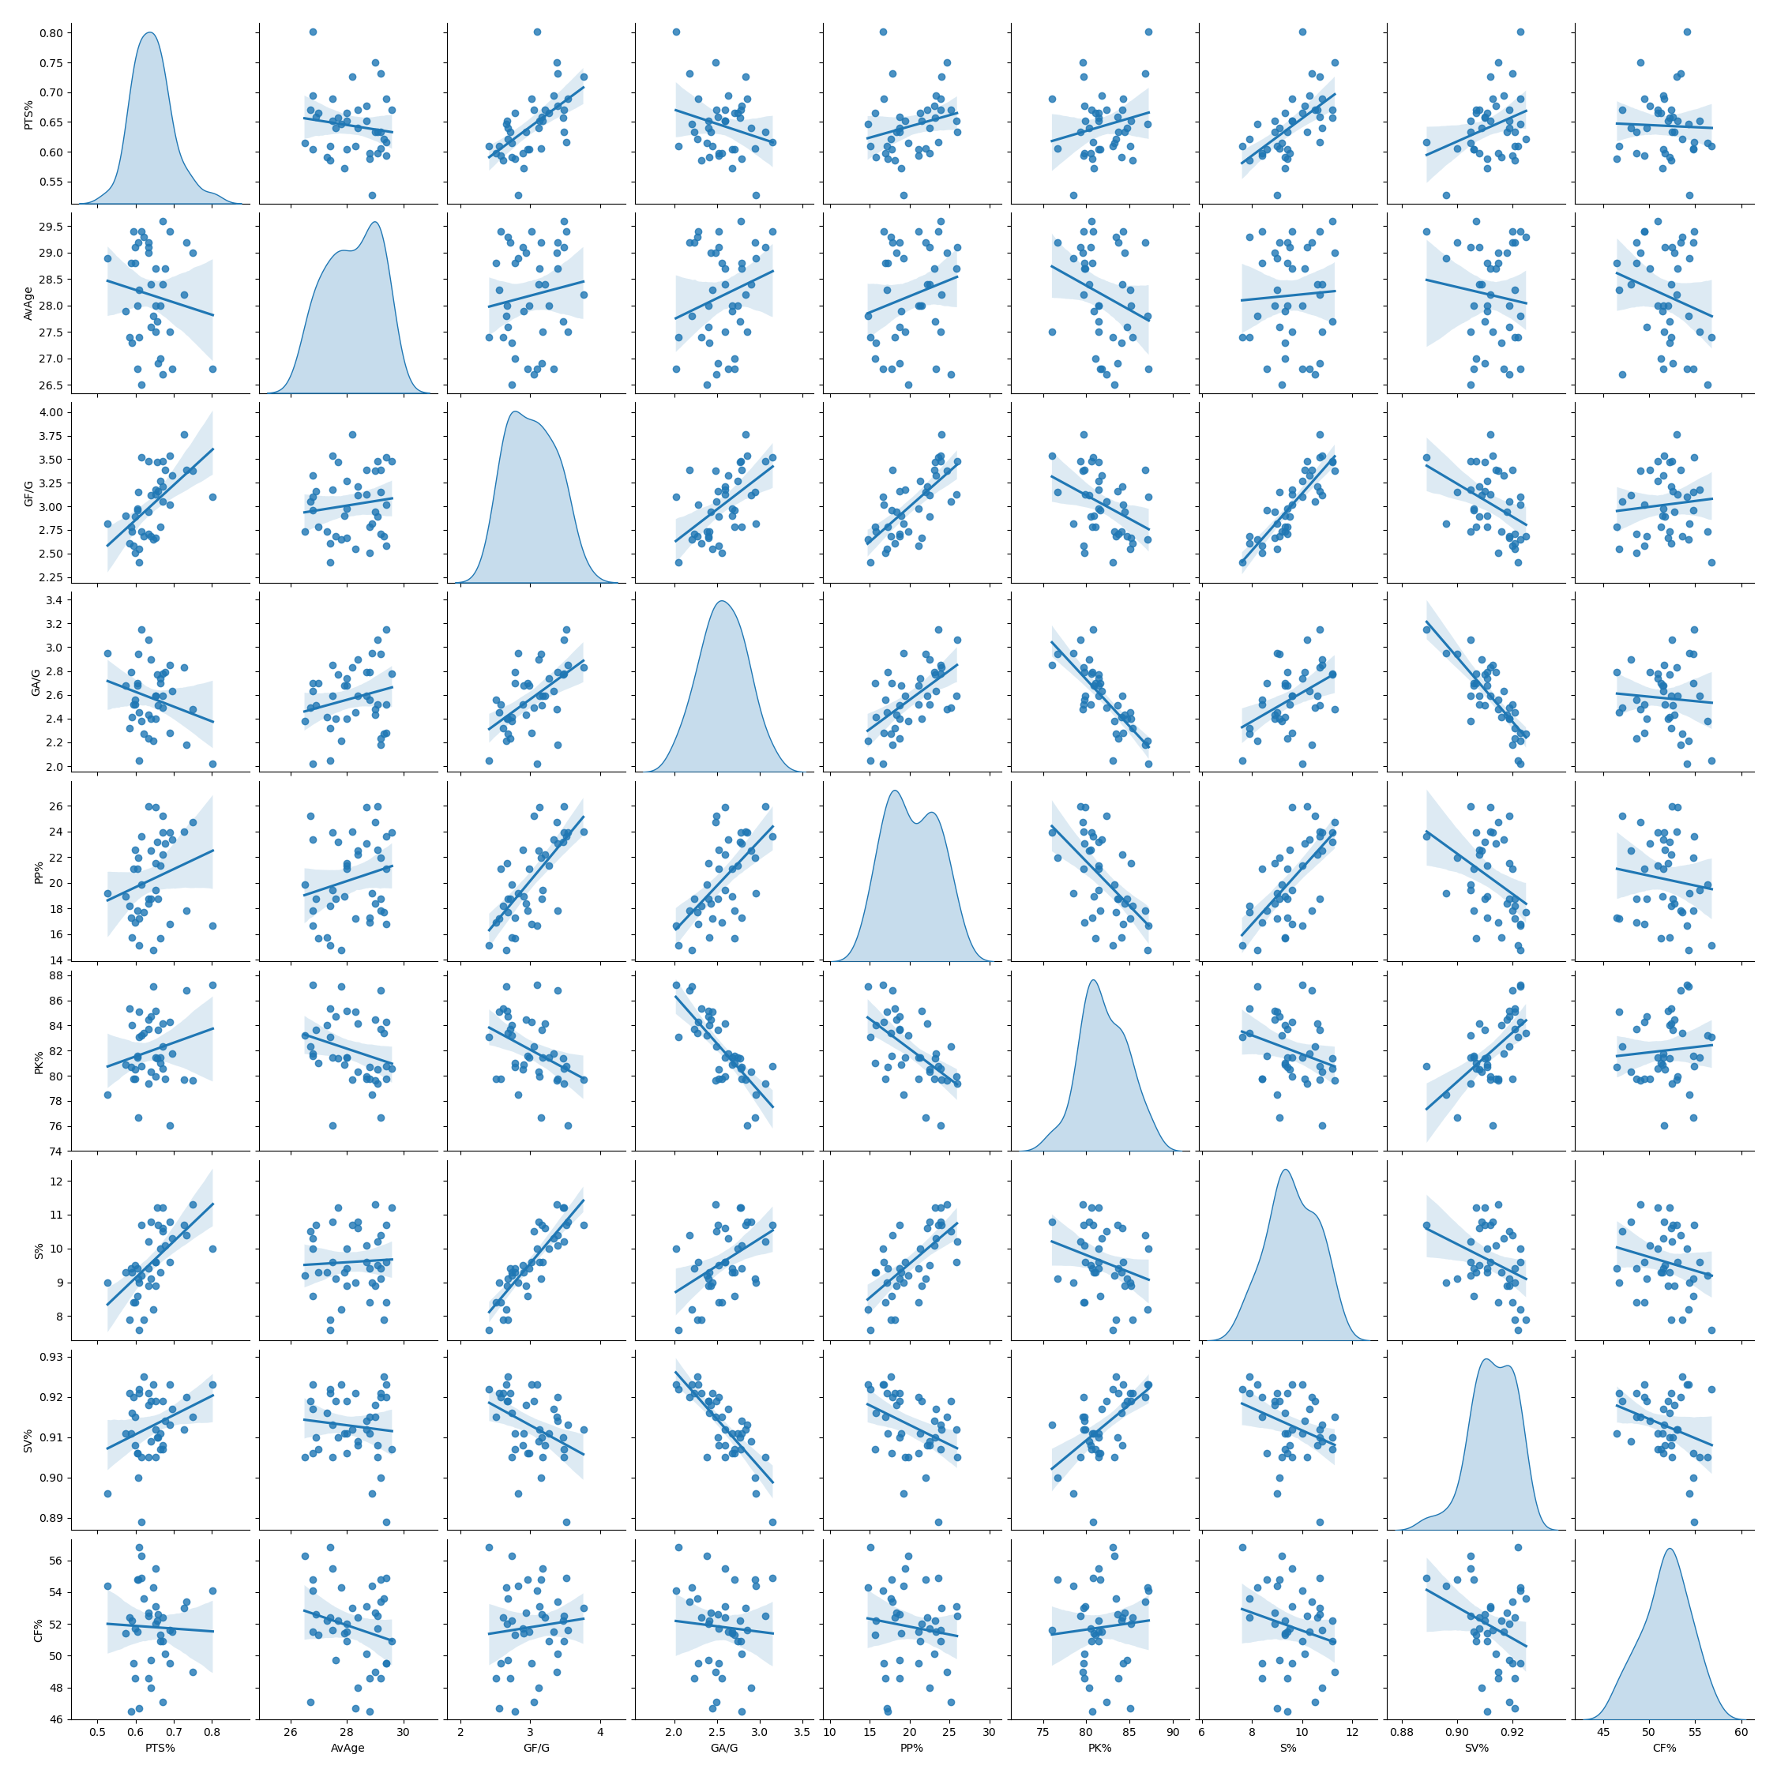
Correlation
Visual representation of using linear regression to identify any potential correlation between the selected stats.

Slide 5
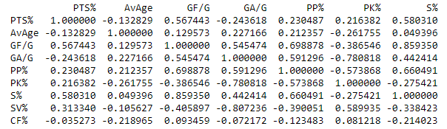
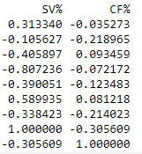
GF/G and S% Correlation
Typically, a moderate positive correlation is an r value between ~0.5 - 0.7 and a strong positive correlation is between 0.7- 1.
GF/G and S% have a moderate positive correlation to PTS% with r values of 0.567 and 0.580.
GF/G and S% also have a strong positive correlation to each other with a r value of 0.859.

Slide 6

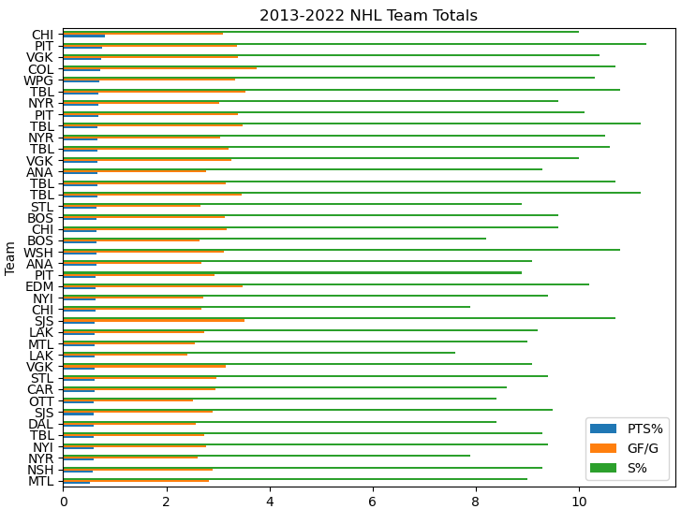

Visual and Mean Stats
Higher GF/G and S% peaks for higher PTS% teams
Reasonable to assume that if a team uses an average of these stats, they will have a successful season.

Slide 7
Why is this information useful?
Professional sports are copycat leagues.
How can GF/G and S% be maximized?
Examine where on the ice successful teams are shooting from.
These are “high danger” areas.

Slide 8


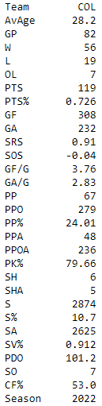
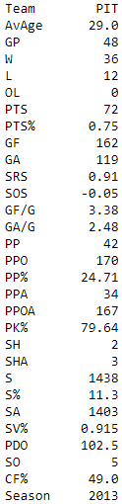

Colorado and Pittsburgh
Colorado (2022) had the highest GF/G stat among all the teams, registering 3.76.
Pittsburgh (2013) had the highest S% stat among all the teams, registering 11.3%.

Slide 9

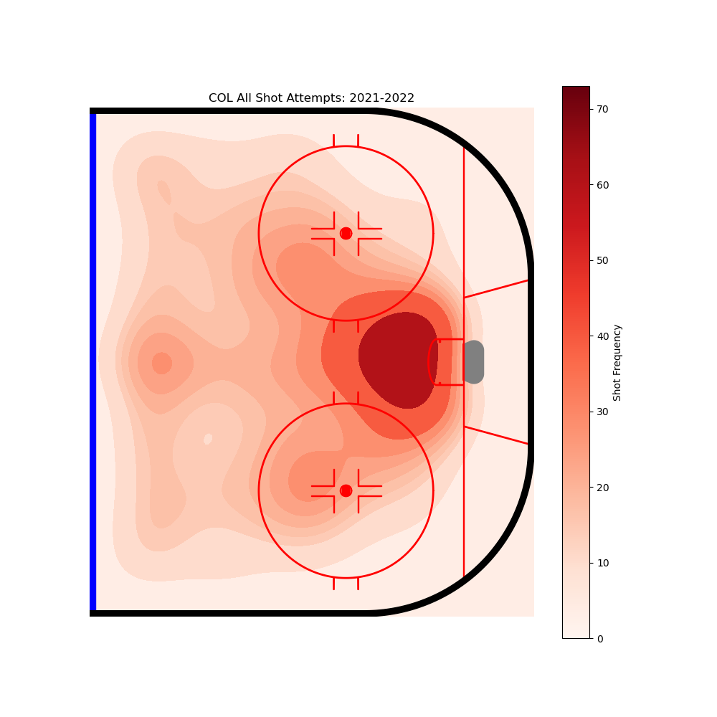
Heat Maps
High Frequency Areas
Low and high slot
Top of the circles
Defense from middle straight on

Slide 10

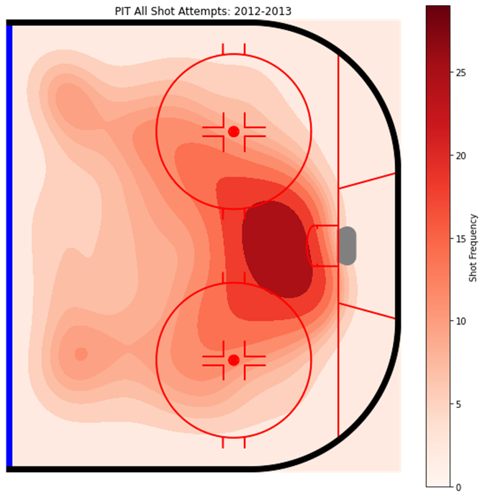
Heat Maps
High Frequency Areas
Low and high slot
Top of the circles
Defense from outside at an angle

Slide 11
Citations
NHL stats, history, scores, & Records. Hockey Reference. (n.d.). Retrieved July 1, 2022, from https://www.hockey-reference.com/
Andrews, Z. (n.d.). Ztandrews/nhlshotcharts: Using python to make NHL shot charts. GitHub. Retrieved July 1, 2022, from https://github.com/ztandrews/NHLShotCharts

