Slide 1



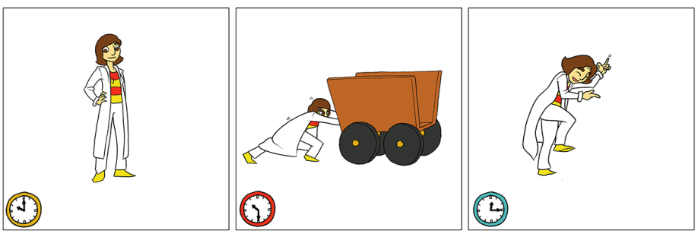
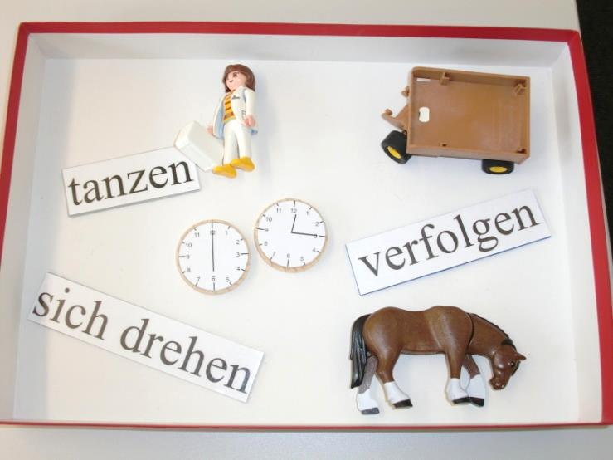
Language-specific and language-independent serialisation patterns for framesetters, topics, and predicates
Heike Wiese, Eva Wittenberg & Mehmet Tahir Öncü
heike.wiese@uni-potsdam.de ewittenberg@ucsd.edu mtoncu@yahoo.com
THE NATURAL ORDER OF INFORMATION
Many studies have shown language-independent preferences for the serialisation of thematic roles (Agent, Patient, Act) REFERENCES
Do such preferences extend to information structure? → relative order of framesetters and topics with respect to their predication.
Background: While topics specify the entity under which a proposition is to be stored, framesetters provide specifications – typically time or place – restricting the domain in which the proposition is valid.
Prediction: Topics and Framesetters will be preferred in initial position, before the predication itself, regardless of language-specific word orders.
SYN
adverbial > subject
frame/link > topic
IS
TIME > PERSON
SEM
MORE ABOUT GERMAN WORD ORDER
MORE ABOUT ENGLISH WORD ORDER
MORE ABOUT TURKISH WORD ORDER
TWO STUDIES
ACT-OUT STUDY
Task: present 3rd picture of comic strip semi-/nonverbally, with ‘playmobil’ figures, wooden clocks, and verbs; verbally in German or Turkish.
(more about task; see paper)
Subjects:
monolingual German, N=
monolingual English, N=
monolingual Turkish, N=
Predictions
VERBAL DESCRIPTIONS
Task: present 3rd picture of comic strip verbally in native language
(more about task; see paper)
Predictions
evtl Schema mit Versuchsaufbau/Proband & Versuchsleiter
RESULTS
ACT-OUT TASK
VERBAL TASK
GERMAN
GERMAN
ENGLISH
ENGLISH
TURKISH
TURKISH
CONCLUSIONS
verbal descriptions followed different language-specific word orders.
in the extra-grammatical task, in addition to language-specific effects, we found a strong overarching pattern where speakers placed framesetters and topics before the verb → information-structural preferences that can violate language-specific restrictions
findings point to information-structural patterns that are independent of, and interacting with, language-specific grammatical constraints.
We would like to thank Suhas Arehalli and Oliver Bunk for assistance in collecting the data. This work was supported by a German Academic Exchange Service (DAAD) postdoctoral scholarship to Eva Wittenberg, and SFB 632, Projekt B6 (grant to Heike Wiese).

