Slide 1

So You Want to Make a Movie...
A Data Analytical Approach to Minimize Your Risk

Slide 2



Evan Johnson
MS Chemical Engineer/
Data Scientist
Intros
Ted Brandon
BS Biochemist
Data Scientist
Jakub Rybicki
MS Geotechnical Engineer/ Data Scientist

Slide 3

Agenda
Approach To Success
Overview of Data
Methods
Findings
Recommendations
Future Research

Slide 4
Focus On Profitability by Selecting Most Profitable Sub-genre
Keep Production Budget Low to Minimize Risk
Partner with Director and Studio Experienced in Producing Selected Sub-genre
Approach to Success
Notes:
***The Bottom Line*** - We are Recommending a Proof of Concept Model. Our focus is solely on showing that Microsoft’s movie studio can be profitable.
Demonstrating profitability at the start will encourage studios, producers, film-crew and actors to participate in future projects.

Slide 5
Overview of Data

Slide 6

Data Sources Utilized
Box Office Mojo
IMDB
The Oscar Awards
Overview
Methods
Findings
Proposals
Awards

Slide 7
Methods

Slide 8
Methods
Keeping The Data:
USEFUL - Sub-genre, Production Budget, Total Gross Income Data
SPECIFIC - Movies Classified by Sub-genre
RELEVANT - Recently Released (2000 or Later)
IMPACTFUL - At least 20 movies released of that Sub-genre since 2000
Overview
Methods
Findings
Proposals
Awards
Notes:
Useful - only movies where we could find all the necessary data were kept for analysis
Relevant - We want our business decision to be built on data that reflects the current film-making market. For this reason we are only looking at movies made in the year 2000 or later.

Slide 9
Findings

Slide 10
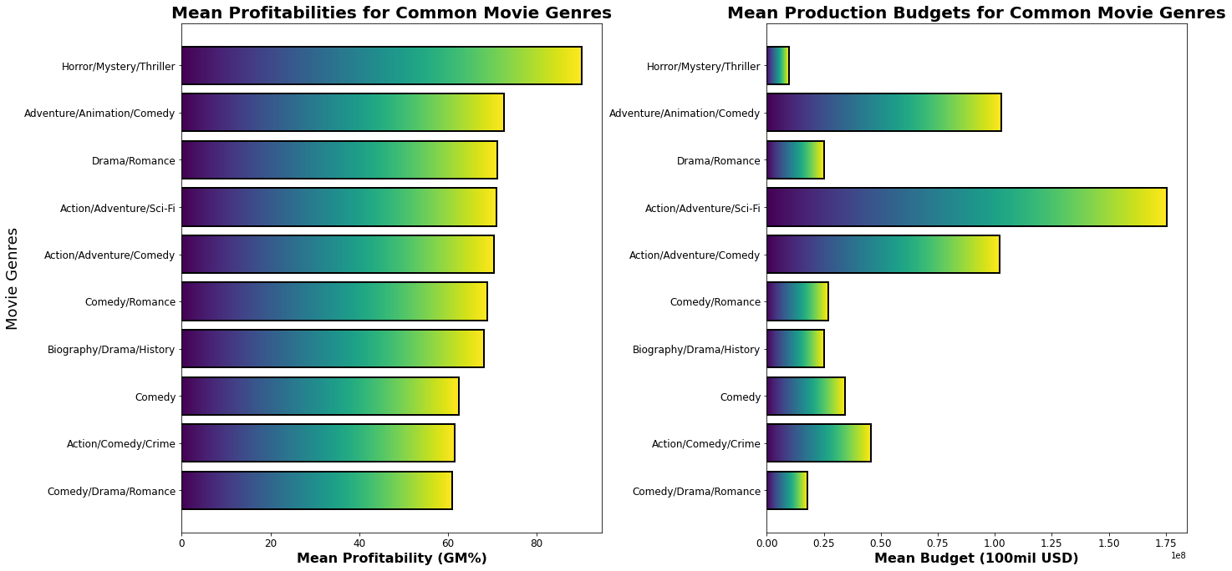
Horror/Mystery/Thriller Genre Shows Highest Profitability With Lowest Risk
Overview
Methods
Findings
Proposals
Awards

Slide 11
Horror/Mystery/Thriller Genre Shows Highest Profitability With Lowest Risk
Overview
Methods
Findings
Proposals
Awards

Slide 12

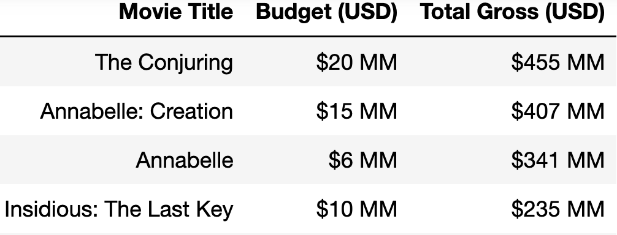
Choosing a Director
50% of the top 10 horror/mystery/thriller movies were directed, produced or written by James Wan.
*Top 4 Grossing Horror/Mystery/Thriller Movies Since 2000 - James Wan Involved In All
Overview
Methods
Findings
Proposals
Awards
Notes:
Successful Horror Mystery Thriller Movies all share a common theme which is strong world building. The top 4 movies all come from the same person - James Wan. James Wan should be looked at as director and screenplay writer.

Slide 13

Partner Up?
Overview
Methods
Findings
Proposals
Awards

Slide 14
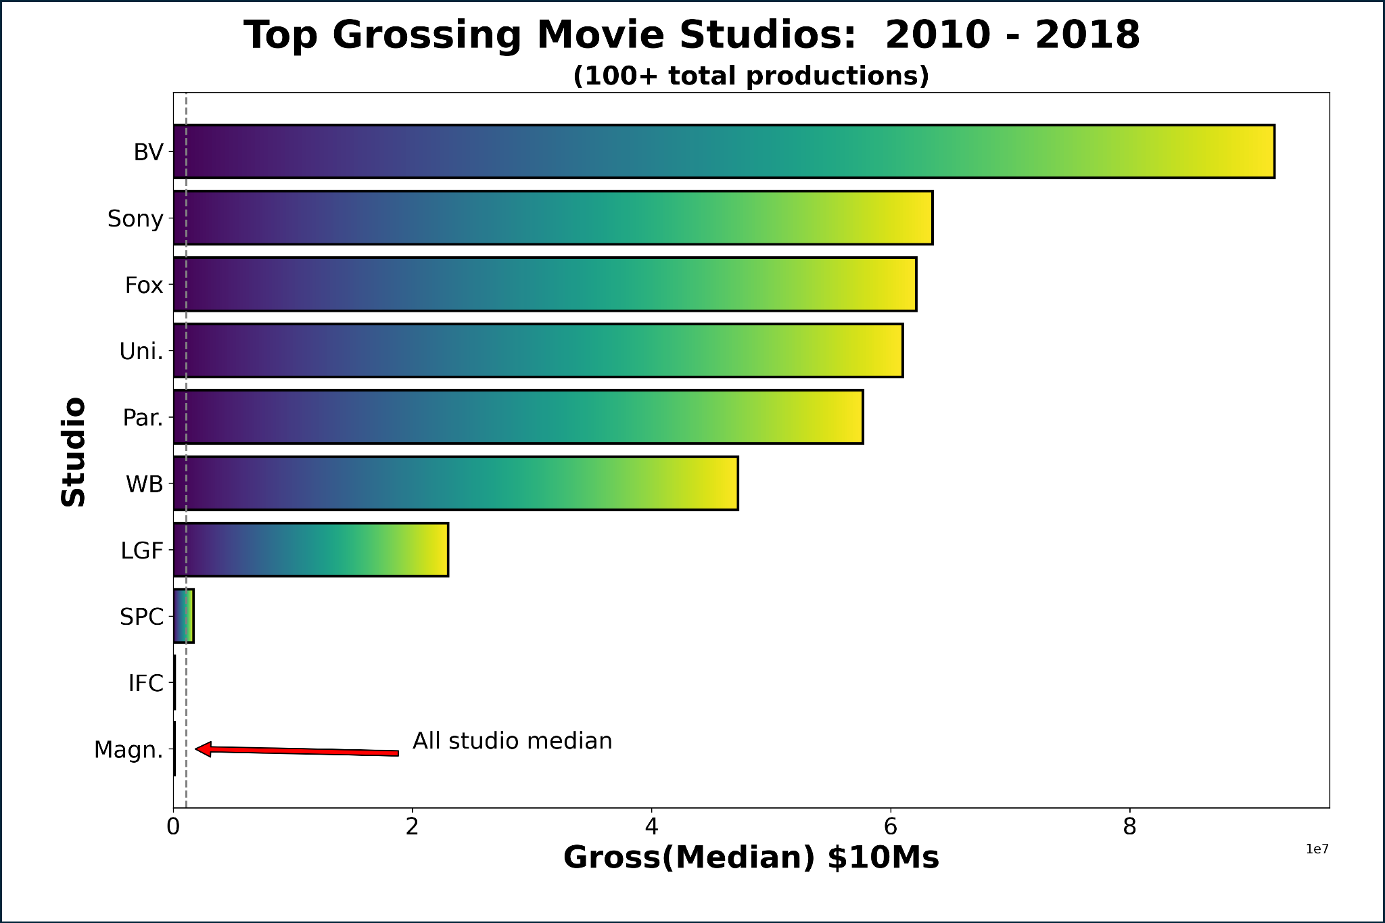
Overview
Methods
Findings
Proposals
Awards

Slide 15
Overview
Methods
Findings
Proposals
Awards

Slide 16
Partner Up?
Paramount: Paranormal Activity Series
Warner Bros.: The Conjuring & Sequel
Lionsgate: You’re Next
The Take Home: These studios have been successful for a reason
Overview
Methods
Findings
Proposals
Awards

Slide 17
Recommendations

Slide 18
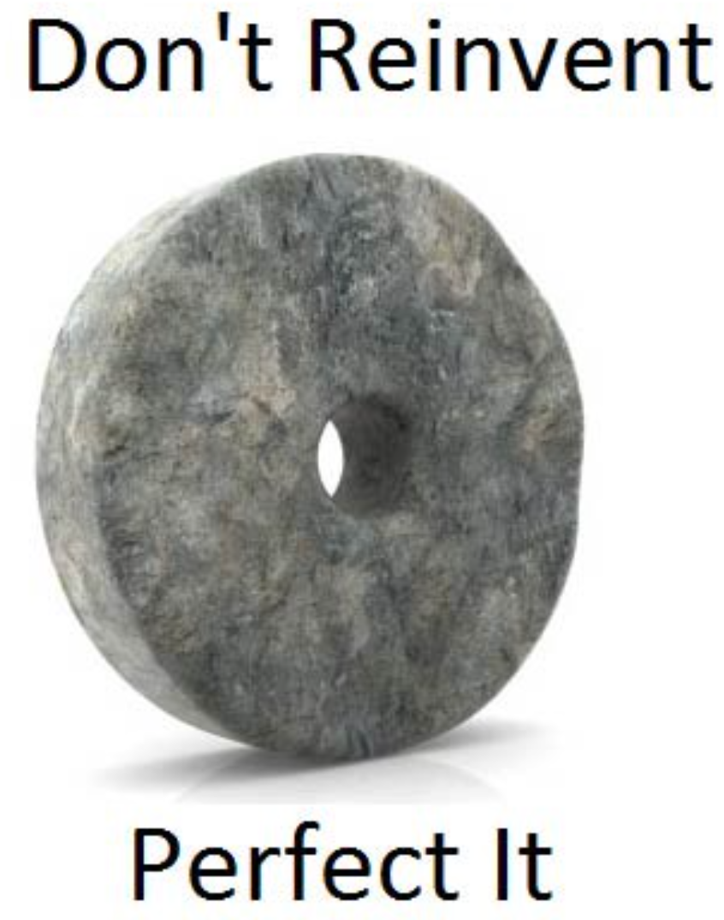
Conclusion
Focus On Horror/Mystery/Thriller type movies initially
Engage with director James Wan who wrote, produced and directed the top horror/mystery/thriller movies of this century
No need to reinvent the wheel
Partner with a studio proven to be successful in this genre
Overview
Methods
Findings
Proposals
Awards

Slide 19
Future Research

Slide 20


Going for Gold
Overview
Methods
Findings
Proposals
Awards
Notes:
Down the line, you may want to start making movies geared towards winning academy awards such as the Oscars.
In the past, even a nomination for an Oscar boosts overall income for a movie title

Slide 21
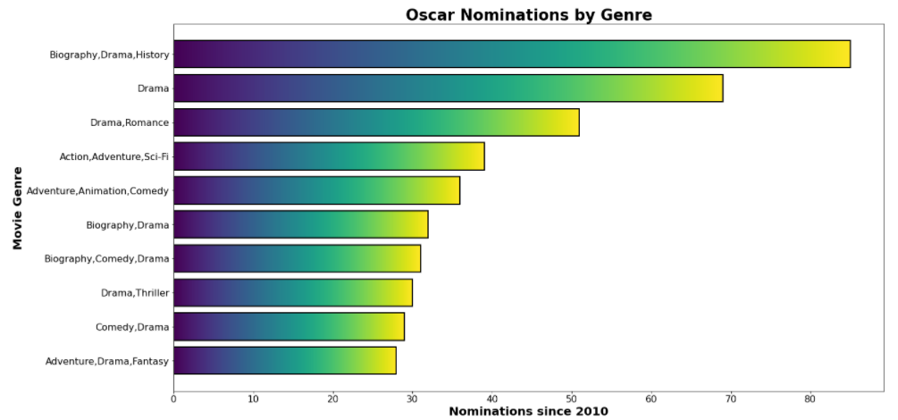
Overview
Methods
Findings
Proposals
Awards

Slide 22
HORROR
Overview
Methods
Findings
Proposals
Awards

Slide 23
DRAMA
Overview
Methods
Findings
Proposals
Awards

Slide 24
Thank You
Evan Johnson
github.com/ewjohn127
Ted Brandon
github.com/theobigdog
Jakub Rybicki
github.com/Jakubryb

Slide 25
Questions?

Slide 26
Appendix

Slide 27
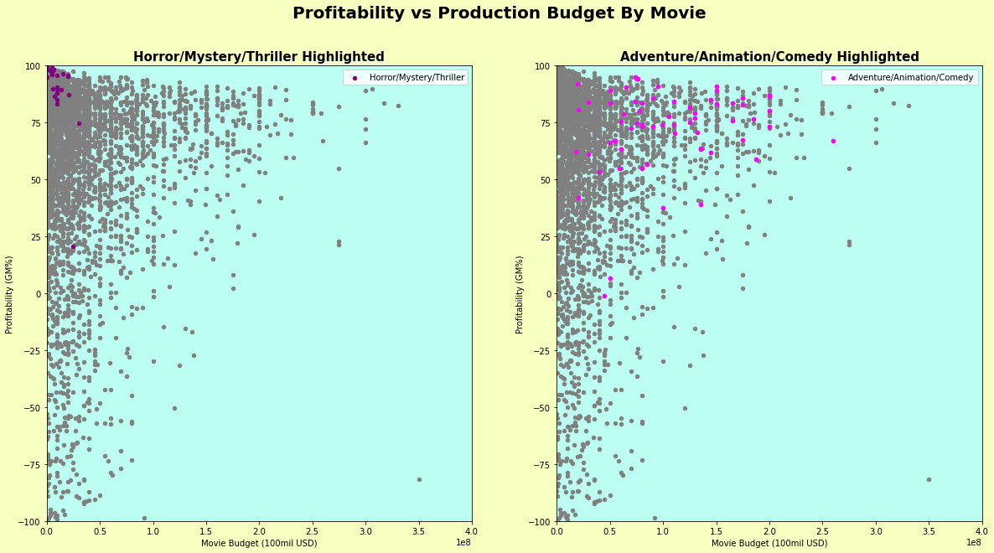
Data
Overview
Methods
Findings
Proposals
Awards

Slide 28
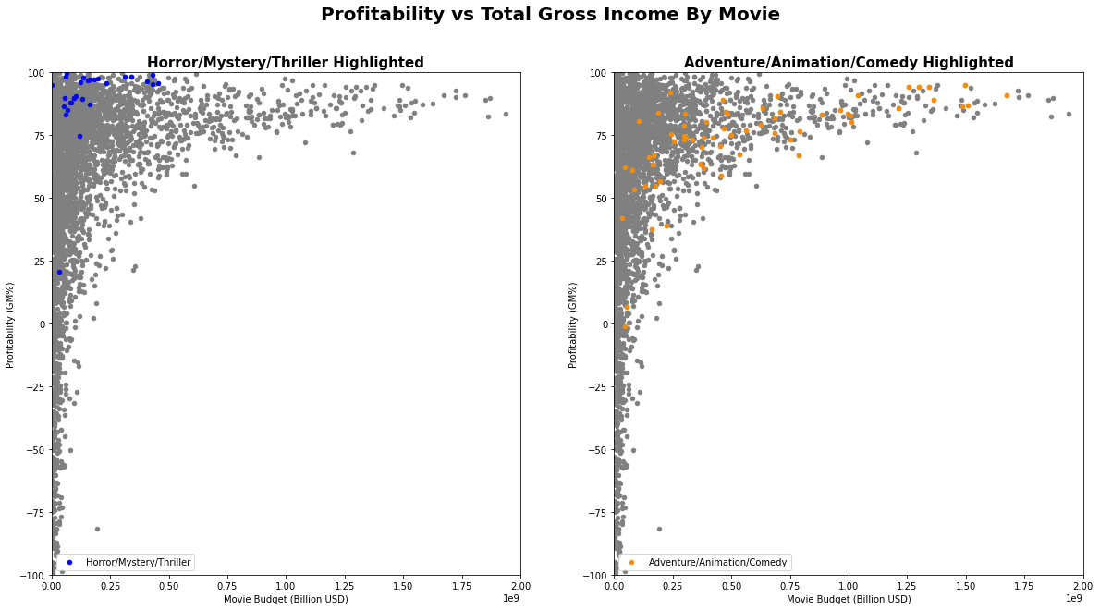

Slide 29
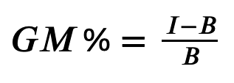
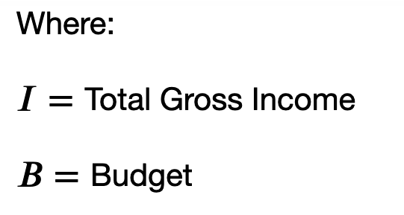
Defining Profitability
Define Profitability as Percent Gross Margin
Notes:
In words, Profitability is what percent of every dollar made is above the cost. The max Profitability a movie can have is 100% (all profit and no costs). There is no limit on the lower end of Profitability. For Example, if a movie that cost $1,000,000 to make only makes $750,000 that would be a Profitability of -33% or a profit loss. The higher the production budget and the lower the gross income, the lower the Profitability.

Slide 30
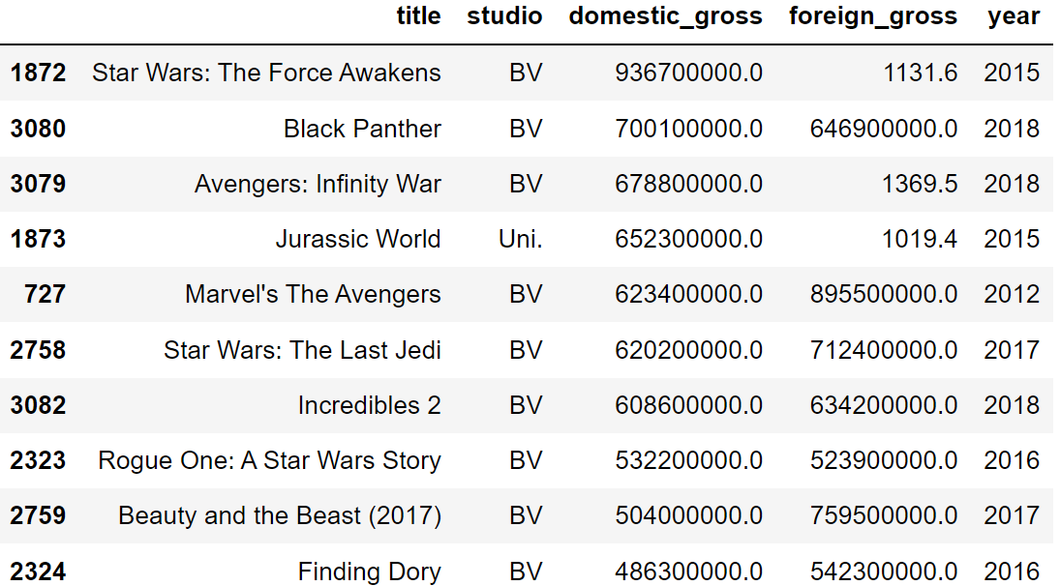
Foreign Gross Inconsistencies

Slide 31
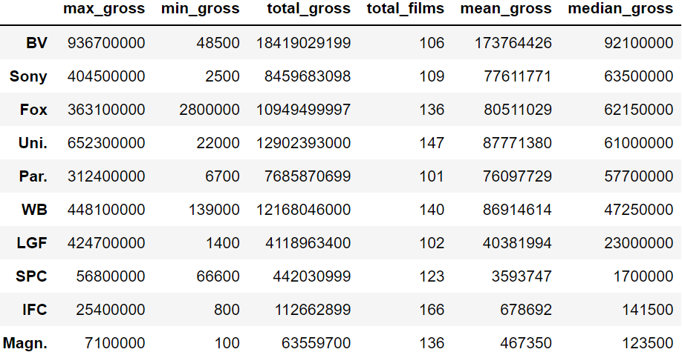
Partner with Another Successful Studio
Data
Overview
Methods
Findings
Proposals
Awards

Slide 32
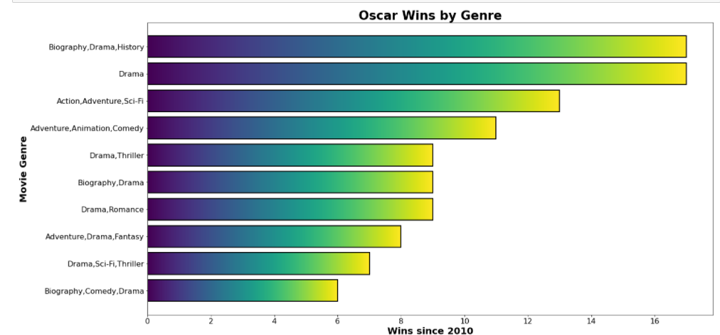
Data
Overview
Methods
Findings
Proposals
Awards

