Slide 1
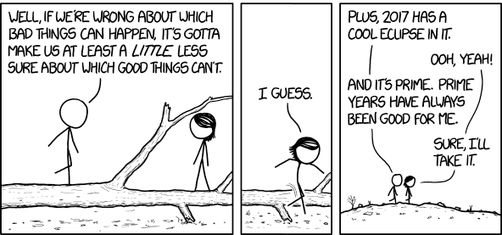
Notes:
2016 ended up being a dumpster fire.
Happy new year!

Slide 2
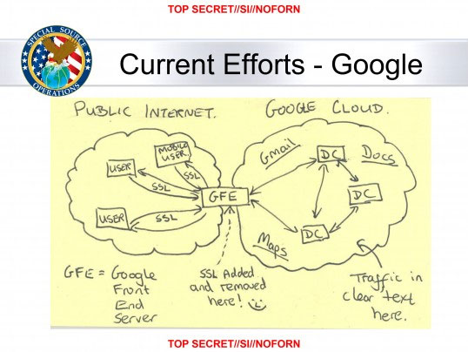
Notes:
If 2016 was bad, let’s back up to 2013.
Remember this? NSA bragging stripping encryption from user traffic entering the cloud.
And in addition to learning about all of this ...

Slide 3

Notes:
This guy is now in charge of the surveillance state (among other things).
Privacy issues that would have continued to be merely important under a Clinton presidency are about to become a crisis.
They were never addressed by the outgoing administration.
The collective anxiety we all feel about the impact of technology on society is nothing new.
We’ve just been ignoring it.

Slide 4
This is not the future we wanted.

Slide 5
“The best minds of my generation are thinking about how to make people click ads."
"That sucks."
Jeff Hammerbacher
Research Scientist, Facebook
Notes:
This is what we’ve been doing for the last 15 years.

Slide 6
"Right now, we have a defeated majority. Many are scared, and many are
motivated -- and few of those are applying their motivation constructively."
Bruce Schneier
Notes:
I recommend you read this blog post in full. It was the first thing I read after the election that made me feel better about what’s next.

Slide 7
RFC: The next four years

Slide 8
RFC: The next four years
Has there ever been a time when it was more important for you to be good at what you do?
Notes:
My hope is this presentation is only the start of a series of presentations on building the future we want.
The new year is upon us, which leaves 11 more NCLUG meetings this year.
I’d like to see the schedule filled with your ideas.

Slide 9
Running your own email server
Notes:
Enough of the why.
Let’s move on to the what.
This is going to be high level. It’s a big topic. I’m not going to cover the details in an hour.
My goal tonight is to demystify what you actually need to do to host your own email.
Mostly it’s just one time changes to dozens of configuration files.
I don’t have anything new to add. The necessary information has already been written by other people and is out there on the web.
Slides with links will be posted for you to refer to after.

Slide 10
Why bother?
Sends a message that we will not tolerate surveillance as a business model
Technology should empower people
Makes you smarter
Everyone here should be doing this anyway
Notes:
If you want to prevent corporations from collecting information about you, and prevent third parties from exploiting that infrastructure, simply refuse to give it to them.
Hosting your own infrastructure is much cheaper now. Free webmail services are less important.
Managing your own email server gives you power over your brand. If you’re trying to get hired for a technical job, it can be a signal that you know your stuff.
If you’re running a business, it’s mandatory.

Slide 11
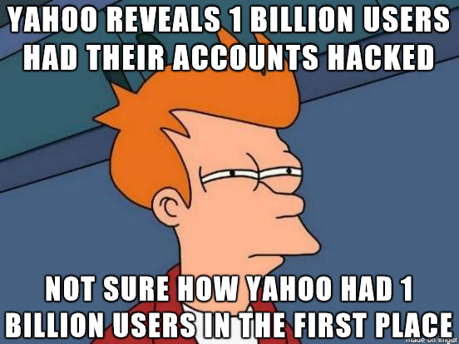
Notes:
Who do you trust?
Yahoo Says 1 Billion User Accounts Were Hacked
Yet another reminder:
If your privacy isn’t important to you, you can be sure it’s not a priority for anyone else.
Never forget:
There is no such thing as the cloud. You are just storing your personal data on someone else’s computer.

Slide 12
Gmail
Remember Google reads your mail.
How were we ever okay with this?
Notes:
Let’s pick on Google again for a minute.
Who needs an email server when you can get free email from Google?
They read your mail!
Having reassessed the landscape, knowing what we know now, how is this a good tradeoff?
In hindsight, really not a great idea.
Again, you have your own computer. You don’t need their cloud.

Slide 13
Gmail has bugs
Gmail eats your patches.
Gmail disrespects mailing lists.
Notes:
Bugs if you’re a power user, anyway
Remember when only Exchange did this?

Slide 14
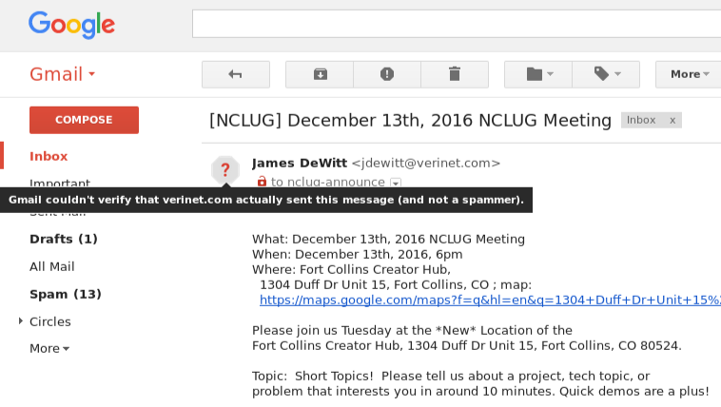
Notes:
Google has policing other deliverability.
I’ll show you later how to get rid of this.

Slide 15
TL;DR
DNS is the hardest part, but only if you have a dirty IP address
Notes:
Setting up your own email server is not trivial, but totally manageable. Most of the work is up front- set aside a weekend at the most.
Consider using this as a reference guide when you decide to take this on yourself.

Slide 16
Overview of email
Mail Transport Agent (MTA)
Mail Delivery Agent (MDA)
Mail User Agent (MUA)
Notes:
Most of the complexity in email is getting all the small pieces to work together.
Mail User Agent is just your email client- won’t be covering that tonight.
We could spend the whole night talking about Mutt and PGP.

Slide 17
Overview of email as ASCII art
The world (mostly spammers)
|
|
|
V
MTA <--> MDA
^ |
| |
| |
| |
| v
Alice Alice
Notes:
Artist’s rendering

Slide 18
Get a box
An old machine running at home will not work.
You need a clean, static IP.
ISPs block port 25.
Notes:
It matters where the box is to be able to get a clean IP.
Personal recommendation: Debian on Linode

Slide 19
If there is any reason to suspect your IP is not clean you will not be able to send email.
In addition to known blacklists, AV programs and individual MTAs maintain their own lists.

Slide 20
Get a domain
A $DOMAIN 11.33.123.456
MX 0 $DOMAIN
AAAA (for IPv6)
TXT v=spf1 a mx ?all
TXT DKIM key
Notes:
MX records should always point to server by name; failed requests will find the A record on their own
If you don’t have your own domain yet this will be easier since you don’t have to worry about disrupting existing email delivery.

Slide 21
When you’re done:
Reverse DNS
$ host edkovsky.org
edkovsky.org has address 45.33.119.7
$ host 45.33.119.7
7.119.33.45.in-addr.arpa domain name pointer host.edkovsky.org
Notes:
It will look like this when you’re done configuring your server and DNS.

Slide 22
Secure the box
Log in
Install system updates
Set hostname
Update /etc/hosts
Set timezone
Set up new user
Set up automatic updates
Notes:
If you use CentOS/RHEL then SELinux is going to prevent some components from communicating which will make your life a lot harder.

Slide 23
Harden ssh access
Copy over your public key.
Disable root login
Enable key only authentication (by disabling PasswordAuthentication)
Listen only on IPv[4|6]
Install fail2ban
Remove unused services
Notes:
Careful here. If you make a mistake you can lock yourself out.
Be sure you include SSH access on the allowed ports when you configure the firewall later.
Once this is set up, you can configure fail2ban to be aggressive with script kiddies. Since you’re only allowing access over ssh with known keys, you can safely set fail2ban to bounce anyone who comes knocking.
Anyone who shows up uninvited is banned for life.

Slide 24
Set up firewall
Open relevant ports:
22 SSH
993 IMAPS
995 POPS
587 SMTP
465 SSMTP
Notes:
IMAP 143
SMTP 25

Slide 25
iptables
Edit by hand:
/etc/iptables/rules.v[4|6]
Enable changes:
iptables-restore rules.v[4|6]
View active rules:
iptables -L
Notes:
Iptables can be unpleasant to configure the first time, but it’s typically fire and forget once it’s running

Slide 26
Get an SSL certificate
Let’s Encrypt
The cheapest and easiest solution.
Use any of their clients or your package manager.
This is valid for both email and web server.
You must already have control over the server to be issued a cert.
Notes:
Free certificate authority created by the Electronic Frontier Foundation.
Please give them your money.
This is not perfect security.
Some people are also uncomfortable with the privileges the LE agent requires.
You could also self sign instead until setup is complete.

Slide 27
Cert is installed here:
/etc/letsencrypt/live/$DOMAIN/
You will need to tell Dovecot where to find it:
/etc/dovecot/conf.d/10-ssl.conf
<ssl_certificate /etc/letsencrypt/live/$DOMAIN/fullchain.pem
<ssl_certificate_key /etc/letsencrypt/live/$DOMAIN/privkey.pem
Notes:
Remember where you put the certificate once it’s issued.
Dovecot config files are occasionally fussy

Slide 28
Install and secure MySQL
Database backend may be over-engineered for a single user system.
Not difficult to set up.
Built for growth if your needs change later.
Notes:
You could do this with Postgres as well. Or any other database backend supported by your MTA of choice.

Slide 29
Install MySQL
create mail server user
create table virtual_domains
create table virtual_users
create table virtual_aliases
insert domains into virtual domains
insert email addresses into virtual_users
insert aliases into virtual_aliases

Slide 30
Configure MTA - Postfix
Remove other MTAs (exim, sendmail)
/etc/postfix/main.cf
/etc/postfix/mysql-virtual-mailbox-domains.cf
/etc/postfix/mysql-virtual-mailbox-maps.cf
/etc/postfix/mysql-virtual-alias-maps.cf
/etc/postfix/mysql-virtual-email2email.cf
Notes:
Most of the Postfix configuration is just to make the MTA get its information from the SQL tables we already created.
The full tutorials in the bibliography show how to use the ‘postmap’ command to verify your settings.

Slide 31
Install Mail Delivery Agent - Dovecot
Make changes to a dozen config files you’ll never have to look at again.
/etc/dovecot/dovecot.conf
/etc/dovecot/conf.d/*.conf
Notes:
Again, detailed instructions are in online tutorials and not worth reproducing here.
Basically, you’ll be setting up directories for mail delivery for each of your users.
Similar to Postfix, you’ll configure Dovecot to talk to MySQL.
Make sure that all connections are secure and authenticated.
Finally, go back to Postfix and tell it to deliver all messages to Dovecot for pickup.

Slide 32
Troubleshooting
swaks --to alice@example.org \ --server localhost –data \ /usr/share/doc/spamassassin/ \
examples/sample-spam.txt
Notes:
Everything worked on the first attempt? Either you are some kind of wizard or you’ve done this before.
If not, spamming yourself is a great way to check local message delivery.

Slide 33
Troubleshooting
$ mutt -f \ /var/vmail/example.org/alice/Maildir

Slide 34
What we’ve done so far
Our server is locked down.
Domains and users are defined in SQL.
Postfix can talk to the outside world.
Dovecot can authenticate users.
Users can send and receive mail over a secure connection.
Postfix, MySQL, and Dovecot talk to each other.
Notes:
As usual, the devil is in the details.

Slide 35
Not done yet
Notes:
Too easy you say?
Our system is capable but still only has the bare essentials.

Slide 36
Dovecot sieves
$ touch /var/vmail/ \
$DOMAIN/alice/.dovecot.sieve
Easiest way to manage them is to let Dovecot do it:
/etc/dovecot/conf.d/15-lda.conf
Notes:
Postfix can pass incoming mail to other programs (called milters) before final delivery to Dovecot.

Slide 37
Sieve example
if header :contains "subject" ["order", "buy"] {
redirect "orders@company.dom";
} elsif ...

Slide 38
Install SpamAssassin
Mandatory if you value your sanity
Fix Debian 8 bug
Enable spam scanning in Postfix
Enable SpamAssassin systemd unit
Add sieve rule to route spam to user's junk folder

Slide 39
DomainKeys Identified Mail
Server signs outgoing messages.
Public key is part of DNS record as additional sender verification.
Use the OpenDKIM package.
Generate the key pair for the root domain: example.com
    NOT mail.example.com
Notes:
Note that Google requires this to make the unverified sender message go away.
It will NOT get you off the hook if your IP is already on someone’s blacklist.

Slide 40
OpenDKIM
OpenDKIM is an additional service
New user
New SystemD unit
Open new port in firewall
/etc/opendkim/mail/txt goes in DNS record
Postfix needs to know about the new milter:
/etc/postfix/main.cf

Slide 41
Antivirus
Don’t be contagious
Install ClamAV
Notes:
I believe this requires an additional milter.
I’ve read complaints it’s a memory hog, but I’ve never had any problems.

Slide 42
Install webmail
If you want it
Requires a web server
I’ve heard nice things about SquirrelMail and RoundCube
Notes:
Web server sold separately.
If you can get email working, a web server is cake.
Install Nginx
Open 80 and 443
Configure 80 to forward to 443 so visitors only get the encrypted version of your site.
Being able to do this is actually why I moved off shared hosting.
I cut my hosting costs in half and implemented better security.

Slide 43
Set up log reports
Use rsyslog to copy journald to /var/log
Use logwatch to email summaries
Configure journtalctl to export logs
/etc/systemd/journald.conf
ForwardToSyslog=yes
SystemMaxUse=50M

Slide 44
rsyslog
rsyslog does not create the directories it needs:
$ mkdir /var/spool/rsyslog
$ /var/log/messages
$ /var/log/secure
$ chmod 0644 /var/log/messages
$ chmod 0644 /var/log/secure
$ sudo systemctl enable rsyslog

Slide 45
logwatch
Main config file is extremely well documented:
/etc/logwatch/conf/logwatch.conf
Set the mailer value to a valid email:
mailer = "alice@example.com”
Notes:
Extra credit: I also use my public GPG key to encrypt the log report before sending it on some of my machines.

Slide 46


Slide 47
That was a lot of yak shaving
Don’t lose it!
Back up /etc
Back up SQL tables
Notes:
But we’re not done yet.

Slide 48
Back up MySQL
On the server:
mysqldump –single-transaction \
–routines –triggers \
–add-drop-table –extended-insert \ -u USER -h 127.0.0.1 -pMYPASSWORD \ $MAILSERVERUSER > \ mail_server_backup.sql

Slide 49
Back up /etc
On your backup machine:
Pick up the SQL dump:
rsync -aP \ $HOST:mail_server_backup.sql $dest
Get incremental backups of /etc:
rsync -Pr $HOST:/etc $dest/etc

Slide 50
Bibliography
Tutorials
workaround.org/ispmail/jessie
linode.com/docs/security/securing-your-server
letsencrypt.org
Verifying setup
mxtoolbox.com
dmarc.postmarkapp.com
ssllabs.com
spfwizard.net
dkimcore.org/tools/keycheck.html

Slide 51
Bibliography
Additional sources
xkcd.com/1779
schneier.com/blog/archives/2016/12/my_priorities_f.html
bloomberg.com/news/articles/2011-04-14/this-tech-bubble-is-different
nytimes.com/2016/12/14/technology/yahoo-hack.html
Additional resources
eff.org
namecheap.com
wiki.archlinux.org
wiki.gentoo.org

Slide 52
https://github.com/ewk/nclug-email

