Slide 1
Less is More
An introduction to Go
Eddie Kovsky
Notes:
Welcome everyone.
This is a basic introduction to some of the feature of Go. It is not meant to be comprehensive. I am deliberately glossing over performance benchmarks and implementation details in this talk.
How many people are familiar with Go? Has anyone here used it?

Slide 2
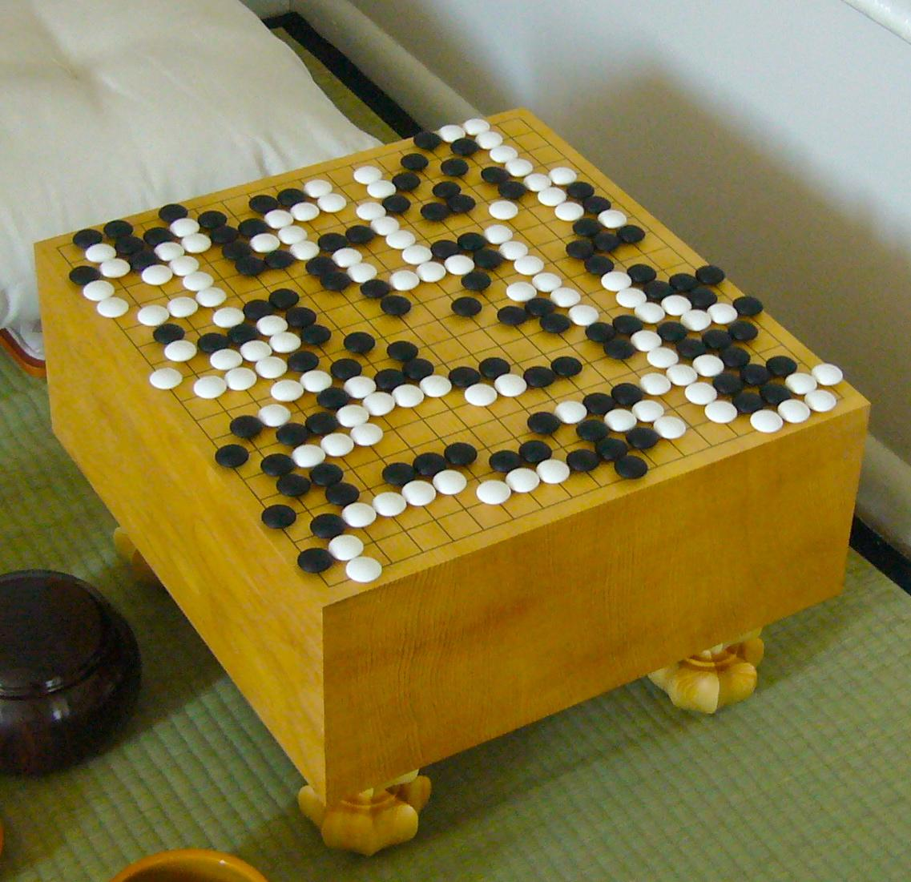
Not to be confused with:
Go (baduk)
FloorGoban.JPG Wikimedia Commons
Notes:
The surrounding game

Slide 3
Not to be confused with:
Go!
A Prolog like language introduced in 2003.
en.wikipedia.org/wiki/Go!
Notes:
The other programming language. Punctuation matters !!

Slide 4
Developed at Google
Rob Pike
Ken Thompson
Robert Griesemer
Ian Taylor
Russ Cox
Notes:
You may recognize these names.
C, Unix, UTF-8

Slide 5
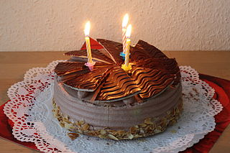
Go is open source
BSD license
Most *nix, ARM, and even Windows
Influenced by ideas in C, C++, and Python
Project turned 5 in November
Creative Ccommons Attribution Share Alike - Author Puschinka
Notes:
Go is just one of the many new languages targeting systems programming.
Compared to other languages in this category, Go is the most mature.
The language most similar to Go is probably Rust.
Compared to Rust, Go is much more high level. Rust is also a larger, more ambitious language.
Go has also been used in production for 5 years. Rust is still in alpha and is expected to ship a final release May 15.

Slide 6
Who uses Go?
Google is replacing production C++ with Go
Expect to see Go eventually replace Java on Android
CoreOS and Docker are written in Go
Scout is replacing Ruby with Go
Electronic Frontier Foundation’s letsencrypt.org

Slide 7
Why is Go interesting?
Go is fast
Type safety
Compact syntax
First class concurrency primitives
Excellent toolchain

Slide 8
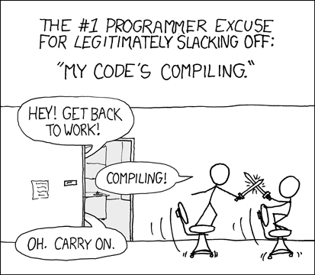
https://xkcd.com/303/
I promise this will be the only xkcd cartoon in the entire presentation.
Notes:
Supposedly Thompson and Pike were discussing how they would design a modern systems language when they decided to build the language they wanted.
Another version says they were waiting for a C++ build to finish and they just wanted a language that would eliminate all the duplicate #include directives.

Slide 9
What do they mean by systems language?
General purpose
Compiled
Safe to use
Big focus on performance (compile time and runtime)
Notes:
It’s not a well defined category.
These are the priorities for Go.
Which begs this question ...

Slide 10
And modern?
Build a new language that takes advantage of modern hardware:
Every device is on the network
Every device has a multicore processor
Garbage collected.
Built in dependency management. (go get)
Also object oriented (kinda), so it's buzzword compliant.
Notes:
We can make new assumptions about underlying hardware.
Most everyone here has a device just like this in their pocket.
go get is a VCS agnostic utility for downloading code repositories.
Buzzword compliant for the manager you have to convince to sign off on it …
Go's "object" system is focused on behavior and composition. Go has interfaces and package scoping, but no type hierarchy or generics.

Slide 11
Magic bullets are not included
“ … no language solves all problems equally well.”
Brian W. Kernighan
Rob Pike
The Practice of Programming
Go solves a problem for Google.
You (probably) do not have Google’s problems.
Notes:
The design choices emphasize writing correct code, kind of like Python intended.
The Go language and toolchain force you to “Do the right thing”.
The “right thing” not just for runtime, but for the next person who has to read your code.
Developer time is less precious than maintenance cost.
For Google, the assumption is that any one of its 20,000 engineers can read, understand, and maintain a Go application.

Slide 12
Go's designers have some strong opinions on how you should write code so that it runs fast AND is easy for other humans to maintain.
This means taking things out.
Notes:
They also had the luxury of starting from scratch.
Your favorite feature from your favorite language probably did not make the cut. Some people on the internet really hate Go’s minimalism, and this is usually their leading complaint.

Slide 13
The Go language is compact
Just like C
Go has 25 keywords.
Language spec is 50 pages. Read it!
Compile and run an http server:
% go run server.go
Notes:
DEMO http://localhost:8080/hello.html
6 lines of code with some boilerplate

Slide 14
Unused resources
Importing a package you don't use?
Defining a variable you don't use?
Notes:
Anyone who hasn’t used Go, care to guess what happens here?

Slide 15
Unused resources are a compile time error
Importing a package you don't use?
% ./nclug.go:11: imported and not used: "math/big"
Defining a variable you don't use?
% ./nclug.go:15: meaningOfLife declared and not used
Notes:
They got rid of those unused #include declarations!

Slide 16
C was too big anyway
while and do-while loops are gone.
ternary x ? y : z operator is gone.
Pointers are included (for call by reference), but there is no pointer arithmetic.
Garbage collection is mandatory.
Notes:
GC, as mentioned earlier

Slide 17
Standard library
regex
bytes
crypto
image
math
net
testing
time
http://golang.org/pkg/
Examples from Go Documentation are licensed under the Creative Commons Attribution 3.0 License, and code is licensed under a BSD license.
Notes:
Like Python, regular expressions are implemented as a library to keep the core language small.
Russ Cox has several good blog posts on why.
TL:DR No backtracking, so it's fast, like everything else in Go.
If you’re interested in things like “non deterministic finite state automata”, you should check it out.

Slide 18
Source code
UTF-8 everywhere
CamelCase
All the multiWord names
Capitalized names are Public.
Every program has a package scope.

Slide 19
Coding style
It isn’t written down.
Coding style is automated by the toolchain.
‘gofmt’
Just remember to run it before you commit.
Or hook it your editor.
Notes:
Demo
This is the “Stop arguing about tabs vs spaces and get back to work” utility.
Semicolons ';' are statement terminators, but the compiler inserts them automatically. Considered bad style to type them out. 'go fmt' will remove them.
There are Go plugins for “your favorite editor”.

Slide 20
Usual operators and types
int , hex, float
42, 0X2a, 2.71828
strings
"are immutable"
bool
true and false
golang.org/ref/spec

Slide 21
rune literals (unicode code points, really UTF char)
Several ways to represent them.
Here's one:
'\u263a' // prints smiley face ☺
C99 comments:
/*
* multiline
*/
and
// single line

Slide 22
Collections
Arrays are typed and immutable.
[1000]*float64 // array of 1000 pointers to float64
Go has slices (of arrays) which you'll use most of the time instead.
nums := []int{13, 2, 3, 4, 5, 10}
Maps are also typed.
map[string]int // Key string to value int
Notes:
Slice literals don't have the element count. Advantage is you don’t have to worry about growing the array size.
Go’s collection types also include a new type channel, which we’ll talk about at the end.

Slide 23
Variables are typed
Type is written at the end of the declaration.
var i int
You can use type inference where it makes sense.
i := 3
All empty variables are initialized to their zero values.
Pointers are also typed.
Notes:
0, false, “”

Slide 24
Go's only looping construct is 'for':
for i := 0; i < 10; i++ {
// stuff happens, electrons are inconvenienced
}
for i, s := range someArray {
// i is array index, s is value at someArray[i]
fmt.Println(s)
}
Notes:
Familiar but foreign.
Unlike C, there are no parentheses around the condition.
Braces (curly brackets) are required.
Iterating over an “collection”: array, slice, string, map, or channel you can use for with range, which behaves like Python’s range operator.

Slide 25
Control flow
if x := f(); x < y {
return x
} else if x > z {
return z
} else {
return y
}
Notes:
Just like the for loop.
Braces are required, even for one line branch.
No parentheses around condition.
Go also keeps goto and switch statements from C

Slide 26
Functions
Return type is declared at the end of function definition, same as variables:
// braces must be on the same line
func min(x int, y int) int {
// do some stuff
}
Notes:
Go is a bit brace heavy, which is the tradeoff for not requiring statement terminators.
Why did they think it was important to move the type declaration to the end?

Slide 27
Rationale: C and the "Clockwise-Spiral Rule"
char *(*fp)( int, float *);
"fp is a pointer to a function passing an int and a pointer to float returning a pointer to a char"
http://c-faq.com/decl/spiral.anderson.html
Notes:
Not that you couldn't find a way to use Go’s syntax to shoot your foot off

Slide 28
Functions can return multiple values
Most functions return at least two values:
the computed return value and an error code.
f, err := os.Open(filename)
if err != nil {
return "", err
}
Ignore the error code (at your peril) using the blank identifier:
f, _ := os.Open(filename)
Notes:
The if err is a common idiom. Okay, it's boilerplate

Slide 29
Concurrency
Concurrency is not parallelism.
“Concurrency is about dealing with lots of things at once. Parallelism is about doing lots of things at once.”
Rob Pike
http://blog.golang.org/concurrency-is-not-parallelism
Notes:
By far Go's most interesting feature.
Go’s concurrency features are designed to make it easier to reason about concurrency.
Recall that multicore support was a priority for the language design. The Go language is designed to make it easy to implement programs that take advantage of multicore systems using concurrency.
But a very narrow definition of concurrency.
Go's concurrency model is about breaking a large problem into manageable pieces.
Parallel execution may only be a side effect.
It's easy to rewrite a program using concurrency and end up with something that runs slower.

Slide 30
Go's concurrency model is based on C.A.R Hoare's
Communicating Sequential Processes (CSP).
http://spinroot.com/courses/summer/Papers/hoare_1978.pdf
Notes:
Hoare- like it sounds.
Hoare is also the inventor of the quicksort algorithm

Slide 31
Go's concurrency model is modeled on Hoare's Communicating Sequential Processes (CSP).
Huh?
Notes:
We all graduated kindergarten. We know what that means, right?

Slide 32
Communicating Sequential Processes
Input and output are basic primitives [of all programming].
Parallel composition of [communicating sequential] processes is a basic method [of program structure].
The composition of processes is parallel, not their execution.
Notes:
One slide summary of the paper.
Exchanging data and doing stuff are fundamental to programming.
IO seems intuitively obvious. Parallel composition of doing stuff should be too.
Humorously, Hoare actually warns that the concepts he introduced in his paper “should not be regarded as suitable for use as a programming language”
Erlang implements similar ideas, but without type safety and with a less familiar syntax. Also nearly 30 years old.

Slide 33
goroutine
“ … a function executing concurrently with other goroutines in the same address space.”
http://golang.org/doc/effective_go.html#concurrency
Notes:
Go has two built in language primitives that enable concurrency.
Goroutines are the first.

Slide 34
goroutine
A goroutine executes concurrently with the function that called it.
The calling function does not wait for a return value.

Slide 35
func main() {
list.sort() // main() waits for sort
}
func main() {
go list.sort() // main() continues
}

Slide 36
Oops!
Since the calling function doesn't wait for the goroutine to return, our program is free to exit before the goroutine finishes.
Notes:
Your terminal emulator may be polite enough to tell you when a background job is still running, but Go isn’t.

Slide 37
Channels
Channels are how goroutines communicate.
The sender and receiver will block until both are ready.
Works without managing any locks.
Used properly, channels are usually sufficient to keep your program running until goroutines complete.
Notes:
Channels are Go’s other concurrency builtin.
This is a big deal! Channels are the only new types, which is just a hybrid IO object and collection.
No semaphores, wait queues, mutex. No global variables for the programmer to manage.
Runtime can detect deadlocks, though reasoning through those isn’t as easy as catching them.

Slide 38
Channel “arrows” <- always point the same direction
Receiver on left.
Sender on right.
Context will provide their meaning:
c <- 1 // channel c receives signal ‘1’
<-c // channel c sends its next value; value is discarded without a receiver
Notes:
LAST DEMO
Did I mention that this is a big deal?
Locking mechanisms are still lurking in the implementation, but you do not have to think about them most of the time.
I’ll also show you a more complicated example where we do have to count threads and manually close the channels.

Slide 39
Go get Go*
% git clone https://go.googlesource.com/go ~/bin/gosource
% cd gosource
% git checkout go1.4.1
% cd src
% ./all.bash
*Oops, another Go pun
Notes:
Do not install it from your package manager
On my 2nd gen i7 this only takes about 3 minutes
This won’t work when 1.5 ships this summer. The C toolchain will be completely removed by then. Go will bootstrap Go, so you’ll need a Go binary from somewhere else.

Slide 40
Set up your workspace
# Path to Go installation
export GOROOT=$HOME/bin/gosource
# Go expects one directory for all source files
export GOPATH=$HOME/Projects/GoWorkspace

Slide 41
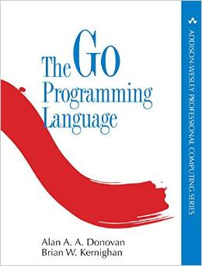
Resources
Effective Go and the Language Specification
golang.org
The Go Programming Language
by Alan Donovan, Brian W. Kernighan
Russ Cox’s Regex Essays
swtch.com/~rsc/regexp/regexp1.html
GopherCon
Denver, July 7-10 gophercon.com
Notes:
I have high expectations for this book. Due out in November.

Slide 42
Thank you
Eddie Kovsky
ewk@edkovsky.org

