Slide 1

SRAM LLC
AI Adoption Playbook
Donovan Palmer, Ed Kreienberg, Will Zheng
AIML 950 | Human and Machine Intelligence | Northwestern Kellogg

Slide 2

D
THE BUSINESS & COMPETITIVE ADVANTAGE
SRAM makes the parts that make bikes go, stop, and shift
Powering bikes from weekend rides to the Tour de France.
REVENUE
BRANDS
MTB SHARE
$1B+
6
#1
Private, Chicago-founded
Integrated portfolio
Market leader globally
SRAM AI Adoption Playbook
1

Slide 3
D
THE BUSINESS & COMPETITIVE ADVANTAGE
SRAM makes the parts that make bikes go, stop, and shift
Powering bikes from weekend rides to the Tour de France.
REVENUE
BRANDS
MTB SHARE
$1B+
6
#1
Private, Chicago-founded
Integrated portfolio
Market leader globally
SRAM
RockShox
Zipp
Quarq
Hammerhead
TIME
Drivetrains + Braking
Suspension
Wheels + Cockpit
Power Meters
GPS Bike Computer
Pedals
Gears, chains, and disc brakes for every bike
Forks and shocks that absorb trail impacts
Aero wheels, handlebars, and stems
Sensors that measure rider output in watts
On-bike computer for navigation and training data
Clip-in pedal systems for road and mountain
AXS Wireless Ecosystem | All 6 brands connect wirelessly and share data
SRAM AI Adoption Playbook
1

Slide 4
W
THE STRATEGY
Going from Early wins to AI-first enterprise
Each step builds the infrastructure and organizational trust the next step requires.
Step 1
Step 2
Step 3
Step 4
Democratize AI Tooling
Enterprise Data Consolidation
Deploy AI to Operations
Revenue + Innovation
Month 36-60+
Month 0-12
Month 0-24
Month 0-36
AXS Intelligence Platform (unified rider data layer) OEM Automation + Upgrade Recs Generative Design + R&D
GitHub Copilot + Claude Code for engineers Microsoft CoPilot for business function staff Quarterly AI innovation forums
AWS-native data lakehouse on existing AWS infrastructure SAP ERP + Salesforce CRM connected to central platform Prerequisite for Steps 3B + 4
3A: AI support agent for AXS + Hammerhead dealers 3B: SageMaker demand forecasting on pilot SKUs Bounded, measurable pilots
$300K annual cost ~$1mm annual cost savings
$10mm investment Unlocks significant opportunity downstream
3A: ~$100k net ongoing annual savings; revenue uplift due to improved customer retention 3B: ~$4.1mm net cost savings annually
~$20M ARR new subscription revenue
~$8.5mm annually in revenue uplift at scale ~$4mm cost savings annually
Step 2 runs in parallel with Steps 1 and 3A | Steps 3B and 4 depend on Step 2 data infrastructure
SRAM AI Adoption Playbook
3

Slide 5
W
STEP 1: DEMOCRATIZE AI TOOLING
Building AI fluency from the ground up is the prerequisite
Deploy AI into existing tools, build organizational comfort, and identify champions before committing to Steps 3 and 4.
GitHub Copilot + Claude Code
Microsoft CoPilot
SRAM's software engineers
Business function staff
AI pair programming in existing IDEs. Accelerates the technical work Steps 2-4 require. Integrates directly into existing GitHub workflows.
AI-assisted notes, email, and meeting summarization across all business functions. Integrates directly into Microsoft 365.
Annual cost: $150k/yr
Annual cost: $150k/yr
75% of engineers active weekly by Month 6
60% of staff active weekly by Month 9
Quarterly AI Innovation Forums | Surface grassroots use cases, identify AI champions
5+ champions named by Month 12
Total investment: ~$300k/yr | Total benefit: ~$1.0mm/yr labor-equivalent | Net value: ~$700k/yr
SRAM AI Adoption Playbook
4

Slide 6
W
STEP 2: ENTERPRISE DATA CONSOLIDATION
Data infrastructure is the prerequisite, not an optional investment
SRAM has no centralized ERP, CRM, or data warehouse today. Customer data lives in Shopify. AXS telemetry is siloed from Hammerhead ride data.
SOURCE SYSTEMS
AWS DATA LAKEHOUSE
AI / ML LAYER
SAP ERP (order + inventory)
Amazon Bedrock (LLM agents)
Unified SKU-level order data
Salesforce CRM (dealers + warranty)
Amazon SageMaker (forecasting)
Dealer sell-through rates
AXS + Hammerhead telemetry
Amazon Kendra (doc retrieval)
PowerBI + Databricks (BI layer)
Shopify (DTC orders)
Salesforce AgentForce
Data quality gates enforced
Quarq power data
All Step 3 + 4 tools run here
24-MONTH INVESTMENT
DOWNSTREAM VALUE
DATA READINESS TODAY
$10mm
$36.6mm/yr
60-70%
SAP + Salesforce + Lakehouse
Steps 3B + 4 depend on this
AXS + Hammerhead pilot-ready
SRAM AI Adoption Playbook
5

Slide 7
D
WHERE AI ADDS VALUE
12 AI initiatives across four business functions
AI opportunities exist across every function at SRAM.
Quick Win
Medium Effort
Long-Term Bet
ENGINEERING
Generative Design
AXS Intelligence
AI-Tuned Components
Physical testing is slow and expensive
Telemetry data is collected but unused
Suspension and shifting are static
SRAM AI Adoption Playbook
6

Slide 8
D
WHERE AI ADDS VALUE
12 AI initiatives across four business functions
AI opportunities exist across every function at SRAM.
Quick Win
Medium Effort
Long-Term Bet
ENGINEERING
Generative Design
AXS Intelligence
AI-Tuned Components
Physical testing is slow and expensive
Telemetry data is collected but unused
Suspension and shifting are static
SALES
OEM Proposal Automation
Part Recommendations
DTC Personalization
Proposal cycles are slow, manual
No guided upsell at point of service
Velocio has no targeting capability
SRAM AI Adoption Playbook
6

Slide 9
D
WHERE AI ADDS VALUE
12 AI initiatives across four business functions
AI opportunities exist across every function at SRAM.
Quick Win
Medium Effort
Long-Term Bet
ENGINEERING
Generative Design
AXS Intelligence
AI-Tuned Components
Physical testing is slow and expensive
Telemetry data is collected but unused
Suspension and shifting are static
SALES
OEM Proposal Automation
Part Recommendations
DTC Personalization
Proposal cycles are slow, manual
No guided upsell at point of service
Velocio has no targeting capability
SUPPLY CHAIN
Demand Forecasting
Inventory Allocation
Customer Analytics
No forecasting system exists today
Stockouts and rush shipping losses
Shopify data is siloed, unused
SRAM AI Adoption Playbook
6

Slide 10
D
WHERE AI ADDS VALUE
12 AI initiatives across four business functions
Start where domain knowledge is high and outcomes are measurable. Support is the proving ground for everything that follows.
Quick Win
Medium Effort
Long-Term Bet
ENGINEERING
Generative Design
AXS Intelligence
AI-Tuned Components
Physical testing is slow and expensive
Telemetry data is collected but unused
Suspension and shifting are static
SALES
OEM Proposal Automation
Part Recommendations
DTC Personalization
Proposal cycles are slow, manual
No guided upsell at point of service
Velocio has no targeting capability
SUPPLY CHAIN
Demand Forecasting
Inventory Allocation
Customer Analytics
No forecasting system exists today
Stockouts and rush shipping losses
Shopify data is siloed, unused
START HERE
RECOMMENDED PILOT
SUPPORT
AI Support Agent
Warranty Automation
Compatibility Assistant
70% of dealer questions are repetitive
Fraudulent and mis-filed claims cost time
Riders get wrong parts, return them
SRAM AI Adoption Playbook
6

Slide 11
D
STEP 3A: THE PROBLEM
Poor support drives customer churn, not product quality
Riders love SRAM hardware. They struggle with firmware updates, part compatibility, and warranty resolution.
TRUSTPILOT RATING
AUTOMATABLE
TOP COMPLAINTS
1.6 / 5.0
~70%
Firmware + Pairing
Warranty friction and support delays
Questions follow documented patterns
Reddit, app stores, Trustpilot
TODAY
WITH AI PILOT
1. Dealer emails a question
1. Same question arrives
"Which AXS derailleur firmware works with my 2024 Eagle cassette?"
Dealer submits via Zendesk. Nothing changes for them.
2. Agent searches manually
2. AI searches approved docs instantly
Opens a 200-page compatibility PDF. Searches wikis and past tickets.
Amazon Kendra indexes compatibility tables and firmware notes.
3. Agent writes a response from scratch
3. AI drafts a response for the agent
Types the answer, double-checks part numbers, hopes nothing changed.
Amazon Bedrock generates an answer. Agent reviews before sending.
4. Dealer waits ~4 hours for first response
4. Dealer gets a faster, verified answer
70% of questions follow the same documented patterns every time.
Target first response: ~2.5 hours. Human approves every response.
SRAM AI Adoption Playbook
7

Slide 12
D
STEP 3A: THE PILOT
Four roles, three systems, one bounded scope
AXS and Hammerhead dealer support tickets only. Every AI-generated response requires human approval before it reaches a dealer.
WHO DOES WHAT
WITH WHAT SYSTEMS
Product Owner
From the support organization
Zendesk
TICKET INTAKE
Owns pilot scope and success criteria. Runs the weekly quality review. Decides whether to expand, hold, or kill. Reports to the C-suite AI Sponsor.
Receives dealer support tickets. Routes AXS + Hammerhead tickets to the AI workflow. All other tickets follow the existing manual process. No changes to the dealer-facing experience.
Integration Engineer
1 engineer (internal or contractor)
Connects Zendesk to Amazon Kendra and Bedrock. Indexes AXS + Hammerhead docs into Kendra. Maintains the knowledge base as docs update. Tunes Bedrock prompts based on agent feedback.
Amazon Kendra
KNOWLEDGE BASE
Indexes SRAM compatibility tables, firmware release notes, and service bulletins. Searches approved documentation only. Updated by integration engineer as docs change.
Support Agents
Existing AXS + Hammerhead team
Review every AI-drafted response before sending. Edit, approve, or reject each draft. Flag quality issues for weekly review. Full authority to override any AI output.
Amazon Bedrock
RESPONSE GENERATION
Generates draft responses from Kendra search results. Cites the source document for every claim. Flags low-confidence answers for manual handling. Never sends a response without agent approval.
Support Manager
Existing role, expanded scope
Tracks all five SMART goals weekly. Runs Day-45 and Day-90 gate reviews. Escalates kill-criteria violations to the PO. Owns the rollback decision if quality drops.
SCOPE
GUARDRAIL
KILL SWITCH
AXS + Hammerhead tickets only
Human approves every response
2 weeks quality drop = rollback
SRAM AI Adoption Playbook
8

Slide 13
D
STEP 3A: WHAT WE MEASURE
Five SMART goals define success at the Day-120 go/no-go gate
Weber set the bar: a 30% reduction in handle time on AXS support tickets with dealer satisfaction scores holding flat or improving.
GOAL
METRIC
TARGET
OWNER
HOW IT'S MEASURED
TRIGGER IF OFF TRACK
G1
Cut first-response time
-40%
Support Manager
Measured weekly vs. current SLA baseline in Zendesk
Below -20% at Day 90 triggers scope review
G2
Resolve without escalation
+15 pts
Support Manager
First-contact resolution rate tracked weekly vs. baseline
Flat or declining at Day 90 triggers agent retraining
G3
AI draft acceptance rate
>70%
Product Owner
% of AI drafts approved by agents without major edits
Below 50% at Day 90 triggers knowledge base rebuild
G4
Agent throughput increase
+25%
Support Manager
Tickets handled per agent per day, tracked weekly
No improvement by Day 90 triggers workflow audit
G5
Hold customer satisfaction flat
No decline
Product Owner
Dealer CSAT survey scores, measured biweekly
Any sustained 2-week drop triggers immediate rollback
KILL CRITERIA
2 consecutive weeks of quality decline | Any safety error reaching a dealer | Dealer opt-out rate above 15% | Any of these triggers full rollback
SRAM AI Adoption Playbook
9

Slide 14
D
STEP 3A: FINANCIALS AND TIMELINE
12-month pilot
Day-90 scope review, Day-120 go/no-go gate, Month 7-12 scale to full catalog.
Financial Breakdown
12-Month Timeline
M11
M7
M8
M9
M12
SETUP COSTS
M5
M10
M1
M2
M3
M6
M4
Zendesk AI + Kendra + Bedrock integration
$150k
Setup + Integration
Knowledge base indexing and tuning
$100k
Knowledge Base Indexing
Integration engineer (6 months)
$150k
AI Draft Rollout (AXS)
Product owner allocation (6 months)
$100k
AI Draft Rollout (Hammerhead)
ANNUAL OPERATING COSTS
Response Time Tracking
AI platform licensing (Bedrock + Kendra)
$200k/yr
Escalation Rate Tracking
Knowledge base maintenance
$50k/yr
Throughput Measurement
Quality review and oversight
$50k/yr
CSAT Monitoring
ANNUAL GROSS BENEFIT
Weekly Quality Reviews
Warranty claim accuracy
$400k/yr
Day-90 Checkpoint
Reduced escalations and handle time
N/Q savings
Day-120 Go/No-Go
Customer retention improvement
Incremental
SRAM AI Adoption Playbook
10

Slide 15
E
STEP 3B: DEMAND FORECASTING
No forecasting system exists today; SageMaker fills that gap
Stockouts, markdown losses, and overproduction are addressable without touching the product. Requires the Step 2 data foundation as a hard gate.
TODAY
WITH SAGEMAKER PILOT
1. Brand-level judgment drives production
Month 25-27: Model development
No centralized inventory visibility. Dealer sell-through not systematically tracked.
SageMaker trained on unified lakehouse data. Back-test validates MAPE target of 15% or less.
2. Stockouts surface as surprises
Month 27-33: Shadow mode
Rush shipping absorbs margin. Markdowns clear overstock at loss.
Model runs in parallel. Planners receive recommendations but make decisions as normal.
3. Planners react to problems
Month 30-36: Active pilot
Decisions made without model support. Data exists at brand level, not enterprise level.
Planners act on model recommendations with full override authority. Overrides logged.
SRAM AI Adoption Playbook
11

Slide 16
E
STEP 3B: FINANCIALS AND TIMELINE
Demand forecasting delivers once data infrastructure is live
Begins at Month 25 after the Step 2 data lakehouse is operational. Shadow mode validates accuracy before planners act on recommendations.
SETUP INVESTMENT
ANNUAL GROSS BENEFIT
NET ANNUAL VALUE
ONE-TIME BONUS
~$500k
$4.8mm
~$4.1mm
WC release
SageMaker + data science lead
Stockouts + markdowns reduction
After $700K operating cost
Success Criteria
Timeline
Forecast accuracy (MAPE)
15% or less
Back-tested before launch
Month 0-24
Data foundation (Step 2)
SAP, Salesforce, and lakehouse build. Hard gate for forecasting launch.
Stockout reduction
-30%
Measured against 12-month baseline
Month 25-27
Model development
Markdown reduction
-25%
Tracked at SKU level
SageMaker trained on unified data. Back-test validates accuracy.
Planner adoption
>60%
Month 27-33
Shadow mode
Recommendations reviewed weekly
Planners compare model vs. judgment. No operational changes yet.
Month 30-36
Active pilot
Live recommendations with override. Overrides logged for model retraining.
SRAM AI Adoption Playbook
12

Slide 17
E
WHAT COULD BE
Hardware company to performance intelligence by 2031
Each capability creates a new recurring revenue stream. SRAM's installed base of connected components becomes a platform, not a one-time sale.
THE UNLOCK
AXS Intelligence Platform
NEW REVENUE: Premium subscription tier
Unified rider dashboard: power, gearing, suspension, heart rate in one view. No competitor has the product breadth to build this.
SRAM AI Adoption Playbook
13

Slide 18
E
WHAT COULD BE
Hardware company to performance intelligence by 2031
Each capability creates a new recurring revenue stream. SRAM's installed base of connected components becomes a platform, not a one-time sale.
THE UNLOCK
AXS Intelligence Platform
NEW REVENUE: Premium subscription tier
Unified rider dashboard: power, gearing, suspension, heart rate in one view. No competitor has the product breadth to build this.
Predictive Maintenance
AI-Tuned Performance
Dealer Intelligence
Connected components predict chain and brake pad replacement before failure. Installed base becomes recurring revenue.
Suspension auto-adjusts to terrain. Shifting optimizes for rider power. Products improve continuously after purchase.
Telemetry tells dealers which parts approach end-of-life in their area. Proactive ordering replaces reactive.
NEW REVENUE: Per-device monitoring subscription
NEW REVENUE: Premium optimization tier
NEW REVENUE: Dealer analytics license
Hardware sells data access → Data improves performance → Performance sells hardware
SRAM AI Adoption Playbook
13

Slide 19
E
STEP 4: NEW REVENUE STREAMS
Premium AXS, subscription model, and four distinct revenue paths
Each initiative is viable only after Step 2 data infrastructure is live. Combined, they represent $39M+/yr at maturity.
AXS Intelligence Platform
Generative Design + R&D
Unified rider data: AXS drivetrain, RockShox, Quarq power, Hammerhead GPS in one view. No competitor has the breadth to build this.
AI-assisted design, digital twin simulation, automated patent search. Field telemetry trains AI on actual performance data at scale.
$5mm build
~$20mm ARR at scale
$4mm build
$6mm/yr benefit
OEM Proposal Automation
Compatible Upgrade Recs
Salesforce AgentForce + CPQ accelerates spec proposals and automates documentation. 1% OEM win rate improvement = $2.5mm/yr.
SageMaker recommendation engine lifts basket Value through dealer and DTC channels. Predictive maintenance drives repeat purchases.
$1mm build
~$2.5mm/yr benefit
$500k build
$4mm/yr benefit
Step 4 total: ~$10.5mm investment | $32.5mm/yr at scale
SRAM AI Adoption Playbook
14

Slide 20
W
TRADE-OFFS AND RISKS
Three risks worth naming before the decision
Dealer trust is fragile
One confident wrong answer from the AI reaches a dealer, and the support team loses credibility it spent years building. Human-in-the-loop and weekly quality reviews mitigate this, but they also slow throughput gains.
MITIGATION: Kill criteria trigger rollback at first safety error
Data consolidation has no executive sponsor
Weber owns sales and manufacturing but not the CRM, ERP, or inventory systems. Phase 2 requires a unified data layer across those systems. Without a senior sponsor, data integration stalls and the pilot stays isolated.
MITIGATION: CEO assigns cross-functional data owner in parallel
AI hype creates unrealistic internal expectations
SRAM's engineering culture values precision. If leadership frames AI as a silver bullet rather than a tool, early imperfections will fuel skepticism and internal resistance to future phases.
MITIGATION: Frame pilot as experiment with defined success and failure criteria
SRAM AI Adoption Playbook
16

Slide 21
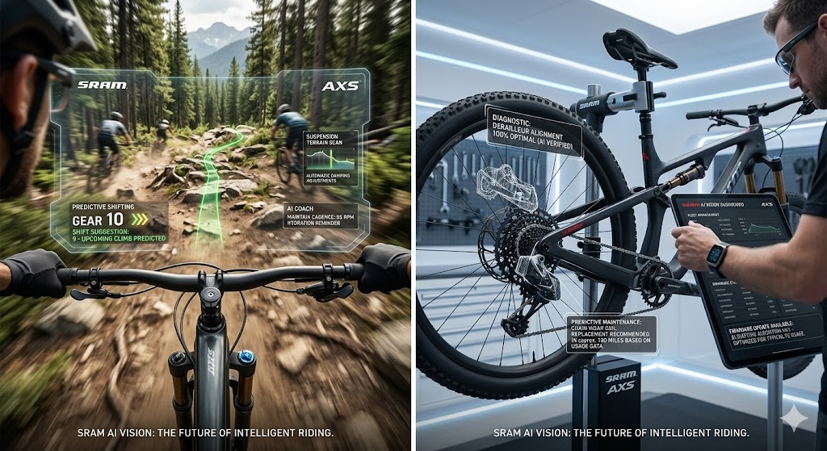
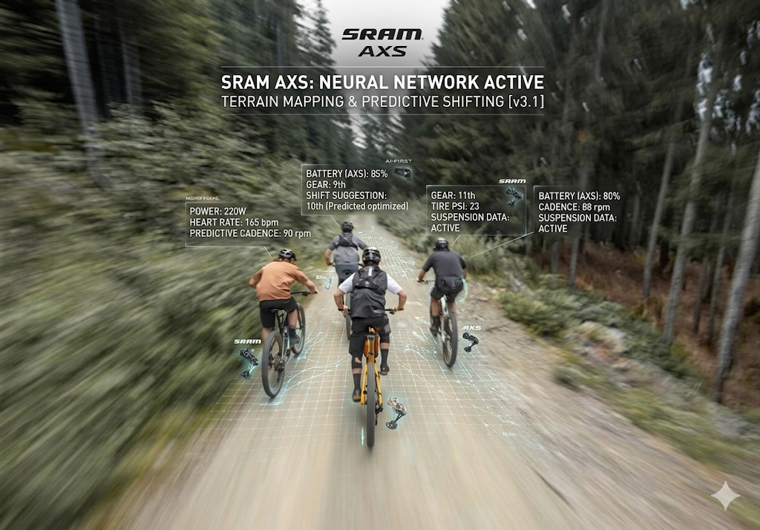
Questions
SRAM AI Adoption Playbook
17

