Slide 1
Education Outcomes
By Evan Wolpert

Slide 2
Motivation
The quality of Education and student performance is very inconsistent in the United States.
My goal was to more accurately predict student testing based on differences in a given student’s circumstances
Additionally, I wanted to find the factor most indicative of student success

Slide 3
Data and encoding
the dataset has 20 features including but not limited to Hours Studied, Attendance and Parental Involvement
The data was split 80% for training and 20% to test the models
Used a combination of one-hot encoding and ordinal encoding to transform columns into numerical and binary values depending on the category to better use the data

Slide 4
Methods for score prediction
Linear Regression
used the linear regression model from Scikit-Learn
Neural Networks
TensorFlow and Keras to build neural network with dropout, batch normalization, and adaptive learning rate scheduling
EarlyStopping to prevent overfitting
Scikit-learn to evaluate performance
Support Vector Machines
Trained on preprocessed data
Used RBF kernel, tuned with parameters C=10 and 𝛾=0.1

Slide 5
Results for score prediction
Model | Mean Squared Error | coefficient of determination (R²) | Accuracy
Linear Regression | 3.25 | .77 | 98.56
Support Vector Machine | 3.33 | .76 | 96.6
Neural Network | 4.87 | .66 | 87.52

Slide 6
Reasoning
Linear Regression performed best meaning the dataset has a fairly linear relationship between features and the target variable exam score.
Support Vector Machines performed second best since the RBF kernel can model non-linear relationships effectively.
Neural Networks performed the worst due to possible overfitting and the small size of the dataset

Slide 7
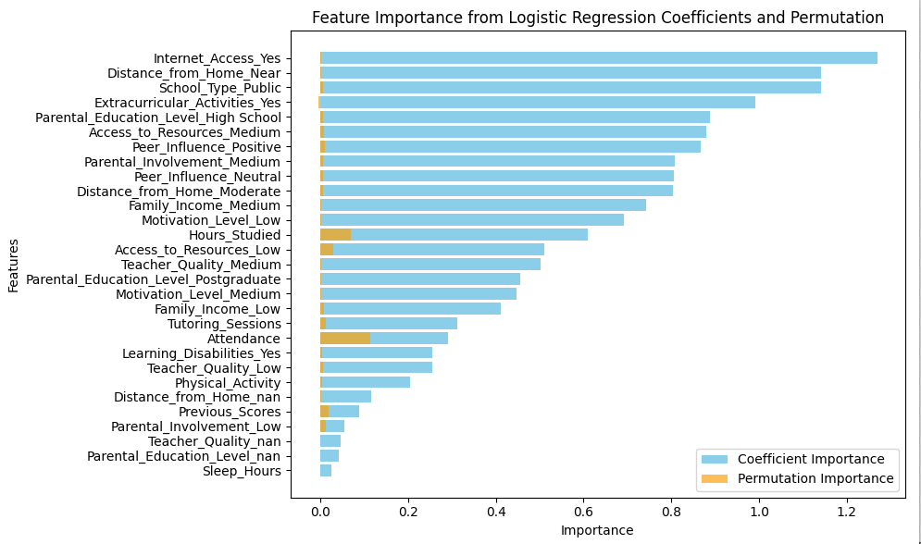
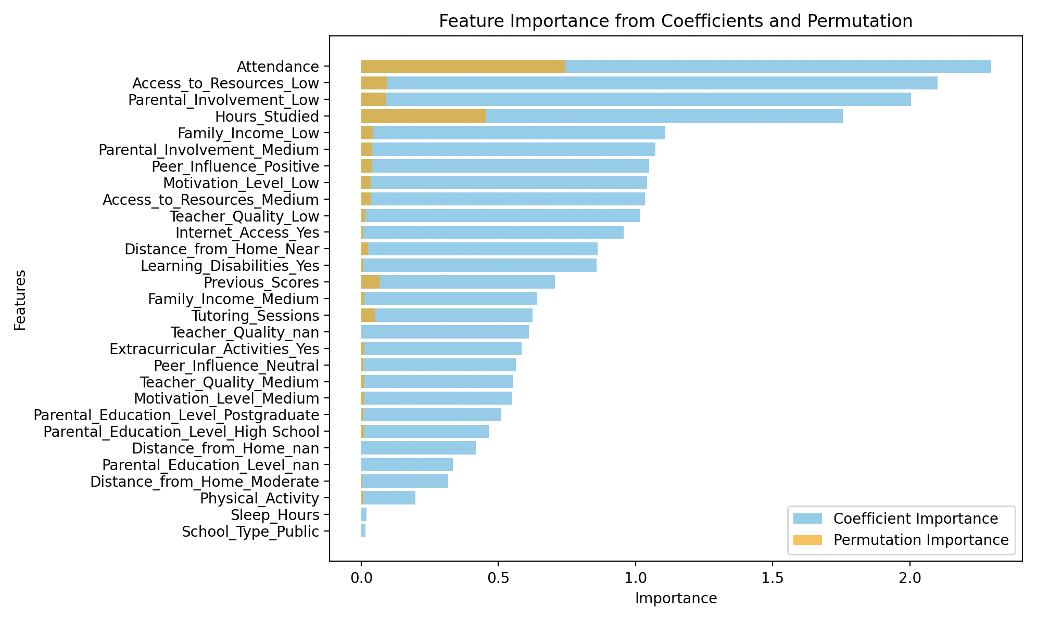
Most important feature

Slide 8
Reasoning
Logistic regression coefficients use the model's internal weights and assumes a linear relationship while permutation importance uses the actual impact on predictions
Logistic regression focuses on individual feature contributions while permutation importance considers the combined predictive value of features.
Logistic regression relies on feature scaling and can be affected by noise while permutation importance is model-agnostic measure of feature relevance.

Slide 9
Future Work
Gather more data and include geographical information such as state or city
Use tree-based algorithms like Random Forests and Gradient Boosting to get a more accurate best feature calculation
Try different encodings of the data to examine its effect on the algorithms.

Slide 10
Conclusions
Linear regression worked best for predicting student exam scores
Many factors impact student success, and the amount they study or attend class is not always the reason for their exam performance
When trying to improve education in this country, it is crucial that we focus on areas other than classroom content and attendance since societal conditions can greatly impact student success

