Slide 1
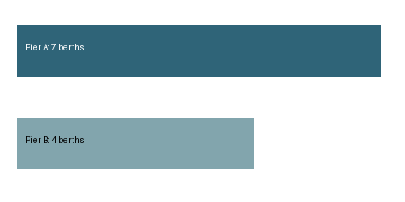
Dock review is pending.
Inspect pier A
before cargo arrival.
Display date: 14 October
Pier | Owner | State
A | Leena | Pending
Notes:
Notes only: Leena must confirm the crane by 14 October.

Slide 2

Dock review is pending.
Notes:
Do not treat a berth count as arrival authorization.

