Slide 1
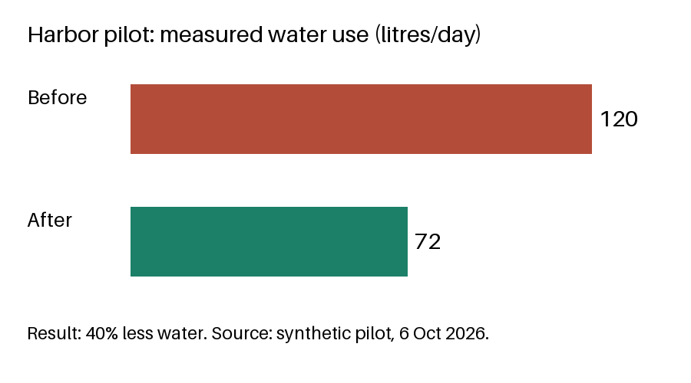
Harbor decision and dependencies
CRITICAL: installation may start only after valve inspection.
Notes:
Presenter note: ask Mira to book the inspection by 12 October.

Slide 2
Visual-only scheduling evidence: inspection capacity

