Slide 1

Efficacy of Motivational Interviewing in Weight Loss
Eric Robbins
Family Medicine Clerkship

Slide 2
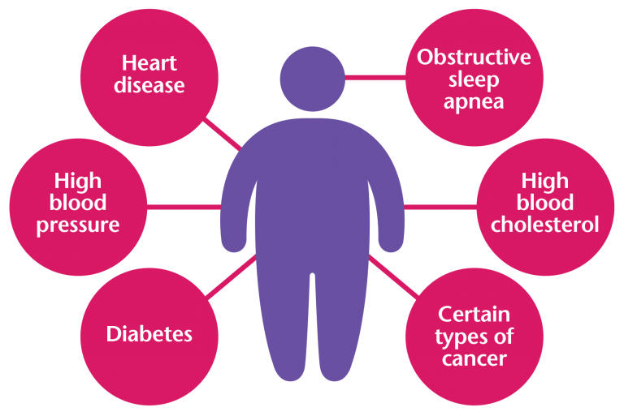
47 y/o M w/ hx of HTN, HLD, and pre-diabetes and BMI of 40
Costs
What should we do?
Why MI?
Fast, cheap, scalable
Image courtesy of https://esmmweighless.com/preventable-cost-obesity/
Notes:
$147–$210 billion per year
Increased job absenteeism
ER costs for patients with chest pain: 41% higher [3]

Slide 3
What is Motivational Interview?
Stages of Change
Open-ended Questions
RULE mnemonic
Collaboration
Notes:
RULE: resist telling them what to do, understand their motivations, listen with empathy, empower them

Slide 4
PICO Question
P: Patients 18–65 y/o with a BMI>=25 in the primary care setting
I: Motivational interviewing by a clinician (MD, NP, RN, etc.)
C: Typical behavioral interventions (brief advice, Nutritionist referral, CBT, group therapy, etc.)
O: Weight loss >=5% at >=3 months follow up or weight loss associated with a clinically significant outcome (decreased BP, cholesterol, HbA1c, etc.)

Slide 5




The Process
MeSH terms “Motivational Interviewing”
and “Weight Loss” Articles
Types :: Systematic Reviews, Meta-Analysis, RCTs
“motivational interviewing”
AND “weight loss”
Topic :: Obesity in Adults
“motivational interviewing”

Slide 6
The Findings – Sources
Systematic Reviews / Meta-Analyses
Armstrong et al. (2011)
12 RCTs, 11 in meta-analysis. 1,448 participants
Barnes and Ivezaj (2015)
24 RCTs, 0 in meta-analysis. Unknown participants
Individual RCTs
Multiple individual RCTs, ranging from small (80 participants) to larger (523 participants)
No Cochrane Reviews specific to MI and weight loss

Slide 7
The Findings – Conclusions
Systematic Reviews / Meta-Analyses
Armstrong et al. (2011)
Weight: -1.47 kg [95% CI -2.05, -0.88])
BMI: -0.25 kg/m2 (95% CI -0.50, 0.01).
Barnes and Ivezaj (2015)
~1/2 of studies showed 6% to 35.7% of pts lost >=5% of initial body weight
Individual RCTs
-1.34 kg at 6 months, non-significant at 24 months
3.3% weight loss, -4 mmHg decrease of SBP
-19.6 in TC, -13.78 in LDL. Comparing MI to “standard practice” in Spain
HbA1c 9.8% (MI) vs. 10.8% (UC) in weight-control program

Slide 8
The Findings – Caveats
Significant heterogeneity
P:
Sex/age range of participants
limited evidence for non-White patients
I:
Few studies discussed the “how” of MI training
Some studies did or did not include: group interventions, multiple MI sessions, frequent follow-ups, dietary protocols, etc.
C:
No universal comparator (brief advice, attention control, CBT, group programs, etc.)
O:
Follow-up times (3 to 60+ months)

Slide 9
Strength of Recommendation
Systematic Reviews and/or Meta-Analysis
MI seems to help or, at worst, make no difference in weight loss
Weight loss most significant when used in conjunction with other programing
DynaMed Plus
Level 2 [mid-level] evidence: behavioral interventions associated with small reduction in body weight in adults with overweight and obesity
AACE/ACE grade A, Best evidence level 1: include behavioral interventions (including MI) to enhance adherence to diet and exercise
based on RCTs or Meta-Analyses

Slide 10
Recs. for Clinical Practice
Motivational Interviewing can (probably) work!
One part of the toolkit
Regardless of pursued method, ensure frequent follow-up

Slide 11
References
Tremmel M, Gerdtham U-G, Nilsson P, Saha S. Economic Burden of Obesity: A Systematic Literature Review. International Journal of Environmental Research and Public Health [Internet]. 2017 Apr 19;14(4):435. Available from: http://dx.doi.org/10.3390/ijerph14040435
Peitz GW, Troyer J, Jones AE, Shapiro NI, Nelson RD, Hernandez J, et al. Association of Body Mass Index With Increased Cost of Care and Length of Stay for Emergency Department Patients With Chest Pain and Dyspnea. Circulation: Cardiovascular Quality and Outcomes [Internet]. 2014 Mar;7(2):292–8. Available from: http://dx.doi.org/10.1161/CIRCOUTCOMES.113.000702
Armstrong et al. (2011) Motivational interviewing to improve weight loss in overweight and/or obese patients: a systematic review and meta-analysis of randomized controlled trials. International Association for the Study of Obesity, 12, 709-723 doi: 10.111/j.1467-789X2011.00892.x
Barnes RD, Ivezaj V. A systematic review of motivational interviewing for weight loss among adults in primary care. Obesity Reviews [Internet]. 2015 Mar 5;16(4):304–18. Available from: http://dx.doi.org/10.1111/obr.12264

