Slide 1

Cracking GRE
Quant session 1

Slide 2
A little about me
BUET ME 13 Graduated in 2018
IBA MBA 61D
Bangladesh Mathematical Olympiad
Ministry of Primary and Mass Education
CVC Finance Limited

Slide 3
Overview of GRE Quant
Overview of Cracking GRE quant
How to proceed
Tips
Materials

Slide 4
Why focus on quant??
Isn’t this easy?
Overlooked quite often
Patterns changed
Difficulty level got harder
Longer Questions
Second order calculations
Powerpreps are not so relevant

Slide 5
Materials
Magoosh (Not FREE)
Greg Mat (FREE)
Manhattan 5 lb (For starters and for basics)
KMF (Mold tests)

Slide 6
GRE Quant
2 sets
1 additional set might be quant
35 minute for 20 question per set
No calculator
On screen calculator (Not so handy)

Slide 7
How to proceed?
Practice and practice
Note down where you made mistakes
Revise those from materials

Slide 8
How to proceed?
Note down which of the questions you did not understand
The English language is a barrier. Decoding the question, we are not used to this
Go back to the materials
DO NOT SKIP ANY TOPIC ( You must answer every question)
And there is a possibility that the topic may have more than one question

Slide 9
Tips
There is a backdoor (Example of Percentage problems)
ETS doesn’t want you to make long calculations
Efficient (Skip avoidable calculations) and effective (make an informed choice)
ALWAYS calculate for every problem, Write them down, DO NOT SKIP any steps

Slide 10
Pitfalls
Statistics
Mean, Median, Mode, Standard Deviations
Counting
Permutation and Combinations
Probability
Euclidian Geometry
Number Properties
Primes
Factors

Slide 11
For these sessions
Keep pen and paper ready
Do not skip any topic
And.. Ignore my handwriting :P

Slide 12
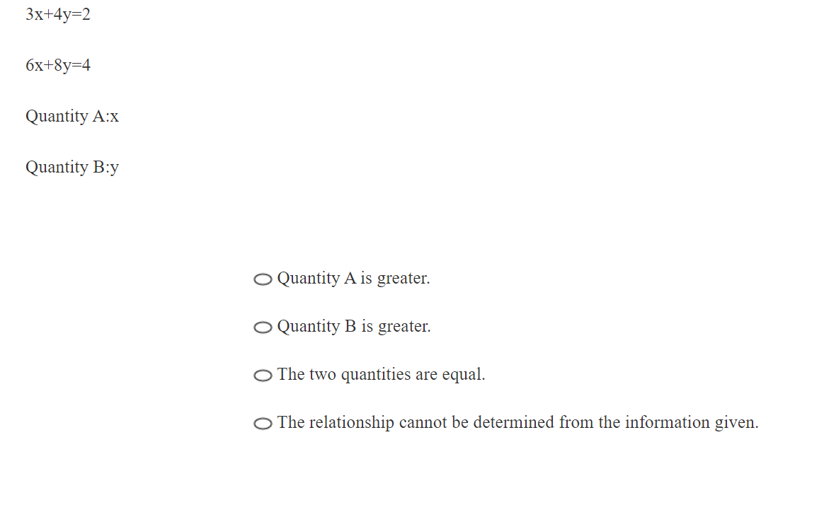

Slide 13
Number Properties
Can be easy but very tricky.
From three to five questions per set.
Basic
Divisibility
Prime Numbers
Factor, Prime Power Factor
Remainder
Consecutive Numbers
Odd even

Slide 14
Things that must be kept in mind
Integers can be positive or negative
Zero is not positive, it is non-negative
If the question does not specify what kind of number (i.e. integer, non-negative), then for that instance, every sort of number must be considered (i.e., decimals in the defined region, negative numbers)
DO NOT FORGET DECIMALS

Slide 15
If x is a non-zero integer and 0<y<1, which of the following must be greater than 1?
x
x/y
xy²
x²y
x²/y

Slide 16
15<x<30
15<y<30
15<z<30
Quantity A: The range of the three Number x, y and z
Quantity B: 15

Slide 17
x and y are integers and xy<0.
Quantity A: x^{y}
Quantity B: 0

Slide 18
Divisibility
Divisible by 2,3,4,5
Pair of divisor
Factorize 64

Slide 19
Prime Numbers and Prime Power Factorization
1 is not prime
Prime factor
Find the divisor
Column A Column B
The number of distinct The number of distinct
Prime factors of 20⁶ Prime factors of 32¹⁰

Slide 20
What is the greatest integer value of n such that 2^{n} is a factor of 200⁶ ?

Slide 21
M is a positive two-digit number. When the digits are reversed, the number is N. If K = M + N, which of the following is true? A. K must be even B. K cannot be square C. K cannot be divisible by 13 D. K must be divisible by 11 E. If M is even then K must be even

Slide 22
When positive integer N is divided by 167, the remainder is 35, and when positive integer K is 167, the remainder is 17. What is the remainder when 2N+K is divided by 167?

Slide 23
Count the divisors
16000 has how many positive divisors?

Slide 24
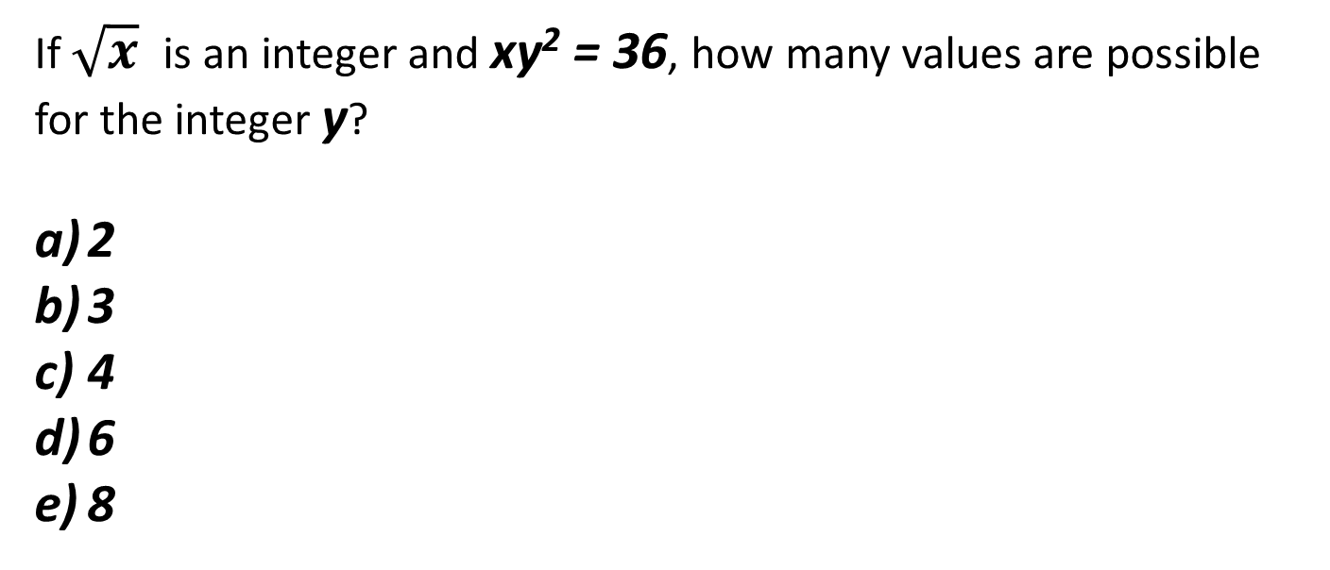
If $\sqrt{x}$is an integer and xy² = 36, how many values are possible for the integer y?
2
3
4
6
8

Slide 25
Divisors
m is the least positive integer for which 18m can be expressed as the square of an integer.
n is the least positive integer for which 9n can be expressed as the square of an integer.
Quantity A: m
Quantity B: n

Slide 26
m and n are positive integers.
n and n+2 are factors of m
Quantity A: m/n
Quantity B: n+2

Slide 27
Odd even
Sign of O/E
Multiplication division of O/E
Consider the possibilities

Slide 28
w, x, y, and z are consecutive odd integers such that w<x<y<z. Which of the following statements must be true?
Indicate all such statements.
a. wxyz is odd
b. w+x+y+z is odd
c. w+z=x+y

Slide 29
abcd is even and positive, and abc is odd and positive
Quantity A Quantity B
1 d

Slide 30
If x and y are integers, w=x²y+x+3y, which of the following statements must be true?
Indicate all such statements.
If w is even, then x must be even
If x is odd, then w must be odd
If y is odd, then w must be odd
If w is odd, then x must be odd

Slide 31
Consecutive number
Divisibility
Odd even
n(n+1)(n+2)
(n-1)n(n+1)
n^3-n

Slide 32
If n is the smallest of three consecutive positive integers, which of the following must be true?
n is divisible by 3
n is even
n is odd
n(n+2) even
n(n+1)(n+2) is divisible by 3

Slide 33
Remainder
Quantity A Quantity B
The remainder when
10¹¹ is divided by 2
The remainder when
10¹¹ is divided by 2
The remainder when
3¹³ is divided by 2

Slide 34
If K is the least positive integer that is divisible by every integer from 1 to 8 inclusive, then K=

Slide 35
N is a positive integer, and K is the product of all integers from 1 to n inclusive. If K is a multiple of 1440, then the smallest possible value of N is:

Slide 36
Last digit
What is the unit digit of 7⁹⁴?

Slide 37
WORD PROBLEMS

Slide 38
At a local election there were two propositions on the ballot, R and S. Twice as many voters voted "yes" for R as for S. If the number who voted "yes" for R but "no" for S was 750 and the number who voted "yes" for S but "no" for R was 310, how many voted "yes" for both propositions?
122
127
130
135
140

Slide 39
30 iPods were up for sale at the local electronic store. The store owner sold the first 20 iPods for at least $17 and the next 9 iPods for at least $21. If the owner made $600 in revenue, then what is the maximum price of the last iPod?

Slide 40
When Joan Defaw sold her her stock for $800 she makes a c% loss. When She sold her stock for $1200 she made c% profit. What is the value of c?
4
5
10
20
25

