Slide 1
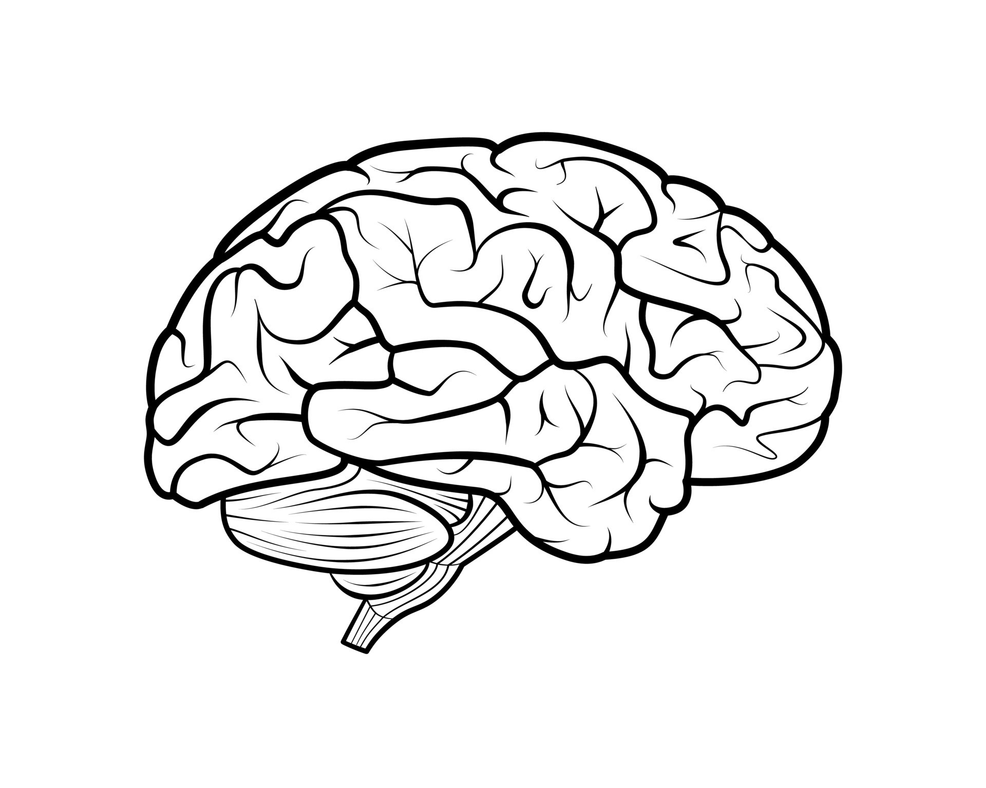
DQN: Theory to Scratch
Kyoungin Baik
RLLAB

Slide 2
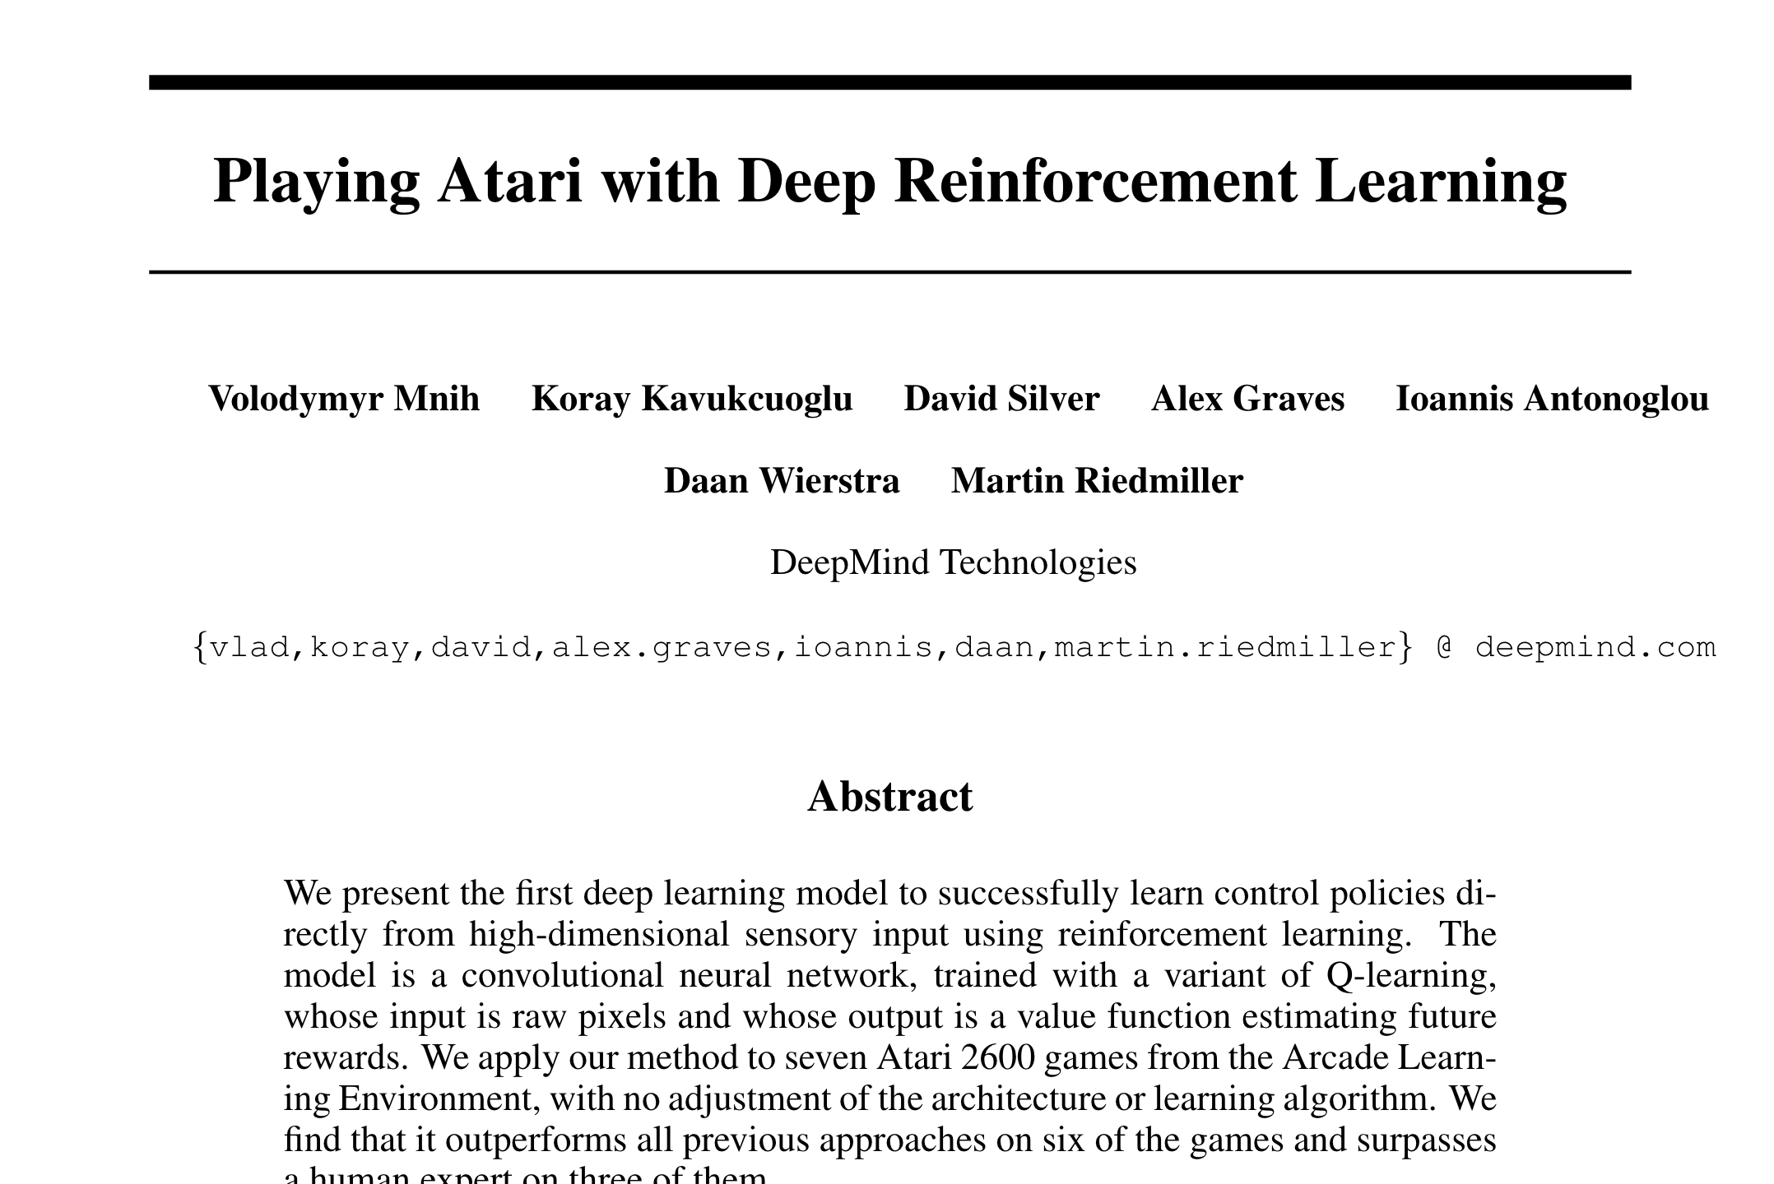
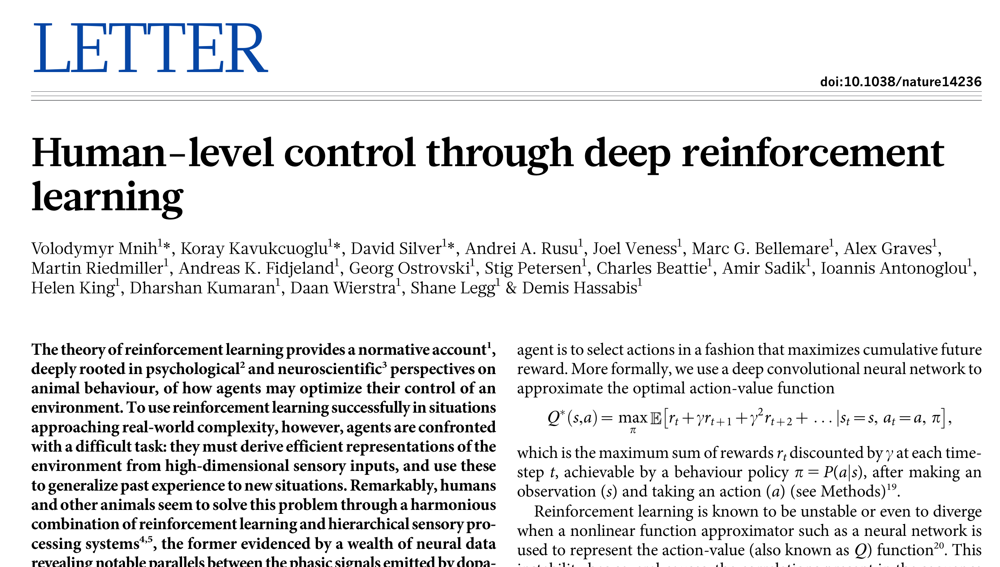
Deep Q-Network (DQN)

Slide 3
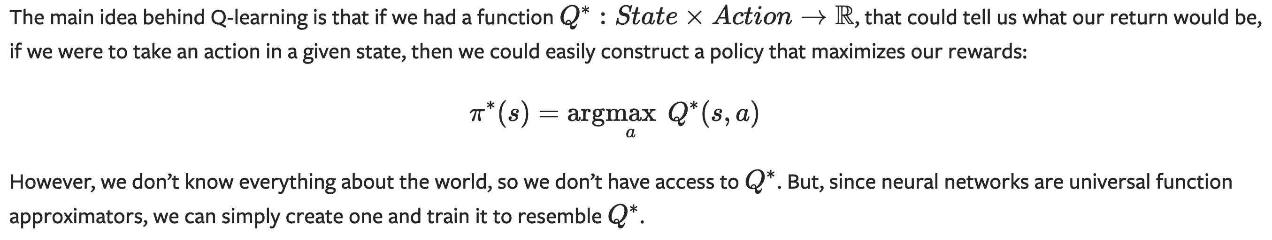
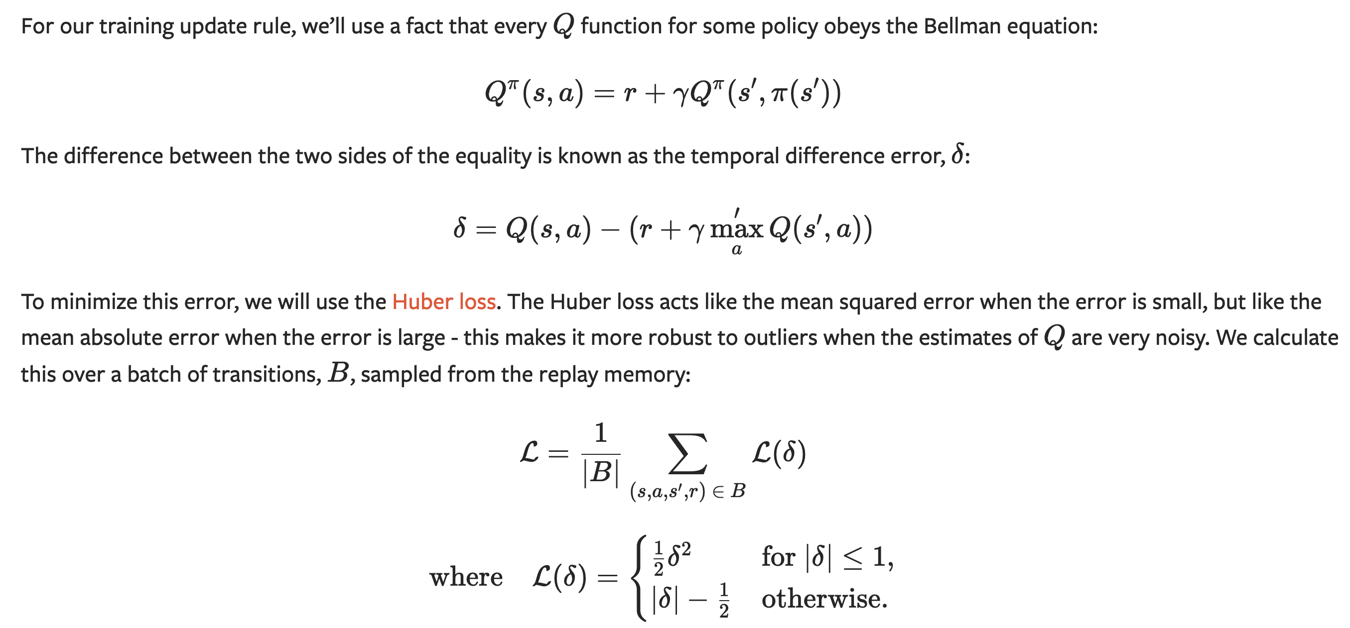
Deep Q-Network (DQN)

Slide 4
Deep Q-Network (DQN)
Problem formulation:
Reinforcement Learning presents several challenges from a deep learning perspective
Issue 1: Most deep learning applications require large amounts of labelled training data
Issue 2: Most deep learning algorithm assume the data samples to be i.i.d
Issue 3: Distribution shift
Notes:
+ Issue1 : RL algorithms, on the other hand, must be able to learn from a scaler reward signal that is frequently sparse, noisy and delayed.
+ Issue2 : while in RL one typically encounters sequences of highly correlated states
+ Issue3 : Problematic for deep learning methods that assume a fixed underlying distribution

Slide 5
Deep Q-Network (DQN)
Related Research:
TD-gammon
Application is limited
Combining model-free RL with non-linear function approximators, or indeed with off-policy learning could cause the Q-network to diverge.
Deep learning RL until now,,,
Converge when evaluating a fixed policy with a nonlinear function approximator
Learning control policy with linear function approximation using a restricted variant of Q-learning
Neural Fitted Q-learning (NFQ): batch update, not end-to-end
Not yet been extended to nonlinear control…
Notes:
+ Application : Same method to chess, Go and checkers were less successful. Led to widespread belief that the TD-gammon approach was a special case that only worked in backgammon. (because the stochasticity in the dice roll helps explore the state space and also makes the value function particularly smooth)
+ NFQ : NFQ optimizes the sequence of loss function in equation 2, using the RPROP algorithm to update th e parameters of the Q-network

Slide 6
Deep Q-Network (DQN)
Goal:
Create a single neural network agent
learning directly on RGB images using SGD
able to successfully learn to play as many of the games as possible
Notes:
+ Goal : network was not provided with any game-specific information or hand-designed visual features, and was not privy to the internal state of the emulator: it learned from nothing but the video input, the reward and terminal signals, and the set of possible actions

Slide 7

Deep Q-Network (DQN)
Approach:
Use an experience replay mechanism (Randomization over data)
Removing correlations in the observation sequence
Smoothing over changes in the data distribution
Utilizing Bellman’s equation to Q-Network (variant of the Q-learning algorithm, w/ SGD to update weights)
$Q^{∗}\left(s, a\right)= 𝔼_{s^{′}\sim ℇ}[r+γ\max_{a′}{Q^{∗}\left(s^{′},a^{′}\right)| s, a}]$
$L_{i}\left(θ_{i}\right)=𝔼_{s, a\sim ρ(∙)}[\left(yi−Q\left(s,a;θi\right)\right)2]$ (y_{i} = Q*(s,a) is the target for iteration i, $ρ$(s,a) : behavior distribution)
Adjust Q towards target values that are only periodically updated, thereby reducing correlations with the target
Familiar to Q-learning Algorithm
Model-free ( solves RL task directly using samples from the emulator, without explicitly constructing an estimate of it)
Off-policy
Greedy strategy on behavior distribution
CNN to learn successful control policies from raw video data in complex RL environments
Notes:
+ Utilizing : iteration method is totally impractical, because the action-value function is estimated separately for each sequence, without any generalization. Instead, it is common to use a function approximator to estimate the action

Slide 8
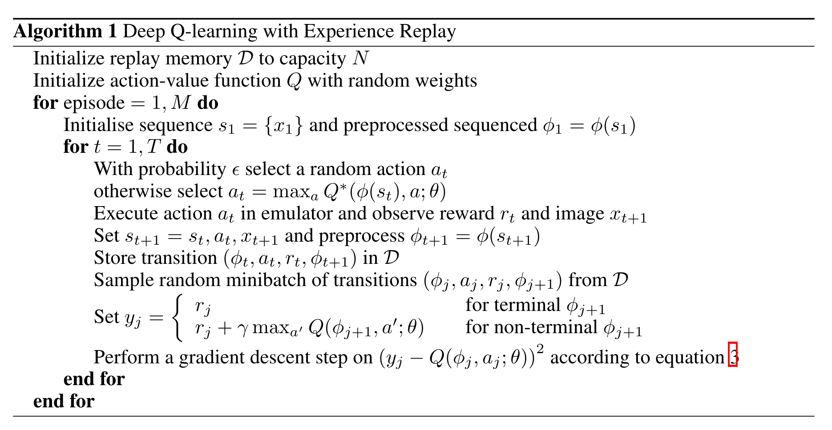

Deep Q-Network (DQN)
Algorithm:
+ Basic preprocessing
(reducing the input dimensionality)
210 x 160 pixel images w/ 128 color palette,
84 x 84 x4 image produced by $φ$
image with 110 x 84
gray-scale (from RGB)
+ Model Architecture
Separate forward pass for each action
→ Input unit: state representation
output unit: each possible action, corresponding to the predicted Q-values of the individual action for the input state
Notes:
+ Model Architecture :is required to compute the Q-value of each action, resulting in a cost that scales linearly with the number of actions
Main advantage of this architecture is the ability to compute Q-values for all possible action in a given state with only a single forward pass through the network
+ We now describe the exact architecture used for all seven Atari games. The input to the neural network consists is an 84 × 84 × 4 image produced by φ. The first hidden layer convolves 16 8 × 8 filters with stride 4 with the input image and applies a rectifier nonlinearity [10, 18]. The second hidden layer convolves 32 4 × 4 filters with stride 2, again followed by a rectifier nonlinearity. The final hidden layer is fully-connected and consists of 256 rectifier units. The output layer is a fullyconnected linear layer with a single output for each valid action. The number of valid actions varied between 4 and 18 on the games we considered. We refer to convolutional networks trained with our approach as Deep Q-Networks (DQN).

Slide 9
Deep Q-Network (DQN)
Contribution:
Each step of experience is potentially used in many weight updates, which allows for greater data efficiency
With Experience replay (randomizing the samples from replay buffer) breaks correlations between consecutive samples and therefore reduces the variance of the updates
When learning by experience replay, it is necessary to learn off-policy making it capable to average over many of its previous states, smoothing out learning and avoiding oscillations or divergence in the parameters.
→ Successful Deep RL algorithm for diverse application.
Notes:
+ Application : Same method to chess, Go and checkers were less successful. Led to widespread belief that the TD-gammon approach was a special case that only worked in backgammon. (because the stochasticity in the dice roll helps explore the state space and also makes the value function particularly smooth)
+ NFQ : NFQ optimizes the sequence of loss function in equation 2, using the RPROP algorithm to update th e parameters of the Q-network

Slide 10

Deep Q-Network (DQN)
Sell this paper
Agent only observes images of the current screen and $r_{t}$(game score)
Without,
Emulator’s internal state
Direct feedback from actions
POMDP
Assumption
(standard) Emulator will terminate in a finite number of time-steps (finite MDP)
(standard) Future reward are discounted by a factor of $γ$ per time-step

Slide 11
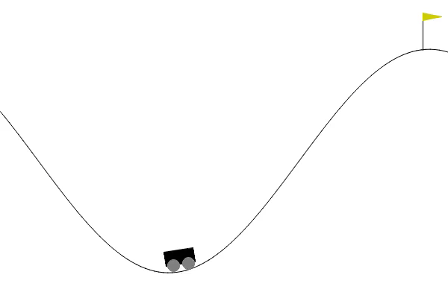
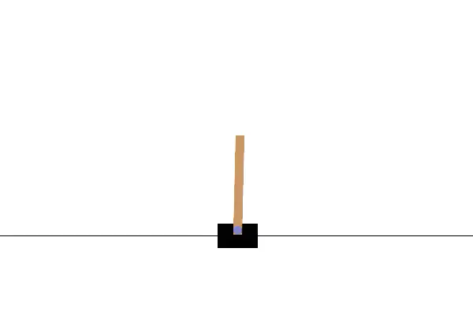
Deep Q-Network (DQN)
Experiments:
https://github.com/exaFLOPs26/Scratch/tree/main/DQN

