Slide 1
presentation
Muhammad fathir van rizky

Slide 2
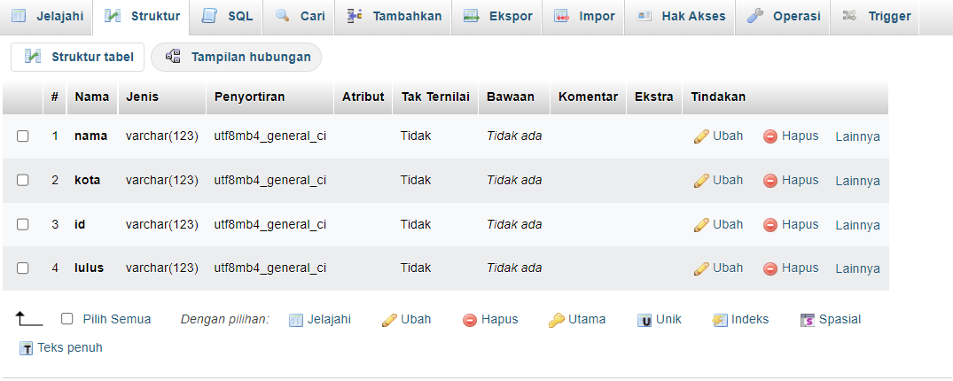
STRUCTURE TABLE

Slide 3
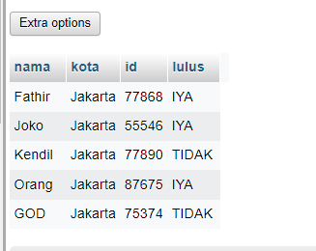
DATA

Slide 4
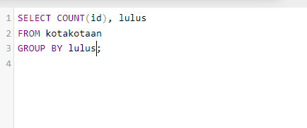
SQL

Slide 5
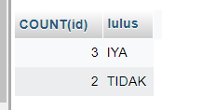
hasil

