Slide 1

CAREFLOW PRETRIAGE
Cutting Hospital Waiting Time Before Patients Reach the Triage Desk
A digital pre-triage system for emergency departments — built for hackathon validation, designed for real hospital scale.

Slide 2
STATISTICS
The Waiting-Room Crisis Is Measurable — and Worsening
4+ hrs
70%
Average ED Wait
Non-Emergency Visits
In many public hospitals across Uganda and Sub-Saharan Africa
Mis-prioritized during peak hours, crowding out critical cases
1 in 8
40%
Preventable Outcomes
ED Overcrowding Rise
Adverse events linked to delayed triage globally
Increase since 2020 across health systems worldwide
Triage nurses often manage 1 nurse : 20+ patients during surges. Every minute of delay for stroke, sepsis, or trauma reduces survival odds. Staff burnout and "left without being seen" rates continue to climb.

Slide 3
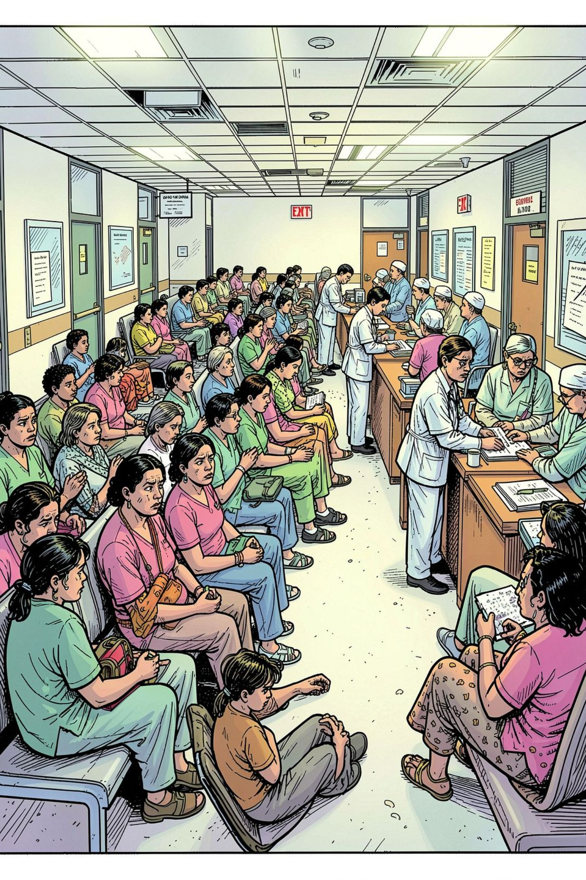

PROBLEM STATEMENT
Manual Triage Creates a Bottleneck at the Front Door of Care
No Prioritization at Entry
Patients queue at registration before any clinical assessment — critical cases wait behind stable patients because acuity is unknown upfront.
Paper-Based, Slow Intake
Paper forms and verbal intake delay the first clinical touchpoint, compounding wait times at every step.
Staff Can't Scale with Volume
Hospitals cannot hire triage staff fast enough to match patient volume, leaving no real-time visibility on incoming acuity mix.
Core pain: Time-to-triage — not time-to-treatment — is where lives and throughput are lost.

Slide 4
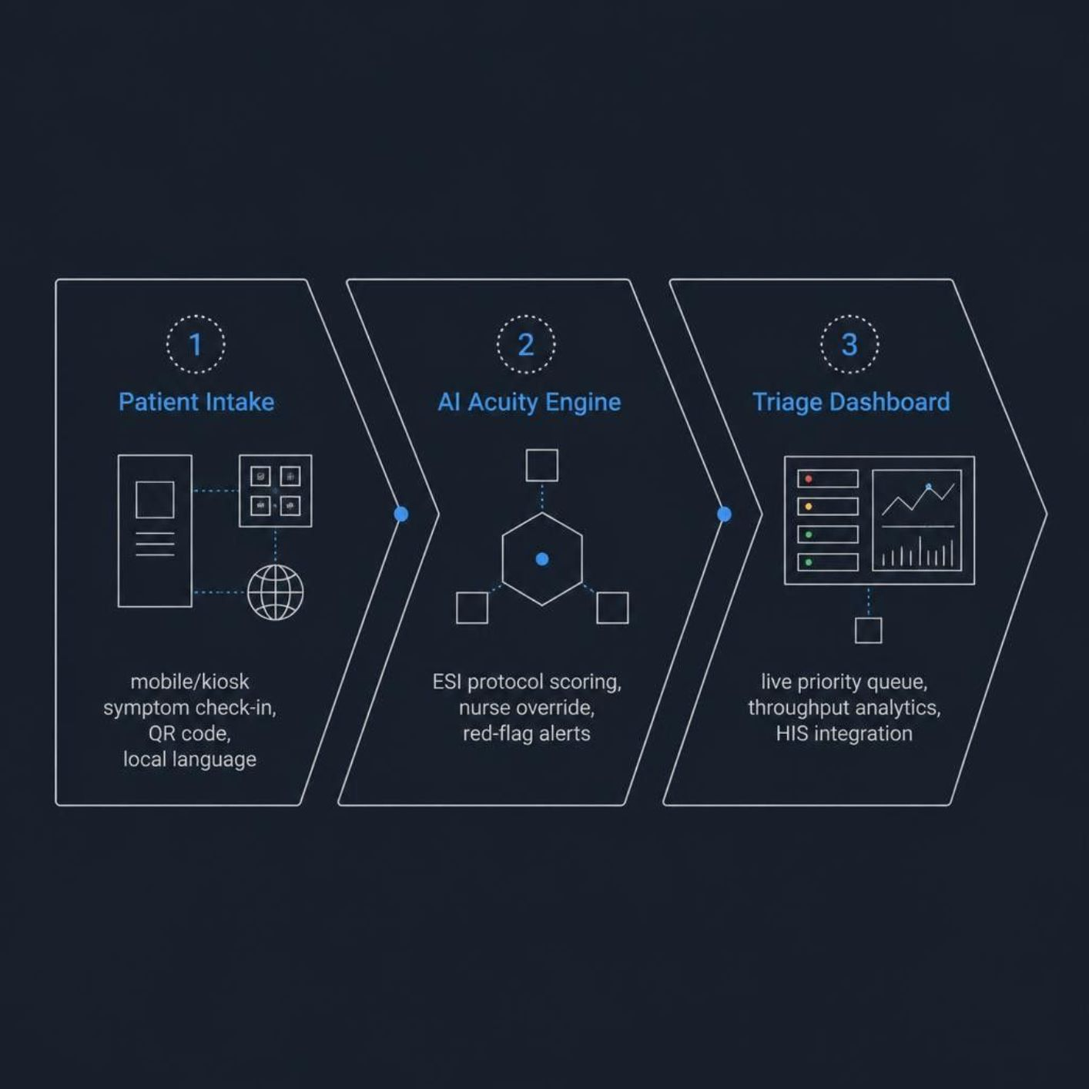
SOLUTION
CareFlow PreTriage — Intake and Prioritization Before the Triage Desk
Patient-Facing
Mobile/kiosk symptom intake in local language
Guided questions aligned to ESI & local protocols
QR check-in at entrance or pre-arrival link
Clinical Workflow
AI-assisted acuity scoring with nurse override
Live priority queue fed to triage dashboard
Alerts for red-flag symptoms (chest pain, sepsis)
Hospital Ops
Throughput analytics & peak-hour forecasting
Integrates with existing HIS via HL7 FHIR APIs
Deployable on tablets — no new hardware

Slide 5

VALUE PROPOSITION
Faster Care for the Sickest Patients — Without Adding Headcount
30–50% Faster
Reduction in time-to-triage for high-acuity cases (pilot target)
2× Throughput
Triage capacity during peak surges with the same staff
< 4 Weeks
Pilot deployment vs. 12–18 months for legacy ED systems
Low CAPEX
Runs on phones & tablets hospitals already own
Consistent, protocol-driven prioritization reduces bias and error. Nurses focus on clinical confirmation — not repetitive data collection. Leadership gains live visibility to redeploy staff before queues break.

Slide 6
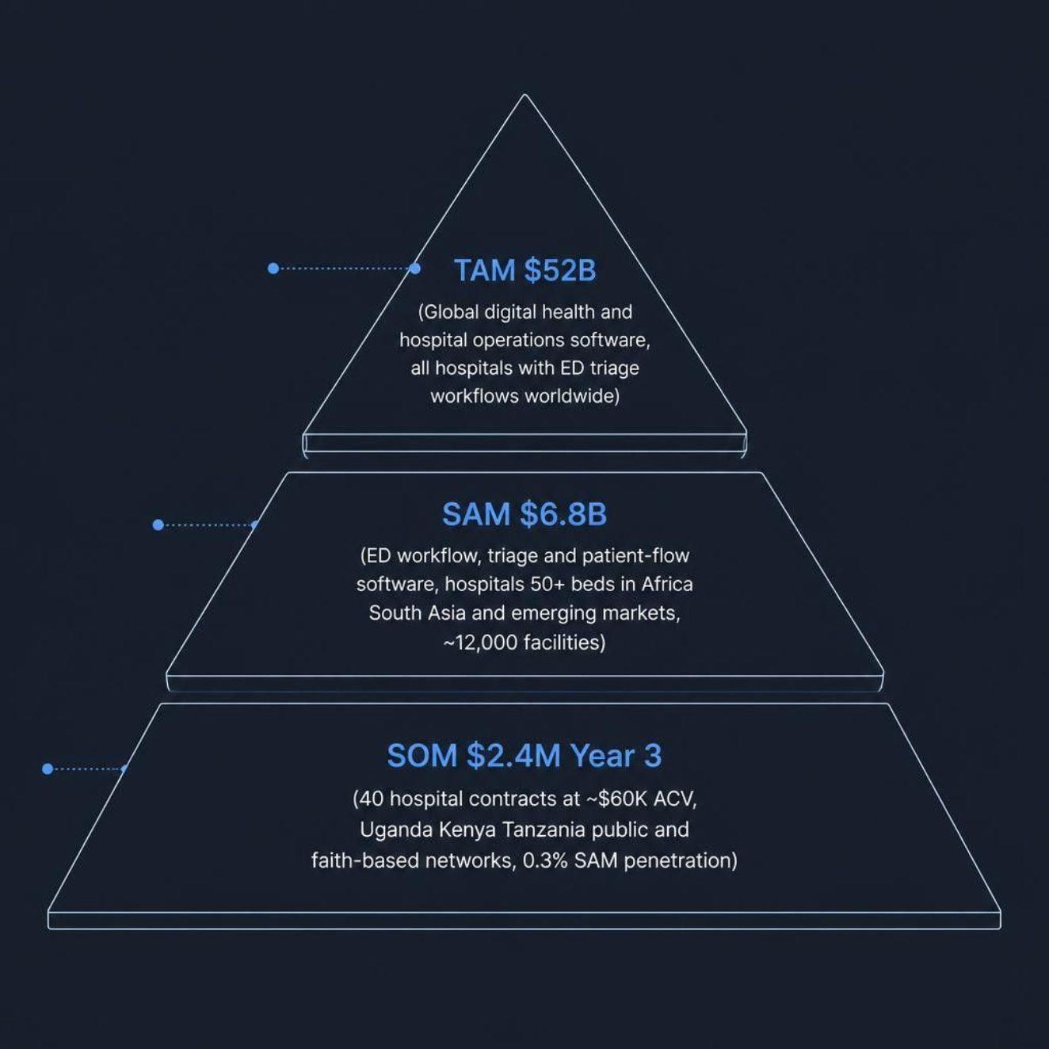

MARKET SIZE
A Large Global Market, Focused Initial Beachhead
TAM — $52B
Global digital health & hospital operations software (2026) — all hospitals with ED or outpatient triage workflows worldwide.
SAM — $6.8B
ED workflow, triage & patient-flow software for hospitals 50+ beds in Africa, South Asia & emerging markets (~12,000 addressable facilities).
SOM — $2.4M (Year 3)
40 hospital contracts at ~$60K avg. ACV across Uganda, Kenya & Tanzania public and faith-based networks — conservative 0.3% SAM penetration.
Beachhead: East African public referral hospitals — high volume, acute wait-time pain, willing pilot partners.

Slide 7
MARKET STRATEGY
Land with Pilots, Expand Through Trust and Integration
Phase 1 · 0–6 Months
Phase 3 · 18–36 Months
Hackathon MVP → single-hospital pilot with MOH or referral hospital partner
Regional expansion via faith-based & private hospital groups across East Africa
1
2
3
Phase 2 · 6–18 Months
3–5 hospital network rollout; publish outcomes on wait time, LWBS, and acuity accuracy
Integrate, Don't Replace
Clinical Champions
Clear Regulatory Path
Connect with incumbent HIS vendors (OpenMRS, local EMR) — sell workflow enhancement, not rip-and-replace.
Head nurses & ED medical officers serve as internal advocates to drive adoption.
Classify as clinical decision support (CDS), not autonomous diagnosis.

Slide 8
BUSINESS MODEL
Recurring SaaS with Services — Aligned to Hospital Budgets
Revenue Streams
Unit Economics (Target)
Core SaaS: $4,000–$8,000/month per facility (tiered by bed count & volume)
Implementation & training: $5,000–$15,000 one-time
Analytics+ module: $1,500/month (forecasting, benchmarking)
Per-encounter fee: $0.50–$1.00 for high-volume sites
Gross margin: 75%+ (cloud-hosted, minimal field hardware)
CAC payback: < 12 months via pilot-to-contract conversion
LTV / CAC target: 4× with 3-year average contract length
First pilot: Discounted or free to prove ROI metrics

Slide 9


IMPACT
Better Outcomes, Equitable Access, Scalable for Underserved Systems
10K+
Patient-Hours Saved
Per hospital annually (projected)
↓ LWBS
Fewer Left Without Being Seen
Critical cases — stroke, obstetric emergency, trauma — reach clinicians faster
Equity
SDG 3 Alignment
Same protocol-driven prioritization for every patient, regardless of queue position or background.
Direct contribution to universal health coverage goals — designed for public hospitals that cannot afford enterprise ED suites.
Open Architecture
Adaptable to local languages, clinical guidelines, and reduced staff burnout through smarter queue management.
Impact thesis: Every minute saved in pre-triage is a minute gained for saving lives.

Slide 10

THE ASK
From Hackathon Prototype to Hospital-Grade Patient Flow
We are seeking a pilot hospital partner and seed support to validate a 30% time-to-triage reduction in 90 days.
Our Team
Our Ask
Clinical and engineering backgrounds with deep health systems expertise in emerging markets.
1 referral hospital pilot · $150K seed funding · 90-day outcome study with published results
Get in Touch
· Live demo available today

