Slide 1
Notes:
30K feet view

Slide 2
Notes:
30K feet view

Slide 3
Notes:
30K feet view

Slide 4

Init record
Verify token exists
Insert record
Delete token
Delete record
Notes:
30K feet view

Slide 5
Notes:
30K feet view

Slide 6
Notes:
30K feet view

Slide 7
Store messages
Create tokens
Send messages
Notes:
30K feet view

Slide 8
Notes:
30K feet view

Slide 9
Create record
Load record
Store messages
Verify token exists
Create tokens
Update record
Checkpoint
Delete token
Send messages
Delete record
Notes:
30K feet view

Slide 10
Notes:
30K feet view

Slide 11
*
Notes:
30K feet view

Slide 12
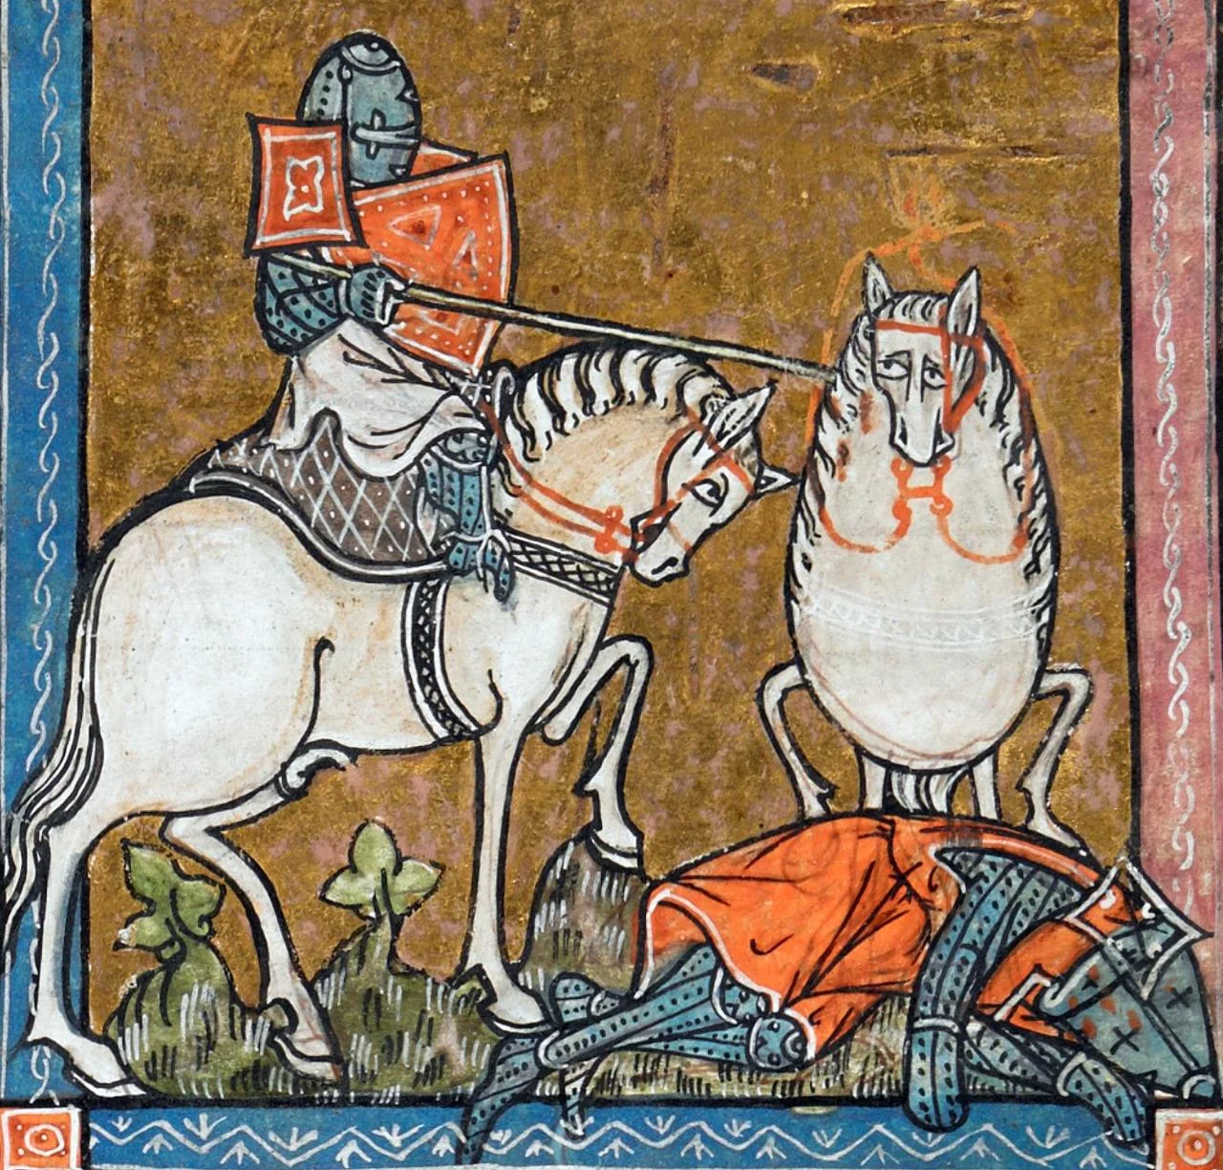
Another story?

Slide 13




Slide 14


Slide 15



Slide 16


Slide 17


Slide 19


Slide 21
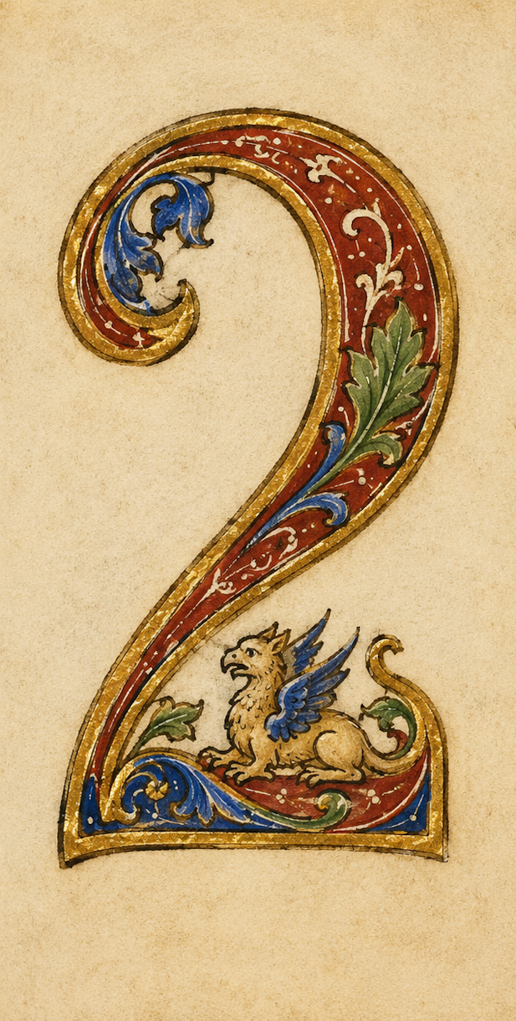

Slide 35
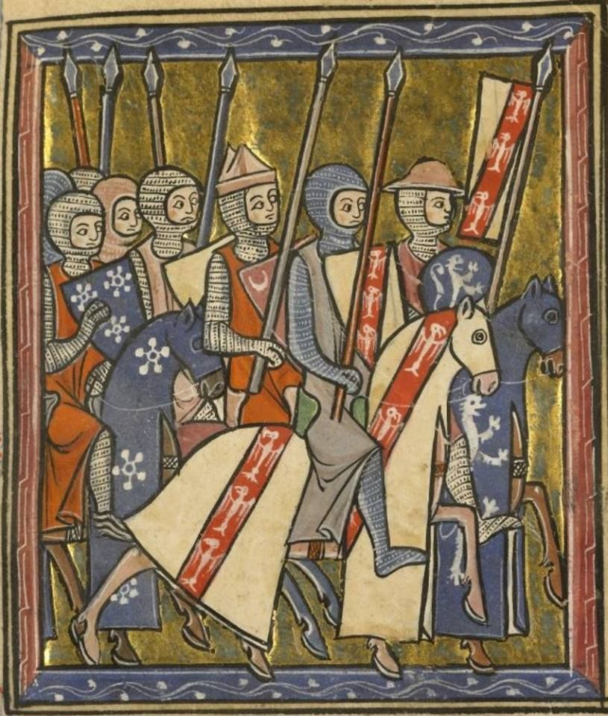
Nay!

