Slide 1
Workflow-based MOCU Implementation using RADICAL Cybertools

Slide 2
MOCU Code Analysis and Configuration
Call Graph of MOCU Code
Input Parameters of MOCU Code
n_theta: changeable
n_psi: changeable
n_mc: no smaller than 2*n_s
n_s: changeable
n_experiment: keep it fixed at 32
n_oed: the same as the number of tasks
oed_type: “mocu” or “random”
Output Files of MOCU Code
3 numpy arrays (.npy)
1 matplotlib graph (.png)
main()
Save numpy arrays and draw plots
compute_oed_error_stats()
Call select_experiment() n_oed times in a for loop
select_experiment()
MOCU calculation

Slide 3
Parallelization of MOCU Code
Stage 1 is followed by Stage 2
Call Graph of MOCU Code
main()
Save numpy arrays and draw plots
Stage 2 (one task): Collect Ji.npy generated by each task in Stage 1, aggregate them, and output the final numpy arrays and plot
compute_oed_error_stats()
Call select_experiment() n_oed times in a for loop
Stage 1 (n_oed tasks): Each call of select_experiment() is handled by one RCT EnTK task, and runs in parallel
select_experiment()
MOCU calculation
unmodified

Slide 4
Workflow Code Structure
[litan@login4.summit MOCU]$ python mocu_entk.py -n 1312 -t 256 -p 256 -s 64
initialization()
for i in range(n_oed)
task_s1[i] = entk.Task()
task_s1[i].exec = ‘mocu_stage1.py’
Stage 1
task_s2 = entk.Task()
task_s2.exec = ‘mocu_stage2.py’
Stage 2
request_resource()
workflow_run()

Slide 5
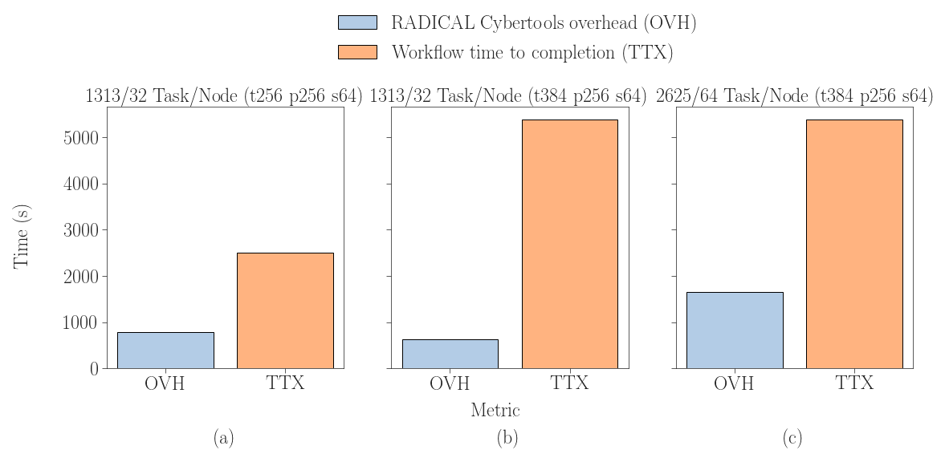
Workflow Performance Evaluation at Scale

Slide 6
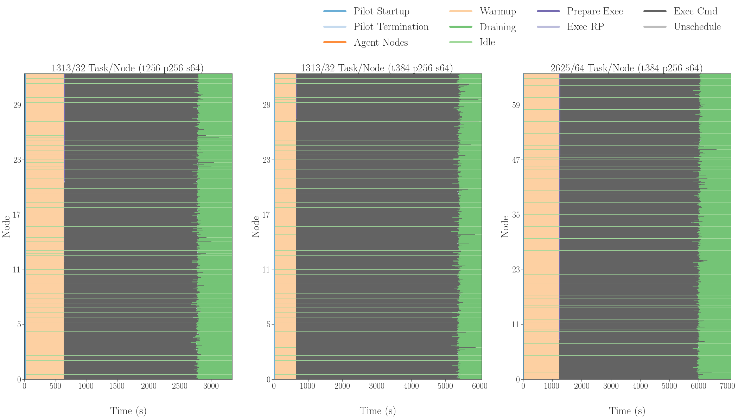
Workflow Performance Evaluation at Scale (Cont'd)

