Slide 1
Workflow-based MOCU Implementation using RADICAL Cybertools

Slide 2
Content
Overview of RADICAL Cybertools
MOCU Code Analysis and HPC Implementation
(Anthony’s Graphical Model)
MOCU Code Analysis and HPC Implementation
(Byung-Jun’s Kuramoto Model)
Discussion

Slide 3
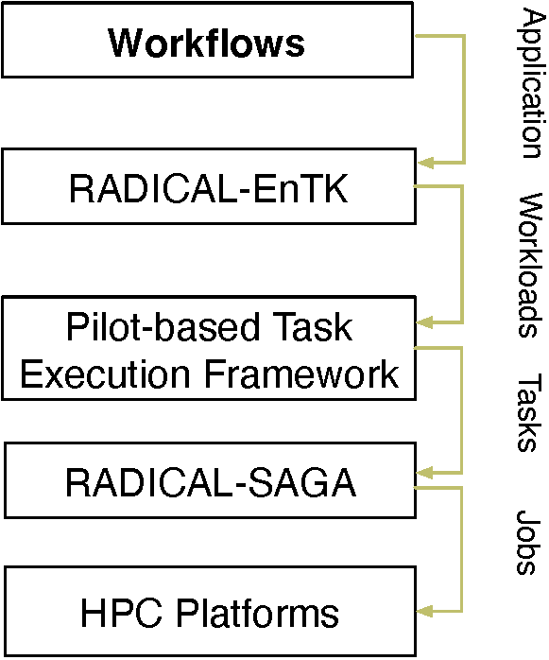
RADICAL Cybertools *
A suite of software systems developed to support the execution of workflows and workloads on HPC infrastructures
Three major components: RADICAL-SAGA, RADICAL-Pilot, and RADICAL Ensemble Toolkit (EnTK) [ task -> stage -> pipeline -> workflow ]
Widely used to support scientific code execution on leadership-class computing facility, e.g., Summit at ORNL, Frontera at TACC
* https://radical-cybertools.github.io/

Slide 4
MOCU* Code Analysis and Configuration
Call Graph of MOCU Code (Anthony)
Input Parameters of MOCU Code
n_theta: changeable
n_psi: changeable
n_mc: no smaller than 2*n_s
n_s: changeable
n_experiment: keep it fixed at 32
n_oed: the same as the number of tasks
oed_type: MOCU or random
Output Files of MOCU Code
3 Python numpy arrays (.npy)
1 matplotlib graph (.png)
main()
Save numpy arrays and draw plots
compute_oed_error_stats()
Call select_experiment() n_oed times in a for loop
select_experiment()
MOCU calculation
* MOCU: Mean Objective Cost of Uncertainty

Slide 5
Workflow Transformation of MOCU Code
Stage 1 is followed by Stage 2
Call Graph of MOCU Code (Anthony)
main()
Save numpy arrays and draw plots
Stage 2 (one task): Collect Ji.npy generated by each task in Stage 1, aggregate them, and output the final numpy arrays and plot
compute_oed_error_stats()
Call select_experiment() n_oed times in a for loop
Stage 1 (n_oed tasks): Each call of select_experiment() is handled by one RCT EnTK task, and runs in parallel
select_experiment()
MOCU calculation
unmodified

Slide 6
Workflow Code Structure
[litan@login4.summit MOCU]$ python mocu_entk.py -n 1312 -t 256 -p 256 -s 64
initialization()
for i in range(n_oed)
task_s1[i] = entk.Task()
task_s1[i].exec = ‘mocu_stage1.py’
Stage 1
task_s2 = entk.Task()
task_s2.exec = ‘mocu_stage2.py’
Stage 2
request_resource()
workflow_run()

Slide 7
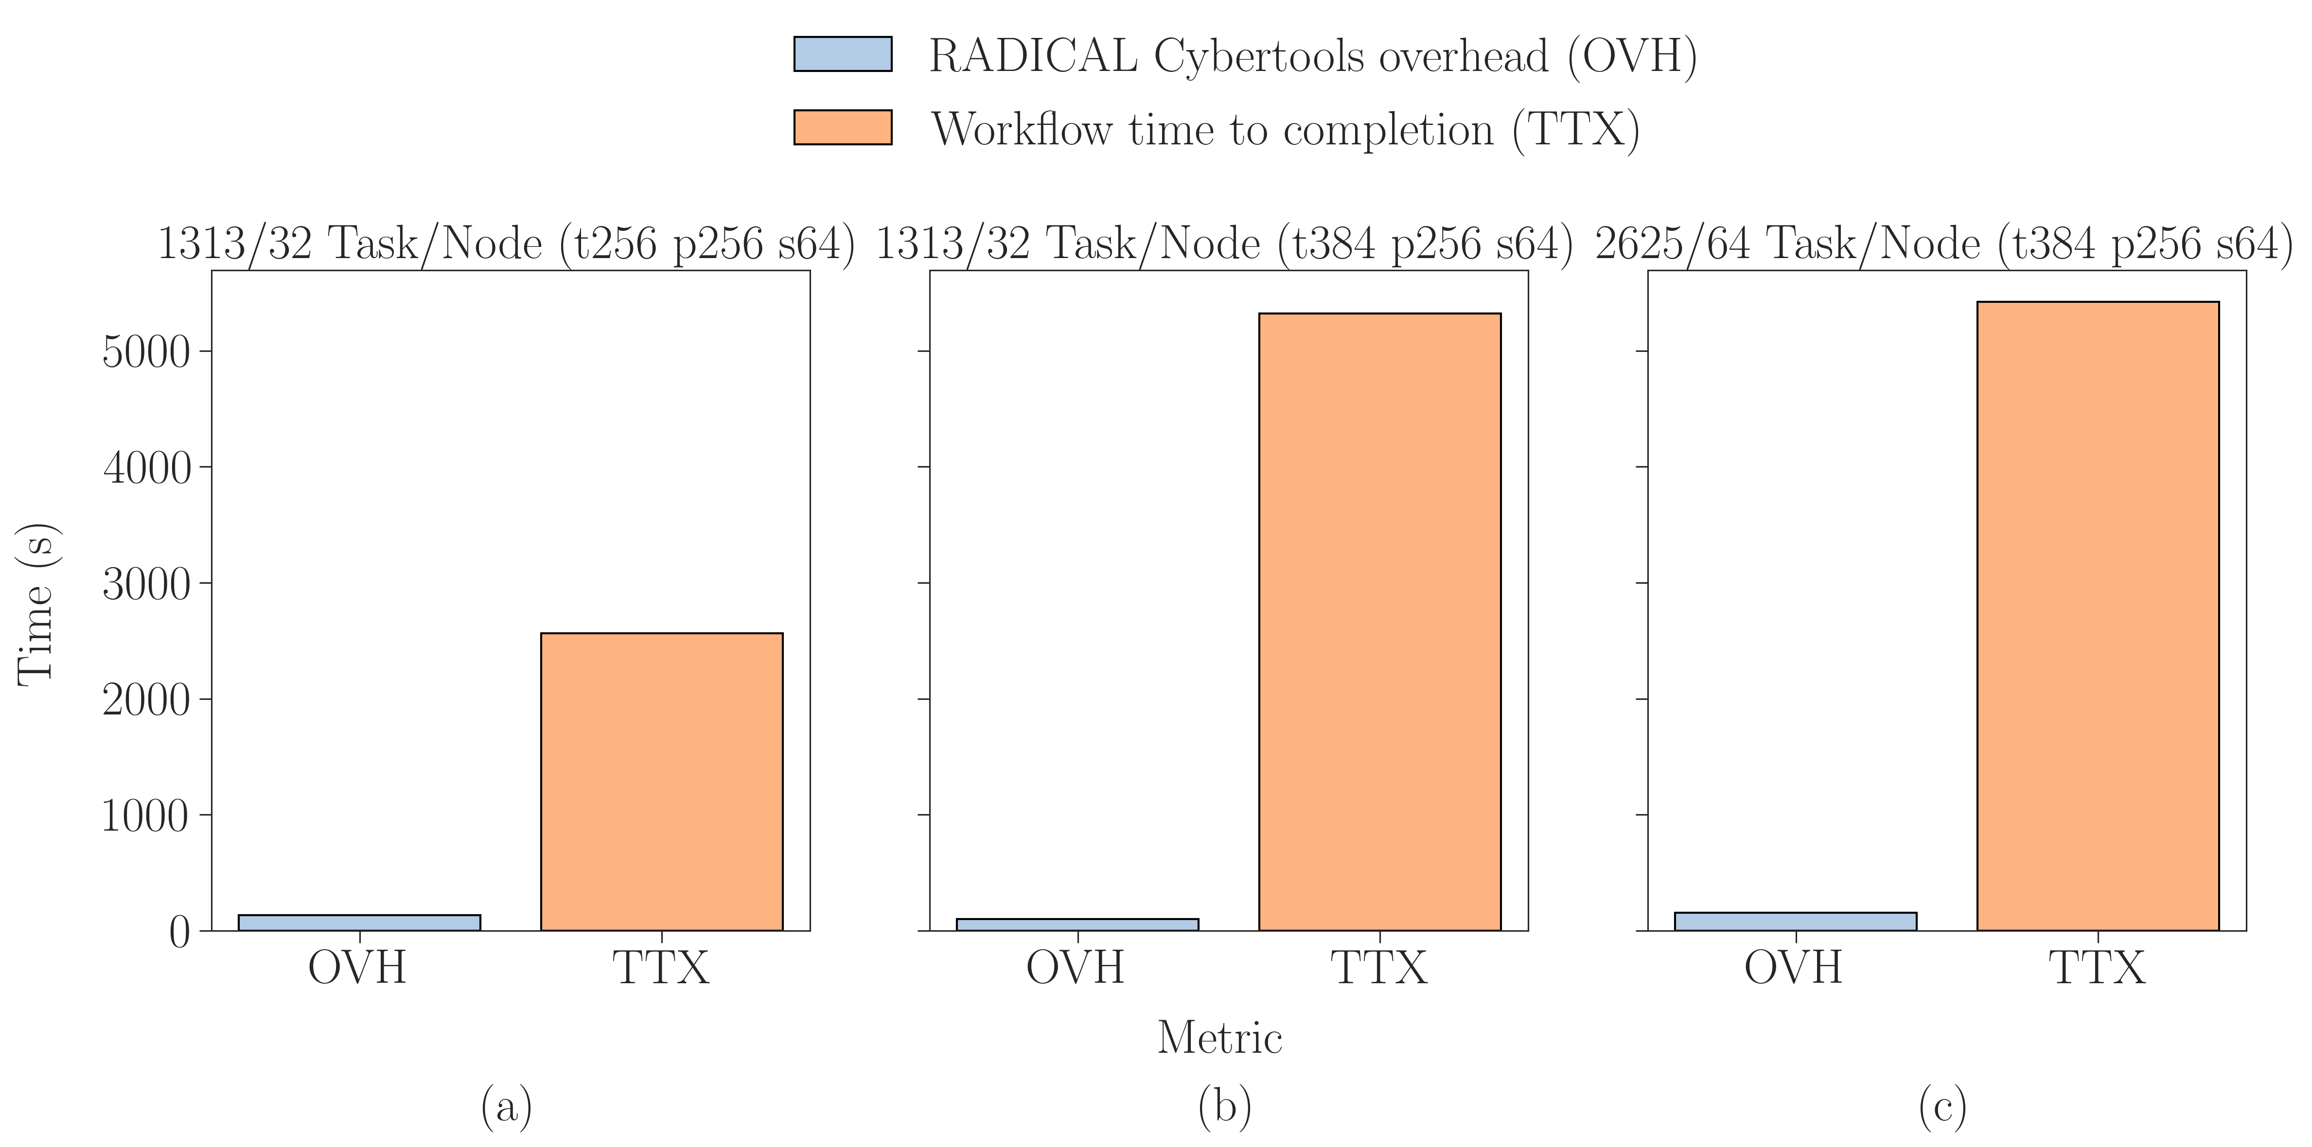
Workflow Performance Evaluation at Scale

Slide 8
Workflow Performance Evaluation at Scale (Cont'd)

Slide 9
MOCU Code Analysis and Configuration
Call Graph of MOCU Code (Byung-Jun)
Input Parameters of MOCU Code
N: number of oscillators, changeable
K_max: sample size, changeable
M: time steps, fixed at 640
w: upper/lower bound, empirical values
oed_type: MOCU, Entropy, or random
Output Files of MOCU Code
1 MOCU matrix (Python 2D numpy array)
1 MOCU sequence (Python numpy array)
main()
Initialize MOCU matrix and sequence
Compute MOCU matrix by solving OED with N oscillators and sample size K_max in a nested for loop
MOCU()
find_MOCU_seq()
Compute MOCU sequence using the MOCU matrix

Slide 10
Status Quo of HPC Implementation
Call Graph of MOCU Code (Byung-Jun)
Sequentially call MOCU() and find_MOCU_seq()
main()
Initialize MOCU matrix and sequence
Called N*(N-1) times, parallelized by PyCUDA on one single GPU
Compute MOCU matrix by solving OED with N oscillators and sample size K_max in a nested for loop
MOCU()
Dependency 1: MOCU matrix (resolved using EnTK stages)
Dependency 2: cross-iteration
find_MOCU_seq()
Compute MOCU sequence using the MOCU matrix

Slide 11
Discussion
Anthony’s Case
May consider thread-level parallelism (4 hardware threads/core)
Byung-Jun’s Case (work-in-progress)
Multiple OED runs as Anthony’s code to enable parallelism overall
Potential replicas on multiple GPU to enable parallelism on GPU
Breaking iteration-wise dependency to enable parallelism on CPU

