Slide 1

Ionized
Kinetic E
Nonionized

Slide 2



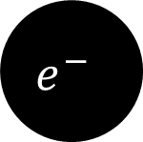
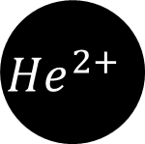

Ionized
Ionized
$$α$$
$$β$$
$$γ$$
$${He}^{2+}$$
$$e^{−}$$
$$γ$$
Concrete
Paper
Aluminum

Slide 3
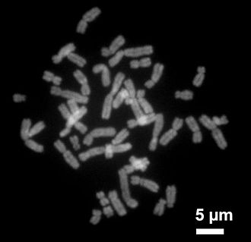
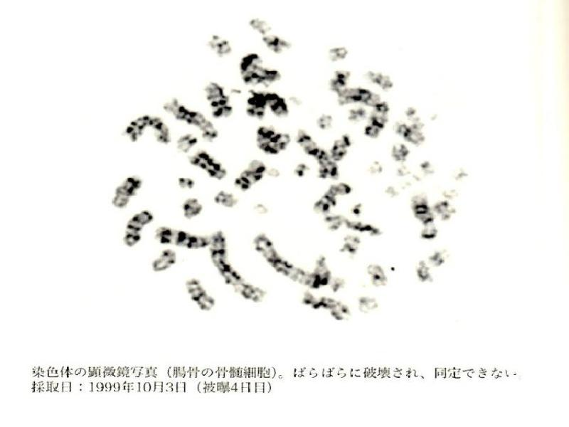


$$γ$$
$$γ$$
Electromagnetic Wave

Slide 4













$$Na$$
$${Na}^{24}$$
$$Na$$
$${Na}^{24}$$
$$Sr$$
$$Sr$$
$$I$$
$$Cs$$
$$I$$
$$Cs$$

Slide 5
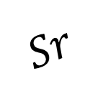




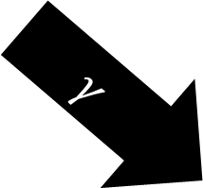



$$e^{−}$$
$$Cs$$
$$Cs$$
$$Sr$$
$$Sr$$
$${He}^{2+}$$
$$I$$
$$I$$
$$γ$$

Slide 6

Kinetic Energy
Cure
Cancer
Cancer
DNA
DNA
Ribosomes
Ribosoems
Enzymes
Enzymes

Slide 7
1
1
Kinetic Energy
AIDS
White Blood Cell
Lymph

Slide 8
2
2
Old
New
Dermis

Slide 9

3
3
No Food
No digestion
Multiple Organ Failure
Multiple Organ Failure
On stomach and Duodenum
On stomach and Duodenum

Slide 10
End
End
Death By
Multiple Organ Failure
Multiple Organ Failure
Heart Attack
Heart Attack

Slide 11
Reference
Reference
https://ko.wikipedia.org/wiki/%EC%97%BC%EC%83%89%EC%B2%B4
https://ko.wikipedia.org/wiki/%EB%8F%84%EC%B9%B4%EC%9D%B4_%EC%B4%8C_%EB%B0%A9%EC%82%AC%EB%8A%A5_%EB%88%84%EC%B6%9C_%EC%82%AC%EA%B3%A0
https://ko.wikipedia.org/wiki/%EA%B8%89%EC%84%B1%EB%B0%A9%EC%82%AC%EC%84%A0%EC%A6%9D%ED%9B%84%EA%B5%B0

Slide 12
Q&A

