Slide 1
Performance Visualization for Configurable Processors Based on Eclipse/CDT
Christopher Songer
Director of Platform Engineering

Slide 2
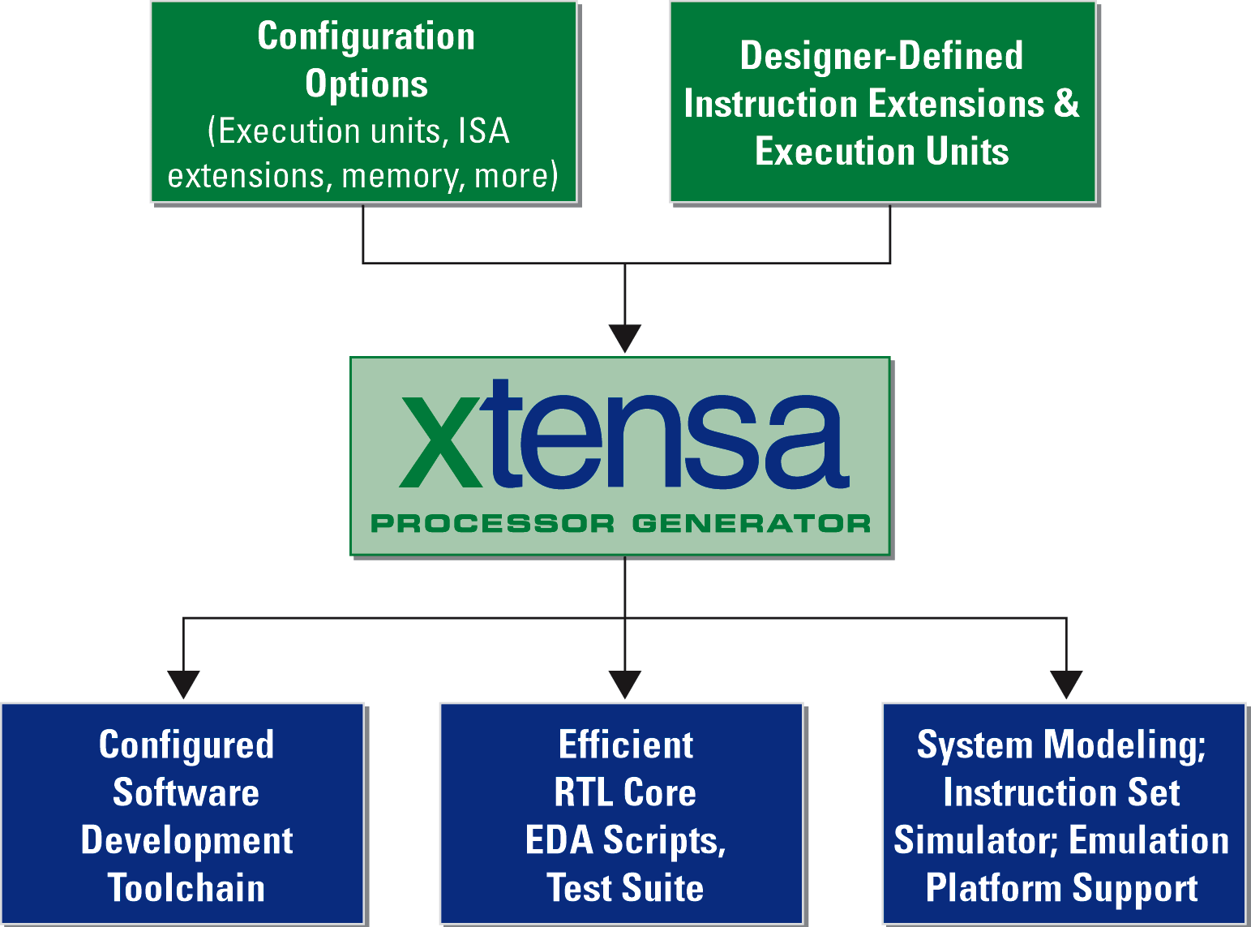
The Tensilica Solution

Slide 3

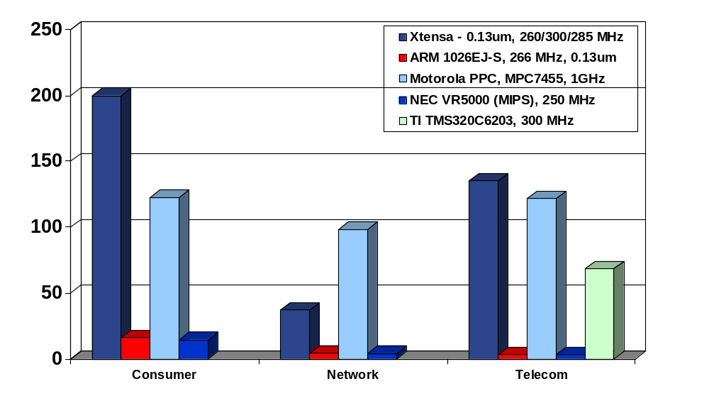

Xtensa Excels in EEMBC
Benchmarks
Single Xtensa Outperforms Even Most Full-Chip, 20W+ Processors
526
More than 2X Faster than Any Other recorded score for the Consumer Suite
Faster than hand-optimized assembly code on full-chip DSP
Benchmark Rating
GHz PowerPC consumes~100X power dissipation -v- Xtensa
NEC (MIPS)
Xtensa
PowerPC
NEC (MIPS)
ARM10
PowerPC
NEC (MIPS)
Xtensa
PowerPC
ARM10
ARM10
Xtensa
TI
Certified by
Tensilica Xtensa processor: simulated optimized scores
ARM: OutofBox Scores for ARM1020E architectural core; operating frequency per ARM1026EJ-S specification
Motorola: MPC7455 CPU, 1GHz Full chip device, 483pin CBGA, 21W power dissipation, Optimized: Network & Telecom; Consumer: OOB
TI: TMS320C6203, 300MHz Full chip DSP, optimized
NEC VR5000 full chip device, out-of-box scores
Competitive Data as of Aug. 7, 2002. Source: www.eembc.org

Slide 4

Xtensa Instruction Set Summary
80 base 24/16bit instructions
  Load and Store (8 instructions)
  Move (5 instructions)
  Shift (13 instructions)
  Arithmetic Operations (12 instructions)
  Logical Operations (AND, OR, XOR)
  Jump and Branch (29 instructions)
  Zero Overhead Loops (3 instructions) (Optional)
  Pipeline Control (7 instructions)
Windowed Registers
  10% code density

Slide 5
Smaller Code; Better Performance
xtensa
Xtensa code is comparable to ARM Thumb without mode switching or performance penalty
Performance (MIPS/MHz)
MIPS 32
ARM 32
MIPS 16
ARM Thumb
Code Density

Slide 6
S/W Development Tools are ‘In-sync’
Base Xtensa S/W toolset built on top of industry standard GNU tools
All tools automatically tuned and extended for application-specific instructions and configuration
Configuration manager
GNU C
Compiler
EGCS 1.0.3
GNU C/C++ Compiler
Assembler
Debugger
Linker
Code Profiler
Instruction Set Simulator
OSKit
Function Libraries
XCC
Compiler
GNU C++
Compiler
Assembler
Assembler
Runtime
libraries
OSKit
Linker
ISS
XTMP API
Debugger
Target
System
Hardware
Emulation
Board
Profiler
Profiler

Slide 7
TIE Compiler Automates Addition of New Instructions and Coprocessors
Tensilica Instructions Extension (TIE) Compiler:
  Input: Verilog and C describing custom functions
    Operand sources, logic/arithmetic functions, and destinations for results
  Output: Updated processor RTL and Software tools
    Updated compiler, assembler, debugger, simulator, and OSKit
Add new, customized, functionality fast:
  Arithmetic and logic functions
  Designer-defined Register Files
  128bit Load/Store Instructions
  New Data Types with automatic C/C++ Compiler Support
  Multi-Cycle Instructions
  Boolean registers

Slide 8
Simple TIE Example
opcode BYTESWAP op2=4'b0000 CUST0
iclass bs {BYTESWAP} {out arr,in ars}
semantic bs {BYTESWAP} {
assign arr = {ars[7:0],ars[15:8],
ars[23:16],ars[31:24]};
}
1
2
3
1
Instruction Coding
2
Inputs & Outputs
3
Functional description
subset of Verilog

Slide 9
Customizing Eclipse/CDT
“Easy Things”
  Compiler support
  Debugger support
“Hard Things”
  Build Model/Make Generation
  TIE Support
  Performance Visualization
  Hardware Centric Features

