Slide 1
An Extensible Open Source Platform for Anything and Nothing in Particular
Eclipse Community BOF at ESC San Francisco
Chris Laffra
IBM Ottawa Labs
Eclipse Overview
Sebastien Marineau
QNX Software Systems Ltd.
CDT Overview
Cory Bialowas
IBM Rational
CDT and IBM Rational Activities
Manas Saksena
Timesys
Embedded Linux IDE using Eclipse and CDT
Chris Songer
Tensilica
CDT Based Performance Viewing for Xtensa Processors
The Eclipse Project

Slide 2
Eclipse Overview
Eclipse Platform
Another
Tool
Java
Development
Tools
(JDT)
Workbench
Help
JFace
SWT
Team
Your
Tool
Plug-in
Development
Environment
(PDE)
Workspace
Debug
Platform Runtime
Their
Tool
Eclipse Project
Notes:
If you only get to show one slide, this is the one that best captures “The Big Picture”.

Slide 3
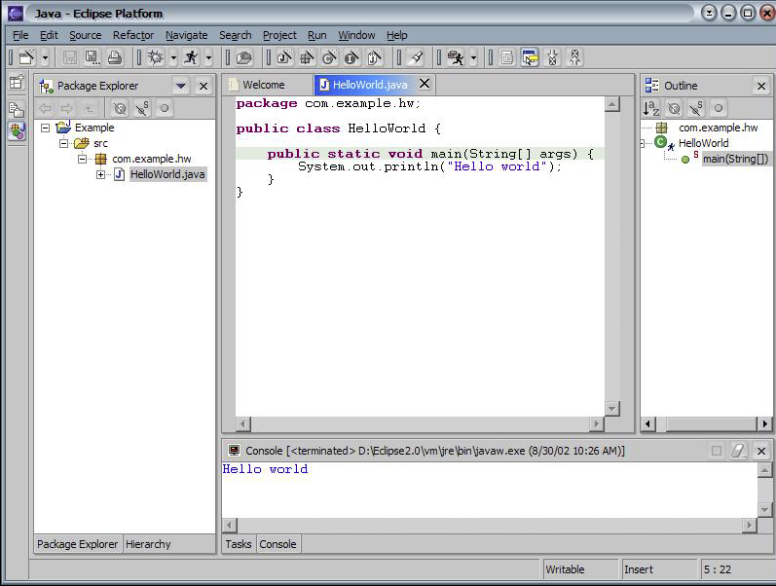
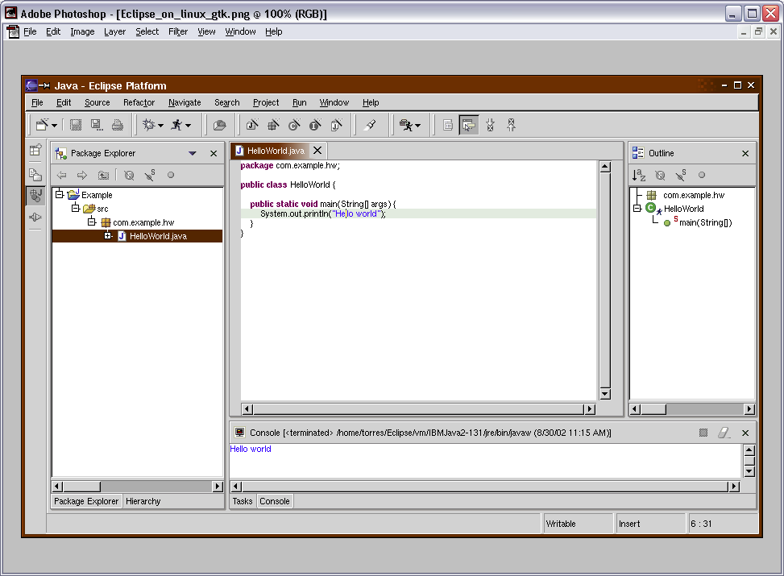
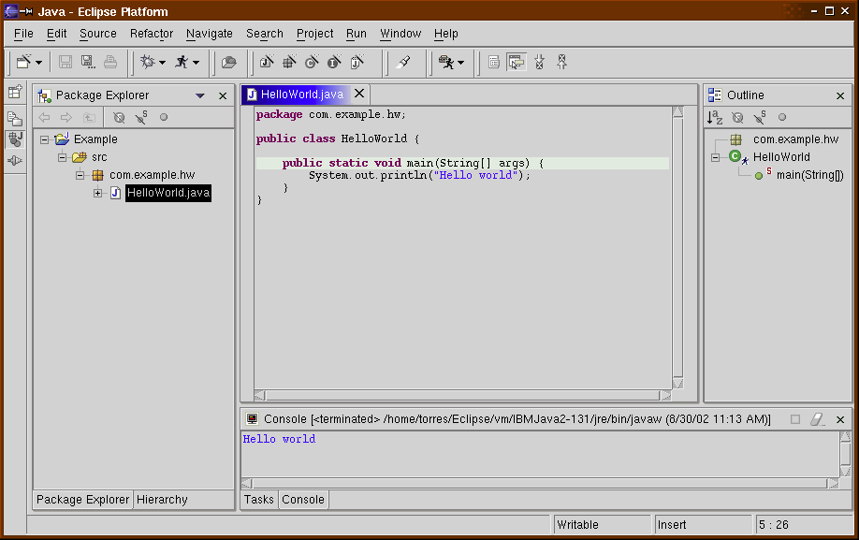
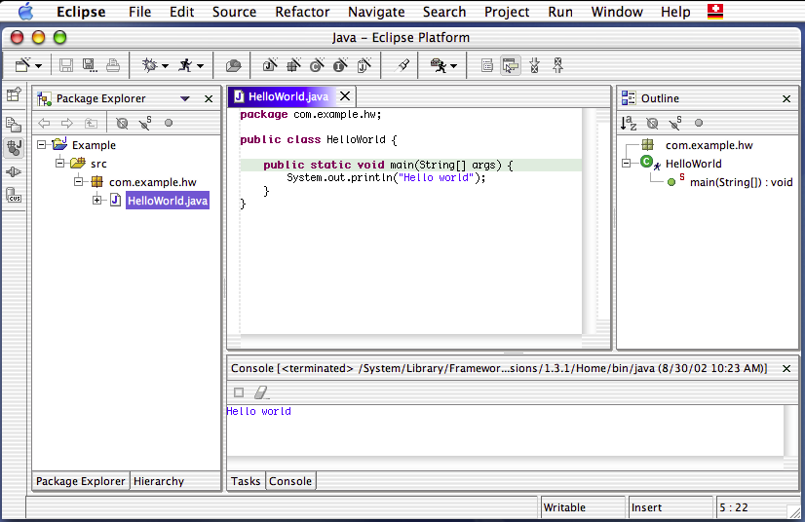
SWT
Windows XP
Linux GTK
SWT
Motif
MacOS X
Notes:
How small? SWT is about 200 classes, with a 200 KB native library.
By comparison, AWT/Swing is about 1000 classes, with a 1 MB native library.

Slide 4
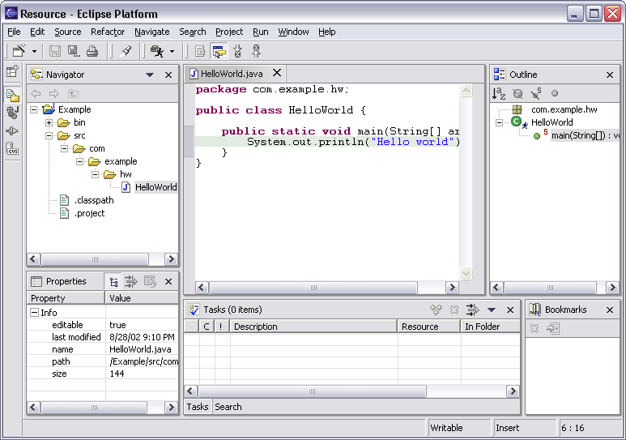
Eclipse Workbench Terminology
Menu bar
Text
editor
Tool bar
Perspective
and
Fast View
bar
Outline
view
Resource
Navigator
view
Tasks
view
Bookmarks
view
Properties
view
Notes:
[Contains animated elements]

Slide 5
Java Development Tooling (JDE)
Java views, editor and refactoring
  Helps programmer write/maintain Java code
  Quick fixes, code completion
Java compiler
  Translates Java source to binary class files
Java debugger
  Debug Java programs (e.g., Eclipse itself)
JDT is a free, state-of-the-art Java IDE
  And hey, it’s free!

Slide 6
Plug-in Development Environment (PDE)
Specialized tools for developing Eclipse plug-ins
Built atop Eclipse Platform and JDT
  Implemented as Eclipse plug-ins
  Using Eclipse Platform and JDT APIs and extension points
Included in Eclipse Project releases
  Separately installable feature
  Part of Eclipse SDK drops

Slide 7
Eclipse Platform - Summary
Eclipse Platform is the nucleus of IDE products
Plug-ins, extension points, extensions
  Open, extensible architecture
Workspace, projects, files, folders
  Common place to organize & store development artifacts
Workbench, editors, views, perspectives
  Common user presentation and UI paradigm
Key building blocks and facilities
  Help, team support, internationalization, …
Notes:
[Contains animated elements]

Slide 8
Eclipse Operating Environments
Eclipse Platform currently* runs on
  Microsoft® Windows® XP, 2000, NT, ME, 98SE
  Linux® on Intel x86 - Motif, GTK
    RedHat Linux 8.0 x86
    SuSE Linux 8.1 x86
  Sun Solaris 8 SPARC – Motif
  HP-UX 11i hp9000 – Motif
  IBM® AIX 5.1 on PowerPC – Motif
  Apple Mac OS® X 10.2 on PowerPC – Carbon
  QNX® Neutrino® RTOS 6.2.1 - Photon®
* Eclipse 2.1 - March 2003

Slide 9

























Industry/Community Traction
35 Commercial products – 260 other projects
Too recent for a logo:
Ericsson,
Fraunhofer/FOKUS
LogicLibrary
QA Systems
SilverMark
Data
As of
March
2003
34 board members

Slide 10
Eclipse.org Statistics
First release in fall 2001
Website hits: 10 million
Full platform downloads: 1 million
Eclipse newsgroups postings: 1600
Downloaded data: 6,000 Gigabytes
PER MONTH(!) IN 2003
First 48 hours after v2.1, download > 1 terabyte

Slide 11
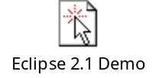
Demo of how extensible Eclipse really is…
Launch Eclipse 2.1 with empty workspace,
Create a sample plugin,
Launch runtime workbench,
Stop the clock.

Slide 13
Community BOF at ESC San Francisco
Chris Laffra
IBM Ottawa Labs
Eclipse Overview
Sebastien Marineau
QNX Software Systems Ltd.
CDT Overview
Cory Bialowas
IBM Rational
CDT and IBM Rational Activities
Manas Saksena
Timesys
Embedded Linux IDE using Eclipse and CDT
Chris Songer
Tensilica
CDT Based Performance Viewing for Xtensa Processors

