Slide 1
Overview for the CDT Community
December 2002

Slide 2

Tensilica Corporate Overview
Semiconductor intellectual property company, founded in 1997 to create and market configurable processor IP.
100+ people world wide with offices in North America, Japan, Taiwan, and Europe.
R&D in Santa Clara CA.
50+ Licensees in consumer electronics, office automation, networking and other industries.
  Announced customers are on www.tensilica.com.

Slide 3
Xtensa Processors
32bit modern RISC with good code density.
  Compelling for embedded and System on a Chip applications.
Customer customized in predefined ways.
  Only spend silicon area on things you need.
  Caches.
  Compute unit options.
  Bus widths.
  Lots of other choices.
Customer extended with new instructions.
  Customer written instructions provide architectural efficiency for their specific application area.

Slide 4

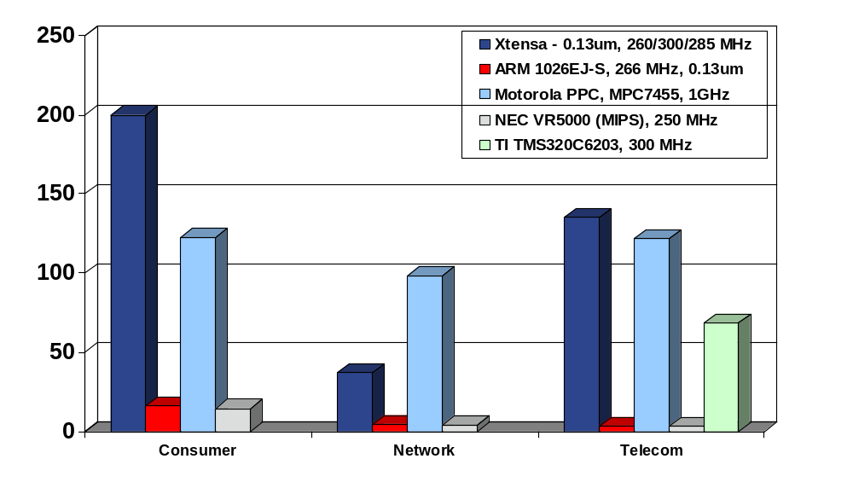

Custom Xtensa Processors
Deliver Striking Performance
Single Xtensa Outperforms Even Most Full-Chip, 20W+ Processors
526
More than 2X Faster than Any Other recorded score for the Consumer Suite
Faster than hand-optimized assembly code on full-chip DSP
Benchmark Rating
GHz PowerPC consumes~100X power dissipation -v- Xtensa
NEC (MIPS)
Xtensa
PowerPC
NEC (MIPS)
ARM10
PowerPC
NEC (MIPS)
Xtensa
PowerPC
ARM10
ARM10
Xtensa
TI
Certified by
Tensilica Xtensa processor: simulated optimized scores
ARM: OutofBox Scores for ARM1020E architectural core; operating frequency per ARM1026EJ-S specification
Motorola: MPC7455 CPU, 1GHz Full chip device, 483pin CBGA, 21W power dissipation, Optimized: Network & Telecom; Consumer: OOB
TI: TMS320C6203, 300MHz Full chip DSP, optimized
NEC VR5000 full chip device, out-of-box scores
Competitive Data as of Aug. 7, 2002. Source: www.eembc.org

Slide 5
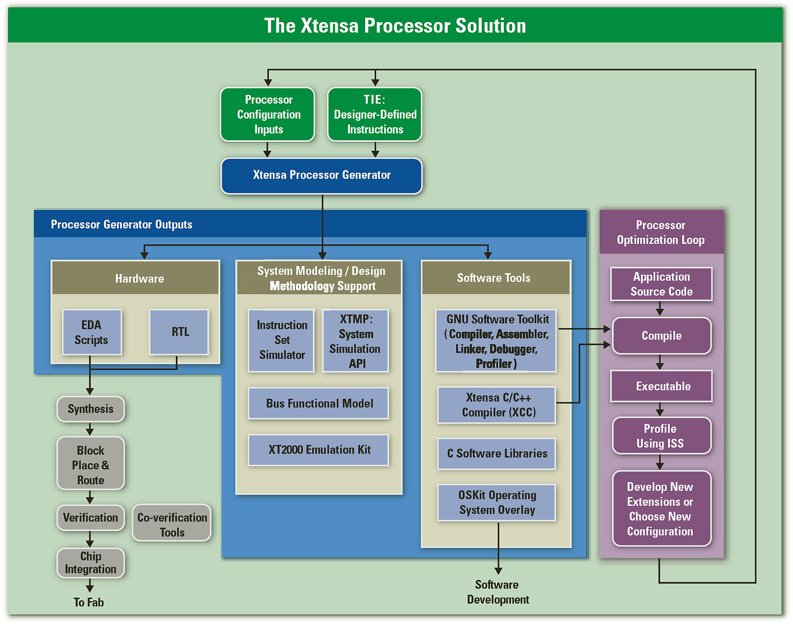
Components of the Xtensa Solution

Slide 6
Tensilica Use of Eclipse and CDT
Fronts for the existing Xtensa tool chain.
  GNU based compilation chain + high performance compiler based on SGI’s compiler.
Drives our backend targets.
  Instruction Set Simulator.
  XTMP System Level Simulator.
  Emulation board and customer silicon.
Extended for lots of Tensilica specific things.

Slide 7
Near Term CDT Related Efforts
Useful to Everyone:
  Profiling support.
    Driving Gprof
    Coherent display of profiling data.
  Target support
    Automatic makefile generation.
    Multiple build management.
Useful to processor / embedded companies
  Architecture support.
  Cross platform execution and debugging.
  Various MP support features.
We are making all of these happen
  Whether the features fall in com.tensilica.* or org.eclipse.cdt.* is being decided in the next few months.

Slide 8
Mid Term Tensilica CDT/Eclipse Goals
MP Debugging.
  Today our customers build asymmetric MP systems.
More robust C-IDE feature set.
  People will always compare to Dev Studio.
Support for more debug targets.
  Trace support (in all it’s flavors)
OS awareness extension by customers.
  Tensilica is not an OS company, but our customers use them and often have their own.

