Slide 1

CDT DEBUGGER
Everywhere we go…

Slide 2

Leitmotiv
Everywhere we go, people wanna know,
  Who we are.
    What we do.
      Where we’re going.
        So we tell them …

Slide 3
Who we are
QNX (did the first implementation GDB-5.0 MI level 0)
IBM / Rational (testing)
Tensilica (various contributions)
Timesys (various contributions)
Redhat (testing , GDB fixes)
Montavista (GDB server)

Slide 4
What we do
Portable source level debugger.
  Views
    Signal,
    Shared library
    Memory
    Variable …
  C Debugger Interface (CDI)
    Isolate the underlying debugger from Eclipse
  MI plugin
    GDB / MI level 1.

Slide 5
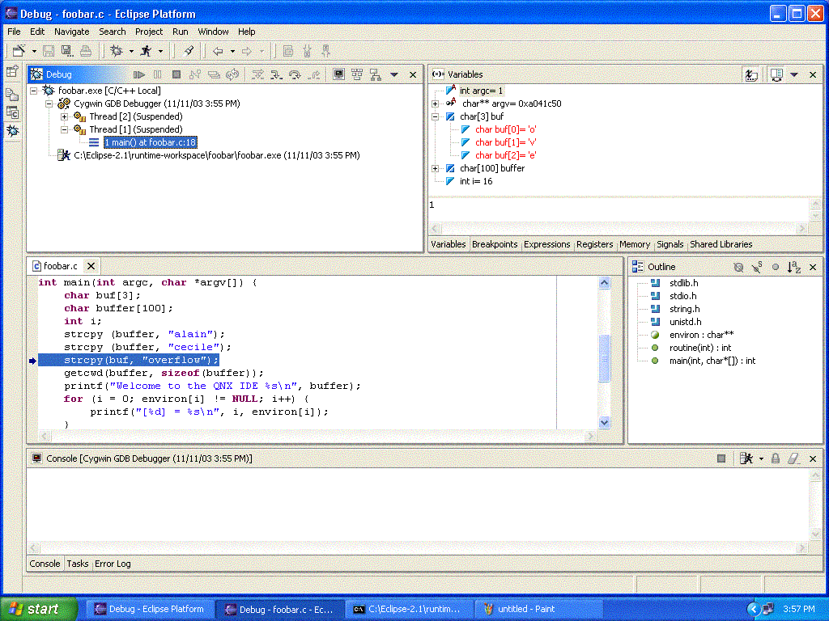
What we do - Perspective
CDT Debug Perspective

Slide 6
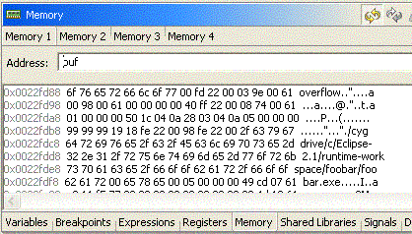
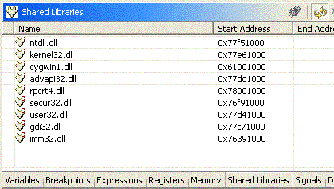
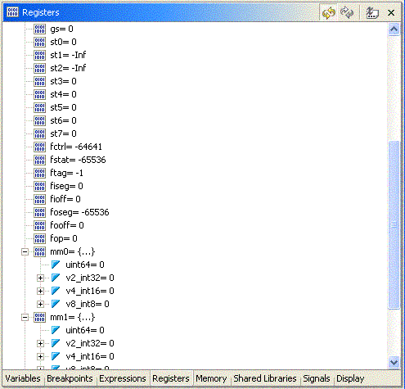
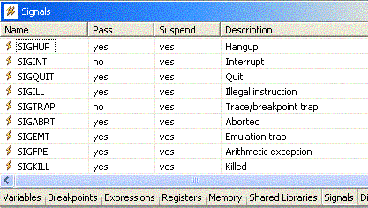
What we do - Debug Views

Slide 7
Where we’re going
First Class Debugger
  Better integration with Eclipse
  Better integration with CDT
    Use the source parser (AST)
    Use the binary parser (ELF)
  UI improvements
  Better C++ support
    Throw/catch exception breakpoints
    Understanding knowledge of STL (showing variables better print of STL variables).

Slide 8
CDT Debug
Overview
CDT Debug Core
CDI Interfaces
CDT Debug 2.0 Plan

Slide 9
Overview
Eclipse Debug UI
CDT Debug UI
Eclipse Debug Core
CDT Debug Core
CDT Debug Launch
GDB / MI

Slide 10
CDT Debug Core
CDT Debug Core
Implementation of Eclipse Debug Core
Specific C / C++ Interface
CDI
GDB / MI
CDT Launch
Extension
point
Cygwin / MI
QNX / MI

Slide 11
CDI Extension Points
<extension
point="org.eclipse.cdt.debug.core.CDebugger">
<debugger
platform="native"
name="%GDBDebugger.name"
modes="run,core,attach"
cpu="native"
class="org.eclipse.cdt.debug.mi.core.GDBDebugger"
id="org.eclipse.cdt.debug.mi.core.CDebugger">
</debugger>
</extension>
<extension
point="org.eclipse.cdt.debug.ui.CDebuggerPage">
<debugPage
class="org.eclipse.cdt.debug.mi.internal.ui.GDBDebuggerPage"
id="org.eclipse.cdt.debug.mi.GDBDebuggerPage"
debuggerID="org.eclipse.cdt.debug.mi.core.CDebugger">
</debugPage>
</extension>

Slide 12
CDI Extension Interface
package org.eclipse.cdt.debug.core;
import org.eclipse.cdt.debug.core.cdi.CDIException;
import org.eclipse.cdt.debug.core.cdi.ICDISession;
import org.eclipse.core.resources.IFile;
import org.eclipse.core.runtime.IPath;
import org.eclipse.debug.core.ILaunchConfiguration;
public interface ICDebugger {
public ICDISession createLaunchSession(ILaunchConfiguration config, IFile exe) throws CDIException ;
public ICDISession createAttachSession(ILaunchConfiguration config, IFile exe, int pid) throws CDIException;
public ICDISession createCoreSession(ILaunchConfiguration config, IFile exe, IPath corefile) throws CDIException;
}

Slide 13
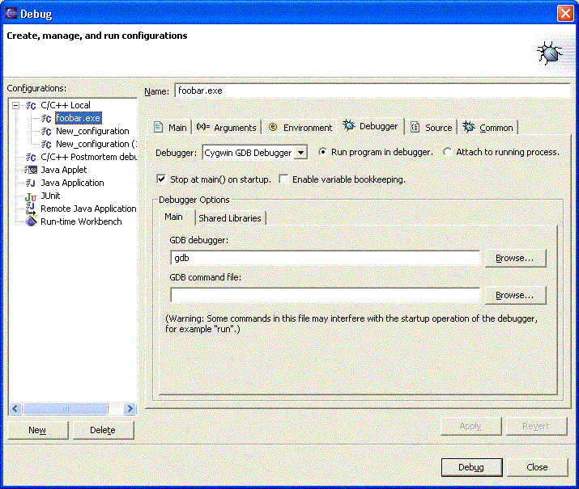
Launch UI

Slide 14
CDI Interfaces
ICDISession
ICDITarget [1]
ICDIThread [1]
ICDIStackFrame [1]
ICDIVariable [n]
.
.
.
ICDIStackFrame [2]
ICDIVariable [n]
.
.
.
ICDIThread[2]
ICDIStackFrame[1]
ICDIVariable[n]
.
.
.
ICDITarget[2]
.
.
.

Slide 15
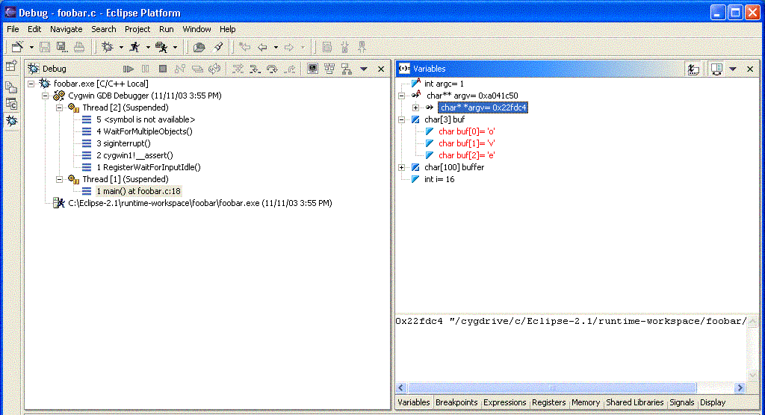
Eclipse Debug UI

Slide 16
CDI Scenario 1
ICDI Session
GDB
ICDI Target
GDB / Inferior
ICDI Thread
GDB / Info Thread

Slide 17
CDI Scenario 2
ICDI Session
Dummy
ICDI Target [1]
GDB / Inferior
ICDI Target [2]
GDB / Inferior

Slide 18
CDT Debug 2.0 Plan
CDI
  Revision
  Documentation
  Abstract implemantation
Breakpoints
  Deferred breakpoints
  Thread-restricted breakpoints
  Breakpoints in external files
Expressions
  Make persistent across workbench sessions
  Add actions to the Expressions view
Source Management
  Performance improvements
  Duplicate files
  Prefix mapping
Editors
  Mixed disassembly/source presentation
Memory View
  New design and implementation
Registers View
  Registers bookkeeping (query on demand)
Variables View
  Improve detail pane
UI Improvements
  Usability

