Slide 1
Eclipse CDT 2.0 at Rockwell Collins
Paul Streit
Rockwell Collins, Inc.
Enterprise Tools Integration

Slide 2
Rockwell Collins environment
Safety-critical avionics, communications, and navigation
Military and Commercial markets world-wide
Many products must meet DO-178B Level A requirements
  Formal, repeatable engineering process
  Intensive testing and verification
  FAA certification requirements
  Artifacts must be produced and captured
Embedded, real-time applications
Custom design and manufacture most of our hardware
Products often in use for 30 or more years
Engineering distributed world-wide

Slide 3
Activities
Strategic enterprise adoption of Eclipse…
  as a portable run-time platform for highly-integrated tools
  as a tool development environment
  to address both legacy and modern project needs
The CDT is a tactical move in our overall strategy
  Good match between Eclipse capabilities and our needs
  Two projects are lined up to pilot the CDT
  Others expected to adopt the CDT depending on the pilots results
  We’re working to adopt the CDT to an internal tool chain
We’ve developed prototype Eclipse solutions in other areas
  Ada
  VHDL

Slide 4
Requirements
Config file
  Facilitates repeatable builds necessary for our engineering process
  All project build settings in one ASCII text file
  Contains non-default tool options, build locations, tool paths, etc
  Extensible for unique needs
  Can be controlled in a CM system
  Individual engineers can create a local copy for experimentation
Managed make enhancements
  Support a variety of cross-compilers and tool chains
  Be much more flexible to accommodate unusual build processes and test tools
  Support host and target builds in same directory structure
  Allow users to modify generated make file

Slide 5
Requirements
Editor enhancements
  Automation of common editing tasks (listed later)
  Navigate to definition of function or variable
Code format (i.e. “prettyprinter”)
  Ability to format whole file
  Customizable to project-level standard
Performance improvements
  File save
  Outline “wiggle”
Specify paths to tools
  Using the PATH environment variable is not dependable

Slide 6
Requirements
Help
  Synchronize content with the software release
  FAQ
  Troubleshooting guidelines
  How to extend CDT using extension points
Debugger
  Console for gdb commands
  Support older versions of gdb
  Publish interface
Parser
  Offer source code analysis functions
  Support line count utilities

Slide 7
Backup Slides

Slide 8
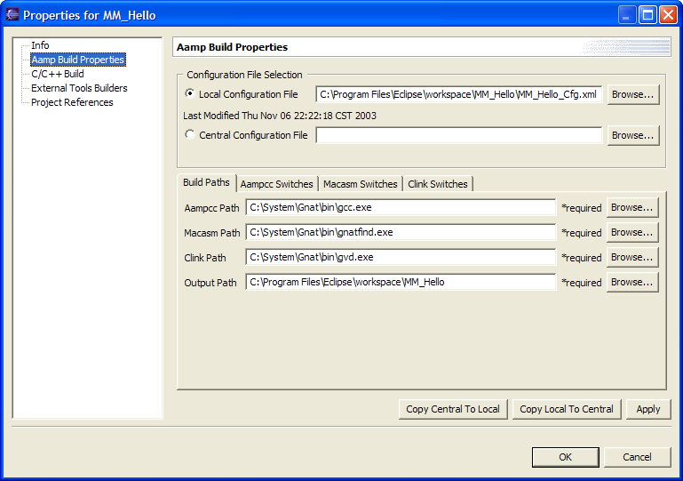
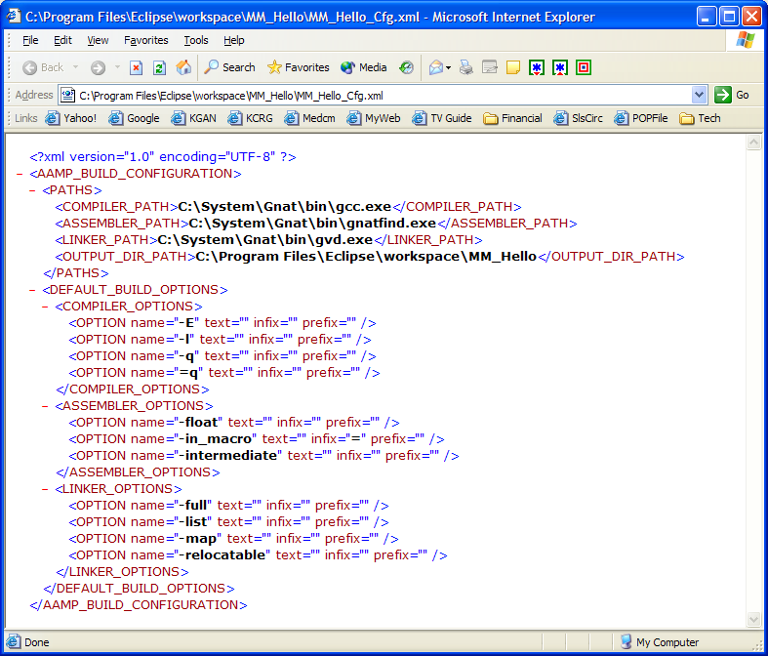
Config File Data Flow
Configure project settings in Eclipse project properties
Project settings saved in XML Config File
Build
1
Project settings written to make include file
2
Make file invoked using make include file

Slide 9
Attributes of Config File
Maintained through Eclipse interface
Stored as XML data
Project-level and/or user-level config file
Contains:
  Paths to command-line tools
  Project-default command switches for command-line tools
  File-specific command switches for command-line tools
  Files to include and/or exclude in the build
  Output directories
  Project directory structure
We plan to use for more than C/C++ build tools
  Will be a standard feature of all Eclipse IDEs we deploy

Slide 10
Common Editing Tasks
Save the current file and open the next file
Collapse and expand language constructs (loops, if-then-else, etc)
Define/undefine ifdef's and have the code collapsed or expanded
Walk the code, i.e. move the cursor to a function call or variable reference and be taken to the definition of that item
Replace every occurrence of a string in the file and a selection of files
Move to the top or the bottom of the file with one key stroke
Cut and paste { . . . } blocks
Repeat the last operation with a single keystroke
Search up or down for any string
Repeat the last search, in the current file and in any subsequent file
Insert non-printable characters, like ^M or ^C, into the text
Go to a line number
Unlimited number of undo's
Auto-indent and un-indent

