Slide 1

Red Hat & CDT 2.0
Jeremy Handcock
CDT Planning Session – November 12, 2003
Red Hat / CDT

Slide 2

Agenda
Red Hat CDT product overview
Current and future CDT activities at Red Hat
Internal and external CDT feedback
Red Hat / CDT

Slide 3
Red Hat CDT Product Overview
Red Hat / CDT

Slide 4
Red Hat Developer Suite
A Red Hat-branded distribution of Eclipse
C/C++ tools are based on the CDT (1.1/1.2)
Target operating system: Red Hat Enterprise Linux
Compiled ahead-of-time using the GNU Compiler for Java (gcj)
Contains additional features/enhancements to accompany the CDT: RPM and Oprofile plugins
Red Hat / CDT

Slide 5
Current and Future CDT Activities
at Red Hat
Red Hat / CDT

Slide 6
Hover Help/API Checking Capability
Displays a short description of a “known” string when the mouse pointer is placed over it
Descriptions are stored in property files, which are extracted from library documentation using custom parsers
Current supported libraries include: glibc, GTK+, and X11
Will be contributed back to the CDT project
Red Hat / CDT

Slide 7
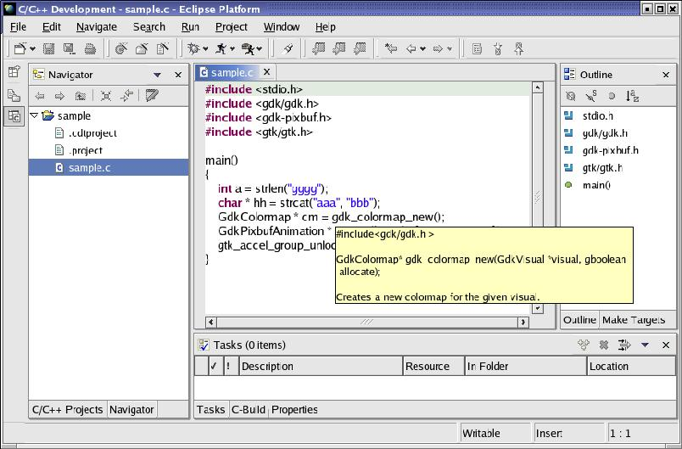
Hover Help/API Checking Capability
Red Hat / CDT

Slide 8
Autoconf Tool
Scope is yet to be defined
Currently looking at something minimal, similar to the tool in KDE's Kdevelop IDE
Plan includes automatic recognition of autoconf projects: the CDT will set up project accordingly using external tools builders
Red Hat / CDT

Slide 9
Testing/Bug Fixing
Current/future target environment: CDT running on Red Hat Enterprise Linux with an open-source Java runtime
Currently testing: CDT 1.2/Eclipse 2.1.1 on Red Hat Enterprise Linux 3, compiled ahead-of-time using gcj
Risk: developer reliance on undocumented VM behavior can create runtime problems
Red Hat / CDT

Slide 10
Documentation
Red Hat developed its own version of CDT 1.1 documentation
Mike Behm is working with the IBM Rational writers on integrating/improving the CDT 1.2 documentation
Red Hat will contribute finished documentation to the CDT project, along with a proposed structure for the CDT documentation plugin
Red Hat / CDT

Slide 11
Feedback on the CDT
Red Hat / CDT

Slide 12
Feedback on the CDT
Usability: an informal study was conducted internally by Red Hatter Bertina Lee, possibly more to come
Minimal external feedback to date: Red Hat Developer Suite was just released
Currently looking at doing some case studies surrounding the use of Eclipse/CDT
“How can we make the CDT as cool as the JDT?”
Red Hat / CDT

