Slide 1
Wind River Eclipse Efforts
Tomas Evensen
Felix Burton
Michael Scharf
11/11/03

Slide 2
Wind River Eclipse Efforts
Wind River Eclipse based products
Wind River CDT related technologies
Wind River wish list for CDT
Possible roadmap to CDT

Slide 3
Wind River Eclipse Based Products
A full-blown C/C++/… IDE for all our embedded products
  Next generation Tornado (IDE for VxWorks)
  Next generation VisionClick/SingleStep (HW bring-up debugger)
  Next generation SNiFF+ (IDE for large projects, multi-language support)
First generation use the Eclipse framework, but not CDT
  Wind River Technologies ported into Eclipse
  Some parts written in Swing
    We have created a robust Swing on top of SWT connection

Slide 4
WIND®POWER IDE 2.X
Eclipse Framework
Host
Project
System*
(SNiFF+
Technology)
Source
Browsing*
Editor*
Unified, MultiX
Debugger*
Profiling
Tools*
(WindView
Technology)
Debugger Frame Work
VxWorks
Plug-in
On-Chip Debug
Connection
Plug-in
Target Agent
Connection
Plug-in
CPU
Plug-in
Compilers
(Diab & GNU)
Network
Network
Target
LPT
Target Board
Embedded OS
Network
Target
Agent
Target
Application
visionPROBE II
JTAG
* WR Extensions to Eclipse
WIND®POWER ICE

Slide 5
Wind River CDT Related Technologies
Wind River has technologies that overlaps with almost every part of CDT
Three choices for each technology:
  Continue to keep technology proprietary
  Throw away our technology and use CDT
  Contribute our technology back to CDT
Overall strategy is to avoid duplication of work unless we feel we provide a differentiating value
Challenge is that our interfaces and needs are sometimes different than what CDT provides
We would also like to find out what technologies the CDT community would be interested in to get from Wind River

Slide 6
Wind River CDT Related Technologies
Parse
  Cross reference database, incremental, fast
Symbol representation (Model)
  Language independent, can implement CDT model
Editor
  Configurable, symbol highlight, pluggable language support
Search/symbol completion
  Crisp cross reference search, independent service
Build System
  Managed build system
Debugger
  Multi-X, asynchronous, extended gdb/mi, on-chip debug support

Slide 7
Wind River Wish List for CDT (1)
Crisp interfaces
  Well defined
  Exclusively used (no back doors)
  Not dependent on implementation (Java interfaces, not inheritance)
  Using three principles between plug-ins:
    Only use Java interface interfaces
    Single threading. All calls between plug-ins (extension points) are done on the event-dispatch thread
    Avoid circular calls (A->B->A). Break circle by posting events
Asynchronous interfaces for target access
  Somewhat different issue than UI responsiveness
  See separate presentation

Slide 8
Wind River Wish List for CDT (2)
Separate CDT into multiple language independent independent pluggable sub-systems
  Parse
  Symbol representation (Model)
  Search/symbol completion
  Editor
  Build
  Debugger
Reasons
  Cleaner architecture
  Allows better multi-language support
  More sharing between CDT, JDT, and other languages
    Getting closer to an UDT (Universal Development Tool)
  Would allow Wind River to contribute more if we can replace some sub-systems

Slide 9
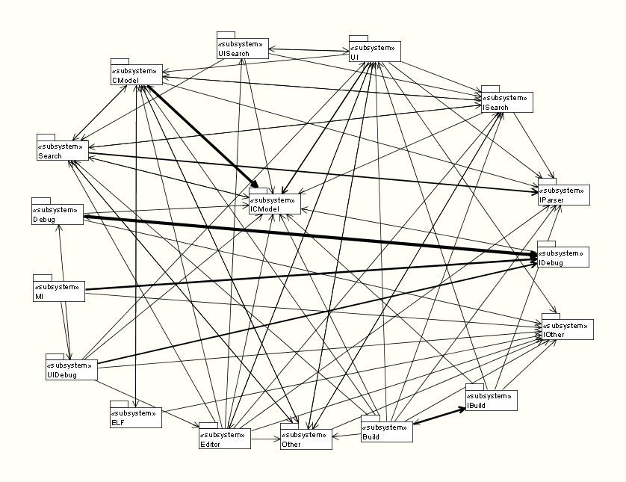
CDT dependency graph

Slide 10
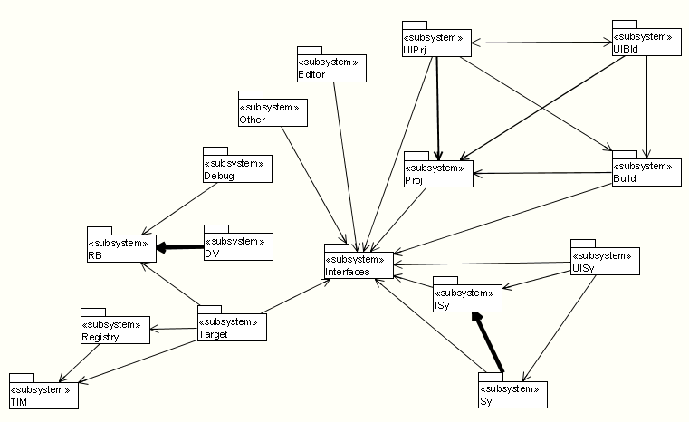
WindPower IDE dependency graph

Slide 11
Possible Roadmap to CDT
Work closely with Eclipse Tools to define new CDT interfaces
  “Crisp”, Asynchronous
Move towards using these new interfaces internally
Work with CDT group
  Incrementally incorporate WindPower technologies into CDT
  Incrementally incorporate CDT technologies into WindPower

Slide 12
Advantages of Asynchronous Model
Felix Burton
Michael Scharf
Tomas Evensen
11/11/03

Slide 13
Synchronous vs. Asynchronous
Different models solve different types of problems:
Synchronous systems
  NFS, ClearCase, Outlook (Exchange)
  Often clear client/server relationship
    Most input come from one source
  Either block or use multiple threads to wait for multiple things
Asynchronous systems
  Networking Routers/Firewalls/…, Win32
  Requests and inputs from multiple entities
  Use events (or select()) to wait for multiple things
  Less sensitive to round-trip delays
A Multi-X embedded debugger has many traits in common with typical asynchronous systems
  Events come asynchronously from multiple targets

Slide 14
Multi-X Debugger Example (1)
In an embedded system, roundtrip time to read from target can be substantial
  JTAG connection, remote debugging
Debugger views need to be asynchronous since UI-thread can’t wait for target
Gdb/mi protocol is asynchronous by design
Views
Async from views
Model
Async gdb/mi
Debug Engine

Slide 15
Multi-X Debugger Example (2)
When a target stops (after step or hitting breakpoint) all views need to be refreshed
  Leads to many requests to read information from target
    Watch windows, register windows, memory windows, …
  Typical synchronous way:
    Each view will synchronously call the target and wait for reply
  Typical asynchronous way:
    Each view will asynchronously send a request to the target and get an event when data is ready
In an asynchronous system the request queue can be optimized
  Multiple step: purge read requests and update only latest
  Scrolling

Slide 16
Synchronous Round-trip delay
Eclipse
Request 1
Request 2
Response 1
Response 2
Debugger
Request 1
Request 2
Response 1
Response 2
Target

Slide 17
Asynchronous Round-trip delay
Eclipse
Request 2
Request 1
Request 3
Response 1
Response 2
Response 3
Debugger
Request 1
Request 2
Request 3
Response 1
Response 2
Response 3
Target

