Slide 1
Where we are today
Sebastien Marineau
CDT
November 12, 2003

Slide 2
CDT – A Bit of History
CDT project launched July/2002
Original participants
  QNX
  Rational
  Redhat
  MontaVista
CDT 1.0 Dec. 2002, CDT 1.1 (May), CDT 1.2 (Oct)
Increasing activity in newsgroups, mailing lists

Slide 3
CDT project goals
Full-featured
  First-class framework for C/C++ tooling in Eclipse
  Platform-neutral framework to support variety of development scenarios
  As full-featured as the JDT
Interoperable
  Broad member support with standardization on common CDT core
  CDT common integration point for all C/C++ tooling

Slide 4
CDT project goals (cont)
Extensible
  Provide powerful base functionality and allow extending/replacing features
  Well-defined APIs for interoperable extensibility
Cooperative
  Pooling of resources for base C/C++ tools components
  Well-defined “value-add” from contributing companies

Slide 5
Architecture
eclipse Platform
Workbench
C Debug
cdt.debug.core
cdt.debug.ui
cdt.debug.mi.core
Debug
JFace
SWT
C Launching
cdt.launch
Workspace
Team
C Core
cdt.core
cdt.ui
Platform Runtime

Slide 6
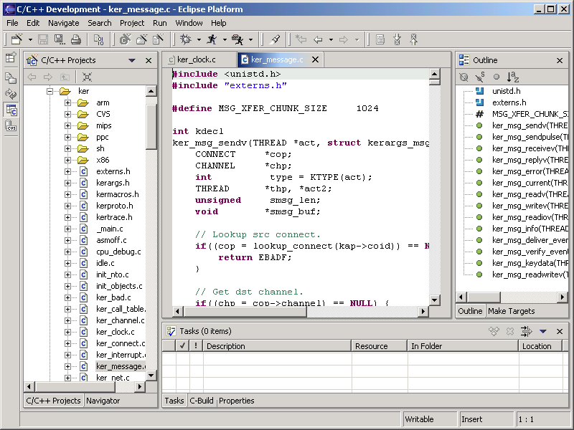
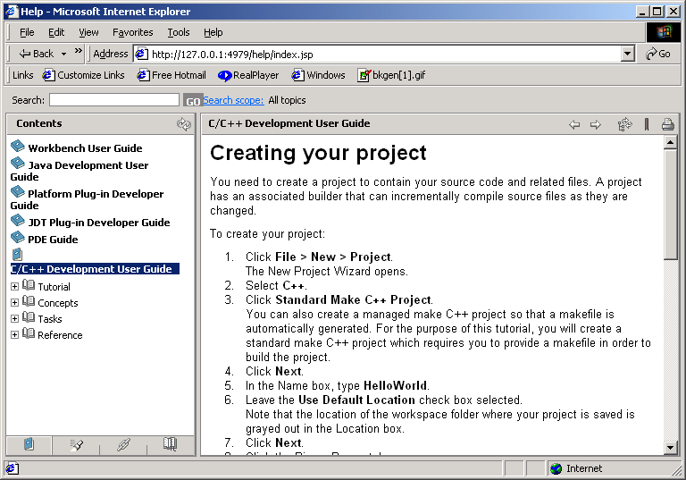
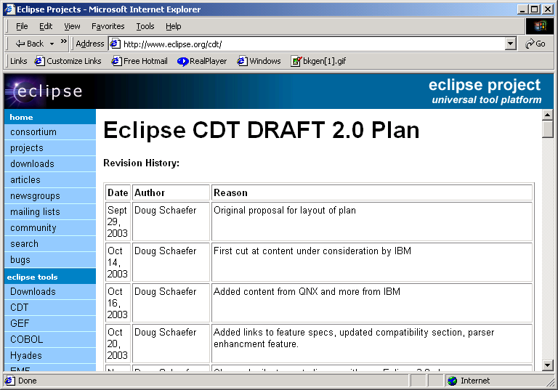
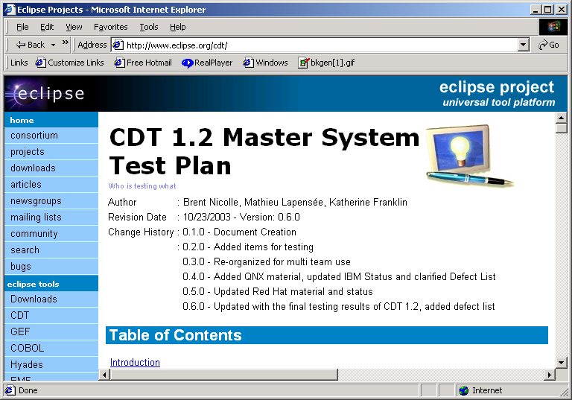
CDT 1.2 Release Highlights
Feature enhancements
  Search, indexer, parser
  First iteration of managed build
  Debugger enhancements (inc. GDB MI/2)
Improved testing
  All platforms tested
  Significant test coverage
Documentation – User’s guide
Improved project management
  Feature plan
  Defect tracking
  Builds
  Web site

Slide 7
Adoption of CDT
Downloads
  Enthusiasts
  Mostly Windows and Linux
Commercial products
  QNX Momentics
  IBM WSDD
  Timesys Timestorm
  Tensilica Xtensa Xplorer
  Redhat Entreprise Linux
Others considering
  IBM/Rational, Wind, Intel, Altera etc.

Slide 8
Why participate in CDT?
Open-source/commercial nature

Slide 9
Objectives for Next Year
Transform CDT into full-fledged platform
  Stable, documented integration APIs
  Increase customizability through extensions
  Round out feature set
  Align with Eclipse 3.0
Increase adoption in commercial products
  Promote CDT through articles
  Gather vendor/user feedback (barriers to adoption)
Increase integrations with CDT
  Provide example integrations on CDT site
  Target value-add tools vendors
  Examples: static code analysis, JTAG and performance tools

Slide 10
Looking Ahead - Challenges
Increase participation from interested companies
  Committers today from QNX and IBM/Rational
Satisfy wide variety of feature requests
  Success and adoption increase range of feedback
  Must balance features and frameworks
Maintain momentum
  Alignment with Eclipse 3.0 leaves gap to CDT 2.0
  Increasing interest from enthusiasts

Slide 11
Agenda
Introductions
Eclipse 3.0 Overview
Participant Activities
CDT 2.0 Presentations
  Plan, features, embedded roadmap
Break-out sessions
Wrap-up

Slide 12
Objectives for today
Share plans, information and feedback on CDT
  Everyone has a different point of view
  Particular interest in feedback from end-users
Finalize CDT 2.0 plan
  Features
  Resourcing
  Timeline
Embedded roadmap discussions
  Agree on concrete steps to move forward

