Slide 1
Java 101 with Design Principles
Basics by Dr. Lakshman Anumolu

Slide 2
Object
A conceptual entity that stores state and behavior
State is stored in “fields”
Behavior is exposed through “methods”
Methods:
Interaction of objects with other parts of the code is defined through methods
https://docs.oracle.com/javase/tutorial/java/concepts/object.html

Slide 3
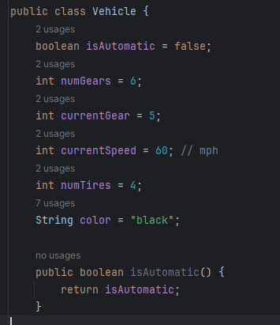
Object
A conceptual entity that stores state and behavior
State is stored in “fields”
Behavior is exposed through “methods”
https://docs.oracle.com/javase/tutorial/java/concepts/object.html

Slide 4
Fields/Variables
Fields store the state of an object
Types:
Instance variables (non-static fields)
Class variables (static fields)
Local variables
Parameters
Naming rules:
Alphabets, $, _
$ is usually not used by convention
https://docs.oracle.com/javase/tutorial/java/nutsandbolts/variables.html

Slide 5
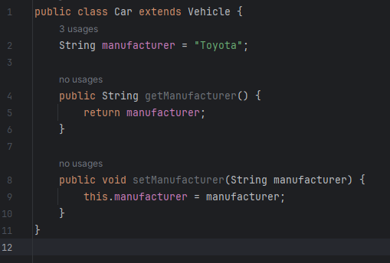
Class
A blueprint using which objects are created
https://docs.oracle.com/javase/tutorial/java/concepts/class.html

Slide 6
Inheritance
Ability to inherit used state (“fields) and behavior (“methods”) from existing classes
Vehicle -> Car, Truck, Motorbike
https://docs.oracle.com/javase/tutorial/java/concepts/inheritance.html

Slide 7
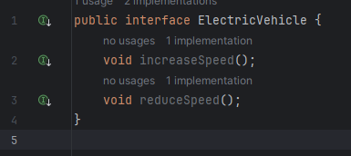
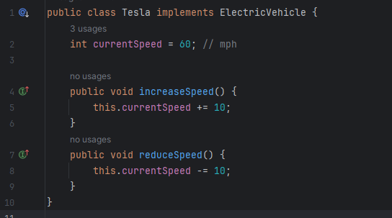
Interface
Interface:
Defines a contract between class and other parts of the code. Contract must be enforced during compile time
Ex. Methods form object’s “interface”
https://docs.oracle.com/javase/tutorial/java/concepts/interface.html

Slide 8
Next Session
Packages
Primitive datatypes
Arrays
Operators
Flow statements

