Slide 1
Oracle – PL/SQL
Dr. Lakshman Anumolu

Slide 2
Search Algorithms
Root
(100)
Root
(50)
Root
(150)
Root
(20)
Root
(60)
Root
(20)
Root
(60)
Root
(10)
Root
(40)

Slide 3
PRIMARY KEY, FOREIGN KEY
Primary key
A key is a combination of one or more columns in a table.
Primary key is one such key that a table contains atmost one of it to uniquely identify a row in a table.
Primary key results carries a unique constraint with itself.
Primary key must be unique, hence no duplicates allowed.
Primary key value should not be changed.
Foreign key
A key is a combination of one or more columns in a table.
Foreign key signifies presence of the values in more than one table.
Table with foreign key is referred to as child table, and the table being referred to is call parent table.

Slide 4
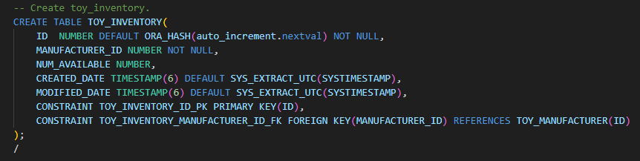
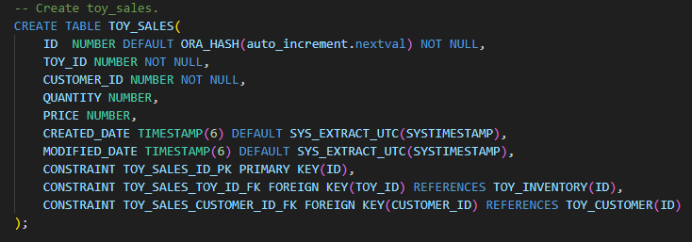
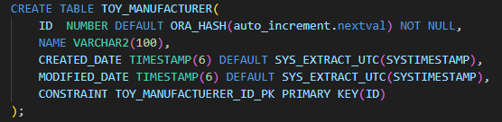
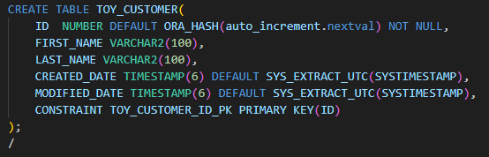
PRIMARY KEY, FOREIGN KEY
TOY_INVENTORY
TOY_MANUFACTURER
TOY_CUSTOMER
TOY_SALES

Slide 5
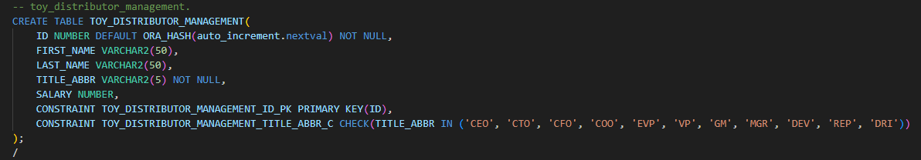
CONSTRAINT
TOY_DISTRIBUTOR_MANAGEMENT

Slide 6
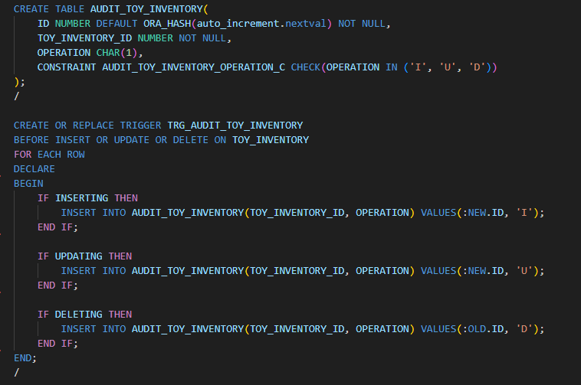
TRIGGER
Why trigger?

Slide 7
Exercise
Create DB for food delivery service
Table: FDS_RESTAURANTS
ID, NAME, CREATED_DATE, MODIFIED_DATE
Table: FDS_ITEMS
ID, RESTAURANT_ID, NAME, PRICE, CREATED_DATE, MODIFIED_DATE
Table: FDS_SALES
ID, ITEM_ID, CUSTOMER_ID, QUANTITY, PRICE, CREATED_DATE, MODIFIED_DATE
Table: FDS_CUSTOMER
ID, FIRST_NAME, LAST_NAME, CREATED_DATE, MODIFIED_DATE
Table: AUDIT_FDS_ITEMS
ID, ITEM_ID, OPERATION, NEW_PRICE, OLD_PRICE, CREATED_DATE, MODIFIED_DATE
OPERATION: must be one among ‘I’, ‘U’, ‘D’
Trigger: TRG_AUDIT_FDS_ITEMS

