Slide 1
Oracle – PL/SQL
Dr. Lakshman Anumolu

Slide 2
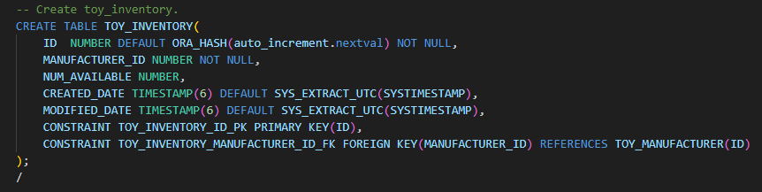
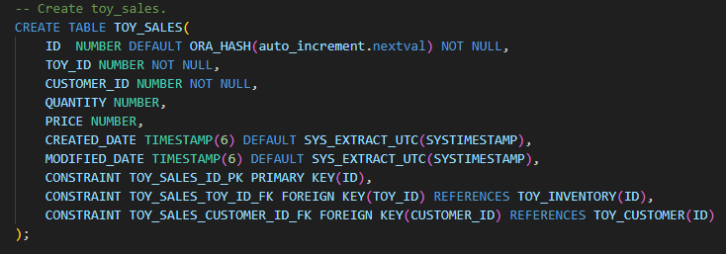
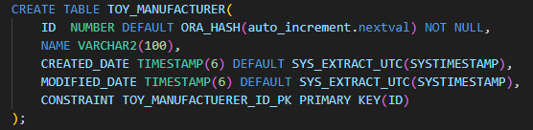
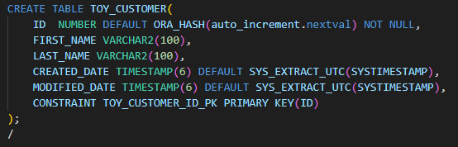
PRIMARY KEY, FOREIGN KEY
TOY_INVENTORY
TOY_MANUFACTURER
TOY_CUSTOMER
TOY_SALES

Slide 3
CURRENT SESSION

Slide 4
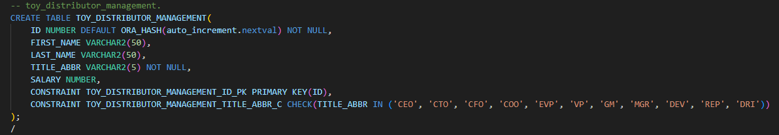
CONSTRAINT
TOY_DISTRIBUTOR_MANAGEMENT

Slide 5
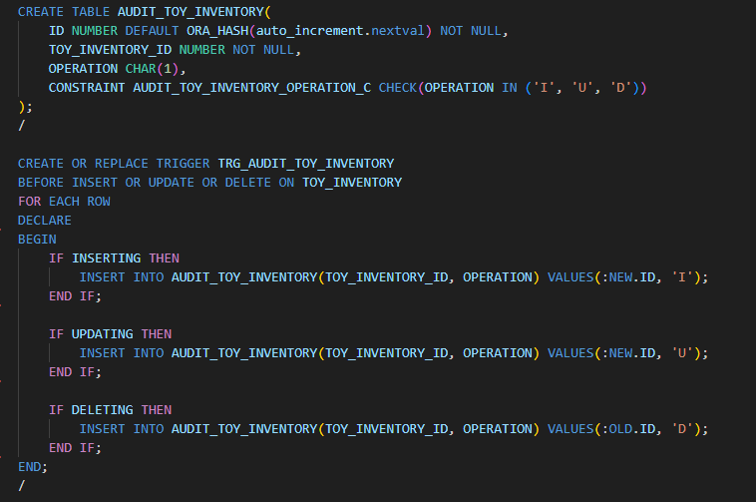
TRIGGER
Why trigger?

Slide 6
Exercise
Create DB for food delivery service
Table: FDS_RESTAURANTS
ID, NAME, CREATED_DATE, MODIFIED_DATE
Table: FDS_ITEMS
ID, RESTAURANT_ID, NAME, PRICE, CREATED_DATE, MODIFIED_DATE
Table: FDS_SALES
ID, ITEM_ID, CUSTOMER_ID, QUANTITY, PRICE, CREATED_DATE, MODIFIED_DATE
Table: FDS_CUSTOMER
ID, FIRST_NAME, LAST_NAME, CREATED_DATE, MODIFIED_DATE
Table: AUDIT_FDS_ITEMS
ID, ITEM_ID, OPERATION, NEW_PRICE, OLD_PRICE, CREATED_DATE, MODIFIED_DATE
OPERATION: must be one among ‘I’, ‘U’, ‘D’
Trigger: TRG_AUDIT_FDS_ITEMS

